Slide 1
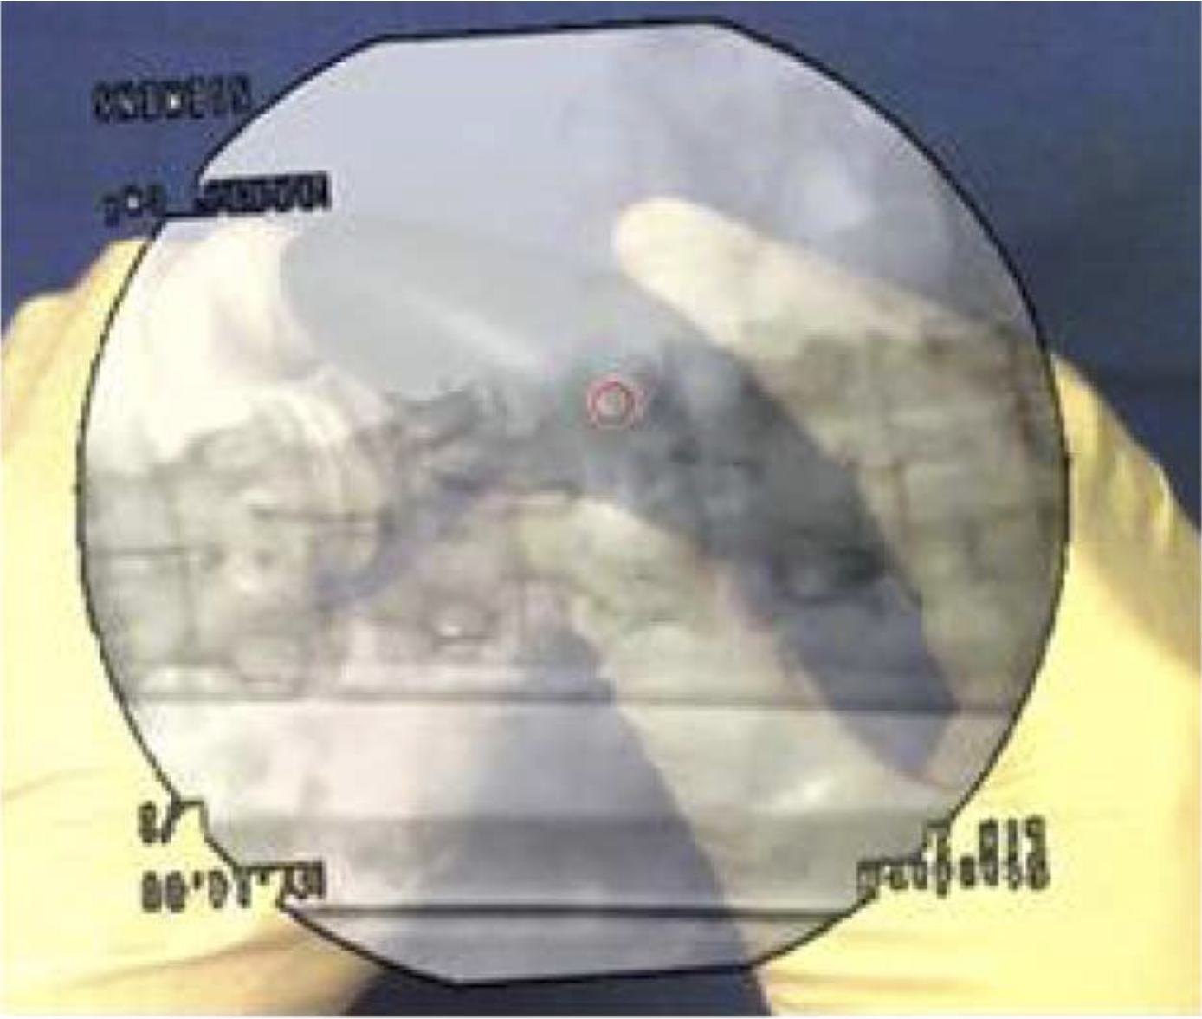
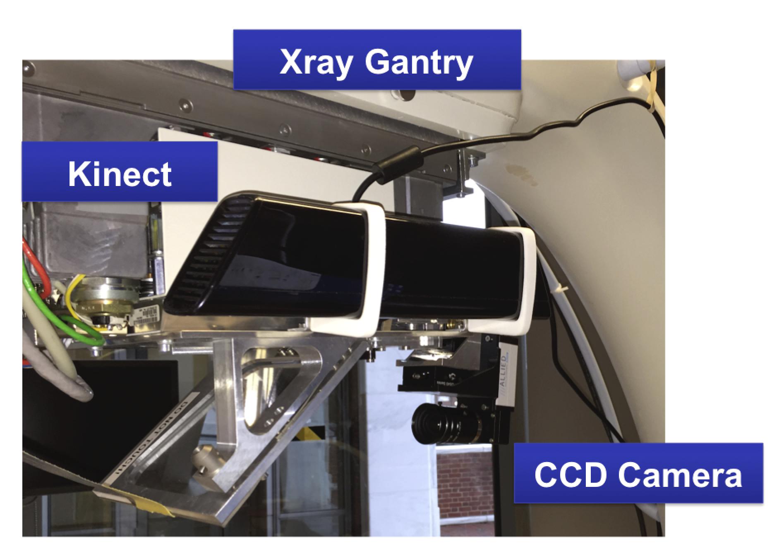
RGBD Camera Integration into Camera Augmented Mobile C-arm (CamC) Han Xiao Mentors: Dr. Nassir Navab, Bernhard Fuerst, Javad Fotouhi
Goals:
Integrate a depth camera to reconstruct a depth map for the CamC camera.
Produce an improved X-ray overlay.
Significance:
Improve the usability.
Provide depth data for further applications.
Results:
An improved X-ray overlay is generated.
A software is developed for reusability.

