Slide 1
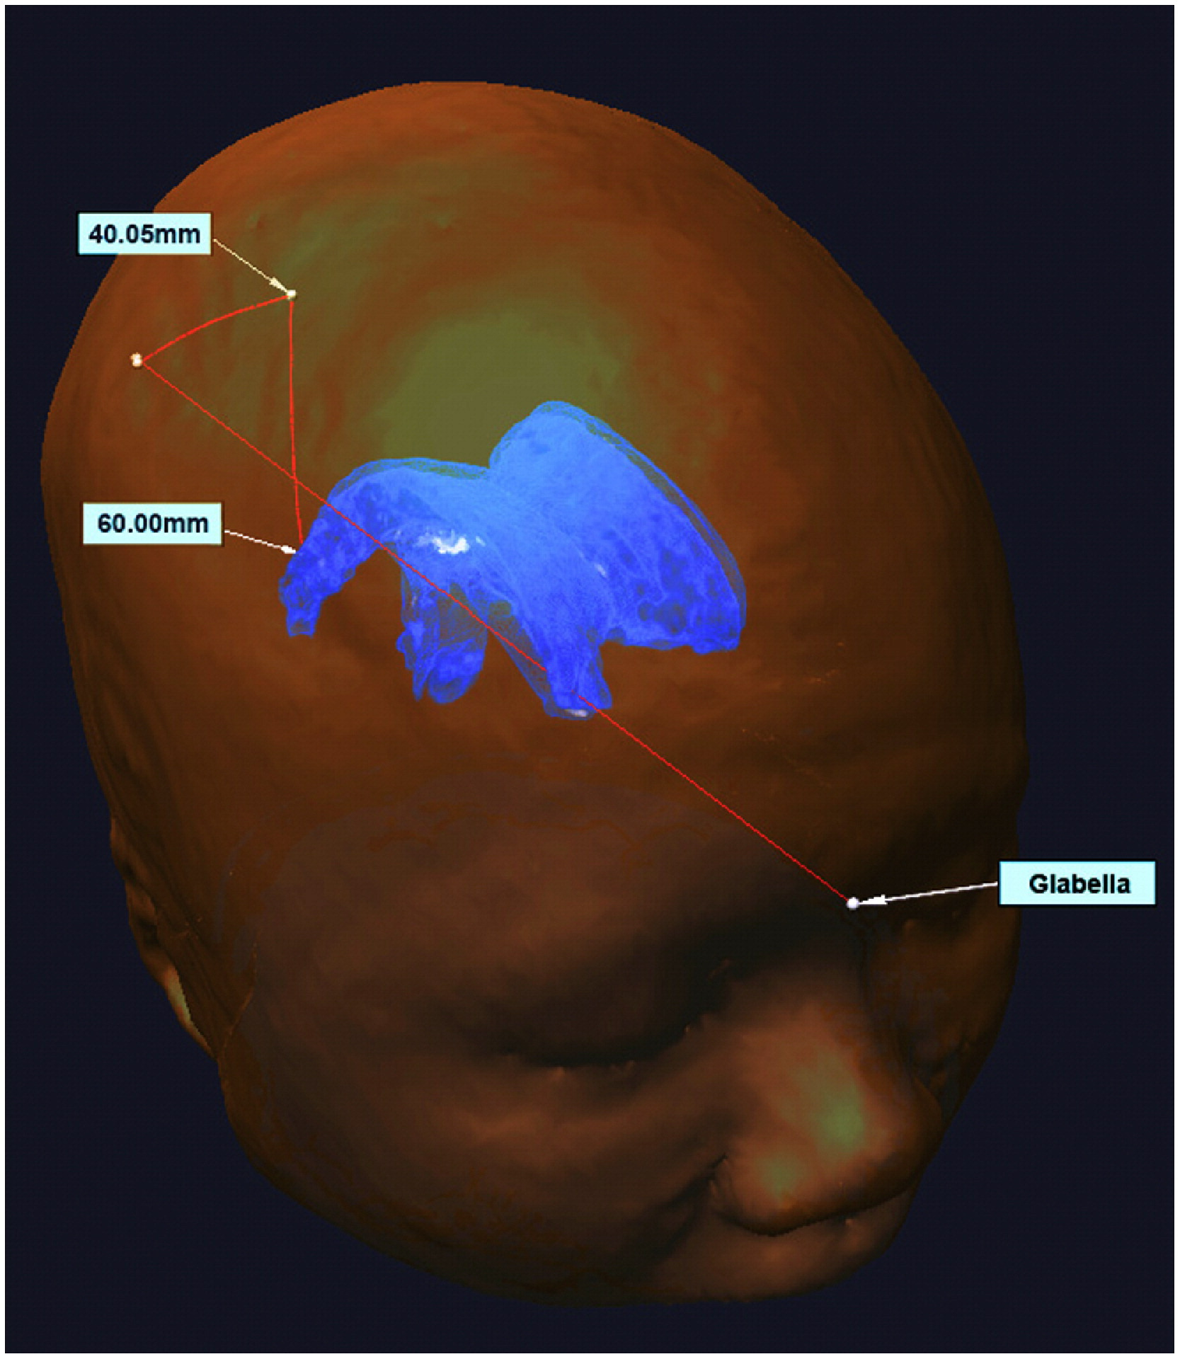
HMD-Based Navigation for Ventriculostomy Group 15: Mingyi Zheng, Yiwei Jiang Mentors: Professor Peter Kazanzides, Ehsan Azimi
Goals:
The goal is to introduce image guidance via augmented reality on HoloLens to improve success rate of catheter placement in ventriculostomy
The image guidance will include AR overlay of
Ventricle model from CT image
Catheter guide overlay
Significance:
Current procedure relies on surgeons to guess the location of ventricle from CT image and anatomic points, which leads to 30% catheter misplacement.
Catheter guide overlay(s)
Ventricle
Azimi, E., et al.: Can mixed-reality improve the training of medical procedures? In: IEEE Engineering in Medicine and Biology Conference (EMBC), pp. 112–116, July 2018

Slide 2
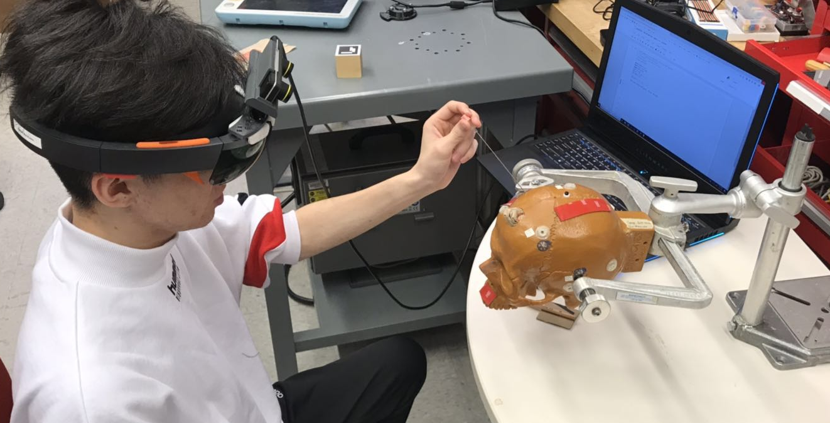
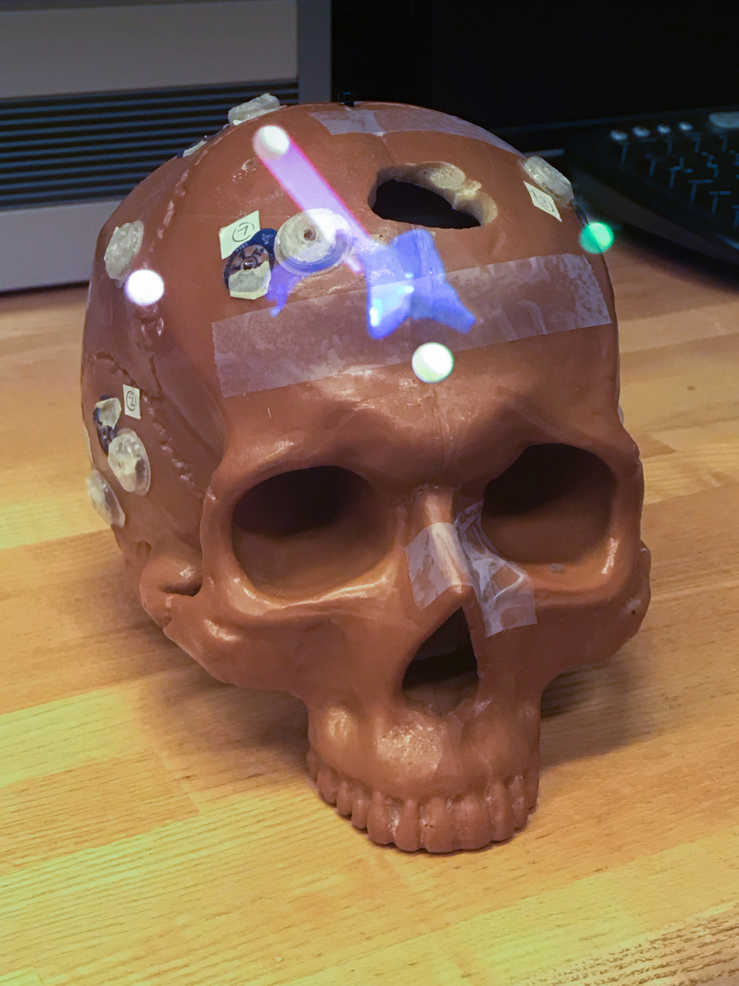
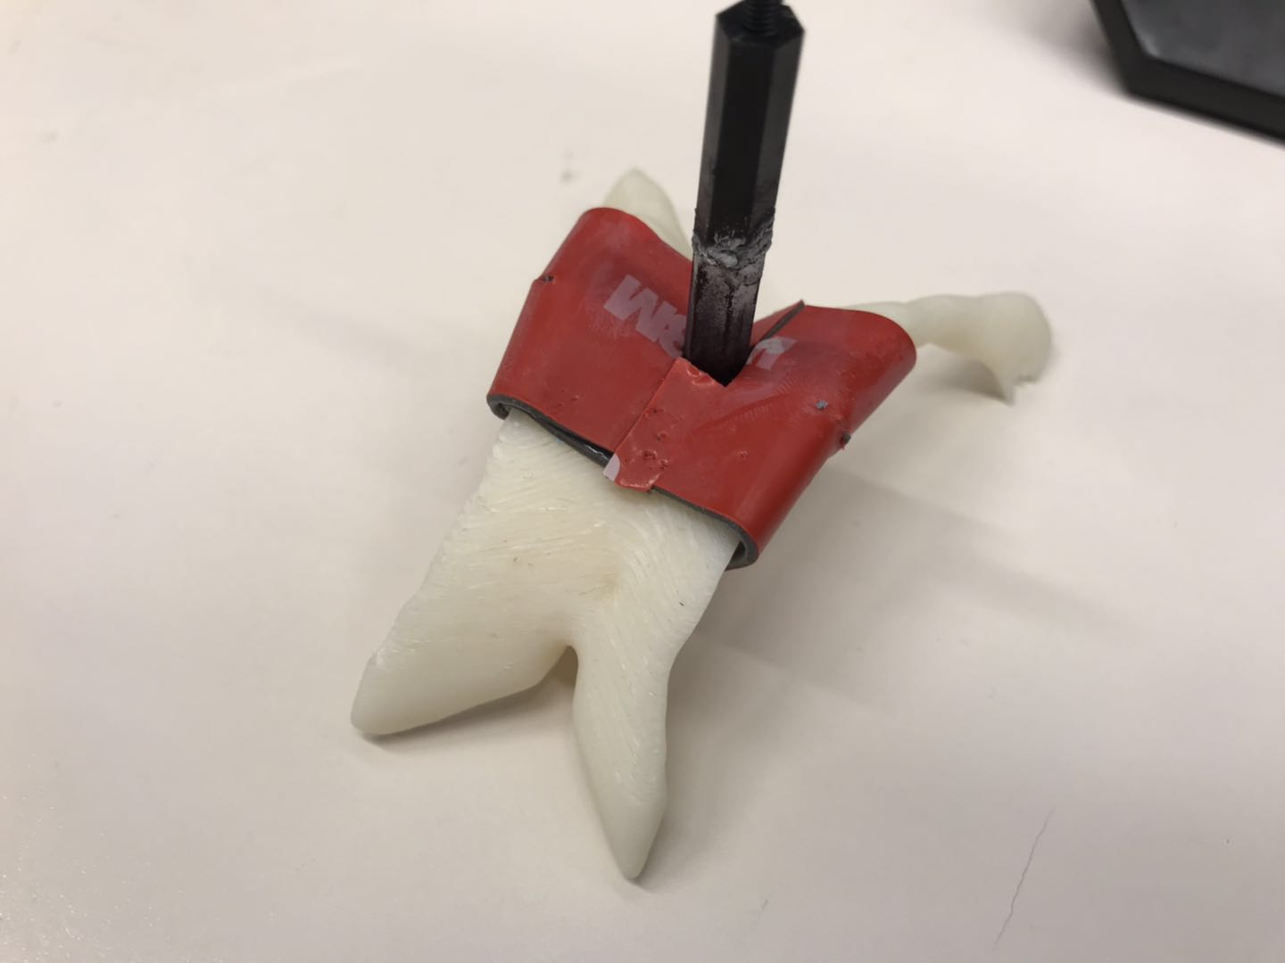
Result
Entry
Catheter Guidance
Overlay of Ventricle
Pilot Test: Mock Ventriculostomy
User View
Red: 20
White: 10
Miss: 0
Our navigation system helps users to perform this mock ventriculostomy.

