Slide 1
Accuracy Assessment and Kinematic Calibration of the Robotic Endoscopic Microsurgical System
Paper by Lihan Feng, Paul Wilkening, Yunus Sevimli, Marcin Balicki, Kevin C. Olds, Russell H. Taylor
Project: Kinematic Calibration and Accuracy Improvement for the Galen Robot
CIS II Seminar Talk by Can Kocabalkanli

Slide 2
Introduction
Paper Choice, Why It Matters, and Important Results

Slide 3
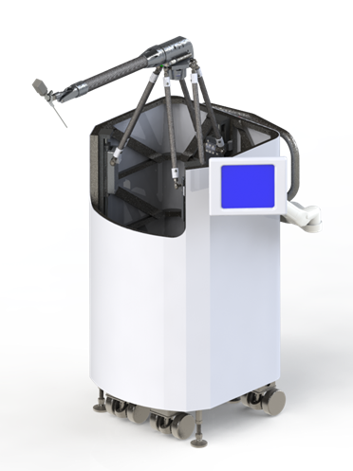
Project Statement & Paper Choice
Accuracy Assessment and Kinematic Calibration of the Robotic Endoscopic Microsurgical System
The paper assesses the accuracy of the Robotic Endoscopic Microsurgical System (REMS)
REMS is calibrated with a standard optical tracker system, and is the predecessor of Galen
This is the procedure we are following for our CIS II project to calibrate the Galen
[1]: Taylor, “The Galen Microsurgery System”, 3/21/2019, LCSR Industry Day, Baltimore

Slide 4
The Problem & The Solution
For a precise surgical robotic system, we need high accuracy and precision
Therefore, the accuracy of the system needs to be evaluated and possibly improved upon
The authors do so by calibrating REMS using optical tracking
They improve the kinematic pose accuracy by hand-eye calibration and correction via Bernstein polynomials.

Slide 5
Important Results
Reports a kinematic calibration method to calculate tool tip positions without requiring calibration for each individual robot link.
The calibration method reduces kinematic errors from an average absolute error of 2 mm to 0.14 mm.

Slide 6
Background
Regarding this study and REMS

Slide 7
Clinical Background
Head and neck surgery (ENT) procedures have narrow workspace around delicate structures
Requires holding fairly long tools with high precision and stability
Systems like the DaVinci are not optimized for ENT procedures
So, specific systems have been adapted for specific tasks and can’t be generalized to other tasks easily
[2]: Sclafani et al: “Total Otolarnygology- Head and Neck Surgery”, Thieme Medical Publishers, 2015

Slide 8
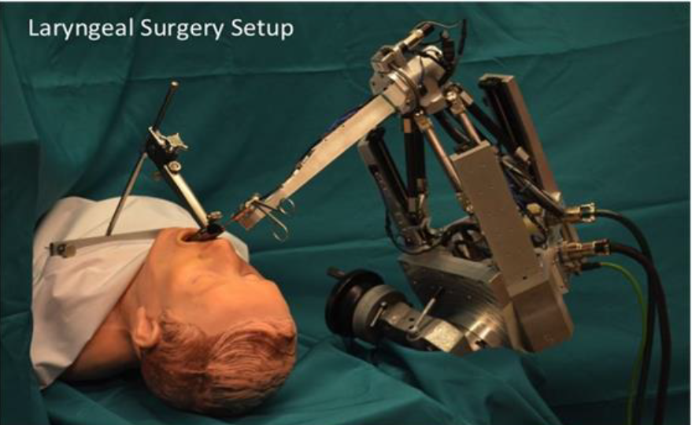
Robotic Endoscopic Microsurgical System
REMS is a collaboratively controlled robot meant to address these drawbacks
Designed to be inexpensive, precise, and intuitive to use
Controlled collaboratively and meant to cancel hand tremor as robot performs the actual motion
Uncalibrated stereotactic accuracy observed to be good, but can be improved.
[3]: K. C. Olds, Robotic Assistant Systems for Otolaryngology-Head and
Neck Surgery, Ph.D Thesis, The Johns Hopkins University, 2015

Slide 9
Kinematic Calibration Theory
The Technical Approach to Calibrating REMS

Slide 10
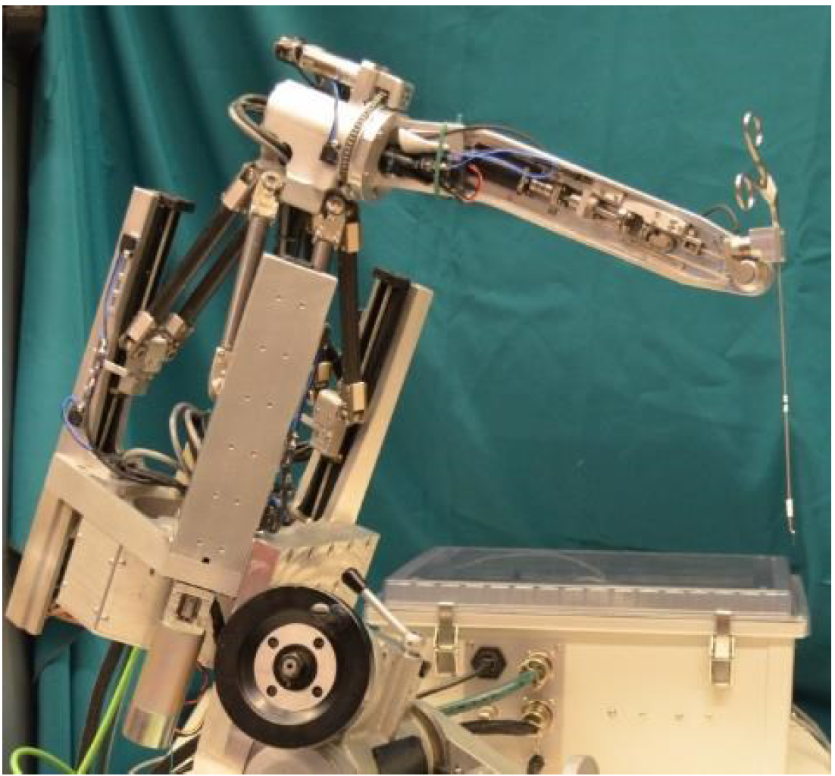
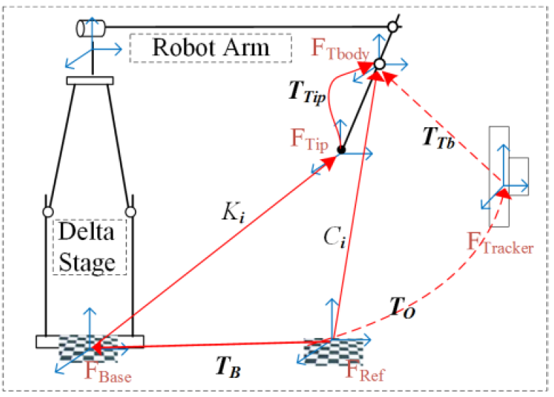
Calibration Protocol
Eye-to-hand approach: external optical tracker, not attached to robot
For a set of n poses, tracker records pose measurements (of fiducials) C, the ground truth
n corresponding forward kinematics poses K are recorded and regarded as “the distorted data”
Then a two-phase procedure is followed: Hand-Eye calibration (solves Ttip and TB) and Bernstein polynomial correction
[4]: Feng et al: “Accuracy Assessment and Kinematic Calibration of the Robotic Endoscopic Microsurgical System”. 2014
Notes:
Weight could cause deflections, also this is more straightforward
(TB and Ttip unknown but constant)
FTracker - Optical tracker frame;
FRef - Optical tracker tool-reference frame;
FTbody - Optical tracker tool-body frame;
FBase - Robot base frame;
FTip - Robot tool-tip frame;
TO - Frame transformation from FRef to FTracker;
TT - Frame transformation from FTracker to FTbody;
C - Frame transformation from FRef to FTbody, calculated by the
tracker itself;
K Frame
transformation from FBase to FTip, calculated by the
REMS’ kinematics.
TB Frame
transformation from FRef to FBase, which is a
constant homogenous matrix between two references;
TTip Frame
transformation from FTip to FTBody, which

Slide 11
Hand-Eye Calibration
From the frame relationship:
$T_{O}∙T_{TB}=T_{B}∙K∙T_{Tip}=C$ (1)
Where C is calculated by tracker. For the i^{th} measurement:
$C_{i}∙T_{Tip}^{−1}=T_{B}∙K_{i}$ (2)
From the initial measurements C₀ and K₀
$T_{Tip}^{−1}=C_{0}^{−1}{∙T}_{B}∙K_{0}$ (3)
Substitute (3) in (2): $C_{i}T_{Tip}^{−1}=C_{i}C_{0}^{−1}T_{B}K_{0}=T_{B}K_{i}$
$${(C_{i}C}_{0}^{−1})T_{B} =T_{B} ({K_{i}K}_{0}^{−1})$$
Similarly for $T_{Tip}$: ${(C}_{0}^{−1}C_{i})T_{Tip}^{−1}=T_{Tip}^{−1}(K_{0}^{−1}K_{i})$
These expressions have the form of the well known AX = XB problem, and the authors use the quaternion method (remember CIS) to solve it.

Slide 12
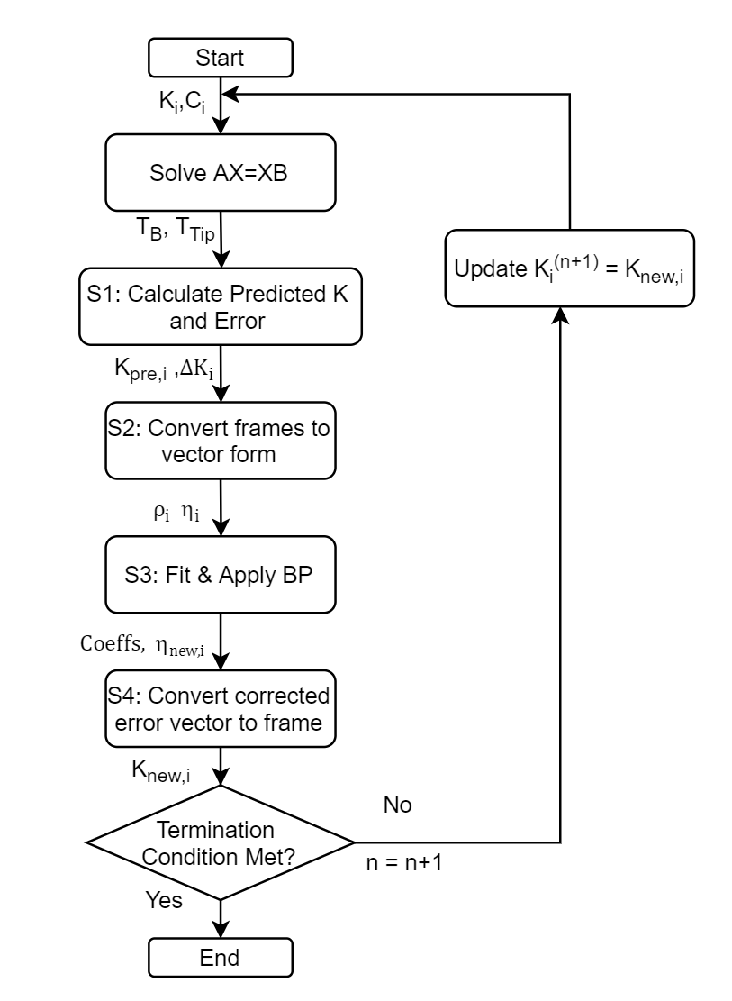
Kinematic Correction
S1: Predict K as $K_{Pre,i}=T_{B}^{−1}∙C_{i}∙T_{Tip}^{−1}$ and calculate error between prediction and measurement as ${∆K_{i}=K_{i}^{−1}∙K}_{Pre,i}$
S2: Convert frame matrices $K_{i}$ and $K_{Pre,i}$ to vector form $ρ_{i}$ and $η_{i}$ resp.
S3: Fit Bernstein polynomial to obtain N-dim vector of coefficients. Apply coefficients to vector $ρ_{i}$ to obtain corrected error $η_{new,i}$
S4: Convert corrected error $η_{new,i}$into frame matrix $∆K_{BP,i}$and compute corrected kinematics as $K_{new,i}=K_{i}∙∆K_{BP,i}$
Notes:
S2: Dof translation pi and 2-Dof rotation (θi, φi) as mentioned above, but Kpre,i is 6-Dof full pose from the tracker
S3: N generally less than 6 to avoid overfitting
After S4: Feed corrected Knew_i to Hand-Eye calibration for next iteration

Slide 13
Calibration Experiment & Results
Results and Analysis for the performed calibration experiment

Slide 14
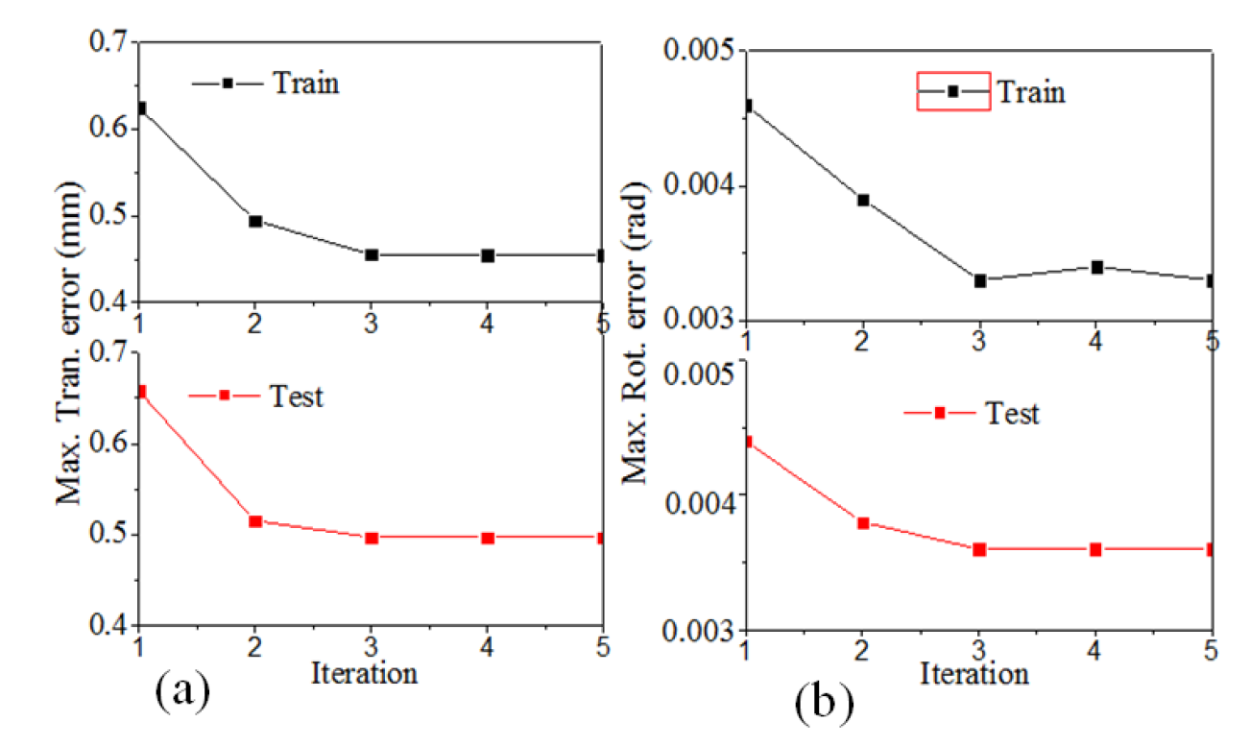
Experimental Procedure
Over 5000 kinematic poses across REMS workspace
75% of this data used to fit the Bernstein polynomial, other 25% used for testing
Error Defined as the norm of the difference between $K_{new,i}$and $K_{pre,i}$ in vector form
1) Iteration Test to see how error varies over iterations – numerically stable after 5
[4]: Feng et al: “Accuracy Assessment and Kinematic Calibration of the Robotic Endoscopic Microsurgical System”. 2014

Slide 15
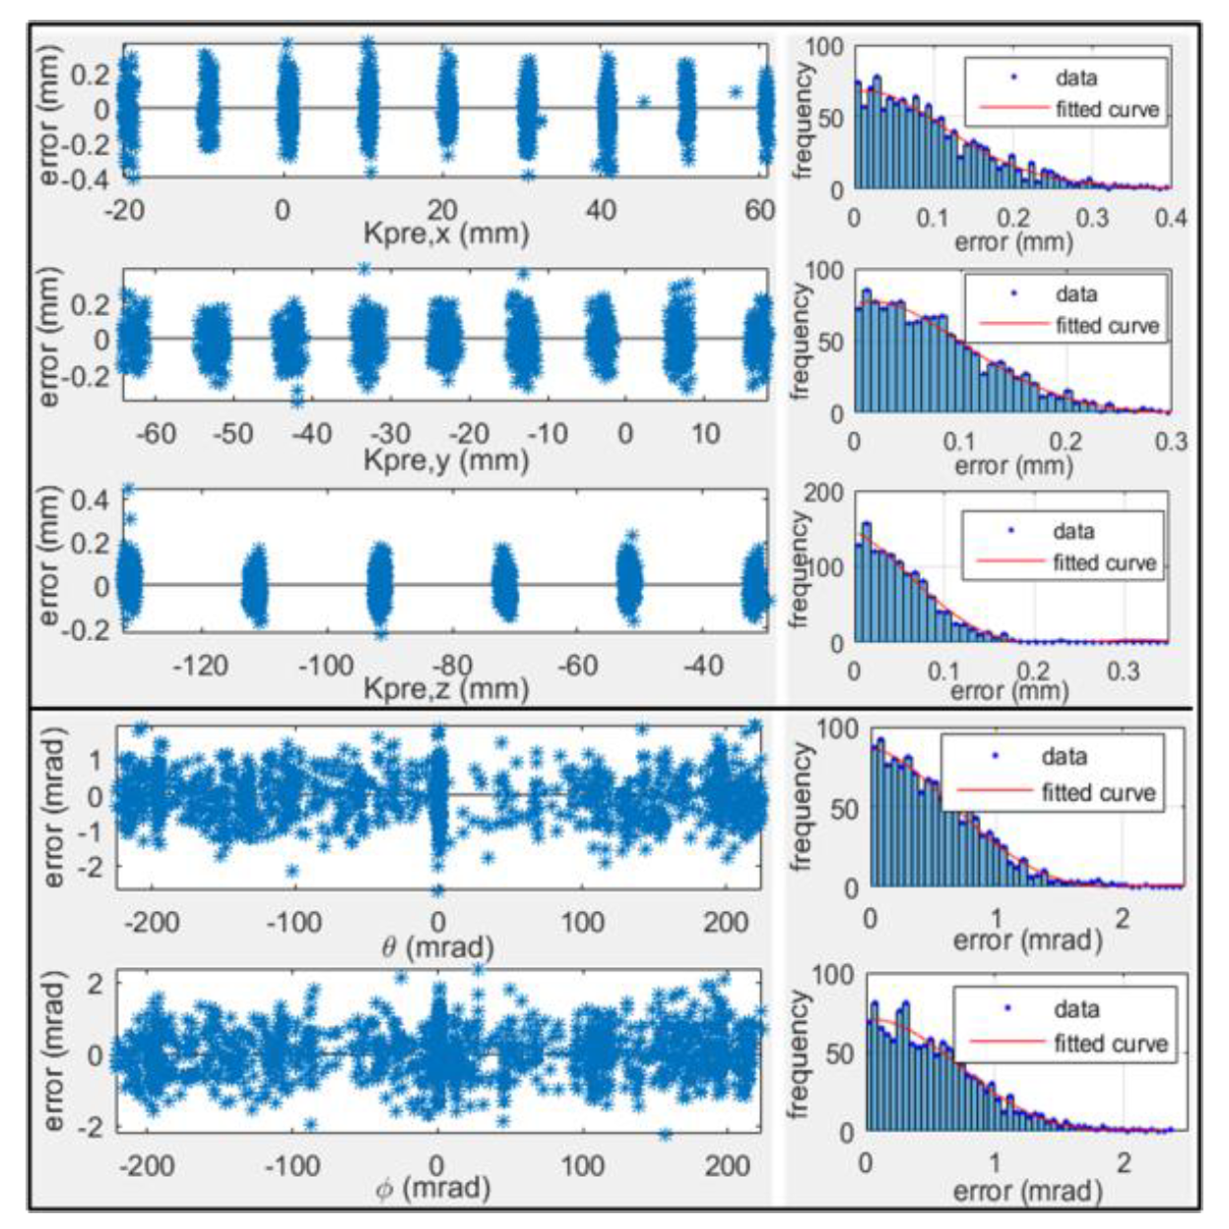
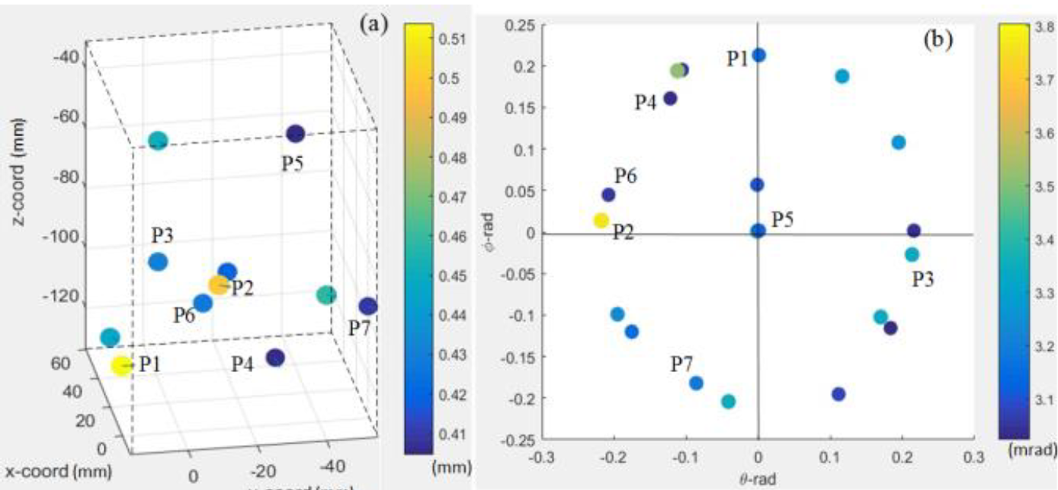
Accuracy Assessment
[4]: Feng et al: “Accuracy Assessment and Kinematic Calibration of the Robotic Endoscopic Microsurgical System”. 2014
Mean absolute error: 0.14 mm (tran) and 0.0011 rad (rot) in a [80, 80, 90] (mm) workspace.
Maximum error: < 0.5 mm (tran) and <0.0038 rad (rot)
Worst Case Analysis:
Analyzed $E_{tran}≥0.4mm or E_{rot}≥0.003 rad$
11 pts in the translational range and 25 points with rotational range
No pattern for $E_{tran}$, but $E_{rot}$ clusters around workspace boundary – possible indicator of the Delta mechanism rotating

Slide 16
Conclusions
Student Assessment & Next Steps

Slide 17
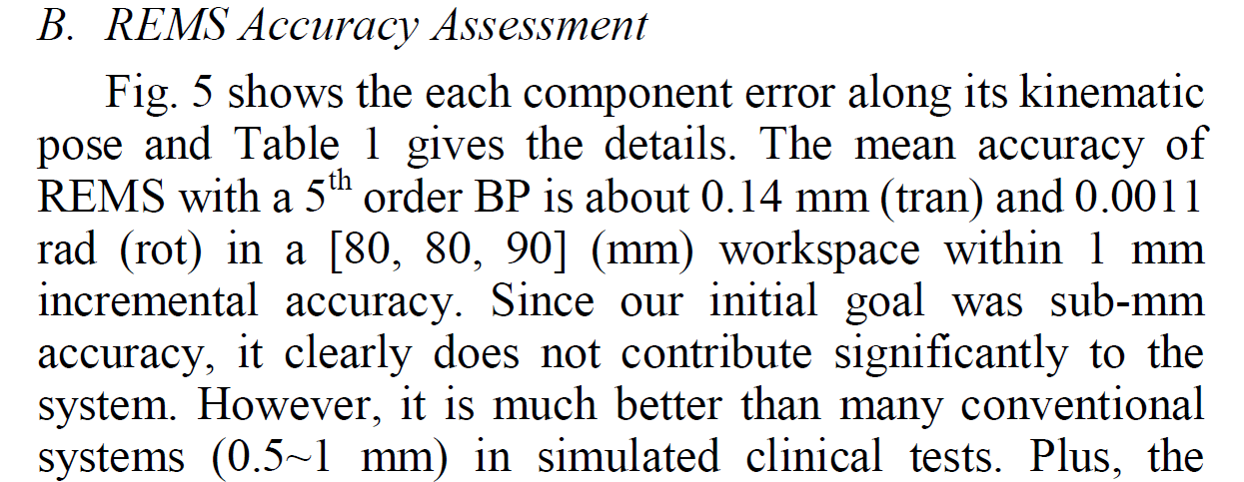
Conclusions
Strengths
Simple, relatively easy protocol for calibrating a robotic surgical system
Protocol conveyed well
Significant improvement of pose accuracy (2 mm to 0.14 mm)
Limitations
Assuming that rotational error is independent of translational position, possibly causing $E_{rot}$ around workspace boundary
It is better to evaluate the fitting result at a new location in case of non-uniform systematic error from the Polaris
Tracker accuracy of 0.35 mm
Confusing language while discussing results
Notes:
Simplicity: We have learnt this in CIS
it is possible that small imperfections in the Delta mechanism may cause the stage to deviate slightly from a perfectly parallel alignment over the motion range.

Slide 18
Next Steps & Relevance
For the authors:
Repeating this procedure with more accurate tracker (Atracsys, 0.09 mm) (DONE)
Evaluation on the relationship between translational and rotational error
Applying this procedure to similar robotic systems
For us:
We will (initially) repeat the assumption that that rotational error is independent of translational position, to reduce the amount of data needed.
We will follow this procedure on the Galen, using the Atracsys system.
Notes:
The translational impact of such imperfections will be accounted for in the translational calibration, however, and very small orientation errors are less important in the intended applications.

Slide 19
References
[1]: Taylor, “The Galen Microsurgery System”, 3/21/2019, LCSR Industry Day, Baltimore
[2]: Sclafani et al: “Total Otolarnygology- Head and Neck Surgery”, Thieme Medical Publishers, 2015
[3]: K. C. Olds, Robotic Assistant Systems for Otolaryngology-Head and Neck Surgery, Ph.D Thesis, The Johns Hopkins University, 2015
[4]Feng et al: “Accuracy Assessment and Kinematic Calibration of the Robotic Endoscopic Microsurgical System”. 2014

