Slide 1
Position Control of BIGSS Lab Snake for
Revision Total Hip Arthroplasty (THA) Surgery
Project 6: Farshid Alambeigi
Mentors: Dr. Mehran Armand, Ryan Murphy, Dr. Russell Taylor
Goals
Mechanical interface of the Snake-like Dexterous Manipulator with the robotic arm- which is a 6 DOF Universal Robot (UR5)
Position control of the tip of the SDM inside the lesion area.
Significance
One motivating application of this minimally-invasive surgical workstation is the treatment of osteolysis (bone degradation) behind the well-fixed acetabular component of a total hip arthroplasty (THA).
Results
Kinematic modeling and control of a coupled 8 DoF robots used for treatment of osteolysis in confined spaces based on a linearized multi-objective constrained optimization algorithm.
Design and fabrication of a mechanical interface

Slide 2
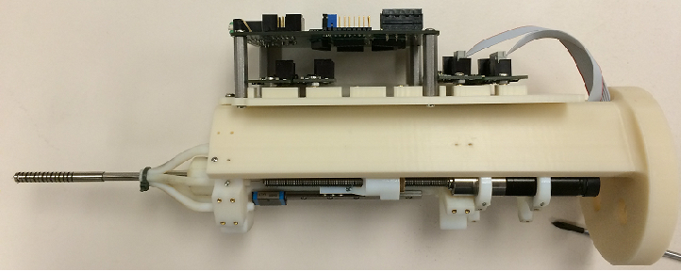
Results

