Slide 1
Augmented Reality Magnifying Loupe for Surgery
Abstract: A magnifying loupe is often used in surgical procedures, including neurosurgery and dentistry, in order to enhance the vision of fine detail. Augmented Reality (AR) guidance in the loupe can potentially help the practitioner in navigation and operation.
Objective: Develop method and prototype to provide AR in the magnified vision of the surgeon or dentist.
Deliverables:
Hardware prototype to integrate a HMD with magnifying loupe
Develop a calibration method to associate the field-of-magnified-vision, the HMD screen space and the task workspace
Conduct a comparative phantom study with the proposed system
Size group: 1-2 students
Skills: AR (Unity, HMD programming), CIS (Calibration), Prototyping
Mentors: Long Qian (lqian8@jhu.edu), Mathias Unberath (unberath@jhu.edu), Peter Kazanzides (pkaz@jhu.edu)

Slide 2
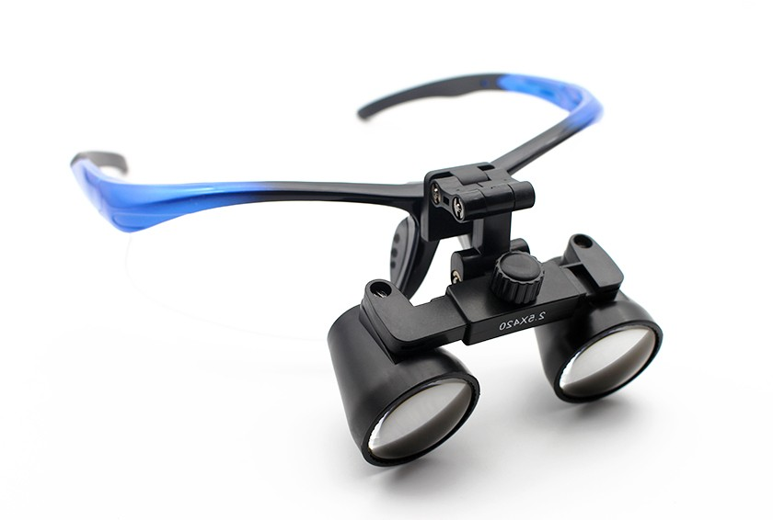
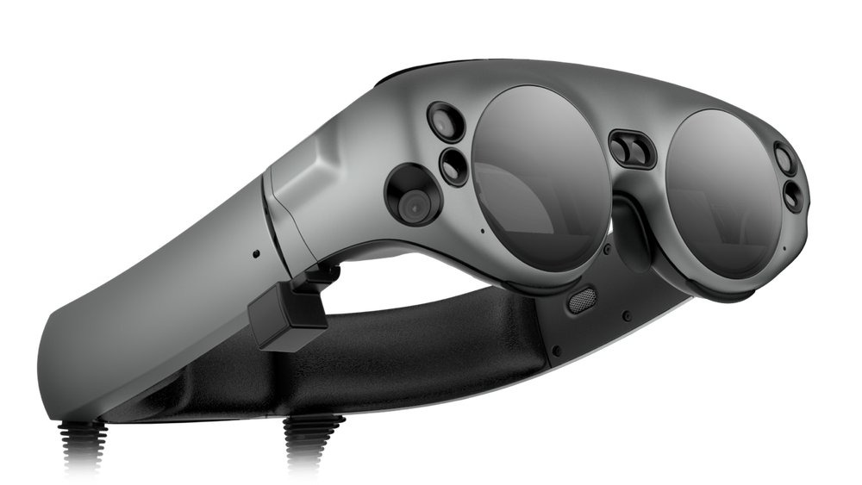
Augmented Reality Magnifying Loupe for Surgery
Optical See-Through Head-Mounted Display (e.g. MagicLeap One)
3.5x Magnifying Loupe
Magnified field-of-vision (Accurate operation)
Augmented Reality guidance on OST-HMD

Slide 3
Augmented Reality Magnifying Loupe for Surgery
Potential Challenges:
Calibration of magnified field-of-vision with virtual space of augmentation
Existing methods (e.g. SPAAM [2]) do not account for magnification
The calibration procedure needs to be user-friendly
The effective part of the HMD screen needs to be identified
Magnifying lenses have significant distortion
A tracking system with good accuracy is necessary to enable AR
Evaluation of the proposed system
Identification of a practical sub-task in surgery or dentistry
References:
[1]: James, Teresa, and Alan SM Gilmour. "Magnifying loupes in modern dental practice: an update." Dental update 37.9 (2010): 633-636.
[2]: Tuceryan, Mihran, Yakup Genc, and Nassir Navab. "Single-Point active alignment method (SPAAM) for optical see-through HMD calibration for augmented reality." Presence: Teleoperators & Virtual Environments 11.3 (2002): 259-276.

