Slide 1
Anomaly detection for treatment planning and a learning health system in radiotherapy
The goal is to improve the integrity of the data in a learning health system with tools that can identify potentially erroneous data with statistical anomaly detection.
What Students Will Do:
Develop framework to run on the database that respond to errant data
Detect errant contours utilizing the database of hundreds of anatomical contours as a norm
Detect errant longitudinal data such as excessive changes in clinical status (e.g .weight)
Allow for customized data integrity checks to be added as future needs are identified.
The system will be constructed to report findings in 3 ways
Listed report of all detected errors
Ability to tag data as suspect
Provide real time check on single data point entry when it is possible
Deliverables:
The overall framework for errant contour detection
Documented API for developing new integrity checks
Size group: 1-3
Skills:
3D shapes, Volumetric Image Segmentation
Anomaly detection methods
Programming experience (SQL, C#, python)
Mentors:
Todd McNutt (tmcnutt1@jhmi.edu)
Pranav Lakshminarayanan (plakshm1@jhu.edu)

Slide 2
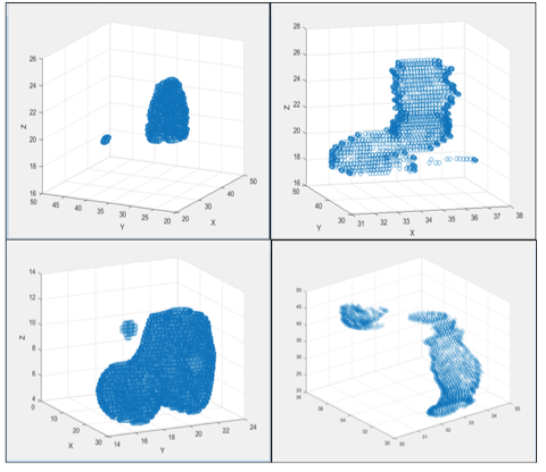
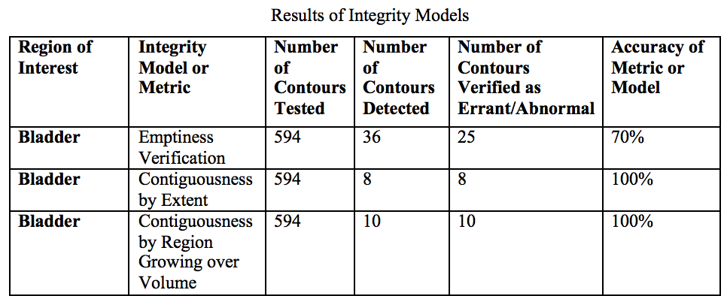
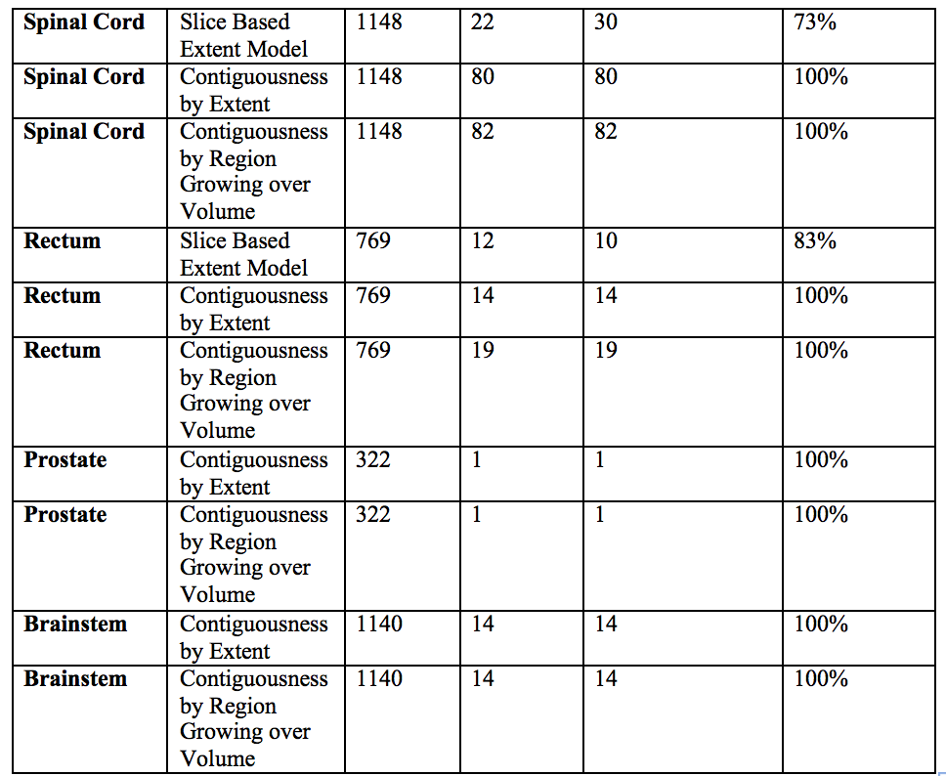
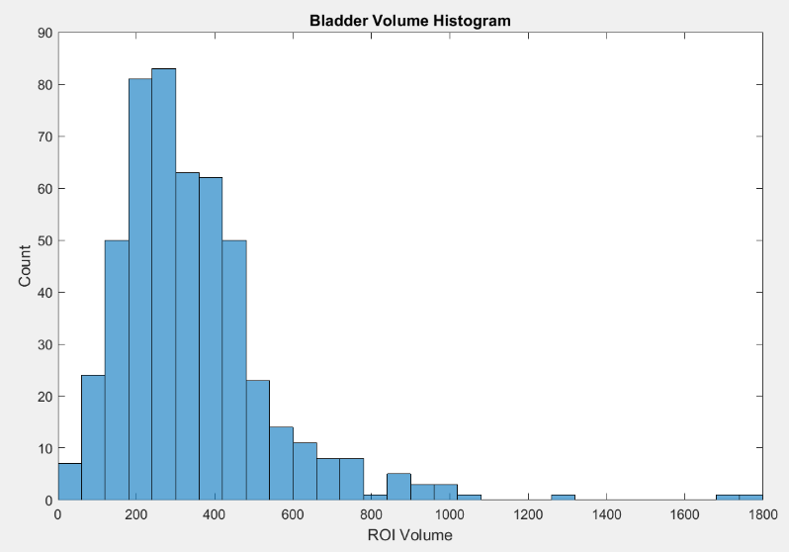
Example detection
Discontinuity
Statistical outlier (volume)

