Slide 1
Enabling Technologies for Robot Assisted Ultrasound Tomography
Team Members: Rishabh Khurana , Fereshteh Aalamifar
Mentors: Emad Boctor, Iulian Iordachita, Russell Taylor
Group 11
Checkpoint Presentation 1
Notes:
R

Slide 2
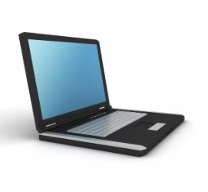
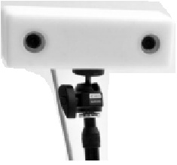
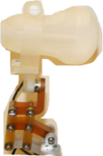
Summary & Goal
Design a prototype that uses a robot controlled ultrasound probe to follow the motion of the free hand probe that can be used for Ultrasound Tomography.
Control Software
Robotic Arm
Passive Arm
Ref coordinate
Project Summary
Progress till now
Timeline
Remained Tasks
Plan
Notes:
R

Slide 3
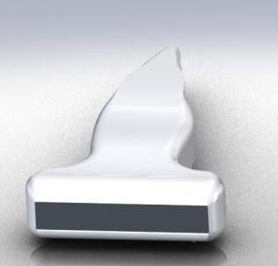
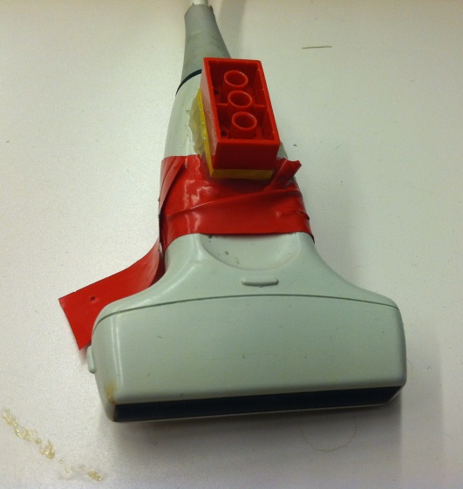
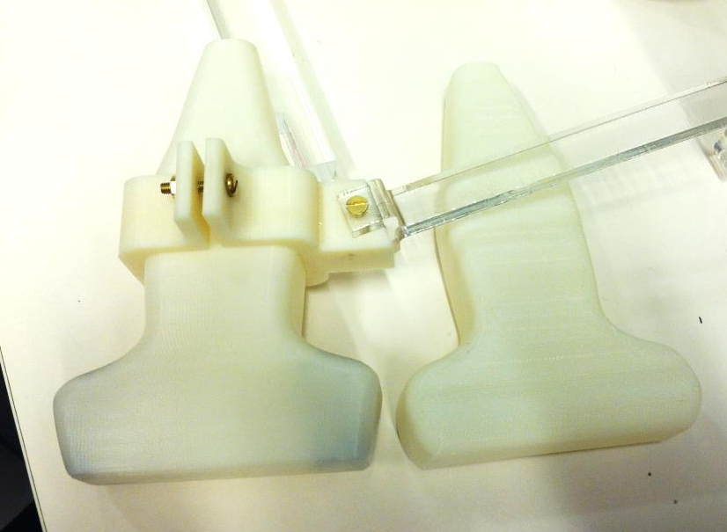
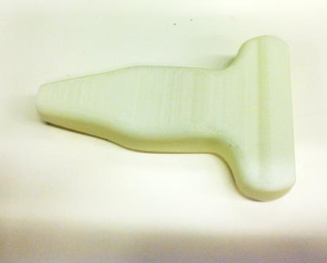
Mock Probe Prototype
Designed CAD file and manufactured the mock probe
Redesigned and manufactured finalized mock probes
Corrected part
Design
First design
corrected
Real Probe
Correction
Manufacture
Project Summary
Progress till now
Timeline
Remained Tasks
Plan
Notes:
R

Slide 4
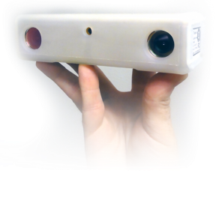
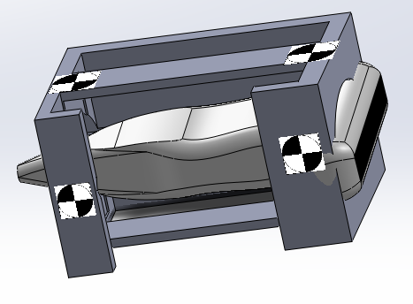
MicronTracker Training
Acquired, installed, and tested MicronTraker
Practiced Field of measurement (FOM)
Learnt Markers design
Rigid body design
Copyright: Claron Inc.
Initial Probe Holder
Micron Markers
MicronTracker FOM
Project Summary
Progress till now
Timeline
Remained Tasks
Plan
Notes:
R

Slide 5
Tracker on top or on robot arm?
Criteria:
1. Workspace limitation (present when tracker on top): Tracker FOM limited -> have to determine an area as workspace -> system cannot operate outside this area
phantom
Workspace limitation
Project Summary
Progress till now
Timeline
Remained Tasks
Plan
Notes:
F

Slide 6
Tracker on top or on robot arm?
Criteria:
2. Tomographic image(present when tracker on robot arm):
Truncated tomography:
in CT, usually, field of view is larger than the organ
in US, usually, field of view is smaller than the organ
If we can capture edge of the organ by a camera, we can compensate for truncated tomography
X-ray source
phantom
CT Gantry
phantom
CT Scan: Complete tomography
phantom
US: truncated tomography
Project Summary
Progress till now
Timeline
Remained Tasks
Plan
Notes:
F

Slide 7
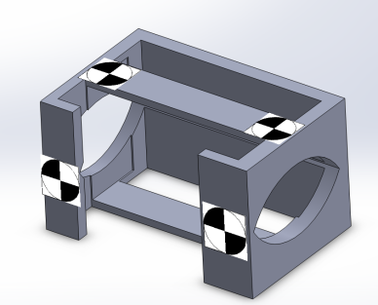
Tracker on top or on robot arm?
Criteria 3. Line of sight (LOS) Problem (present when tracker on robot arm):
Remember rigid body design
Now assume:
Xpoint diameter is 2.4cm and it faces camera, then:
We know: Sx60 FOM: 115x70x55 cm
maximum cylinder diameter is 30 cm
phantom
Probe is always in range
Project Summary
Progress till now
Timeline
Remained Tasks
Plan
Notes:
F

Slide 8
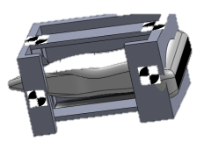
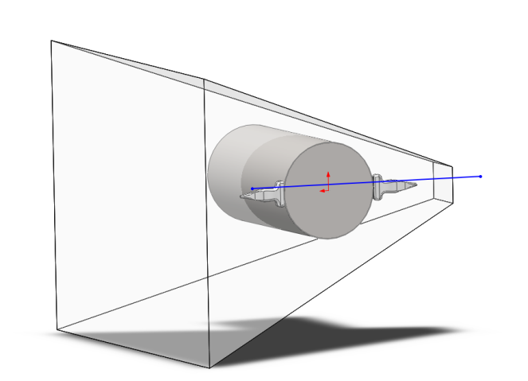
Tracker on top or on robot arm?
Criteria 3. Line of sight (LOS) Problem:
Problem: Cylinder is obstructing the FOM!
Micron FOM
Micron Camera
Phantom
3D view
Project Summary
Progress till now
Timeline
Remained Tasks
Plan
Notes:
F

Slide 9
Tracker on top or on robot arm?
Position of tracker | Top of workspace | On robot arm
No workspace limitation | x | √
Tomographic image | x | √
No line of sight problem | √ | x
Line of sight problem:
Approach 1: Use another tracker that does not have LOS problem
Approach 2: Put camera and markers in a different position
Project Summary
Progress till now
Timeline
Remained Tasks
Plan
Notes:
R

Slide 10
Which type of tracking system?
Electromagnetic vs. Optical
Type of tracker | Electromagnetic | Optical
No line of sight problem | √ | x
No metal restriction | x | √
Tomographic image | x | √
Available and have training | x | √
Project Summary
Progress till now
Timeline
Remained Tasks
Plan
Notes:
R

Slide 11
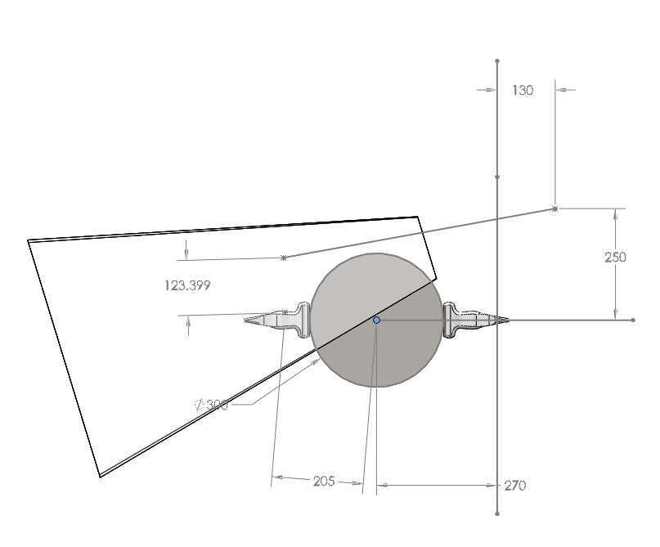
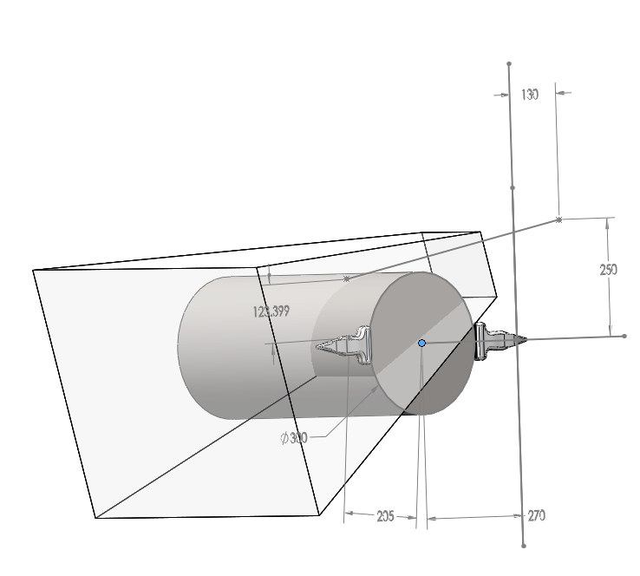
Solution to LOS Problem
Diameter: 30 cm
FOM: Sx60 115 x 70 x 55 cm
Camera: Horizontally mounted
Camera’s angle: 17 degrees
Camera
Marker
FOM
Project Summary
Progress till now
Timeline
Remained Tasks
Plan
Notes:
F

Slide 12
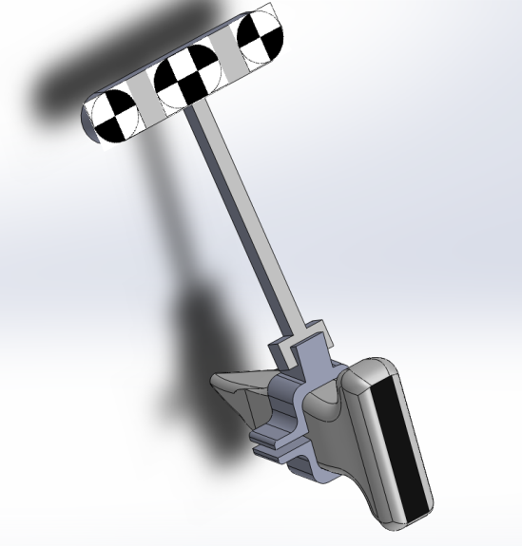
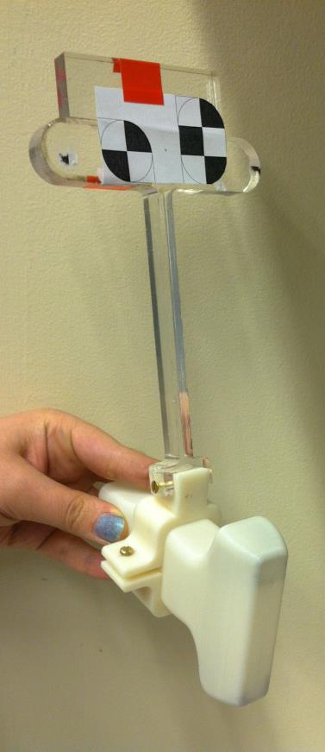
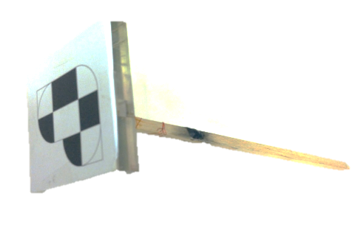
Tracker Rigid Body
Manufacture
Design
Correction
Project Summary
Progress till now
Timeline
Remained Tasks
Plan
Notes:
F

Slide 13
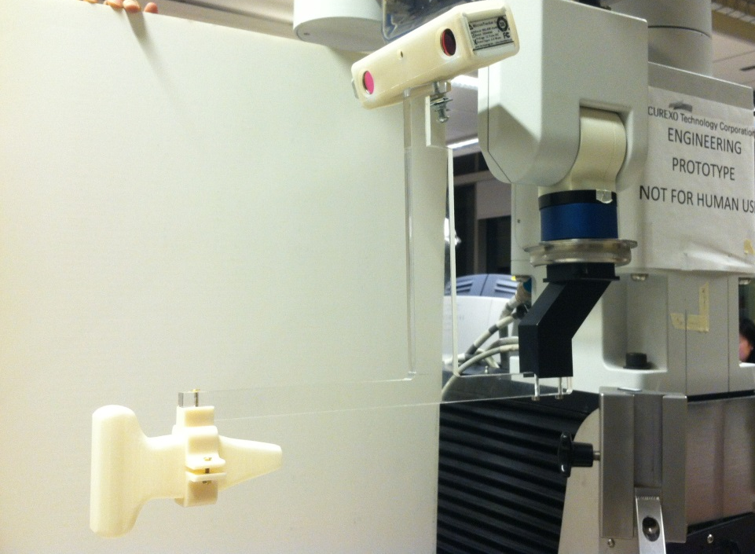
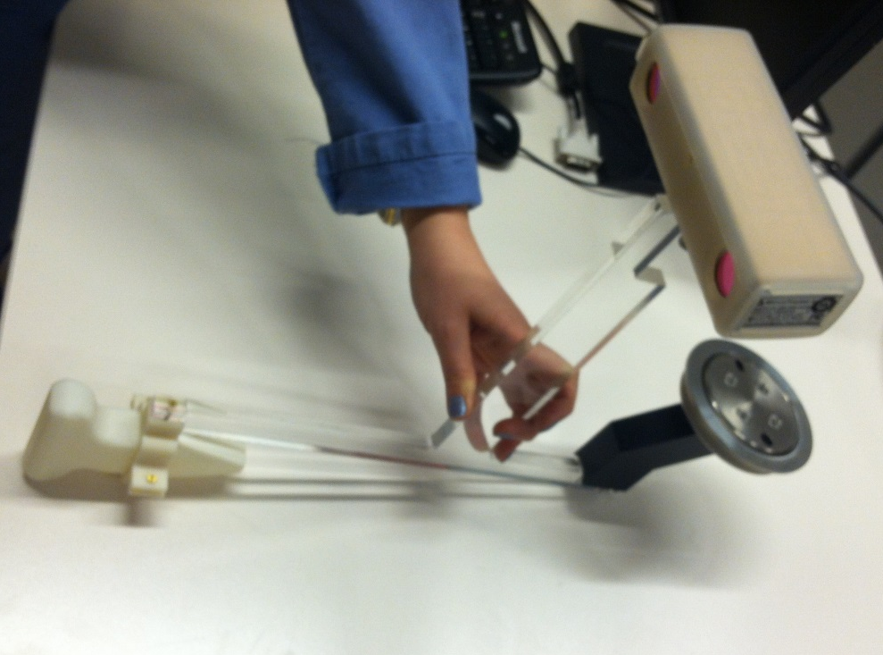
End-Effector
Project Summary
Progress till now
Timeline
Remained Tasks
Plan
Notes:
F

Slide 14
Robot Training
Done:
Installed Simulator
Worked with codes: cisst, saw, robotserver, simulator, …
Implemented calculating tracking code
In progress:
Code development
Working with real robot
Considering safety issues
Understanding tolerable torque, weight, …
Understanding motion, DOFs, velocity, …
Project Summary
Progress till now
Timeline
Remained Tasks
Plan
Notes:
R

Slide 15
Project Timeline
Project Summary
Progress till now
Timeline
Remained Tasks
Plan
Notes:
R

Slide 16
Sources of Delay
EmTracker or Micron
Had to change PC
Simulator installation problem
Additional tasks came up
Exams!
Etc.
Project Summary
Progress till now
Timeline
Remained Tasks
Plan
Notes:
R

Slide 17
Tasks List
End effector (2 weeks)
Robot training (2 weeks)
Code and calculations implementation (2 weeks)
Calibrations (3 weeks)
Phantom and ultrasound imaging (1 week)
B-Mode & EPT (1 week)
Project Summary
Progress till now
Timeline
Remained Tasks
Plan
Notes:
F

Slide 18
Management Plan
Fereshteh:
End effector (Apr. 2)
US Calibrations (Apr. 16)
Phantom and ultrasound imaging (Apr. 23)
Rishabh:
Code and calculations implementation (Apr. 3)
Tracker – Robot calibration (Apr. 10)
Robot training (Apr. 24)
Together
B-Mode & EPT (Apr. 29)
Project Summary
Progress till now
Timeline
Remained Tasks
Plan
Notes:
F

Slide 19
New Timeline
Week Starting with | Responsible | Mar. 25 | Apr. 1 | Apr. 8 | Apr. 15 | Apr. 22 | Apr. 29 | May 6
End effector | Fereshteh
Code & calculation implementation | Rishabh
Tracker-robot calibration | Rishabh
US calibrations | Fereshteh
Phantom & Ultrasound machine | Fereshteh
Robot training | Rishabh
EPT & Bmode investigation | Together
Final Documentation | Together
Project Summary
Progress till now
Timeline
Remained Tasks
Plan
Notes:
F

Slide 20
Thanks!
Questions?

