Slide 1
Automatic Assessment of Surgical Ergonomics

Slide 2
Team
Boyoung Zhao
Eric Han
Clinical Advisors: Dr. Galaiya, Dr. Formeister
Technical Advisor: Max Li

Slide 3
Clinical Relevance
Surgery can require the adoption of awkward postures leading to
Poor Circulation
Muscle/Joint Pain
Increased Fatigue
Observational posture studies indicate surgeons spend >50% of their time in the OR with head in flexion
Jobs requiring neck flexion > 15-20° are associated with tension myalgia
Suboptimal postures are associated with poor efficiency
Optimized surgical setting can improve efficiency and performance

Slide 4
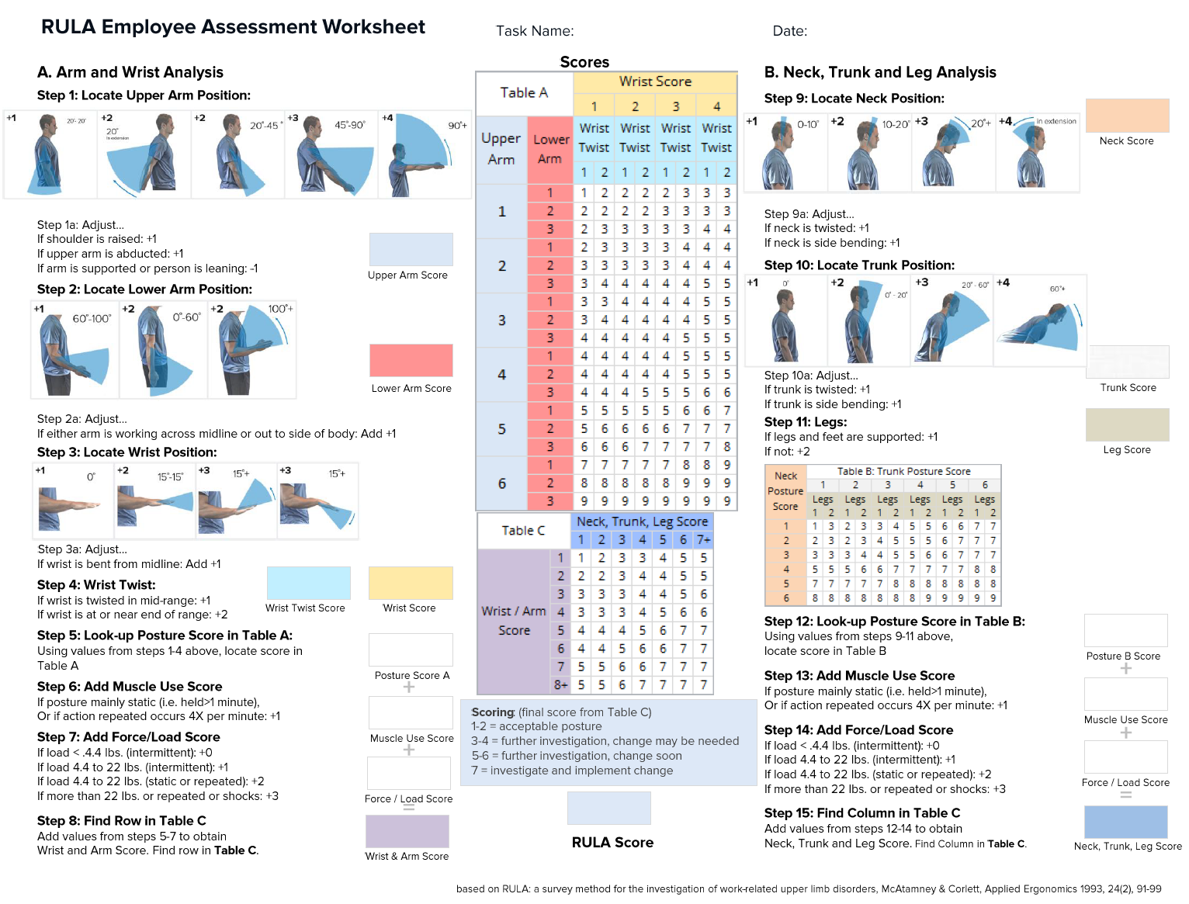
RULA

Slide 5
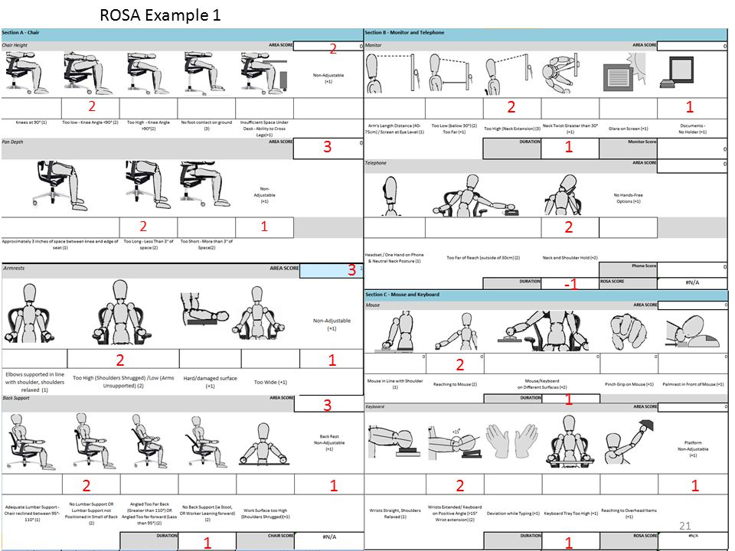
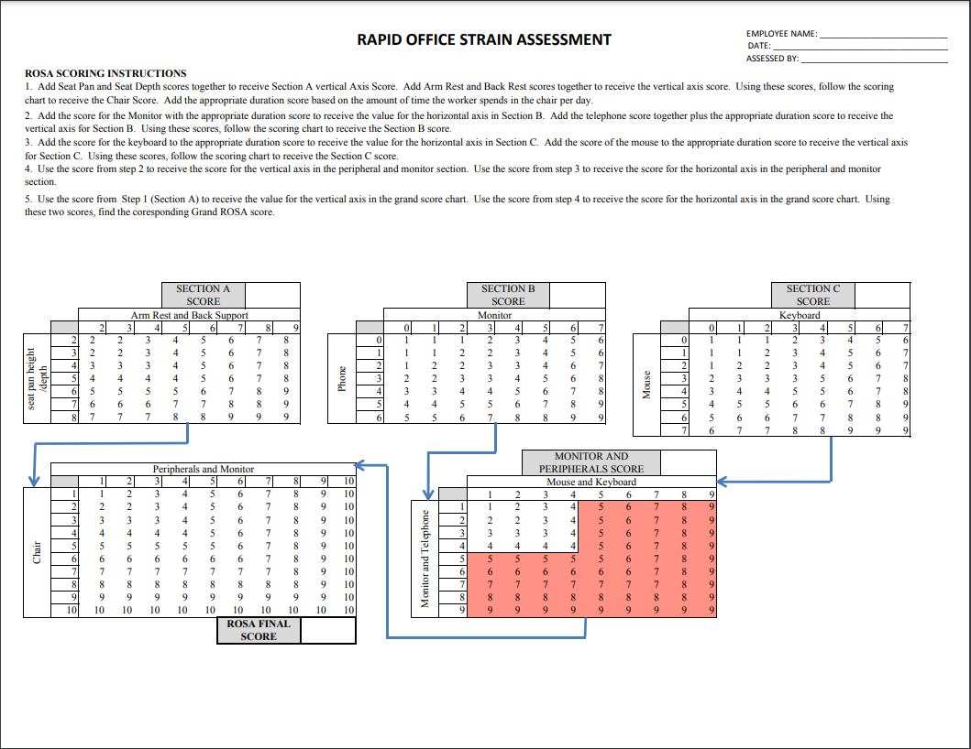
ROSA

Slide 6
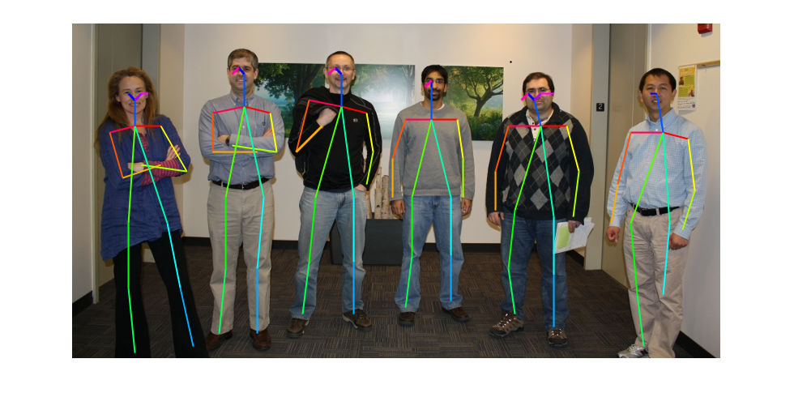
Technical Summary
Using Matlab, implement a human pose estimation algorithm to transform a body into a stick-figure frame
Find all essential angles from this estimate, apply ROSA and RULA algorithms
Ultimately output statistical analysis of how long an individual is in danger zones, scores for each
Osokin, Daniil. “Real-Time 2D Multi-Person Pose Estimation on CPU: Lightweight OpenPose.” ArXiv:1811.12004 [Cs], November 29, 2018. https://arxiv.org/abs/1811.12004.

Slide 7
Deliverables
Minimum | MATLAB code/documentation computing RULA and ROSA for a picture
Expected | Process videos for RULA/ROSA scores, implement user interface for wrist dependency/other possible dependencies
Maximum | Output statistical analysis of when RULA/ROSA reach danger zone periods, weighted average RULA/ROSA score output, include ways to improve posture in output

Slide 8
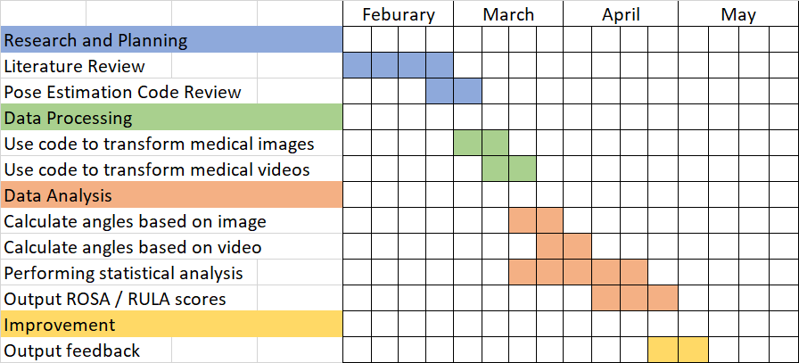
Key Dates

Slide 9
Dependency | Resolution Steps
MATLAB computer vision toolbox, RULA/ROSA algorithms | Gain understanding of code and algorithms, ensure that there are no underlying issues
Images and videos from Drs. Galaiya and Formeister | Create own test videos if necessary
Wrist orientation, which is not provided by the toolbox but is used in the ergonomic algorithms | Tentative plan after discussing with advisors: assign a score of +1 if the wrist is supported and +3 if the wrist is not supported, which is the equivalent of good and poor wrist posture in the algorithms
Positioning of cameras and number of cameras | Use multiple angles and videos of same surgery to assess whether a significant difference in score occurs based on which angle is used
Other factors accounted for in the ergonomic algorithms that are not easily identified using human pose estimation | Talk with Drs. Galaiya and Formeister to see whether a separate input should be included (such as with the wrist)

Slide 10
Management Plan
Meet Dr. Galaiya and Dr. Formeister on Wednesdays @ 4:00 during CIS II seminar, meet as needed if questions
Communicate through email
Consult Max Li for technical questions
Use MATLAB Drive to collaborate on code
Meet daily on Zoom to work on project

Slide 11
Reading List
Jóźwiak Z, Makowiec Dąbrowska T, Gadzicka E, Siedlecka J, Szyjkowska A, Kosobudzki M, Viebig P, Bortkiewicz A. Zastosowanie metody ROSA do oceny obciążenia układu mięśniowo-szkieletowego na komputerowych stanowiskach pracy [Using of the ROSA method to assess the musculoskeletal load on computer workstations]. Med Pr. 2019 Dec 3;70(6):675-699. Polish. doi: 10.13075
Davudian-Talab, Amirhossein & Azari, Gholamreza & Badfar, Gholamreza & Shafeei, Asrin & Derakhshan, Zainab. (2017). Evaluation and Correlation of the Rapid Upper Limb Assessment and Rapid Office Strain Assessment Methods for Predicting the Risk of Musculoskeletal Disorders. Internal Medicine and Medical Investigation Journal. 2. 155. 10.24200.
Namwongsa S, Puntumetakul R, Neubert MS, Chaiklieng S, Boucaut R (2018) Ergonomic risk assessment of smartphone users using the Rapid Upper Limb Assessment (RULA) tool. PLoS ONE 13(8): e0203394.
Rodrigues, Mirela Sant’Ana et al. ‘Differences in Ergonomic and Workstation Factors Between Computer Office Workers with and Without Reported Musculoskeletal Pain’. 1 Jan. 2017.
AIP Conference Proceedings 1883, 020034 (2017); https://doi.org/10.1063/1.5002052 Published Online: 14 September 2017
Dabholkar, Twinkle Yogesh et al. “Objective ergonomic risk assessment of wrist and spine with motion analysis technique during simulated laparoscopic cholecystectomy in experienced and novice surgeons.” Journal of minimal access surgery vol. 13,2 (2017): 124-130. doi:10.4103/0972-9941.195574
Gómez-Galán, M.; Callejón-Ferre, Á.-J.; Pérez-Alonso, J.; Díaz-Pérez, M.; Carrillo-Castrillo, J.-A. Musculoskeletal Risks: RULA Bibliometric Review. Int. J. Environ. Res. Public Health 2020, 17, 4354. https://doi.org/10.3390/ijerph17124354

Slide 12
Questions?

