Slide 1
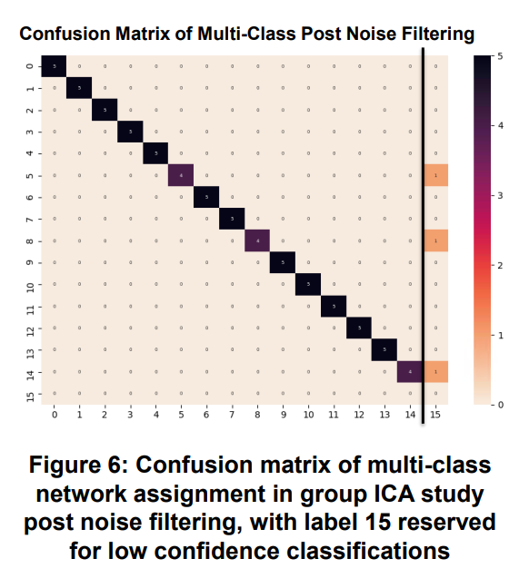
rsfMRI Brain Network Classification Arden Chew Mentors: Dr. Mathias Unberath, Dr. Haris Sair
Goals:
Automate the classification of resting state fMRI brain network components
Significance:
Allows for more precise pre-operative brain surgery and prognosis predictions
Results:
Binary noise classifier for filtering
Multi-class CNN for component prediction
Pearson correlation hierarchy evaluation
2

Slide 2
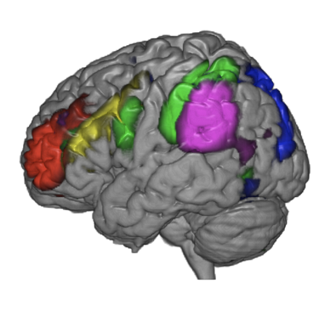
Background
Functional MRI
Measures brain activity by detecting changes in blood flow
Resting state fMRI is used to
explore the brain’s functional
organization
Brain is organized by grouped network components
Hierarchical network relationships
Variation in data clustering and underlying patient physiology make labelling difficult
Incorporating hierarchical data can help

