Slide 1
Scope Holding Device
Develop scope holding device to facilitate endoscope drying process
What Students Will Do:
Discuss requirements with clinical collaborator
– Design solution
– Fabricate solution
– Test solution in simple model
– Redesign until satisfactory
Deliverables:
Device accommodates various endoscopes (bronchs, GI, etc.)
Finalized device
Size group: (no more than 3, if more split into sub projects)
Skills:
CAD/CAM
Machine shop experience
Design experience
Mentors: Russ Taylor, Miriana Pehar, RN (mpehar1@jhmi.edu), Tony Kalloo, MD (akalloo@jhmi.edu)

Slide 2
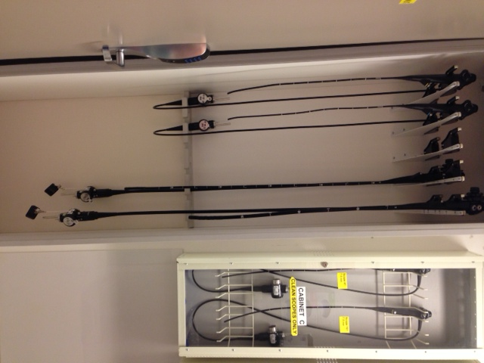
Endoscopy and Endoscope Defined
Endoscopy
A procedure allowing visual examination of internal organs and vessels for management, treatment and prevention of diseases
Endoscope
A reusable, intricately designed medical instrument that allows for images to be viewed on a monitor
Generally inserted through natural orifices of the body
Examples of Various
Types of Endoscopes
Bronchoscopes
Sigmoidoscope
Gastroscope

Slide 3
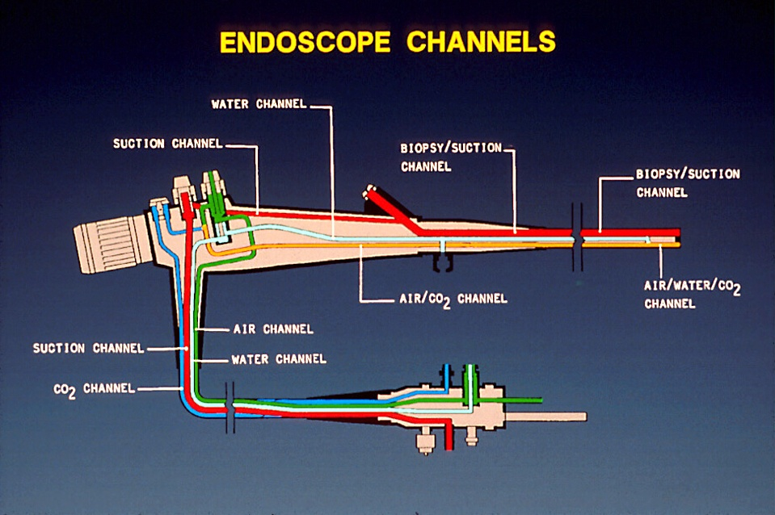
Endoscope Safety Risks
Endoscopes
Difficult instruments to clean and disinfect
Most commonly inked to patient infections
Scope drying
Performed after the endoscope is disinfected
Prevents residual moisture within the endoscope
Prevents bacterial growth
Challenge due to long, narrow, non-visible lumens
Current product market does not offer a solution
Inadequately dried endoscopes have been linked to disease transmission in patients undergoing endoscopic procedures

Slide 4
Scope Drying: Current Process

Slide 5
Project Goals
Develop a scope holding device
Facilitate/improve the scope drying process for various types of endoscopes
Standardize the scope drying practice
Create a simple design that can evolve over time
Explore incorporation of technology into the device later (future goal)

