Slide 1
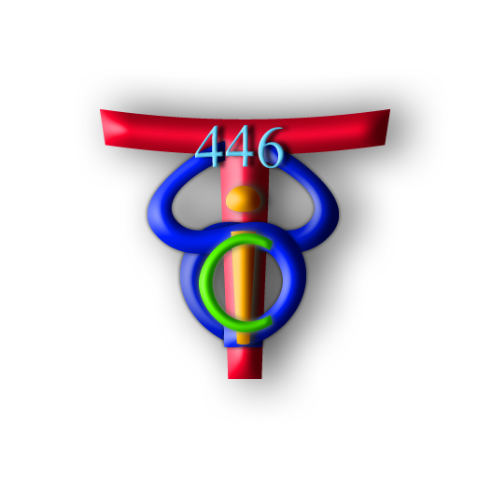
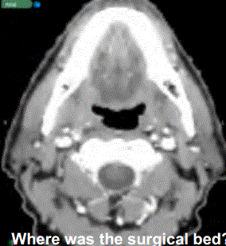
Intraoperative Registration of Pathology for Postoperative Adjuvant Radiotherapy Computer Integrated Surgery II Spring 2014 Team Members: Kareem Fakhoury, Matthew Hauser, Steven Lin Mentors: Dr. Harry Quon, Dr. Jeremy Richmon, Dr. Junghoon Lee
Introduction
We produced a workflow for evaluating tissue deformation as a tumor is removed
Includes methodology of actions pre-, intra-, and postoperatively, as well as postoperative image processing
Registration of intraoperative tracking data to preoperative image data and registration of preoperative images to postoperative images
In effect, we have addressed the problem of providing better guidelines to radiation oncologists on where to deliver postoperative radiotherapy, allowing decreased radiation poisoning
Outcomes and Results
Left two images: Registration of intraop Polaris to preop
Right two images: Registration of intraop Polaris to postop open
Table above shows accuracy of intraop registration via total RMS error between pre- and postop open fiducials and postop open tongue points
Fiducials and markers had diameters of approximately 5 mm
Registration of fiducial points onto both scans is very accurate
Inherent uncertainty as tongue points on preop scan can be found in unlikely places (off of the tongue) due to movement; creates complications for direct placement of Polaris points on preop scan
Table above shows accuracy of registration using the orig. method of preop to postop closed via RMS of tongue clips and total RMS
Table above shows RMS error resulting from different parameter sets when postop open is registered to preop and then subsequently registered to postop closed; greater accuracy
Images below visually show accuracy of this registration method
Pig 1 Pig 2 Pig 3
Pig | Preop Fiducials(mm) | Open Fiducials (mm) | Open Tongue marks (mm)
1 | 4.12 | 3.64 | 1.95
2 | 3.99 | 4.01 | 6.75
3 | 6.49 | 5.07 | 3.90
Total | 8.66 | 7.42 | 8.03
The Problem
Patient receives surgical
resection of tumor and
postoperative radiotherapy of
surgical bed
Volume of radiotherapy overestimated → toxicity and negative physiologic reactions
Need method to evaluate tissue deformation after surgery to decrease volume and increase specificity of radiotherapy
Pig | Clip 1 | Clip 2 | Clip 3 | Clip 4 | Total
1 | 21.6 | 21.7 | 19.5 | 22.3 | 21.3
2 | 24.7 | 23.8 | 25.9 | 24.1 | 24.6
3 | 23.5 | 30.0 | 13.7 | 30.5 | 25.3
 |  |  |  | Avg: | 23.8
The Solution
Take three CT
scans of patient:
preop, postop
with open wound,
postop after
wound closed
Outline pathology with points using Polaris tracking system; register these points to preop CT
Using open source medical imaging software,
Elastix, to register preop scan to each postop scan
Use Transfomix to monitor points’ movement
Guides postop radiotherapy planning
Experimental methodology:
In 3 pig heads, a portion of the tongue was removed simulating surgical resection of tumor
5 fiducials were place on the surface of the head to determine intraop to postop registration
Placed 4 radio-opaque markers on tongue where Polaris points were collected for gold standard
Removed markers from CT images
Determined optimal Elastix parameters for best possible image registrations
Computed RMS errors between measured fiducials and computed fiducials, and between gold standard markers on tongues and computed tongue points
Parameter Set: | Avg Fiducial RMS (Rigid) (mm) | Avg Tongue RMS (Deform.) (mm)
STD, AMS | 20.70 | 21.07
STD, AMS2 | 20.14 | 20.68
STD,AMS, fixed pts | 7.47 | 18.92
Lessons Learned
Inherent error in method: Collecting points around tongue intraoperatively, but intraop tissue doesn’t line up with tissue in preop image
Necessity to think through entire project and pre-define what data we need and what we need to do with it
Future Work
Explore rigid landmark-based registrations
Improve marker positions by placing them on surface of tongue, not protruding and creating error
Credits
KF led data collection process, SL led intraop registration process, MH led image registration process
Support by and Acknowledgements
We thank our mentors for their guidance and funding, as well as Seth Billings for helping us obtain the Polaris
Engineering Research Center for Computer Integrated Surgical Systems and Technology

