Slide 1
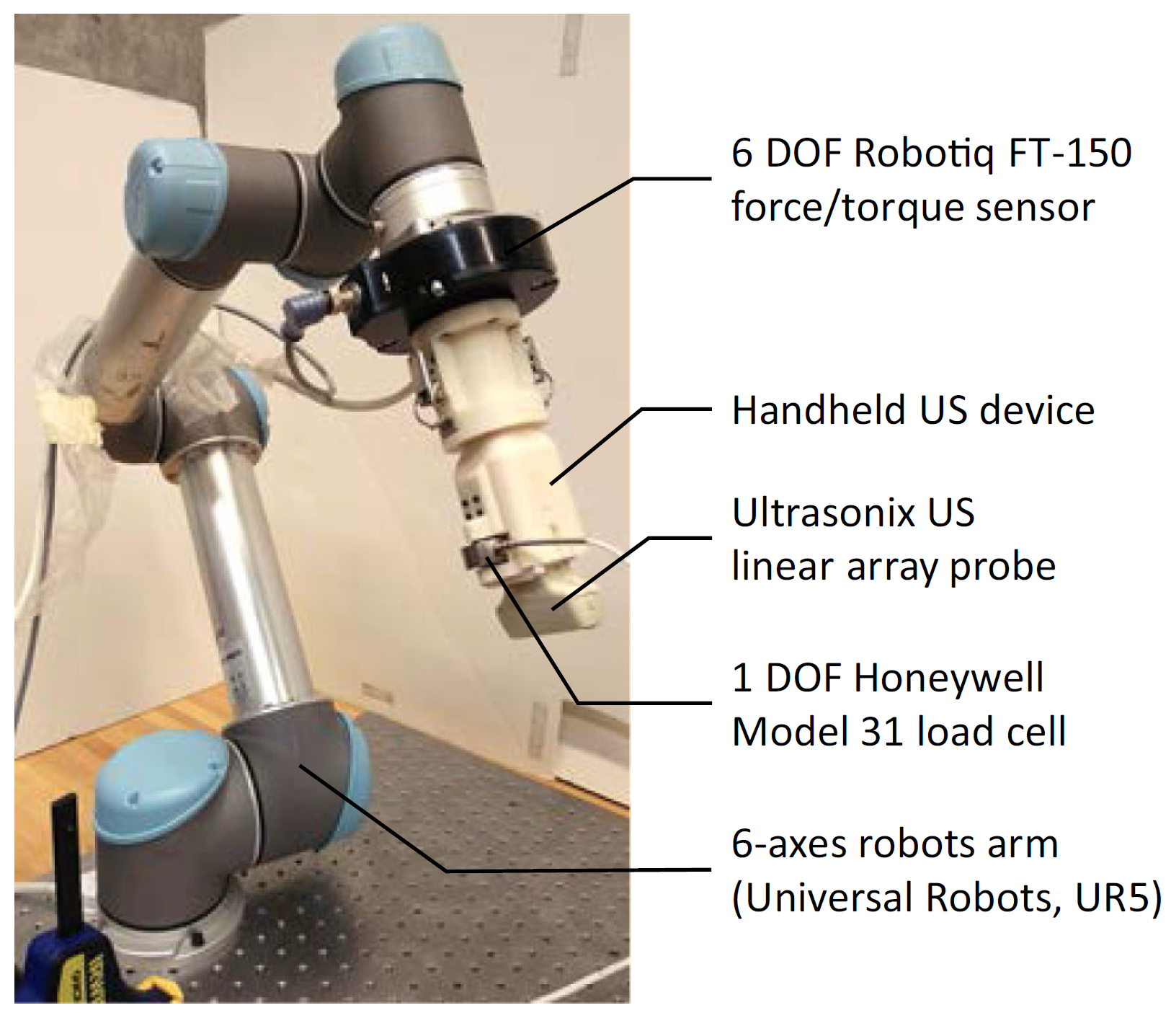
Robotic Ultrasound Assistance via “Hand-Over-Hand” Control
Goal:
Improve the transparency of moving a 6-DOF US robot by hand via dual-force sensing
Significance:
Relieved wrist strain for sonographers
Improved biopsy procedures
Important step on the way to advanced servoing mechanisms
T. Fang, H. Zhang, R. Finocchi, R. Taylor and E. Boctor, "Force-assisted ultrasound imaging system through dual force sensing and admittance robot control", International Journal of Computer Assisted Radiology and Surgery, vol. 12, no. 6, pp. 983-991, 2017. Available: 10.1007/s11548-017-1566-9.

Slide 2
Robotic Ultrasound Assistance via “Hand-Over-Hand” Control
Minimal Deliverable:
Interface with robot and dual force sensors to collect data
Implement rudimentary admittance control
Expected Deliverable:
Implement improved admittance control
Quantitatively evaluate achieved “transparency”
Have sonographers trial and qualitatively evaluate the device
Potential Maximum Deliverables:
Virtual fixtures (aid in synthetic aperture, tomography)
Investigate respiratory gating
Explore basic servoing while maintaining force profile
Skills:
C++, ROS, control system design, mechanical fabrication
Advising & Contact:
Dr. Emad Boctor (eboctor1@jhmi.edu), Dr. Russell Taylor (rht@jhu.edu) Kevin Gilboy (kevingilboy@jhu.edu)

