Slide 1
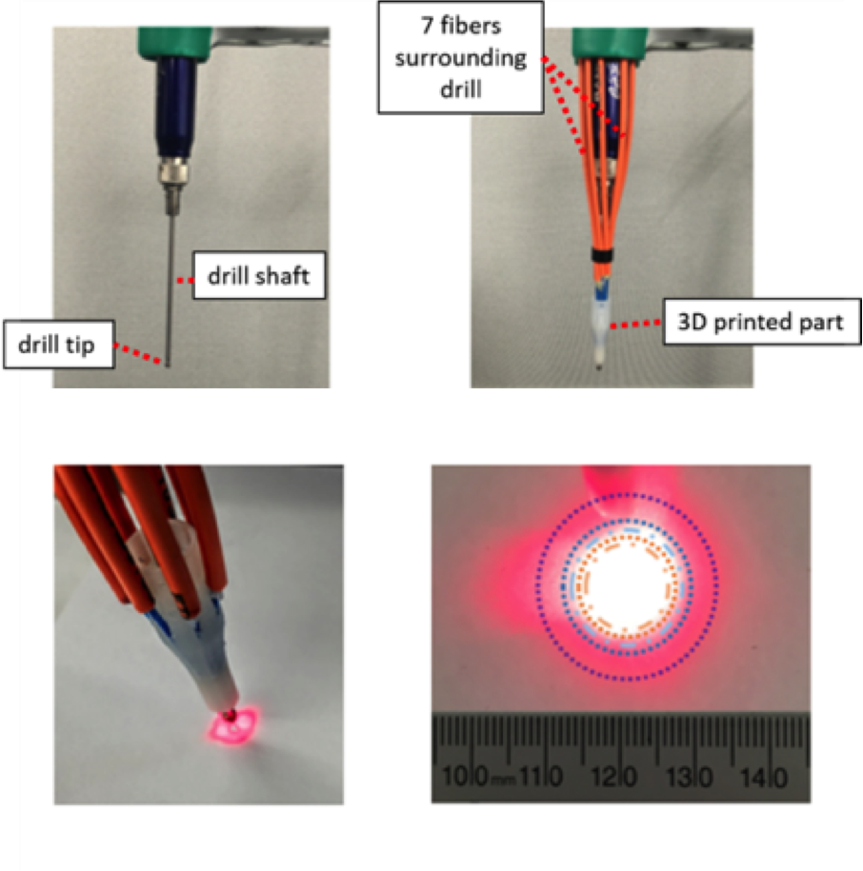
Light Delivery Systems for PA-Guided Surgery
Develop a specialized light delivery system for photoacoustic-guided surgery
What students will do:
Choose a compatible surgical tool
Answer design questions:
How many fibers? (Zemax Simulations)
How far apart? (Monte Carlo Simulations)
Build working prototype and demonstrate surgical photoacoustic task with the da Vinci
Eddins and Bell, JBO, 2017

Slide 2
Light Delivery Systems for PA-Guided Surgery
Deliverables:
Design custom light delivery system
Build phantom for chosen clinical application
Demonstrate working prototype with integrated photoacoustic system and da Vinci surgical system
Perform task with and without photoacoustic guidance
Size group: 2-3
Skills: programming for simulation software (Monte Carlo, Zemax), Solid modeling (SolidWorks, Creo), hands-on experimental skills, experience with lasers and ultrasound desired but not required
Faculty Mentor:
Muyinatu Bell (mbell36@jhu.edu)
Eddins and Bell, JBO, 2017

