Slide 1
Project Title Student Name, Student Name, … Mentors: …..
Goals:
One or two bullets or sentences explaining goals of the project
Significance:
One or two bullets explaining why this is important
Results:
A few bullets explaining what was achieved
Here put 1 or 2 graphics highlighting the project

Slide 2
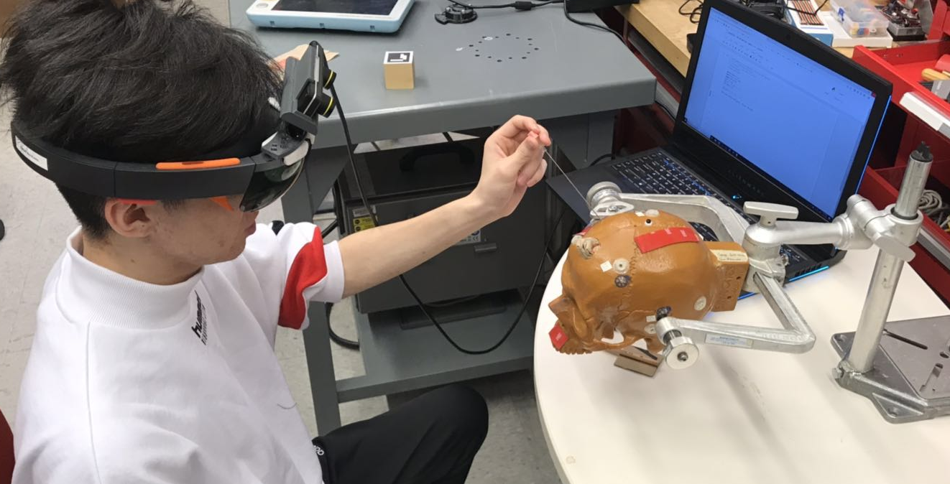
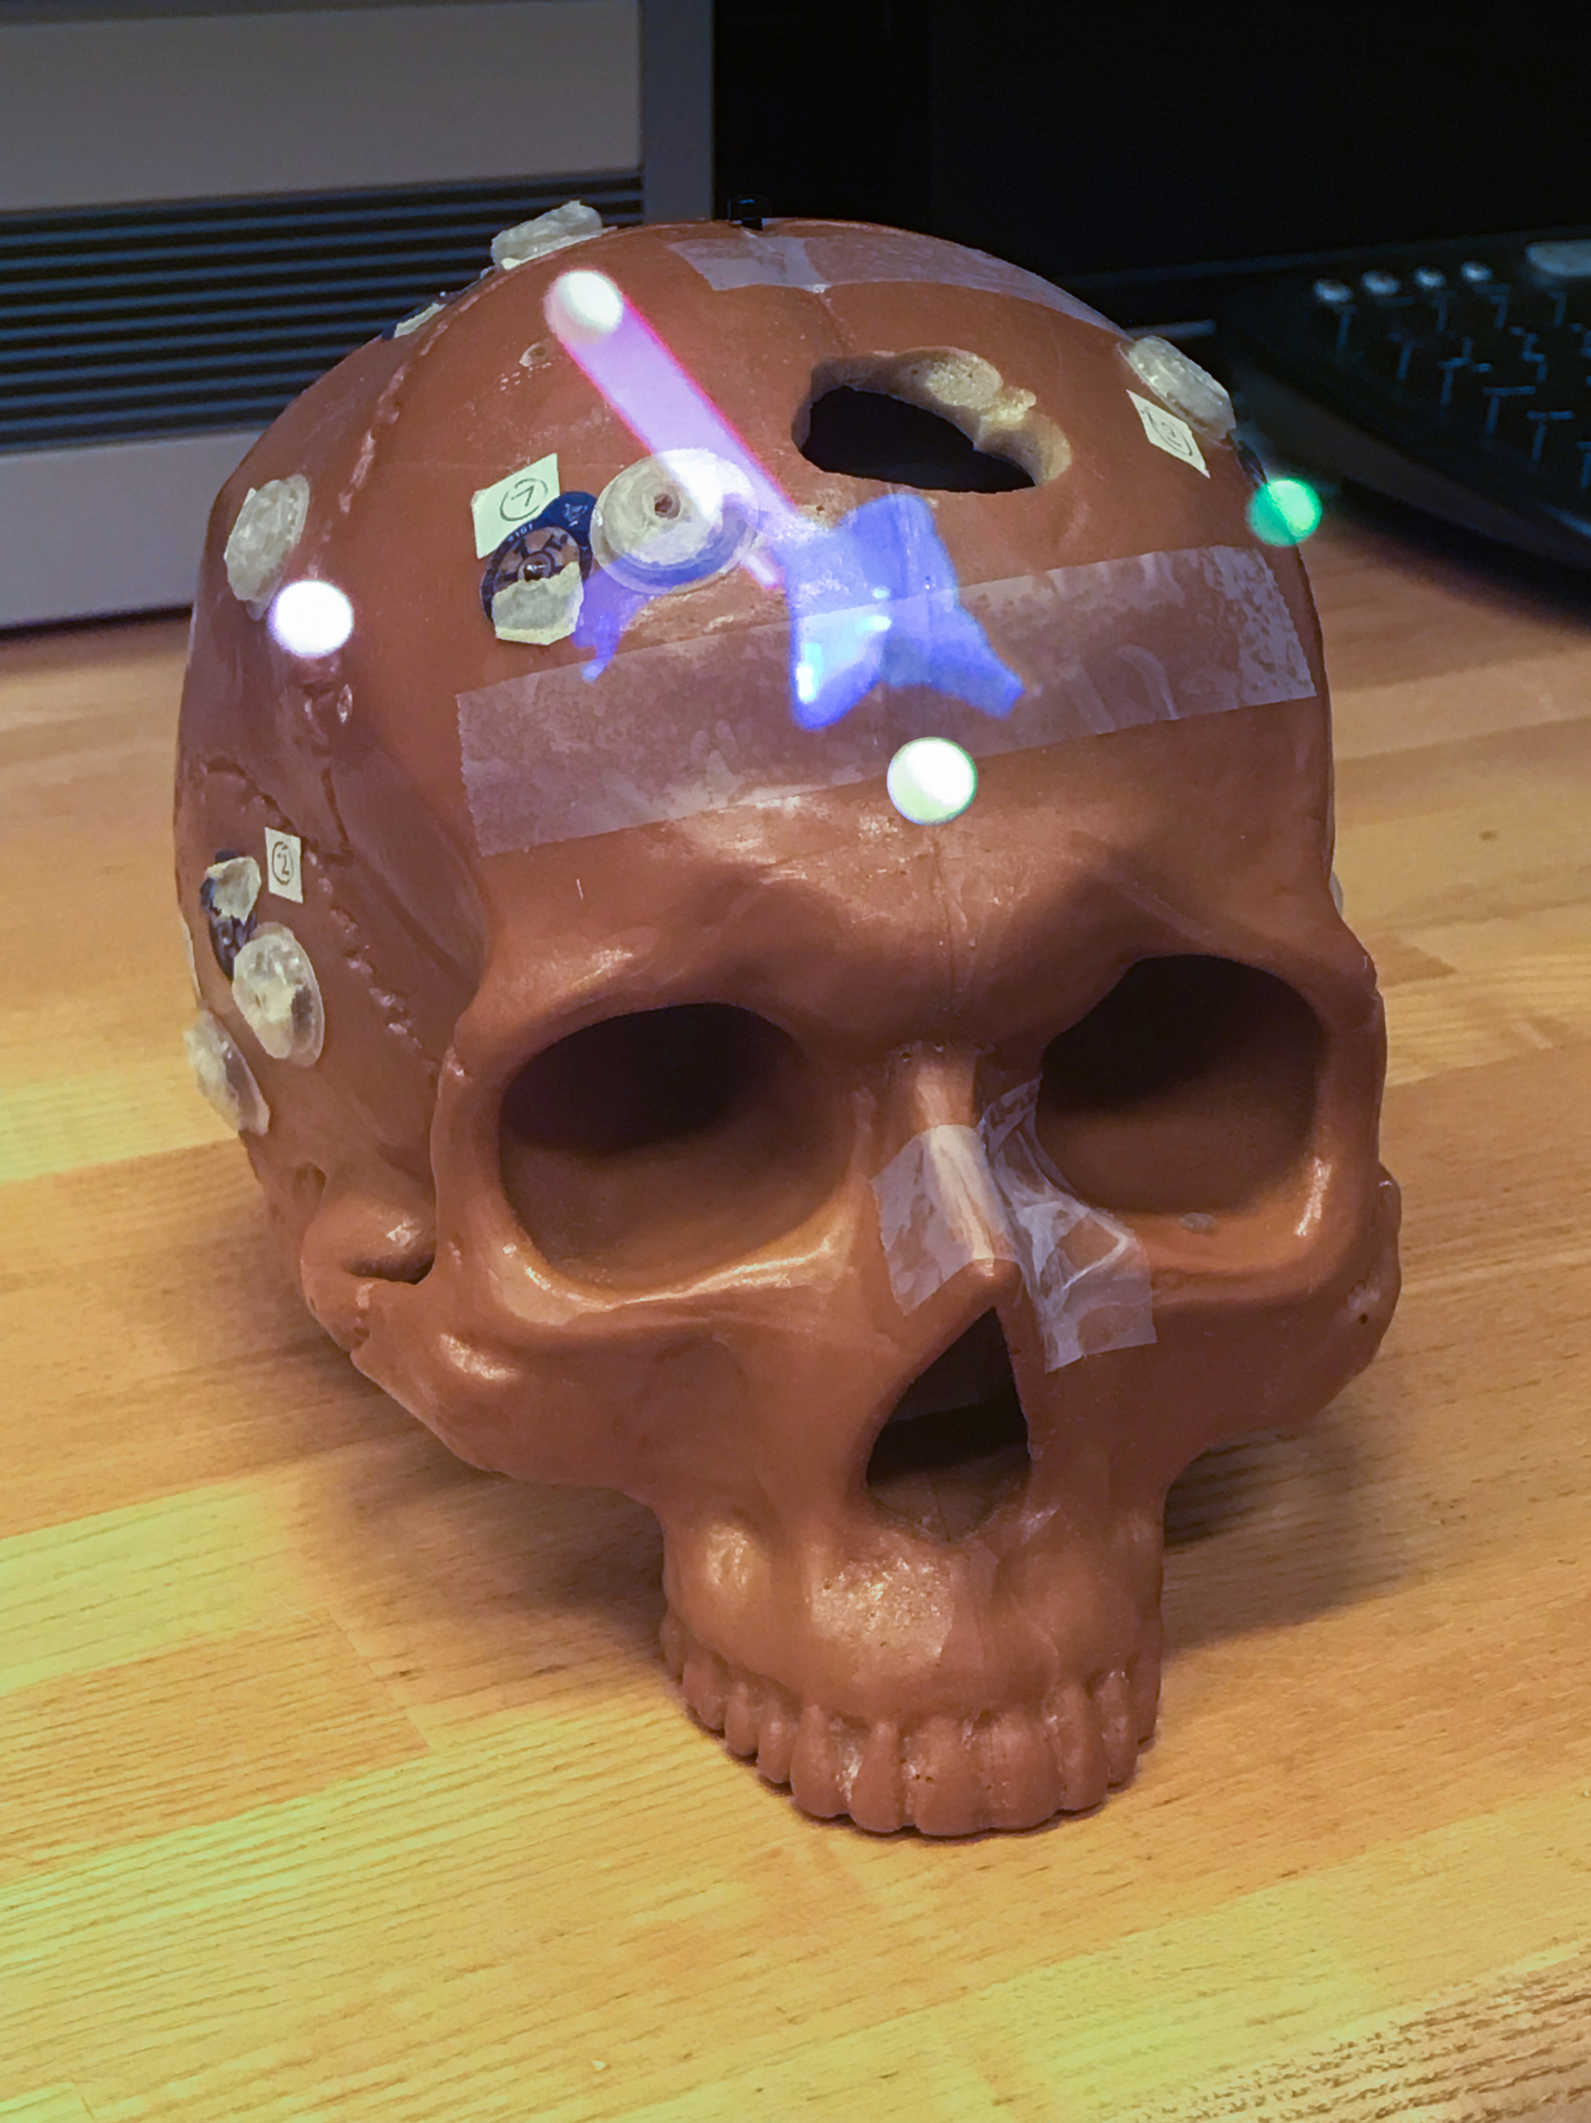
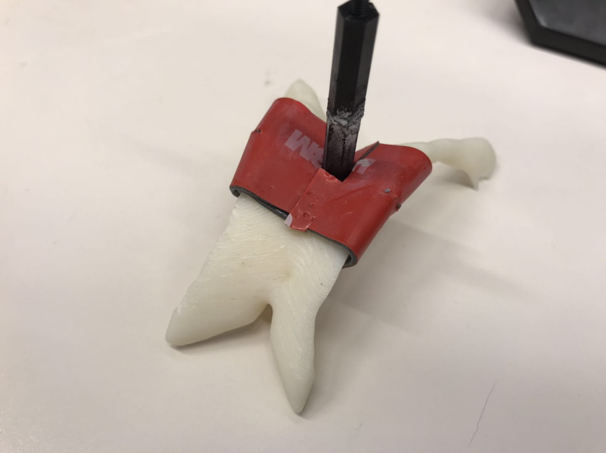
Pilot Test：Mock Ventriculostomy.
Entry
Catheter Guidance
Overlay of Ventricle
Pilot Test
User View
Red: 20
White: 10
Miss: 0
Our navigation system helps users to perform this mock ventriculostomy.

