Slide 1
Anatomical Mesh-Based Virtual Fixtures for Surgical Robots
Student: Yiping Zheng
Mentor: Max Li, Russell Taylor

Slide 2
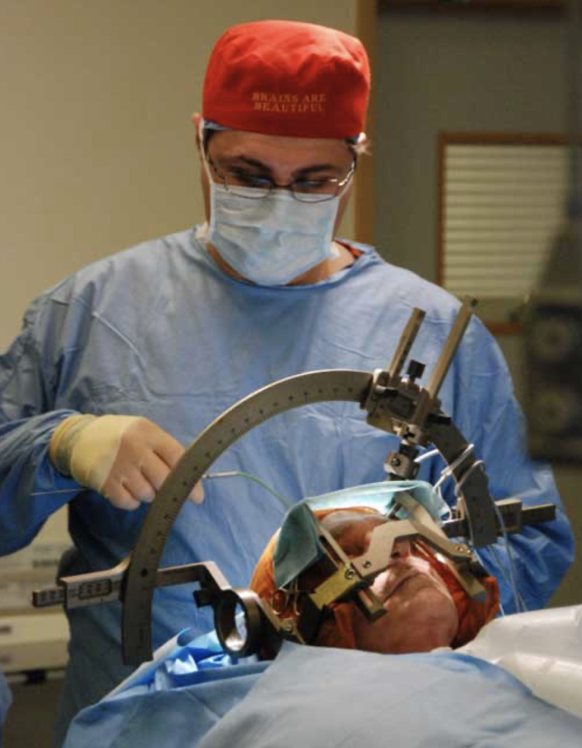
Background
Brain Surgery - BBC News https://www.bbc.co.uk/blogs/thereporters/ferguswalsh/2010/12/brain_surgery_to_relieve_headaches.html
Zhaoshuo Li et al. Anatomical Mesh-Based Virtual Fixtures for Surgical Robots (unpublished by Mar. 2020)

Slide 3
The paper

Slide 4
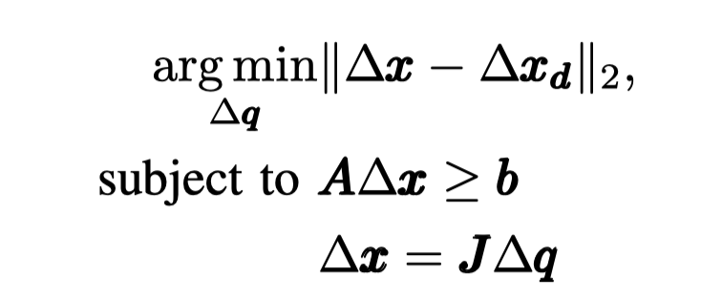
I. Optimization Function
Objective function solved for the desired motion:
where ∆x and ∆x_{d} are the computed and desired incremental Cartesian positions, and ∆q is the incremental joint position. J is the Jacobian matrix relating the joint space to the Cartesian space. A and b are matrix and vectors necessary to describe the linear constraints.

Slide 5
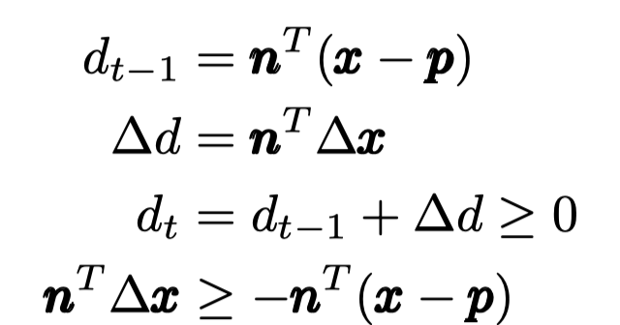
II. Optimization Constraint

Slide 6
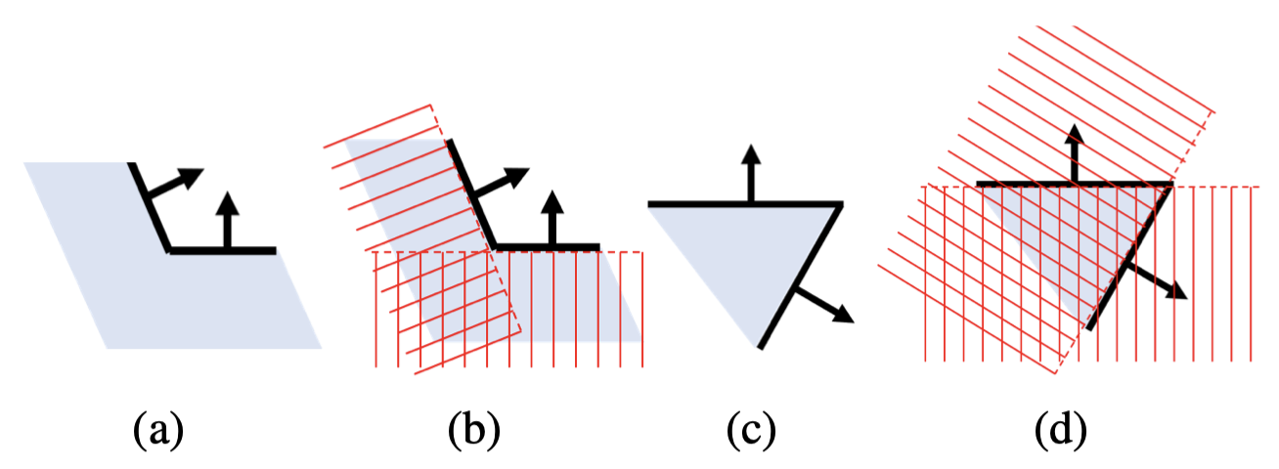
III. Polygon Mesh property
2D illustration of (a-b) a locally concave surface, and (c-d) a locally convex surface. Red crosshatched zones denote forbidden region. Note in (d) many allowable regions are ruled out. Arrows denote the face normals. Light blue zones denote the patient’s anatomy.
Notes:
A locally concave surface (Fig. 2a) produces a convex set of linear constraints. It is safe to include all triangles as plane constraints (Fig. 2b). A locally convex surface (Fig. 2c) produces a non-convex set of linear constraints. Naively adding all triangles as plane constraints will rule out many allowable regions (Fig. 2d).
This necessitates an approach to dynamically activate and deactivate the constraints based on the local convexity and concavity of the anatomical surfaces.

Slide 7
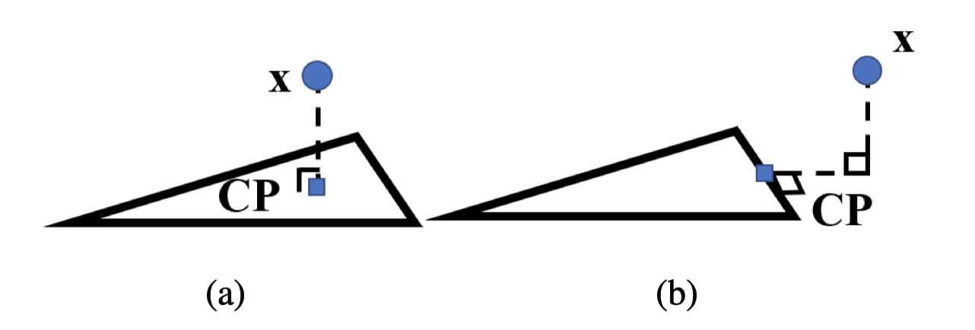
IV. Closest Point
The closest points (CP) on each triangle are necessary to determine the local convexity/concavity and approximate local geometries using plane constraints.
CP location, (a) in-triangle, (b) on-edge. The blue rectangle denotes the CP. The right-angle sign denotes perpendicularity.

Slide 8
V. Polygon Mesh Constraint Algorithm

Slide 9
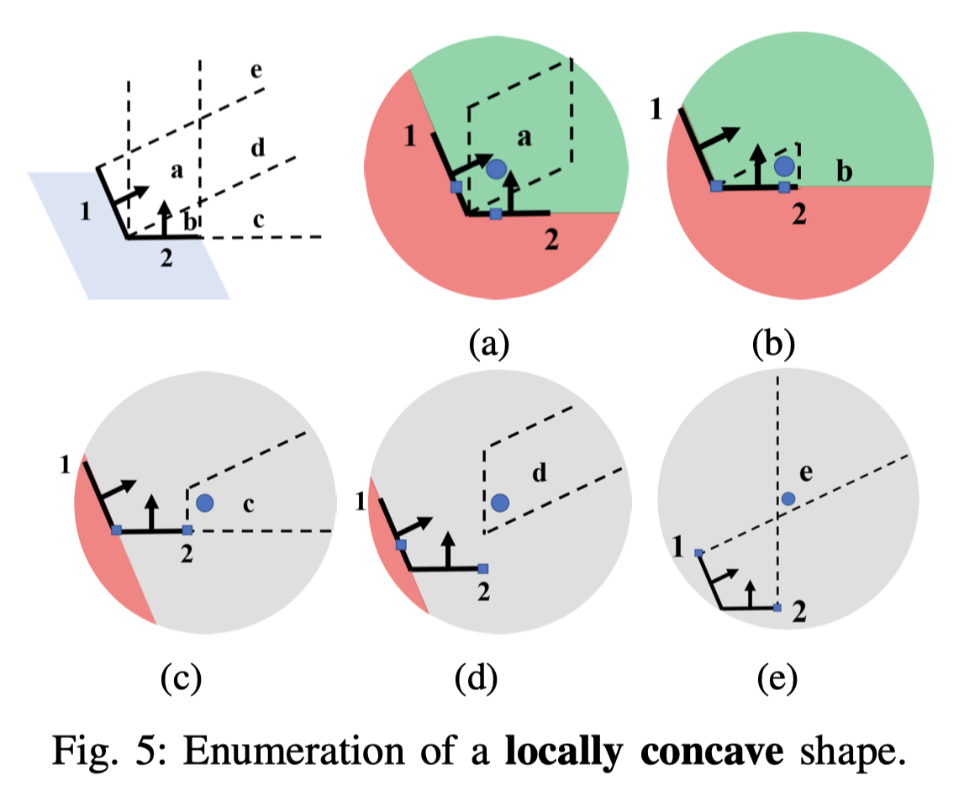
vI. Completeness of Algorithm

Slide 10
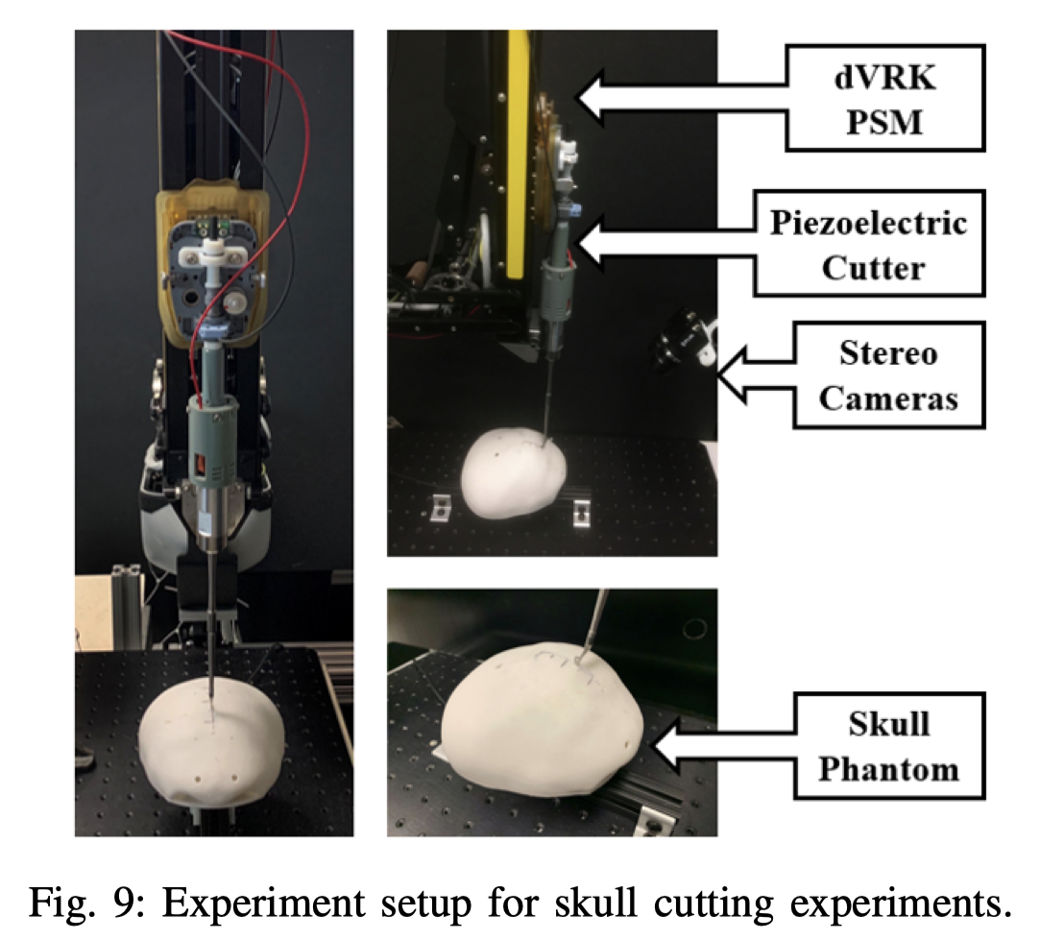
Skull cutting experiment

Slide 11
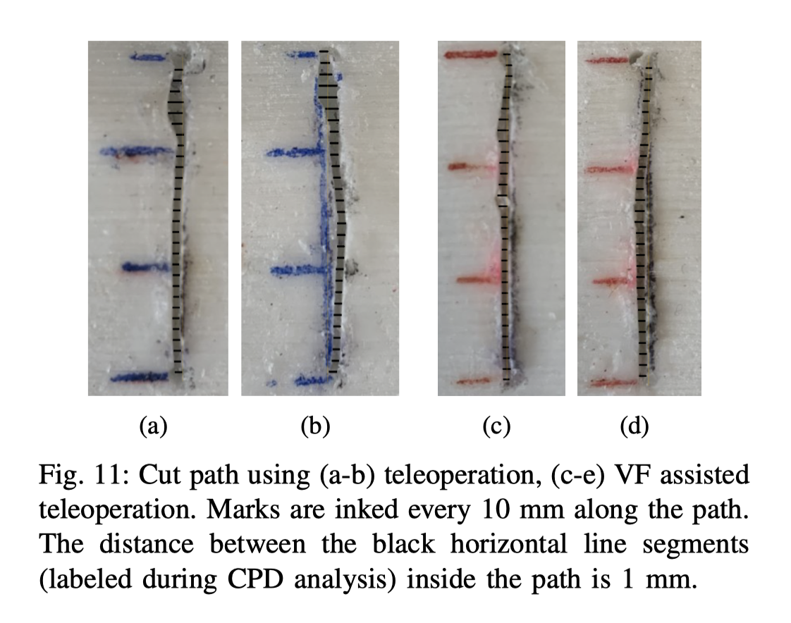
Experiment result

Slide 12
Stengths
Useful
provide a virtual forbidden area for patient anatomies during robot-assisted surgeries.
General
The method does not assume the convexity/concavity of the anatomy near the tool.
Valid
The method has been validated in simulation, and the run time experiment is presented.

Slide 13
Weakness & Future work
Robustness
Haven’t considered the anatomical movement and deformation.
Haven’t considered the shape of the surgical tool.
Lack of real-world success cases.
systematic user studies with multiple clinician users..

Slide 14
Bibliography
Zhaoshuo Li et al. Anatomical Mesh-Based Virtual Fixtures for Surgical Robots (unpublished by Mar. 2020)
Funda, J., Taylor, R. H., Eldridge, B., Gomory, S., & Gruben, K. G. (1996). Constrained Cartesian Motion Control for Teleoperated Surgical Robots. Robotics, 12(3).
Xia, T., Kapoor, A., Kazanzides, P., & Taylor, R. (2011). A constrained optimization approach to virtual ﬁxtures for multi-robot collaborative teleoperation. IEEE International Conference on Intelligent Robots and Systems, 639–644. https://doi.org/10.1109/IROS.2011.6048816
Li, M., Ishii, M., & Taylor, R. H. (2007). Spatial Motion Constraints Using Virtual Fixtures Generated by Anatomy. 23(1), 4–19.
Kapoor, A. (2008). Motion constrained control of robots for dexterous surgical tasks.

Slide 15
Q&A Session
Thank you !

