Slide 1
Surgical Instrument for Robotic Open Microsurgery Seminar Presentation
NSF Engineering Research Center for Computer Integrated Surgical Systems and Technology
Olivia Puleo
Partner: Radhika Rajaram
Mentors: Yunus Sevimli, Dr. Russel Taylor, Dr. Chris Razavi

Slide 2
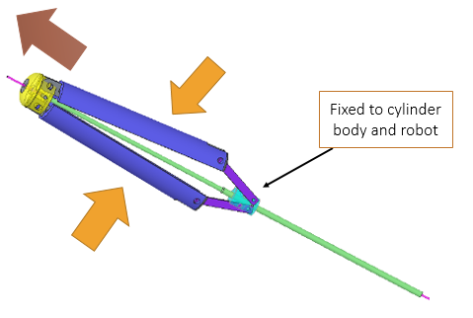
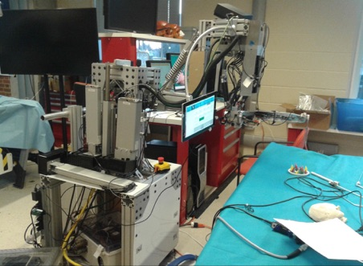
Project Goal
Design and develop a microvascular needle driver and vascular forceps to be integrated with the Galen steady-hand robot
Needs to be held above the robot attachment point, and designed for manufacturability, sterilizability, and ergonomics

Slide 3
Paper 1: Ergonomics in Microsurgery
Patkin, M. "Ergonomics in Microsurgery." The Australian & New Zealand Journal of Obstetrics & Gynaecology 21.3 (1981): 134. Print.
Average hand tremor has a 0.5 - 3.0 mm amplitude with an irregular rate of 7 - 30 Hz
Factors that effect amplitude of tremor can be divided into three groups: long-term, intermediate, and short-term

Slide 4
Implications for Instrument Design
Handle needs to be at least 12 cm long, and have a diameter of about 1 cm
A semi-cylindrical handle cross-section is suggested if any twisting will be done
Closing force should be about 50g
Concavo-convex jaws will make it so that less force is needed, but make back-handed orientation difficult

Slide 5
Assessment
Pros
He provides concrete numbers to strive for in tool design
Takes into account skill level of surgeon as well as environment
Cons
The paper is from 1981 and improvements have been made since then
No quantified assessment, only what he thought things “should” be

Slide 6
Paper 2: New Ergonomic Guidelines for Laparoscopic Instruments
van Veelen, M.A., et al. "New Ergonomic Guidelines for Laparoscopic Instruments." Minimally Invasive Therapy & Allied Technologies 10.3 (2001): 163. Print.
Suggest a new three tier method of evaluating laparoscopic instruments based on its technical, user-friendly, and emotional aspects
Tested instruments and equipment used during laparoscopic procedures both objectively and subjectively according to the three aspects

Slide 7
Comfort Areas in Depth
Technical Comfort
Does the instrument work the way it’s supposed to?
Objective Assessment: Specific to the type of product
Subjective Assessment: Questionnaire

Slide 8
Comfort Areas in Depth
User-friendliness
Is the instrument comfortable to use the way it’s intended to be used?
Objective Assessment: Video analysis of posture and movements as well as analyses of time-tasks
Subjective Assessment: Questionnaire

Slide 9
Comfort Areas in Depth
Emotional Comfort
Does the surgeon like using the instrument?
Objective Assessment: Video observation of surgeon behavior
Subjective Assessment: Questionnaire

Slide 10
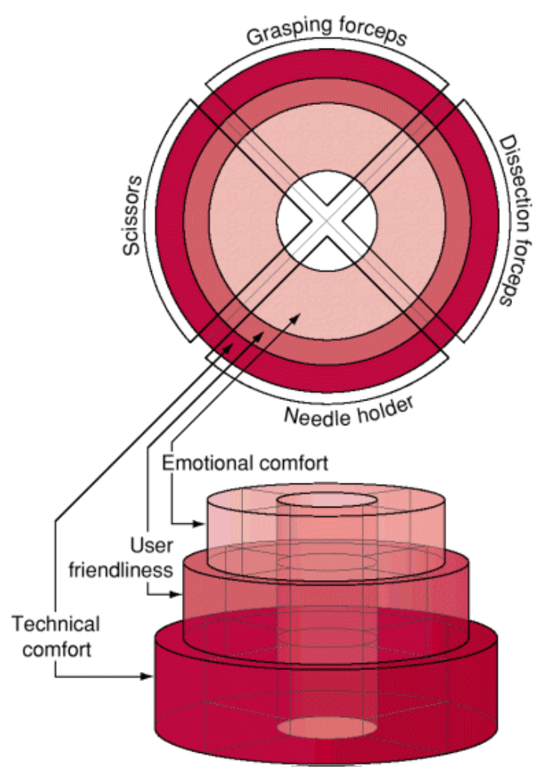
Model of Guidelines
Anything in the center cylinder applies to all instruments within the larger group
Ideally, each subsection would be populated with guidelines for that specific instrument and area of comfort

Slide 11
Assessment
Pros
Gives a thoughtful way of incorporating more than one type of comfort of using an instrument into the overall assessment
Outlines a way of testing prototypes according to the suggested criteria
Cons
Did not validate guidelines for emotional comfort by time of publishing
Overall, they only have guidelines for one of the four types of instruments they mentioned

Slide 12
References
Patkin, M. "Ergonomics in Microsurgery." The Australian & New Zealand Journal of Obstetrics & Gynaecology 21.3 (1981): 134. Print.
van Veelen, M.A., et al. "New Ergonomic Guidelines for Laparoscopic Instruments." Minimally Invasive Therapy & Allied Technologies 10.3 (2001): 163. Print.

