Slide 1
Enabling Technologies for Robot Assisted Ultrasound Tomography
Team Members: Rishabh Khurana , Fereshteh Aalamifar
Mentors: Emad Boctor, Iulian Iordachita, Russell Taylor
Group 11
Checkpoint Presentation 2
Notes:
R

Slide 2
Summary & Goal
Design a prototype that uses a robot controlled ultrasound probe to follow the motion of the free hand probe that can be used for Ultrasound Tomography.
Project Summary
Deliverables
Progress
Timeline Milestones
Dependencies
Notes:
R

Slide 3
Project Block Diagram
Robot side components
Freehand side components
MicronTracker
Freehand marker
Robodoc
Robotic probe
Tissue
Freehand probe
Software components
IEEE 1394 PCI
Interface
Computer
Cisst/saw
Tracker API
Robot server
Project Summary
Deliverables
Progress
Timeline Milestones
Dependencies
Notes:
R

Slide 4
Deliverables
Minimum Deliverables: (Expected by April 1)
A robotic arm should follow the position of a mock ultrasound probe attached to a passive arm, on the other side of a cylinder, using optical tracking system
Expected Deliverables: (Expected by April 22)
Build a transparent cylindrical phantom
The mock probes should be replaced with real ones.
Real data should be collected.
Study EPT and B-Mode. This should be thoroughly investigated.
Maximum Deliverables: (Expected by May 6)
Implement EPT or B-Mode and conduct its accuracy study.
Real images shall be collected and reconstructed on a PC to display real-time ultrasound images.
Project Summary
Deliverables
Progress
Timeline Milestones
Dependencies
Notes:
Previous set of deliverables

Slide 5
Deliverables
Minimum Deliverables:
US calibration, hand-eye calibration
A mock probe attached to a robotic arm following the position of a freehand mock ultrasound probe attached to a passive arm, on the other side of a cylinder, using optical tracking system
Expected Deliverables:
Build a transparent cylindrical phantom
The mock probes should be replaced with real ones.(combined with minimum)
Real data should be collected. (Real time US images seen on the screen)
Study EPT and B-Mode. This should be thoroughly investigated.
Maximum Deliverables:
Implement EPT or B-Mode and conduct its accuracy study.
Real images shall be collected and reconstructed on a PC to display real-time ultrasound images.
Project Summary
Deliverables
Progress
Timeline Milestones
Dependencies

Slide 6
Deliverables
Minimum Deliverables:
US calibration, hand-eye calibration
A mock probe attached to a robotic arm following the position of a freehand ultrasound probe on the other side of a cylinder, using optical tracking system
Expected Deliverables:
Real time US images seen on the screen.
Study EPT and B-Mode. This should be thoroughly investigated.
Maximum Deliverables:
Implement B-Mode and conduct its accuracy study.
Project Summary
Deliverables
Progress
Timeline Milestones
Dependencies

Slide 7
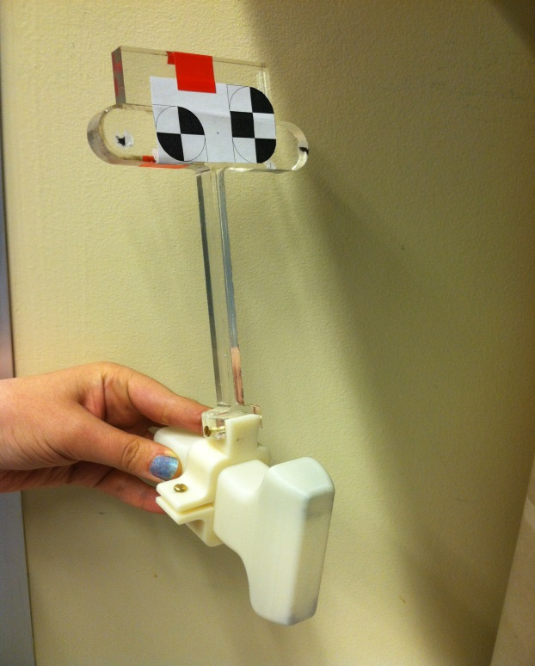
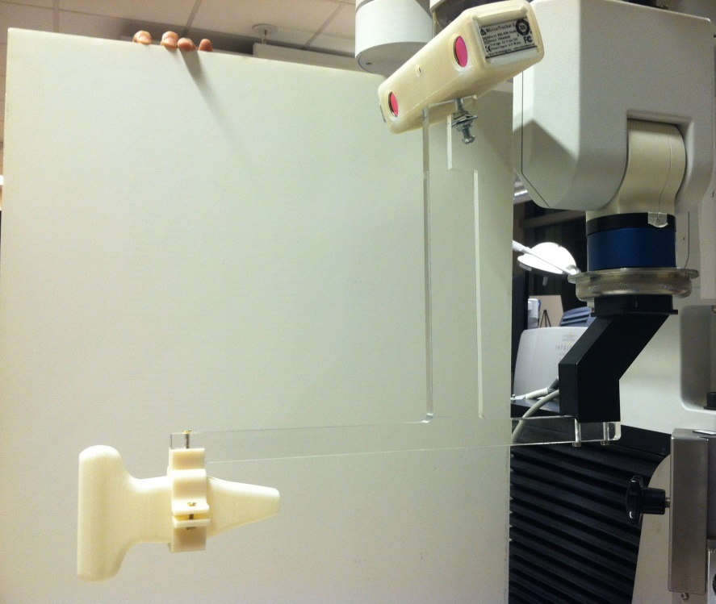
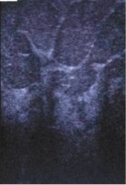
US calibration
Robot
Endeffector
T2
T1
Freehand Probe
Require two ultrasound (US) calibrations T1 and T2
Project Summary
Deliverables
Progress
Timeline Milestones
Dependencies
Notes:
F

Slide 8
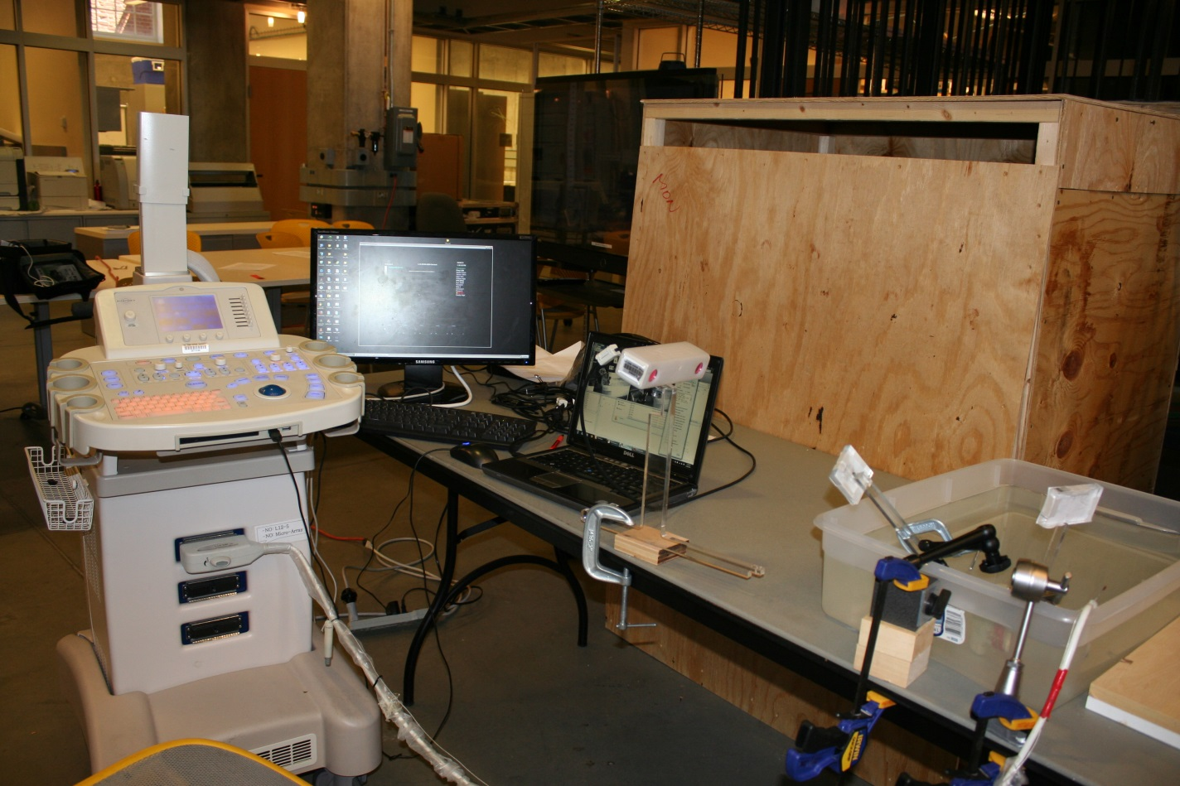
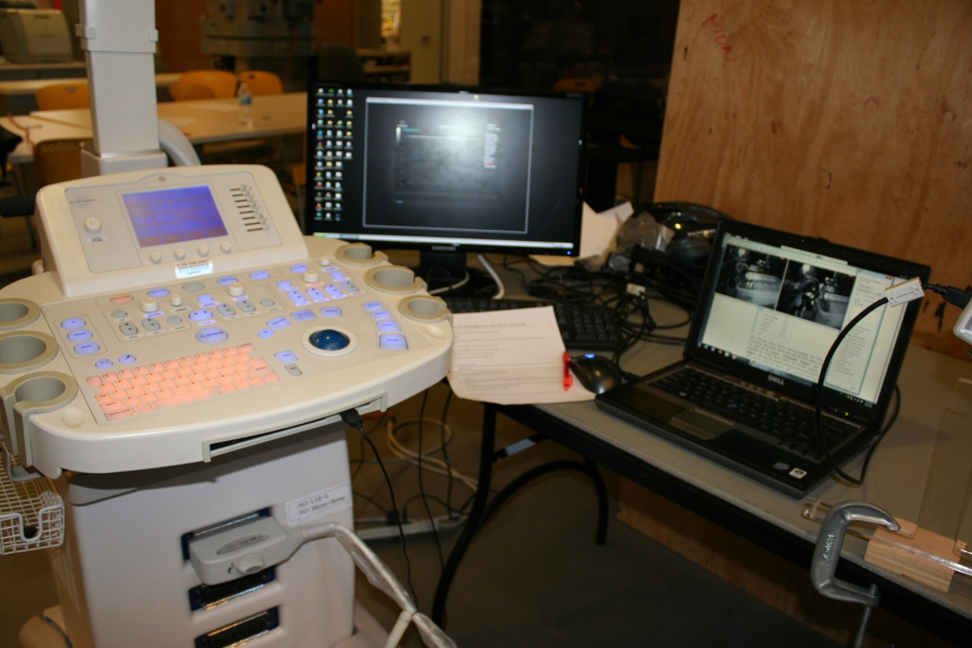
US calibration
Project Summary
Deliverables
Progress
Timeline Milestones
Dependencies
Notes:
F

Slide 9
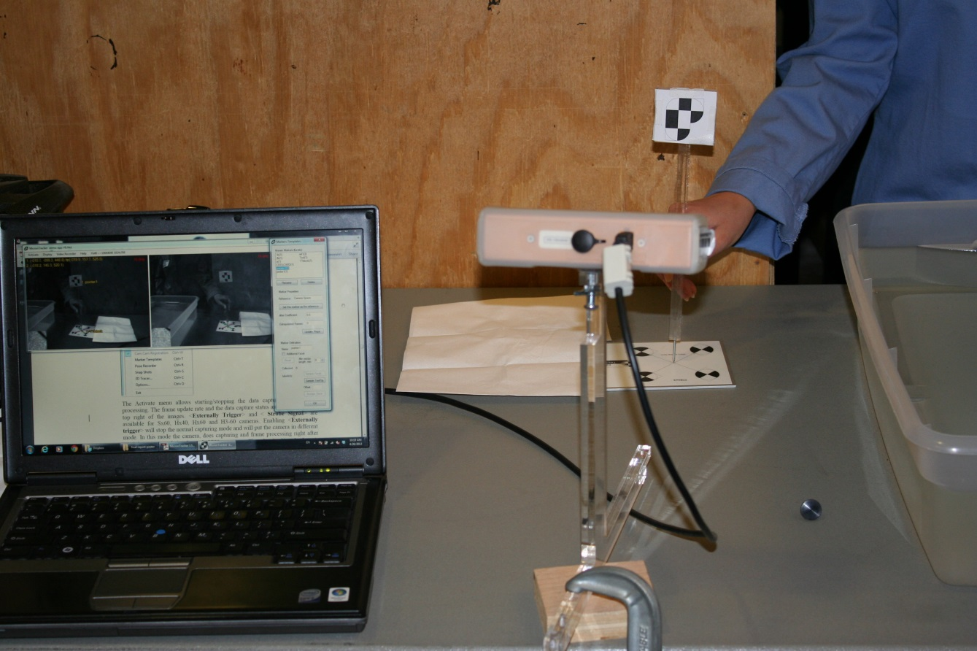
US calibration
Sharp pointer
Calibrated using TTblock
Project Summary
Deliverables
Progress
Timeline Milestones
Dependencies
Notes:
F

Slide 10
US calibration
Results and US images and remained work
Project Summary
Deliverables
Progress
Timeline Milestones
Dependencies
Notes:
F

Slide 11
Mock US calibration
Needed T2 but did not have US probe:
Used a cardboard with known points
T2
Project Summary
Deliverables
Progress
Timeline Milestones
Dependencies
Notes:
F

Slide 12
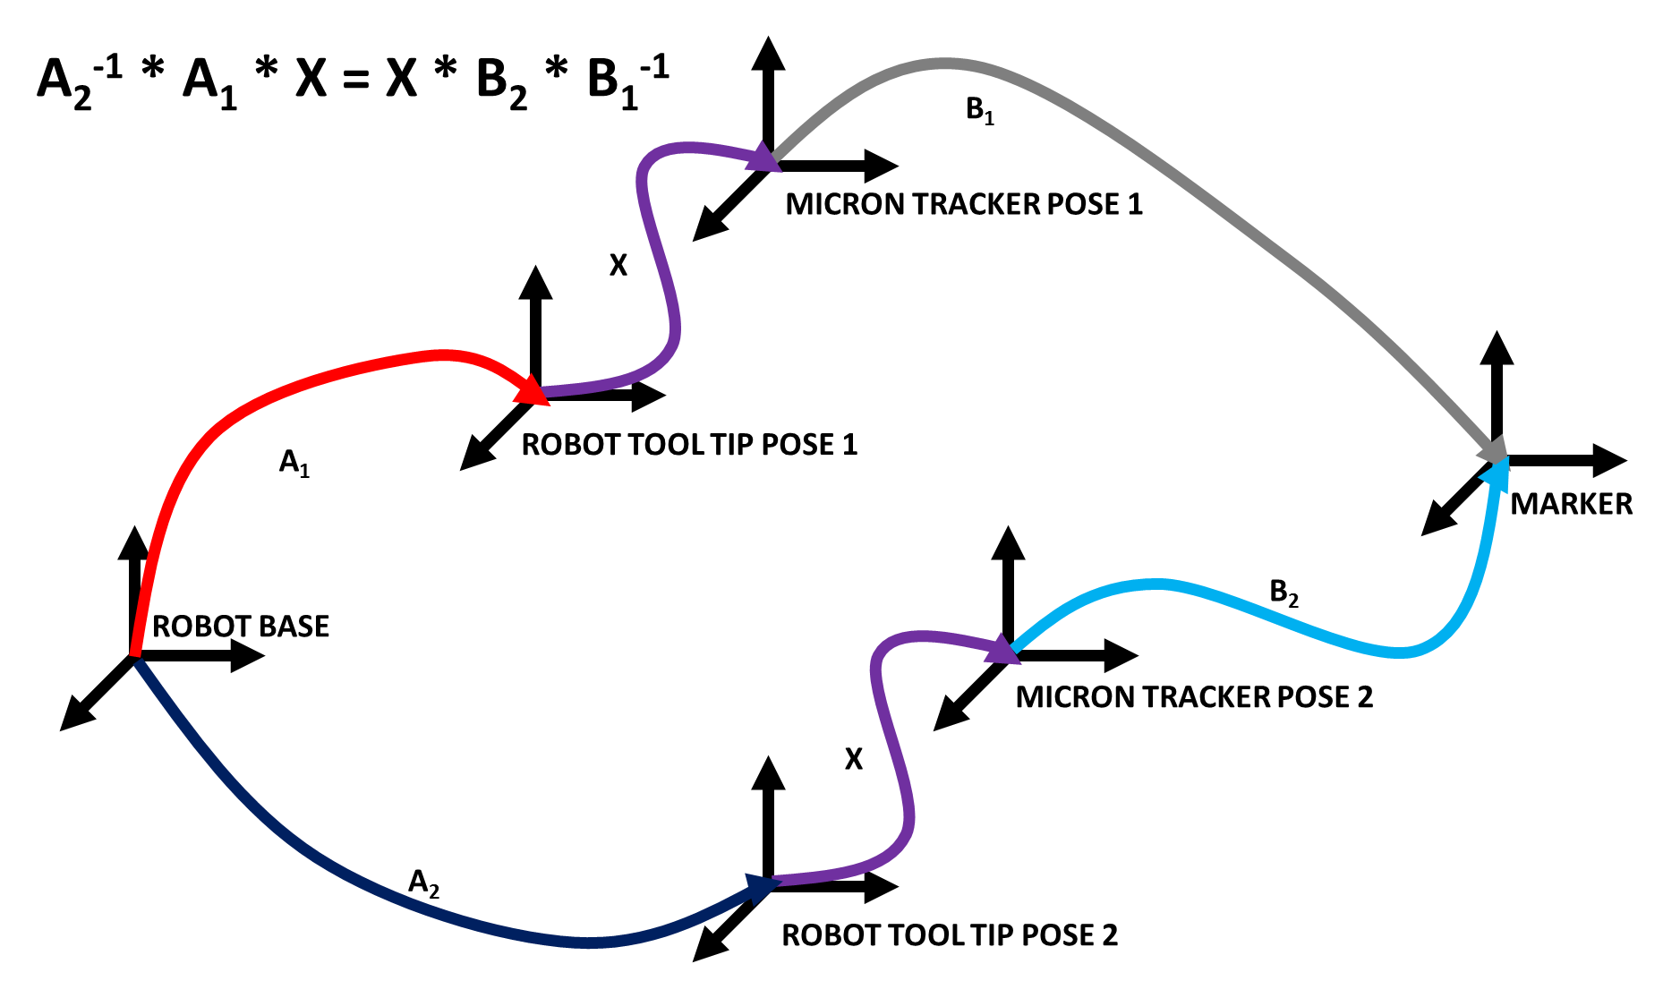
Hand-eye calibration
Project Summary
Deliverables
Progress
Timeline Milestones
Dependencies
Notes:
F

Slide 13
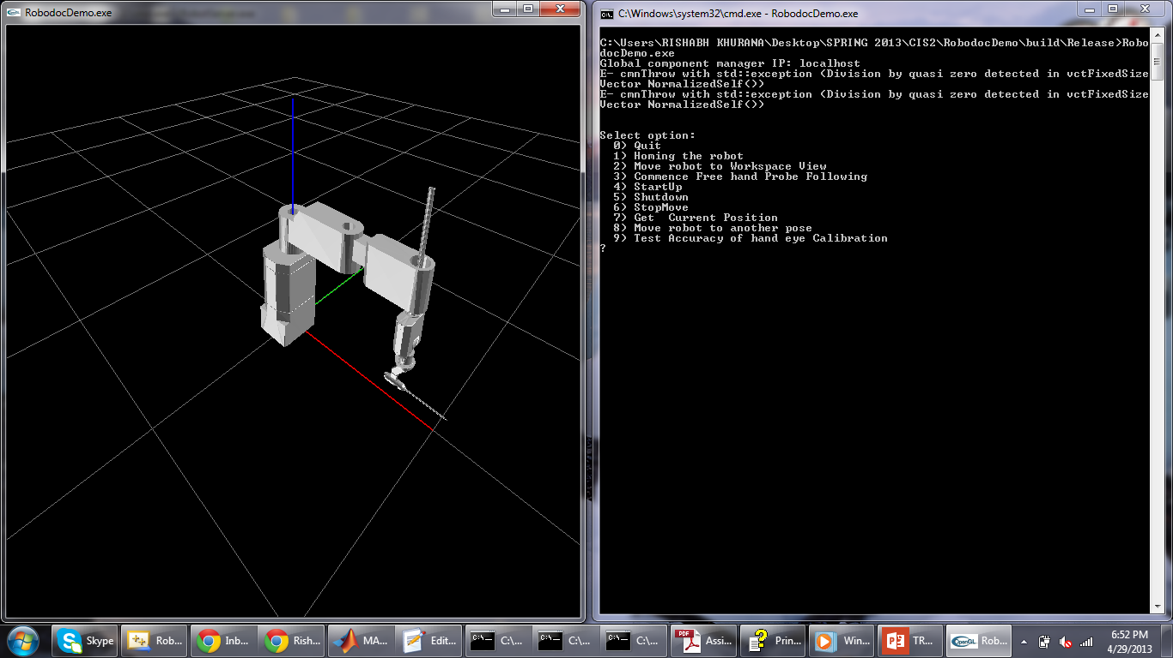

Slide 14
Code implementation flowchart
Project Summary
Deliverables
Progress
Timeline Milestones
Dependencies
Notes:
F

Slide 15
Preliminary experiment
Project Summary
Deliverables
Progress
Timeline Milestones
Dependencies
Notes:
F

Slide 16
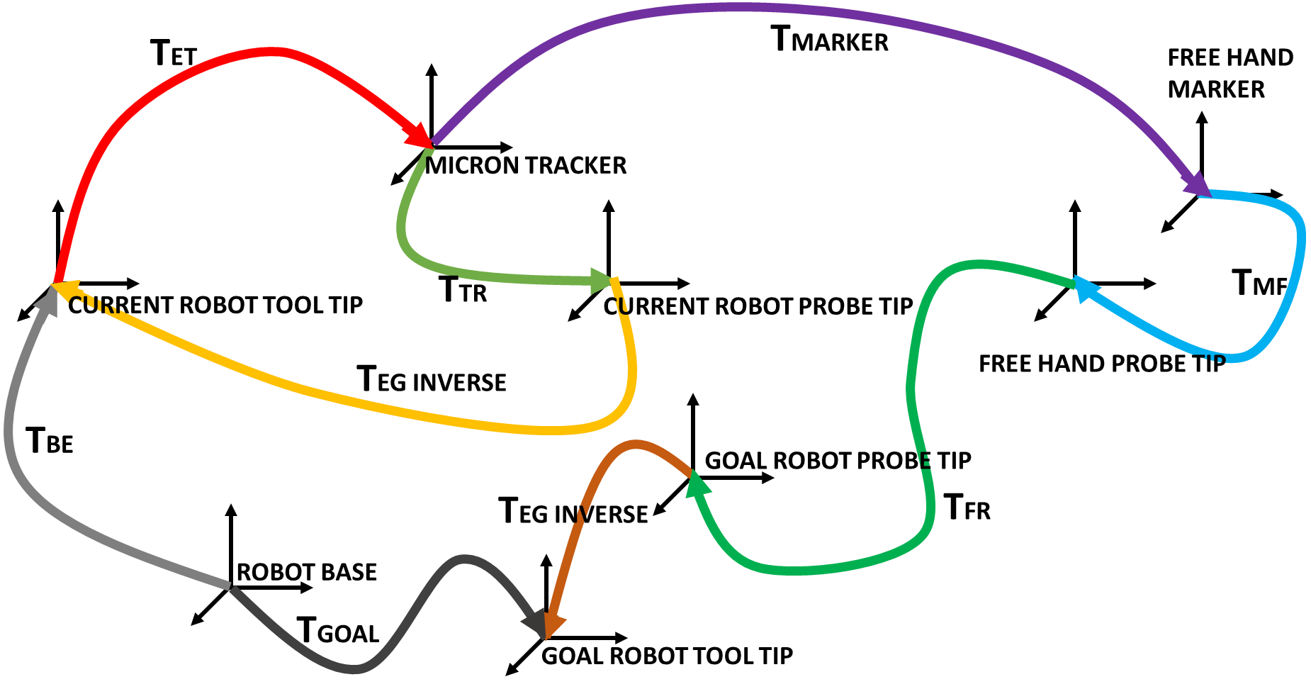
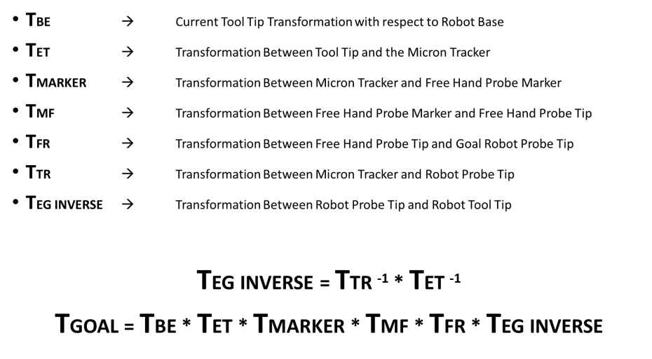
Transformation Diagram
Project Summary
Deliverables
Progress
Timeline Milestones
Dependencies
Notes:
F

Slide 17
Milestones
Previously:
End effector (Apr. 2)
Code and calculations implementation (Apr. 3)
Tracker – Robot calibration (Apr. 10)
US Calibrations (Apr. 16)
Phantom and ultrasound imaging (Apr. 23)
Robot training (Apr. 24)
B-Mode & EPT (Apr. 29)
Current: (by May 6th )
Accuracy study of calibrations
EPT study
Done
Done
In progress
In progress
Done
Done
In progress
Project Summary
Deliverables
Progress
Timeline Milestones
Dependencies
Notes:
Here is the list of milestones we presented in our previous checkpoint presentation. The in progress ones are expected to be done by the end of this week.

Slide 18
Timeline
Week Starting with | Responsible | Mar. 25 | Apr. 1 | Apr. 8 | Apr. 15 | Apr. 22 | Apr. 29 | May 6
End effector | Fereshteh
Code & calculation implementation | Rishabh
Tracker-robot calibration | Rishabh
US calibrations | Fereshteh
Phantom & Ultrasound machine | Fereshteh
Robot training | Rishabh
EPT & Bmode investigation | Together
Final Documentation | Together
Project Summary
Deliverables
Progress
Timeline Milestones
Dependencies
Notes:
This is the timeline we showed in our previous checkpoint presentation

Slide 19
Timeline
Week Starting with | Responsible | Mar. 25 | Apr. 1 | Apr. 8 | Apr. 15 | Apr. 22 | Apr. 29 | May 6
End effector | Fereshteh
Code & calculation implementation | Rishabh
Tracker-robot calibration | Rishabh
US calibrations | Fereshteh
Phantom & Ultrasound machine | Fereshteh
Robot training | Rishabh
EPT & Bmode investigation | Together
Final Documentation | Together
Delayed
Delayed
On Track
Project Summary
Deliverables
Progress
Timeline Milestones
Dependencies
Notes:
Those shown in yellow have been delayed and are planned to be done by May 6th.

Slide 20
Dependencies
 | Dependency | Plan/Source | Status/Comments | Not met?
Phase 1 | 5 DOF robot and training | Robodoc/ Min Yung | Resolved
 | Mock ultrasound probes | Rapid prototyping | Resolved
 | PC or laptop | Provided by Prof. Iordachita | Resolved
 | Optical tracking system | Micron Tracker by Prof. Boctor | Not resolved | Used Prof. Kazanzides’s tracker
 | Cylindrical solid phantom | Acquired | Resolved
 | Mechanical designs & interfacing robot wrist to probe | Prof. Iordachita if we cannot handle | Resolved
 | Required wires/ cables/ tools | Prof. Iordachita lab | Resolved
 | Matlab, Visual Studio | Requested | Resolved
 | Weekly meeting with mentors | Arrange via email | Resolved
Project Summary
Deliverables
Progress
Timeline Milestones
Dependencies
Notes:
r

Slide 21
Dependencies
 | Dependency | Plan/Source | Status/Comments | Not met?
Phase 2 | Ultrasound machine & probes | Provided by Prof. Boctor | Not resolved | Only used one US probe
 | Ultrasound physics and images | Prof. Boctor | Resolved
Phase 3 | Transmitter, receiver and processing units | From Profs Iordachita and Boctor internal funds | Was not requested | Maximum not met
 | Ultrasound imaging reconstruction resources | Provided by Prof. Boctor | Was not requested | Maximum not met
Project Summary
Deliverables
Progress
Timeline Milestones
Dependencies
Notes:
r

Slide 22
Thanks!
Questions?

Slide 23
Timeline
Done
Done
Delayed
Delayed
Delayed
Done
On track
Project Summary
Deliverables
Progress
Timeline Milestones
Dependencies
Notes:
This is the timeline we showed in our previous checkpoint presentation

