Slide 1
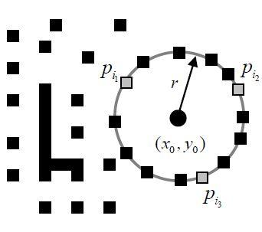
Mobile Device Camera Connector (Tabiscope)
Circle Detection with Learning Automata (LA)
Paper Seminar by Kyle Wong
600.446 Computer Integrated Surgery II
Project 7
Partners: Daniel Ahn, Deepak Lingam
Mentors: Dr. Amit Kochhar, Kevin Olds

Slide 2
Project Overview
Design a low cost endoscopic adapter
Create a system for Android devices
+

Slide 3
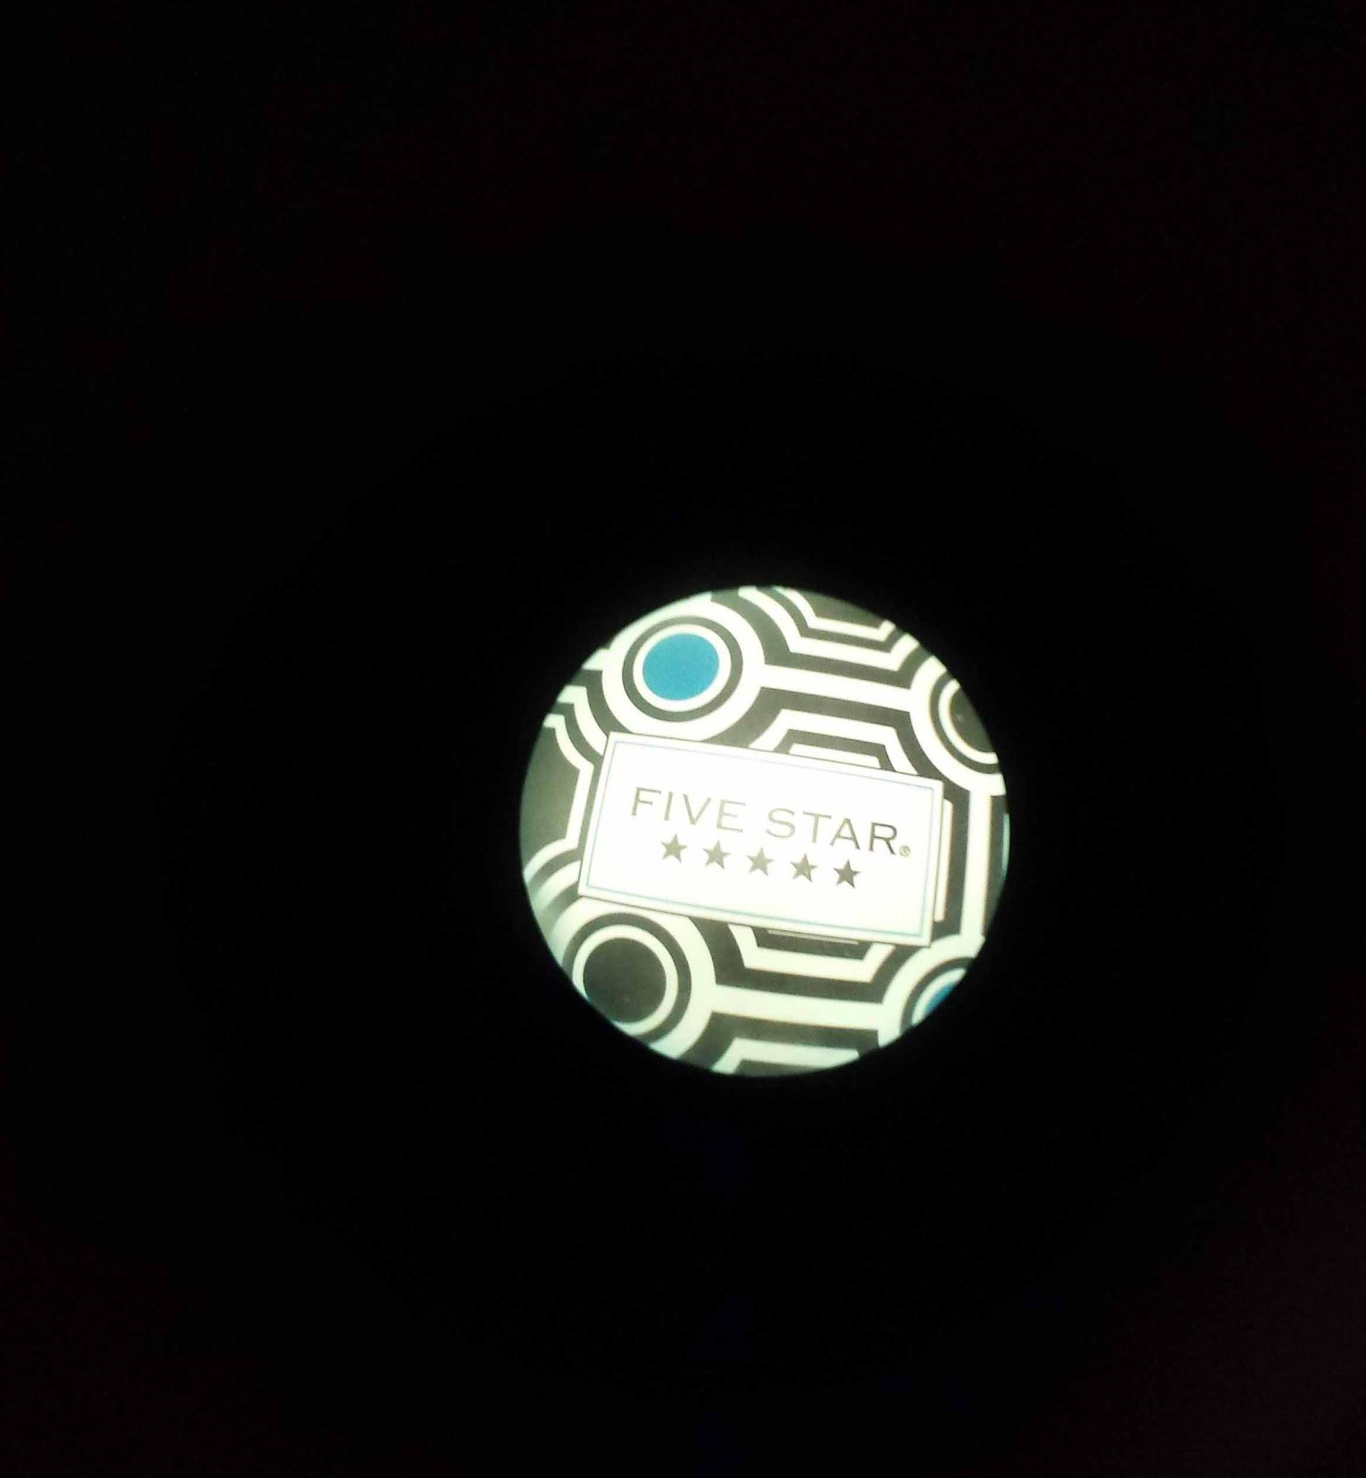
Design Challenge
Real-time image processing method for Circle Detection for auto-zoom, auto-focus, auto-brightness etc.
goal:
automatic

Slide 4
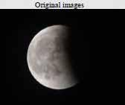
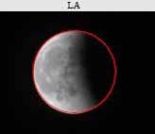
Paper Selection
Cuevas, E., Wario, F., Zaldivar, D., & Pérez-Cisneros, M. (2013). Circle detection on images using learning automata. In Artificial Intelligence, Evolutionary Computing and Metaheuristics (pp. 545-570). Springer Berlin Heidelberg
Cuevas ‘13. Circle detection on images using learning automata.

Slide 5
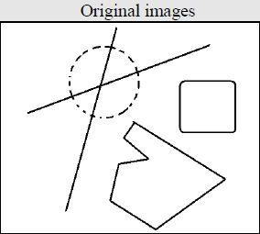
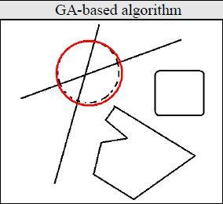
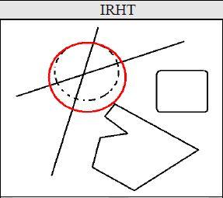
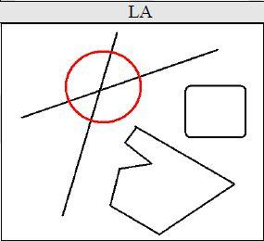
Summary of Problem and Results
Circle detection quickly and accurately
Create a set of synthetic and natural images for comparison
Compare Learning Automata (LA) with Iterative Randomised Hough Transform (IRHT) and Genetic Algorithms (GA)
Cuevas ‘13. Circle detection on images using learning automata.

Slide 6
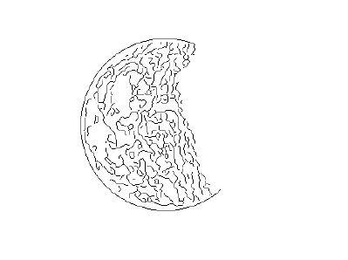
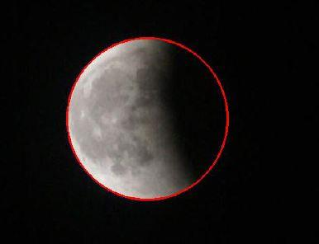
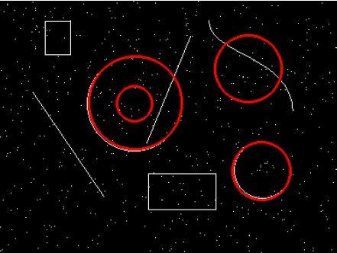
Significance
LA algorithm works for occluded circles and multiple circles and is robust to noise and fast widespread use
Cuevas ‘13. Circle detection on images using learning automata.

Slide 7
Background - LA
Learning Automata (LA) optimize through a learning process
Model actions applied to an environment with a probability density function (pdf)
Pair actions with reinforcement signal to update the pdf to select the next action
Iterate until optimal action is found (threshold reached, or number of iterations is done)

Slide 8
Background - Preprocess
pre-process with Canny Algorithm to get single-pixel edge map; take only a fraction (about 5%) randomly
Matlab - Canny Method
Random Sample
Matlab - Sobel Method

Slide 9
Background - Sample
sample combinations of 3 points and check
Cuevas ‘13. Circle detection on images using learning automata.

Slide 10
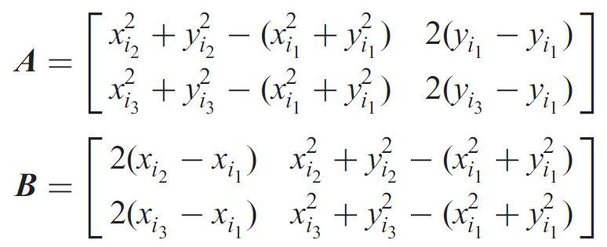
Background 3 Circle-find
Circle calculation

Slide 11
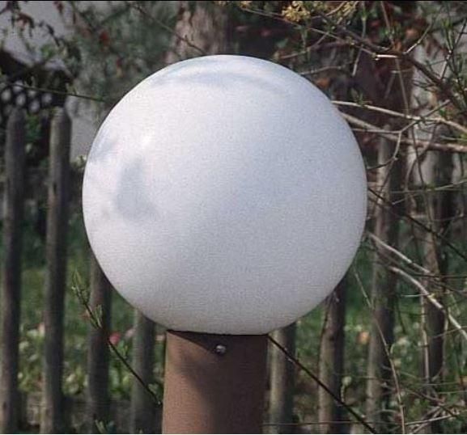
Methods
Synthetic images with noise
Real life images
Cuevas ‘13. Circle detection on images using learning automata.

Slide 12
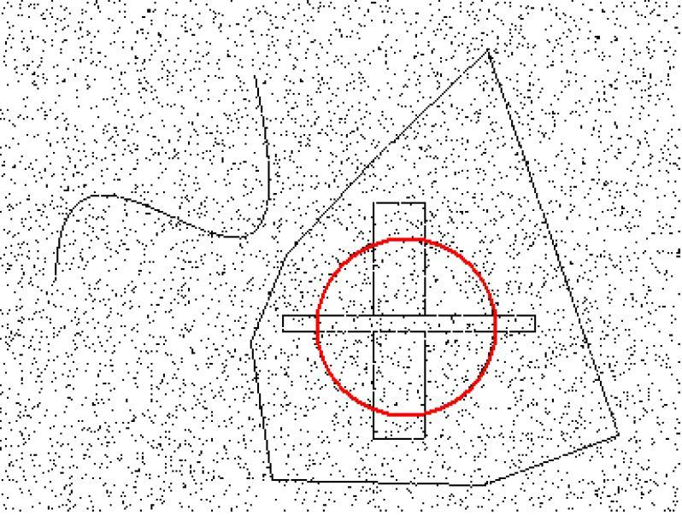
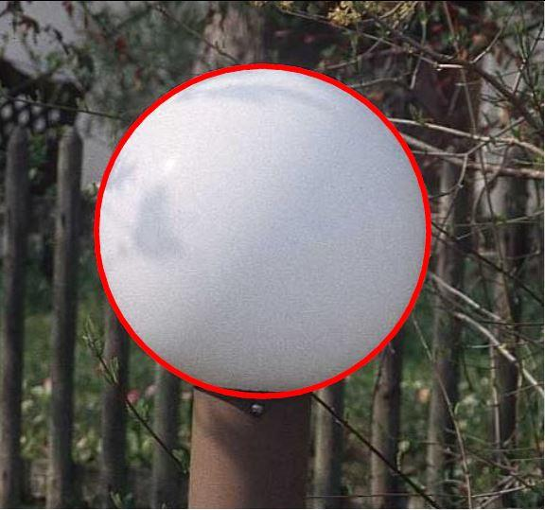
Methods - LA
Synthetic images with noise
Real life images
Cuevas ‘13. Circle detection on images using learning automata.

Slide 13
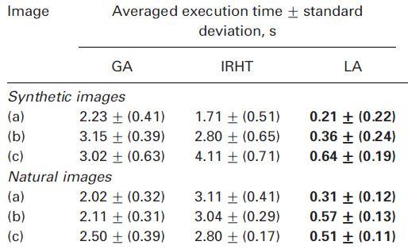
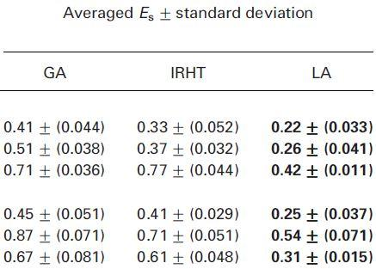
Results
Cuevas ‘13. Circle detection on images using learning automata.

Slide 14
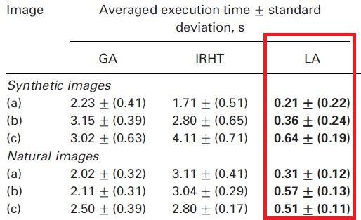
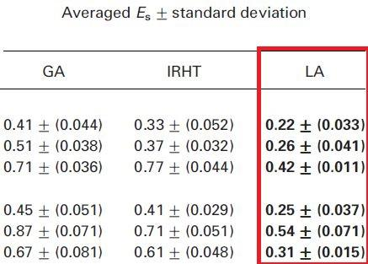
Results - LA Best
Cuevas ‘13. Circle detection on images using learning automata.

Slide 15
Assessment
Positive
Thorough explanation and dataset results
Negative
Self-constructed accuracy (arbitrary and biased?)

Slide 16
Future Work
Compare to other methods like supposedly fast Randomized Circle Detection (accuracy and speed tradeoff)
Compare to basic Circular Hough Transform (for a baseline)
Implement in real-time to show capabilities (using real-time Canny edge detector)

Slide 17
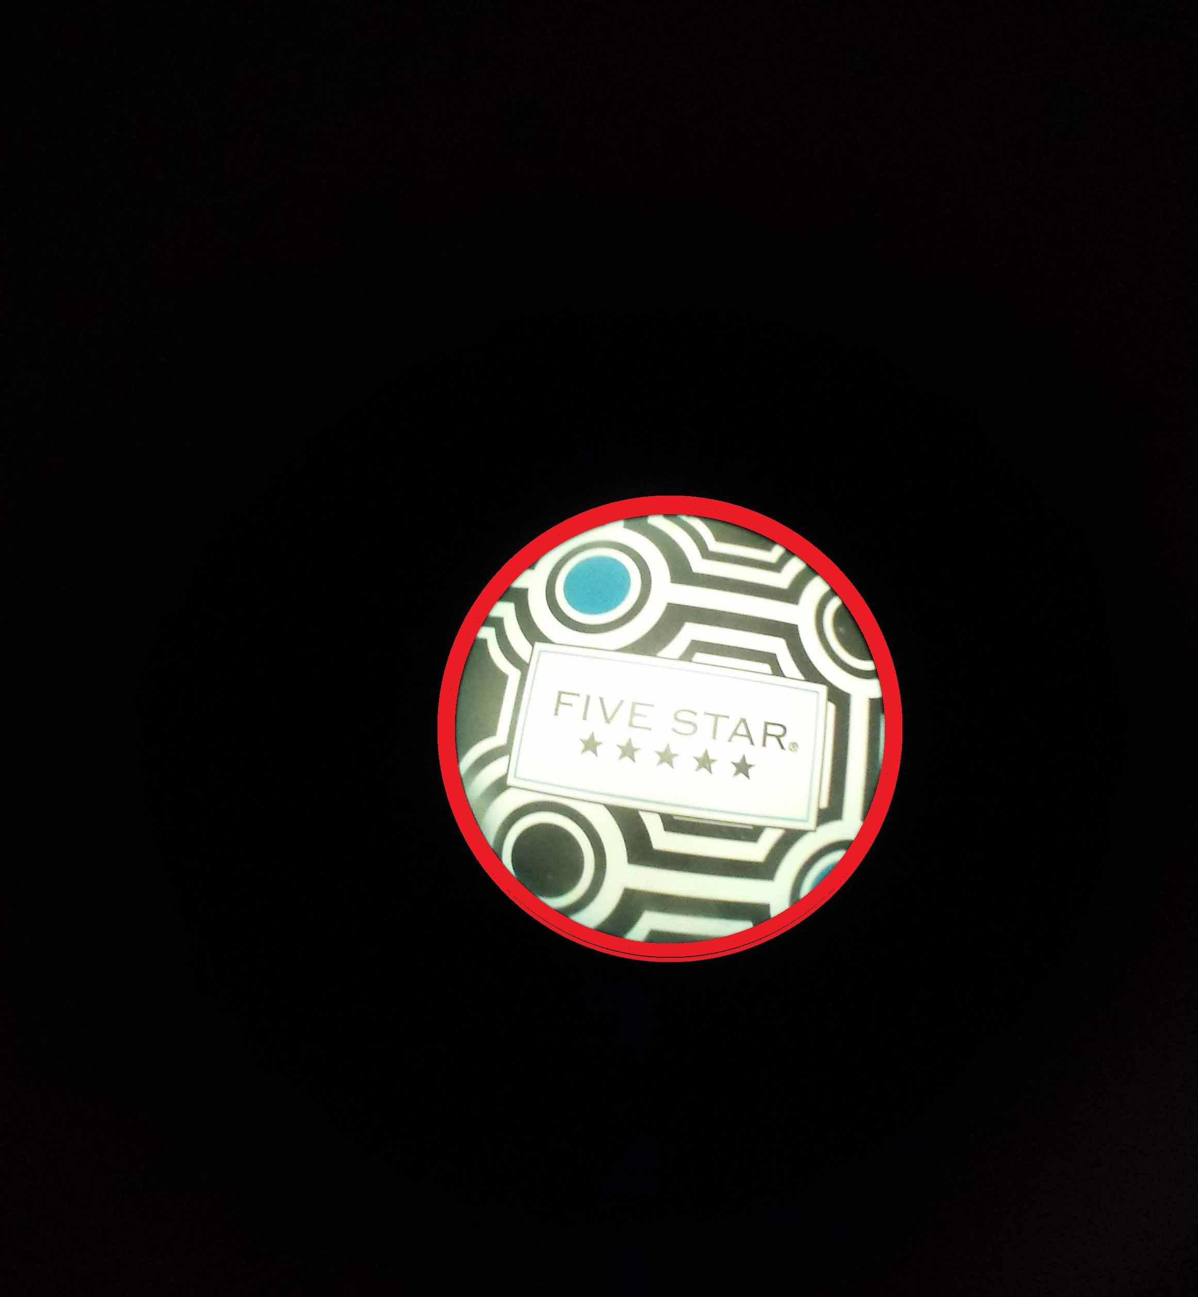
Relevance to our Project
Rapid and accurate circle detection in Endoscopic image
+

Slide 18
Conclusions
Circle Detection and shape recognition are still being researched
Speed, accuracy, memory use, and robustness are vital considerations
Having a standard of measuring these is essential for benchmarking
Learning Automata for Circle Detection may be of use for our Endoscope application

Slide 19
Circle Detection with Learning Automata (LA)
- Questions and Feedback?
Cuevas ‘13. Circle detection on images using learning automata.

