Slide 1
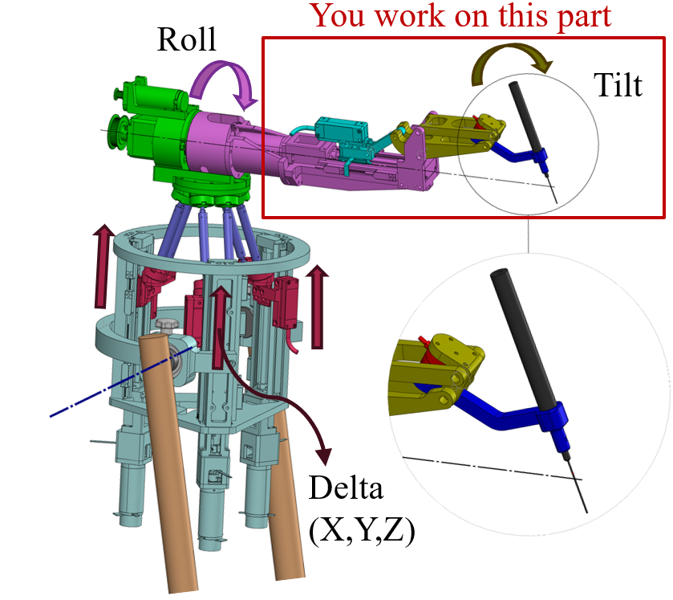
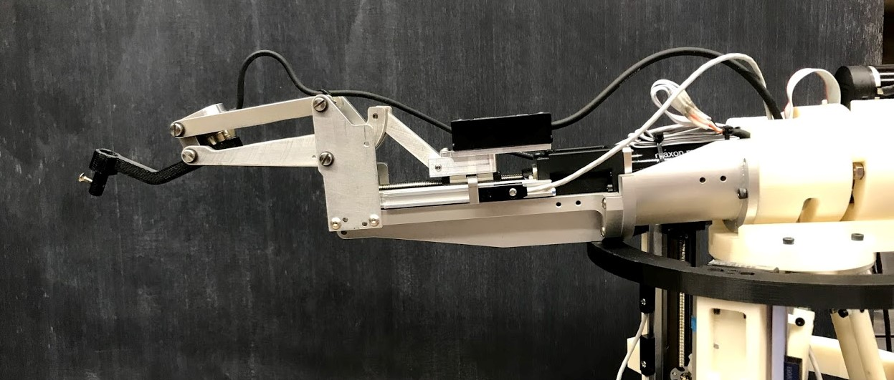
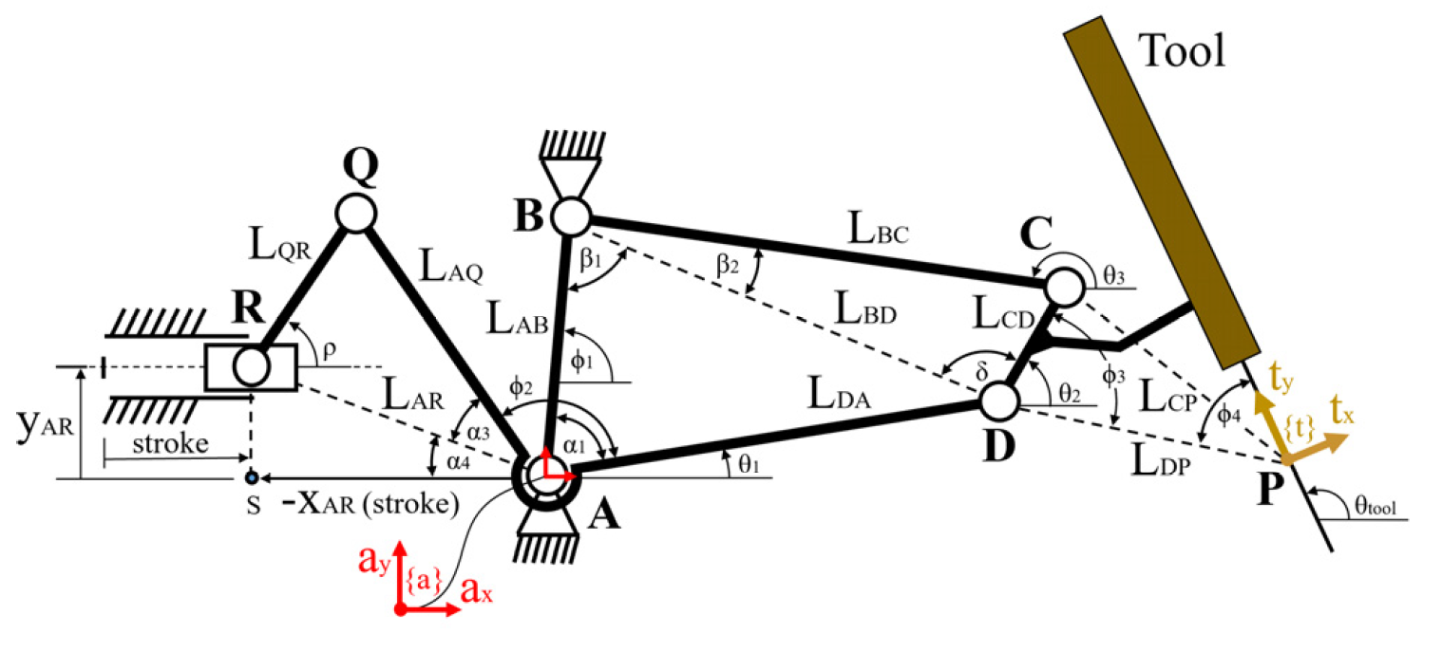
Identification and kinematic calibration of the new 1 DOF tilting mechanism for Eye Robot 3.0
Goal: Investigate the accuracy of and calibrate the new tilting mechanism, which includes a linear stage, a slider-crank mechanism, a four-bar mechanism, and a tool adopter.
Significance: Delicate eye surgical procedures such as retinal vein cannulation and sub-retinal injection require very high accuracy – around 25-30 microns. To achieve that, mechanical and control errors should be carefully identified and compensated.
Slider-Crank
Four-Bar
Linear Stage
Tool Adopter

Slide 2
Identification and kinematic calibration of the new 1 DOF tilting mechanism for Eye Robot 3.0
Mechanism description: A rotary motor moves the slider R, by means of a precise ball-screw unit integrated in the linear stage. This linear motion translates into rotation (tilting) of the tool, by passing through the slider-crank and four-bar mechanisms.
Where to expect errors: The positional errors mostly come from two sources: control errors at joint level, which is related to how accurate we can command the slider to go to the desired position, and mechanical errors, which is related to how accurate the lineages are fabricated and installed.
How to resolve: For position feedback at the joint level (linear motion of the slider) a rotary incremental encoder, connected to the motor, and an absolute linear encoder, connected to the slider, are used.
For the mechanical errors, a precise external measurement sensor (A laser tracker or an Optotrack) will be used to identify the errors, and a calibration model to compensate.

Slide 3
Identification and kinematic calibration of the new 1 DOF tilting mechanism for Eye Robot 3.0
What students will do:
Integrate incremental and absolute encoders into the software.
Verify the accuracy of two encoders with respect to each other and with respect to an external measurement system.
Identify and compensate for errors associated with slider motion.
Design an experiment and Identify errors at the end-effector.
Implement a calibration method to compensate for errors.
Deliverables:
Minimum: Interfacing the encoders to the robot and error checking.
Desired: Complete calibration of the tilting mechanism.
Size group: 1-2
Skills: Good knowledge of Kinematics and Robotics, Familiar with robot calibration, Experienced in MATLAB and C++.
Mentors: Ali Ebrahimi and Drs. Alamdar and Iordachita.

