Slide 1
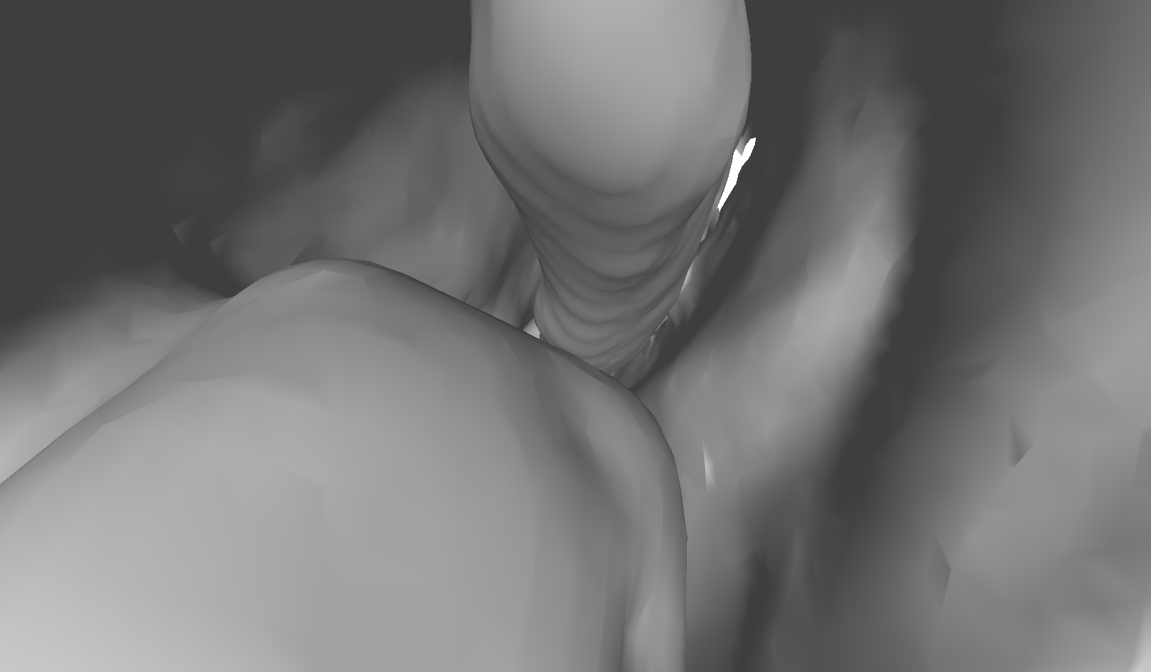
Auto-initialization using Deep Learning
Problem Statement:
Registration algorithms require an initial $F_{guess}$. Algorithms can be very sensitive to this initialization, and manual initializations can be time consuming.
Project Statement:
Automatically initialize registrations intelligently using deep learning for scene matching in medical images of different modalities (video frames and CT rendering)
Simulated video frame
Corresponding camera view in CT rendering

Slide 2
Auto-initialization using Deep Learning
What Students Will Do:
Work with simulation data (with known truth)
Figure out what kind of neural network is best for this application
Train a neural network to learn camera transformations that produce a CT rendering that matches the video scene
Test the neural network on simulation data to see if that correct transformation can be recovered
Deliverables:
Trained and tested neural network
Can it produce an $F_{guess}$ that matches the truth in simulation?
Perform registration starting from the predicted $F_{guess}$ using at least one established registration algorithm (e.g., ICP)
Perform registration using multiple established registration algorithms to assess the quality of the initialization using different methods

Slide 3
Auto-initialization using Deep Learning
Size group:
No more than 3, if more split into sub-projects
Skills:
Deep learning (at least some understanding, can learn more as you go)
Python (preferably, but Matlab/C++ also work)
Mentors:
Ayushi Sinha; asinha8@jhu.edu
Austin Reiter; areiter@cs.jhu.edu

