Slide 1
Force Control Algorithms for Sclera Eye Surgery
Team Members: Ankur Gupta, Saurabh Singh
Mentors: Dr. Iulian Iordachita, Dr. Marin Kobilarov and Dr. Russell H. Taylor
Date: 02/28/2017
Project - 20

Slide 2
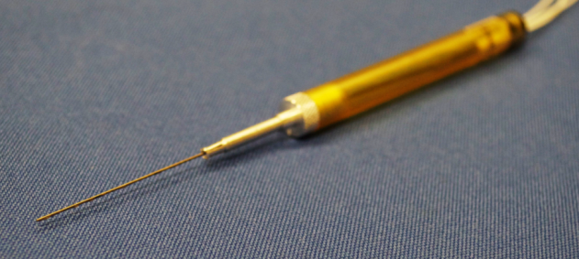
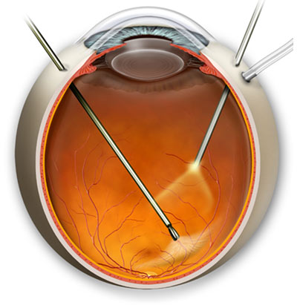
Motivation
The motivation for this project came from the challenges in the eye surgery :
Hand tremor of the surgeon
Excessive forces on the sclera leads to corneal striae
High risk of retinal tears (vision loss)
Inability of human to detect feeble forces
Eye surgery is difficult, requires intensive surgical training and practice
Force Sensor
Force Sensor
F_{sclera}
d_{s}
F_{tip}
www.eyemdlink.com

Slide 3
Background
Taken in part from
Xingchi He
Dissertation Defense
June 30th, 2015

Slide 4
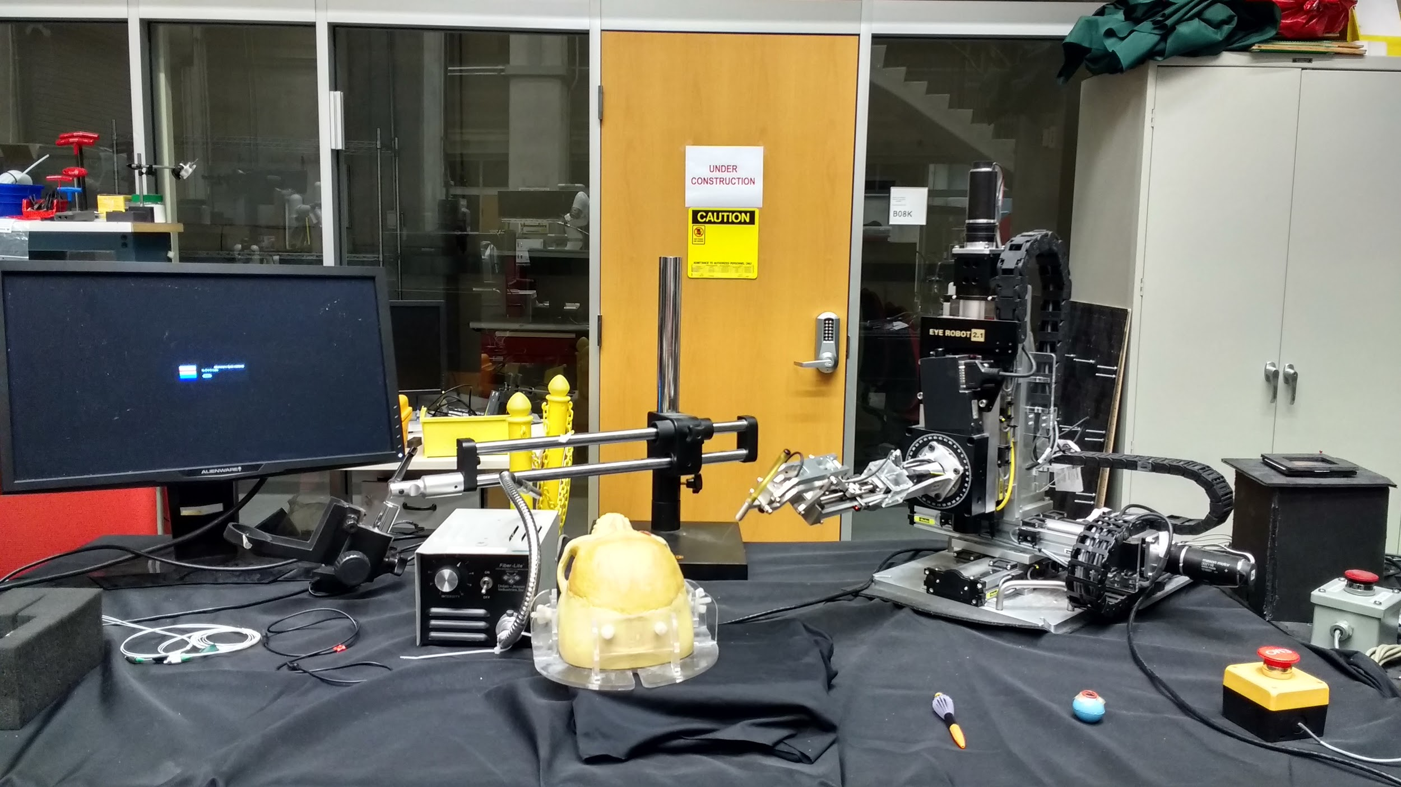
Background:
Microsurgical Workstation
Stereo display
Eye Robot
Video microscope
Smart tools (Force/OCT)
Phantom eye and skull

Slide 5
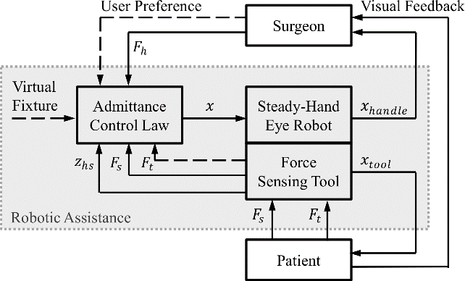
Background:
Admittance Control
Constant Admittance Control
Isotropic admittance
The user input force applied on the instrument handle controls the velocity with which the robot follows the user motion.
The Solid lines in the above figure show the signal flow in current robot control algorithm, dashed lines show the signals that can also be incorporated into the control law. The constant admittance control is given by equations below.

Slide 6
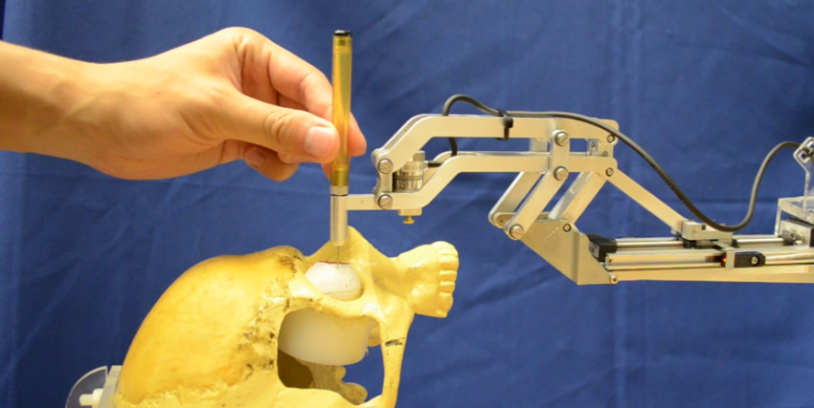
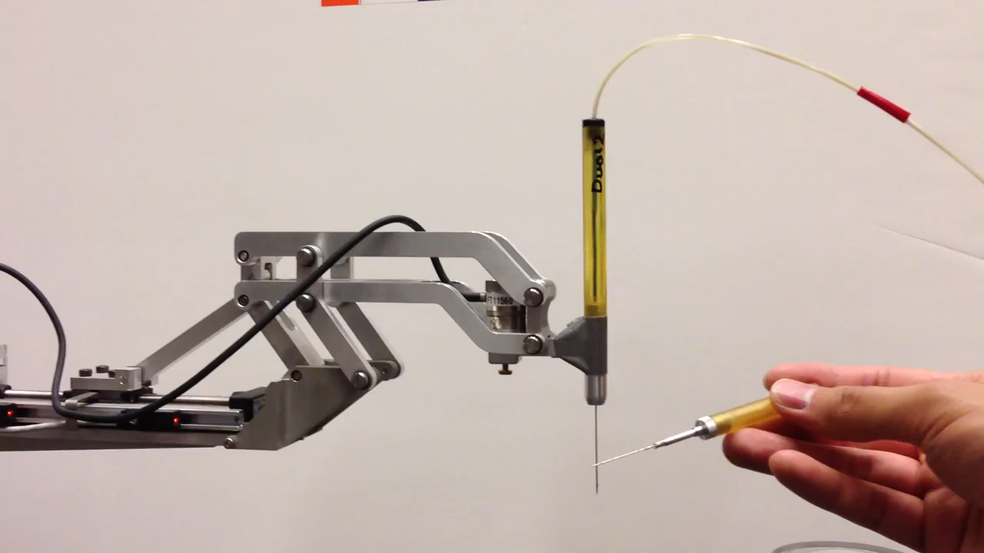
Background:
Admittance Control
Constant Admittance Control
Isotropic admittance
Haptic feedback using force scaling
The robot cooperative control law incorporates scaled sclera force measurement
F_{hs}
F_{ss}

Slide 7
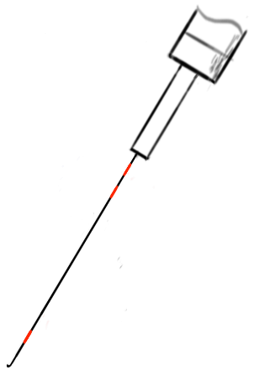
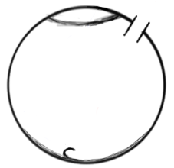
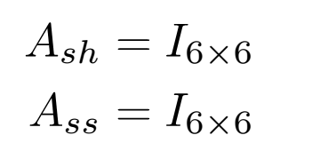
Background:
Variable Admittance Control
6-DOF motion
Isotropic admittance with force scaling
Haptic feedback
e.g. force scaling of sclera force
Anisotropic admittance to render virtual fixture
Motion guidance/constraint
e.g. virtual RCM
4-DOF motion
RCM

Slide 8
Background:
Variable Admittance Control
6-DOF motion
Isotropic admittance with force scaling
Anisotropic admittance to render virtual fixture
4-DOF motion
RCM

Slide 9
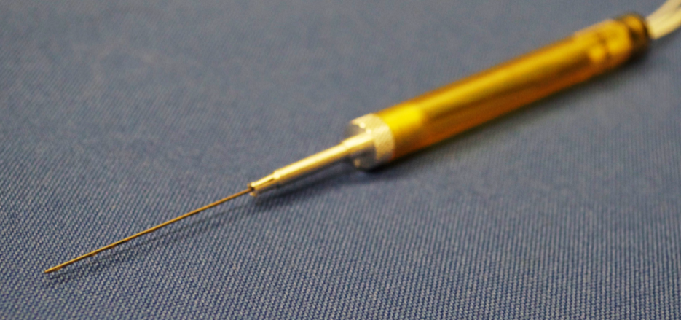
Background:
2-DOF Force Sensing Tools
FBG
F
Fiber Bragg Grating (FBG sensors)
Eye
σ
F_{y}
FBGs
F_{x}
2-DOF Pick Tool
Expansion/contraction of FBG causes shift in wavelength. This driver and calibration has already been done and calibration matrices made available.
FBG sensors
He et al. SPIE Photonic West 2012
Notes:
Previous work: a family of 2-DOF force sensing instrument (pick, forceps tools)
Explain FBG, How FBG works
Explain design concept of 2-DOF tools

Slide 10
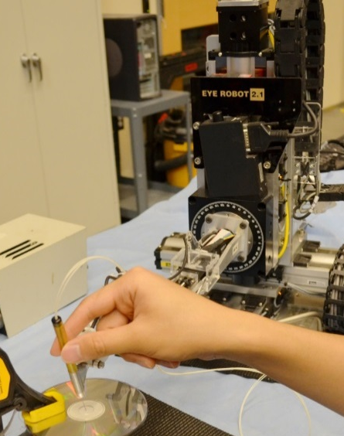
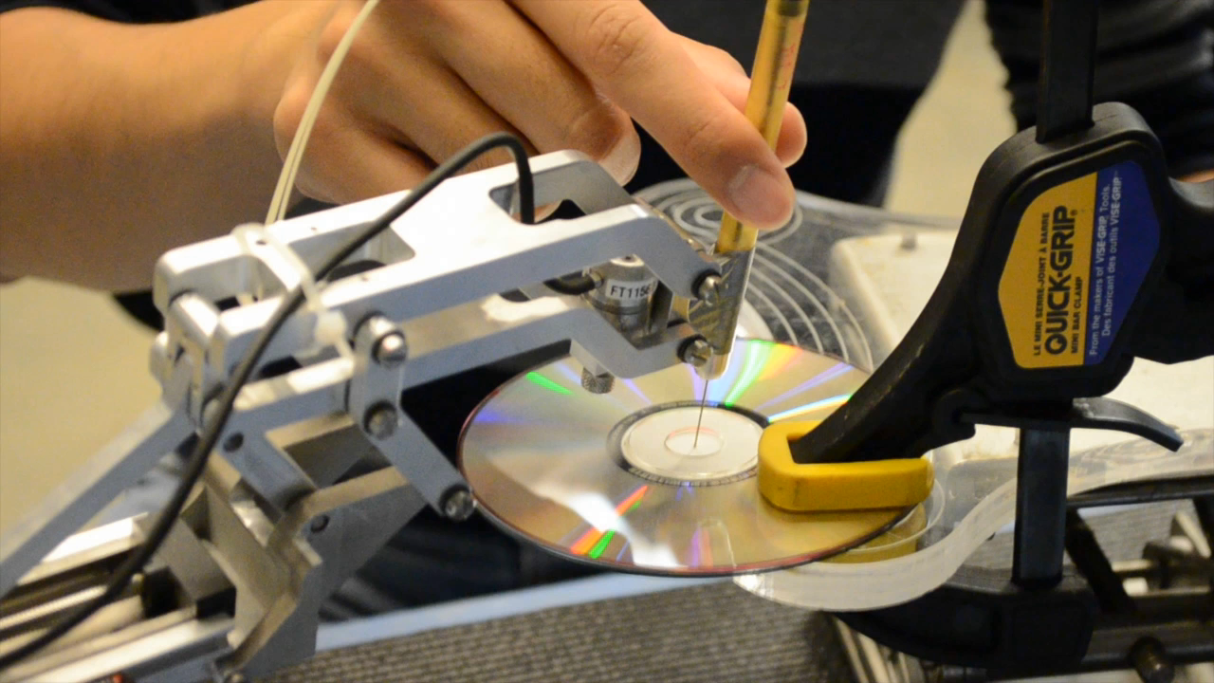
Background:
Tool to Robot Calibration
Standard pivot calibration
Tool shaft rigid
Tool tip pivots around a fixed point
Pseudo Pivot Calibration
Tool shaft flexible
Tool shaft goes through a fixed point
Use sclera force feedback to enforce RCM
{h}
Pivot Motion
RCM Point
{s}
{t}
Notes:
? Transformation from tool frame to robot frame
Pivoting the tool about a fixed insertion port with the robot
to prevent the tool from bending, we use force scaling with a nominal estimate of the transformation from the tool to the robot

Slide 11
Overview
The transition function between the lower bound and the upper bound depth of the sclera depth is considered to be the straight line function but a study has to be conducted for the nonlinear functions as it is assumed that it won't be a linear function for human operative conditions.
Develop a learning based control algorithm. The learning is aimed to be, finally, performed by demonstration by the experienced surgeons.

Slide 12
Detailed Plan

Slide 13
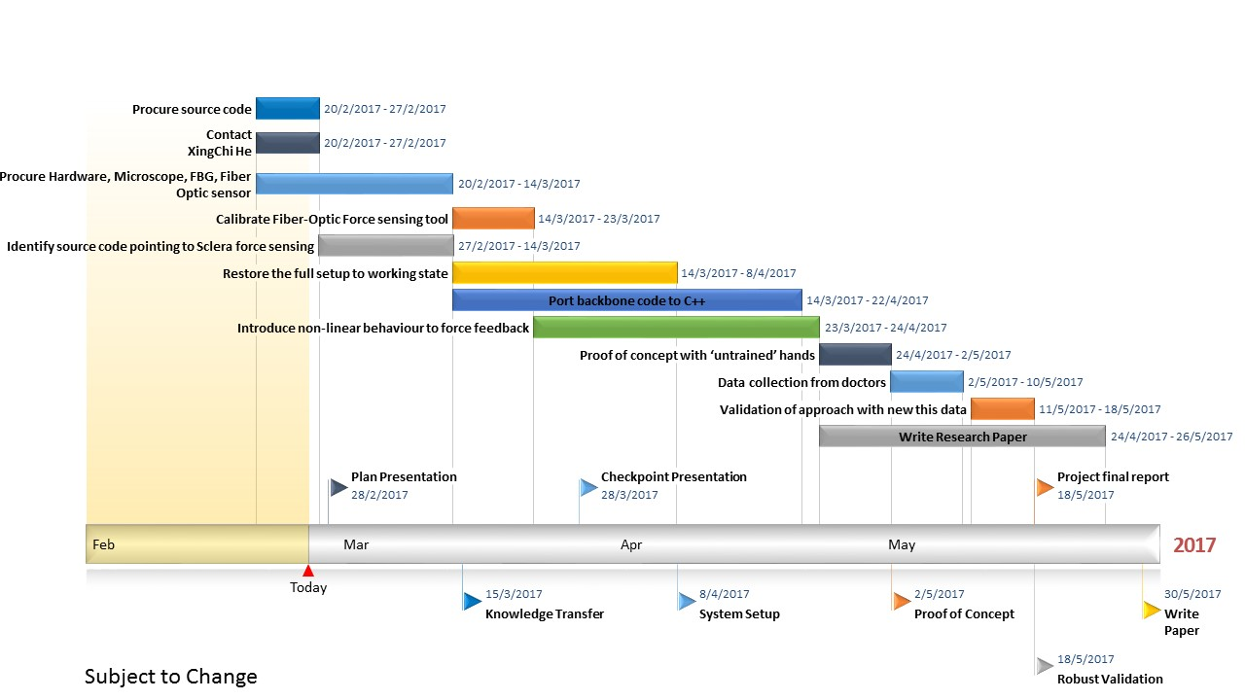
Planned Timeline

Slide 14
Deliverables
Minimum:
Procured software and Algorithm bridge source code
Ported backbone code to C++, if required
Procured and Calibrated Fiber-Optic Force sensing tool (Replace Fiber Optic tool, with low cost workable tool, if FO not procured)
Identified and documented source code that pertains to Sclera force sensing, drivers, APIs, and backbone algorithm
Restored the full setup to state, working with all tools and sensors attached.
Analysis of force feedback curve with multiple and unique coefficients

Slide 15
Deliverables
Expected:
Introduction of non-linear behaviour to force feedback
Proof of concept with ‘untrained’ hands on Chorioallantoic membrane or synthetic sclera-impersonator membrane, such that forces seem natural in the process.

Slide 16
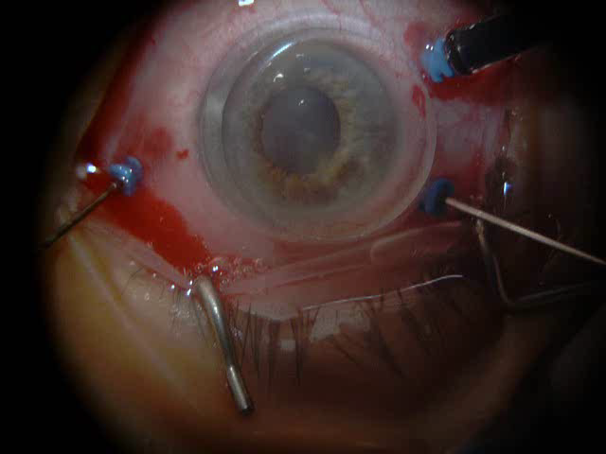
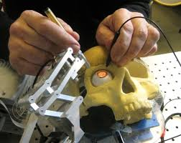
Deliverables
Maximum:
Data collection from ‘experts’ or doctors
Validation of model with ground truth force feedbacks.

Slide 17
Dependencies
No. | Dependency | Resolve by | Status | Plan B
1 | Develop complete understanding of problem and survey for possible approaches, based on feedback from mentors. | 3/3/2017 | In Progress | No Alternative
2 | Procure codebase | 02/24/2017 | Done | -
4 | Xingchi He’s time to discuss existing code and approach. | 3/3/2017 | In progress | Self Learning
5 | Fiber Optic sensor from Dr. Iordachita. | 3/3/2017 | Done | -
6 | Microscope. | 03/10/2017 | In progress | Borrow from other labs
7 | Time with FBG Machine (Currently >=3 projects are using it). | 03/10/2017 | Can only be scheduled after Ben Gorec’s Arrival | Work late night when no one is using the machine

Slide 18
Dependencies
No. | Dependency | Resolve by | Status | Plan B
8 | Availability of tissues, membranes, and phantom for the eye surgery. | ~ 03/10/2017 | Will be done after Berk’s return | -
9 | Getting time with doctors to collect the data and validate the results the results obtained for the nonlinear function. | 05/10/2017 | Not started | Validate results with previously acquired (incomplete) data

Slide 19
Division of Work
Saurabh | Ankur
(MechE and Controls background) | (Programming and ML background)
Restore the full setup to state, working with all tools and sensors attached.
Control Design | Crop the codebase to relevance
Calibration of tool | Port to C++
Acquisition of data from force sensor
Analysis of force feedback from multiple pose of tool wrt RCM | Experimenting with force feedback curve with multiple and unique coefficients
Coefficient Training and validation with non linear parameters
Integration of learned model with existing codebase

Slide 20
Q&A

