Slide 1
Transoral Neck Surgery

Slide 2
Transoral Neck Surgery- Endoscope Holder
In transoral neck surgery an endoscope is inserted between the lip and the jawbone. The goal of this sub-project is to develop an adapter for an existing surgical robot to hold the endoscope and to conduct a user study with surgeons.
Video: (https://www.youtube.com/watch?v=iT5jSgixOWY)
What Students Will Do: Design and fabricate endoscope holder & test on phantom models and phantoms. This will include assessment of device design’s compatibility this laparoscopic instrument manipulation.
Deliverables:
Iterative device designs to be reviewed by mentors
Device prototype to be tested in a cadaver
Report of user study
Size group: 1 (may combine with other project)
Skills: CAD, materials design
Mentors: Christopher Razavi, MD ; Jonathon Russell, MD
crazavi1@jhmi.edu

Slide 3
Transoral Thyroid Surgery- Retraction Device
In transoral neck surgery (.
What Students Will Do: Design a device which can be inserted through a 1.5 cm lip incision that can expand to maintain our working space in the neck while still allowing access to the surgical field.
Deliverables:
Iterative device designs to be reviewed by mentors
Device prototype to be tested in a cadaver
Size group: 2-3
Skills: CAD, materials design
Mentors: Christopher Razavi, MD ; Jonathon Russell, MD
crazavi1@jhmi.edu

Slide 4
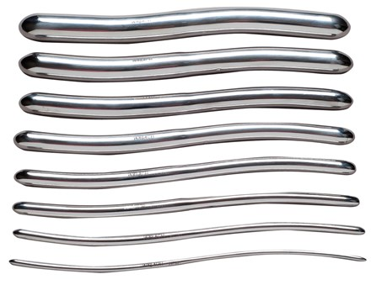
Transoral neck Surgery- Hegar dilator handles
In transoral neck surgery we use Hegar dilators to widen our central incision and enter the neck space. These instruments can be difficult to manipulate given their smooth finish and lack of a handle.
What Students Will Do: Design a reusable and autoclavable handle that can slide on the end of the dilator to help with manipulation. Work in conjunction with JHH clinical engineering to determine the appropriate material it should be made of.
Deliverables:
Iterative designs for review by mentors with a handle or handles that can fit the 4 largest sized dilators.
Prototype of a single handle to be tested in a cadaver.
Size group: 1
Skills: CAD, materials design
Mentors:
Christopher Razavi, MD
Jonathon Russell, MD
crazavi1@jhmi.edu

