Slide 1
Ultrasound needle guidance for hydrogel injection during cervical cancer brachytherapy

Slide 2
What is Brachytherapy?
CTCA
Form of internal radiation which can deliver very high dose radiation to tumor while minimizing damage to surrounding normal organs
Effective treatment for cervical, prostate, breast, skin and other cancers
Complex, challenging procedure which requires accurate real-time imaging & tracking of tumor and surrounding normal tissues

Slide 3
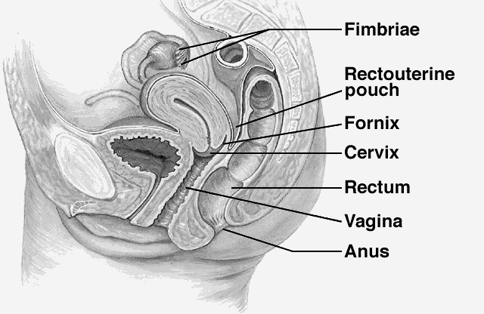
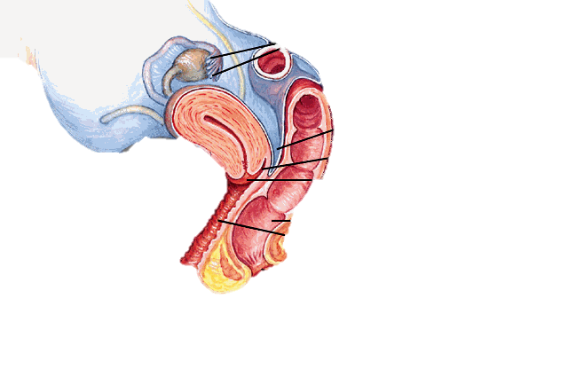
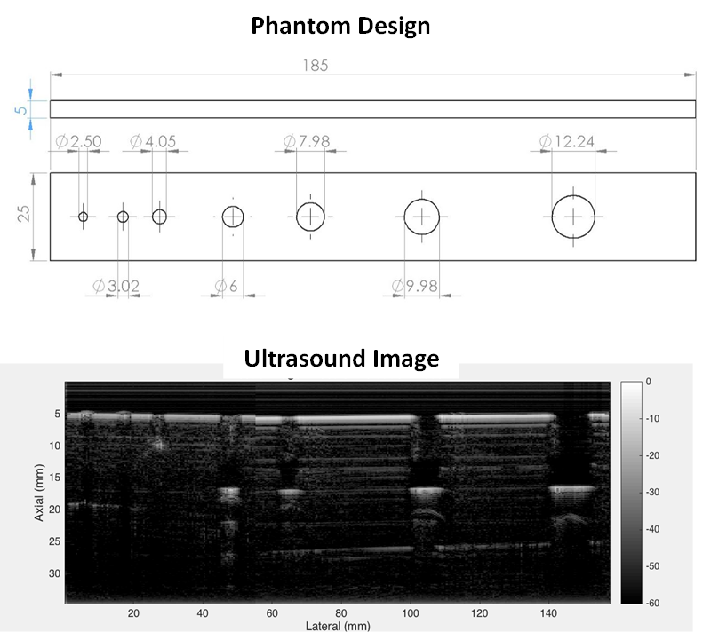
Background & Previous Work
McGraw-Hills
Brachytherapy is standard treatment for locally advanced cervical cancer (following chemo-radiation)
Injecting a hydrogel spacer into the space between the rectum and the cervix/vagina can help to minimize radiation dose to normal structures
Challenge: inaccurate placement of the needle can lead to devastating complications e.g. perforation of the bowels and rectum
Previous Work: Dr. Boctor’s lab has developed an ultrasound needle sized transducer (originally designed for lumbar punctures)
It detects distance between the needle tip and bone/soft tissues
We’d like to adapt this for cervical cancer brachytherapy applications
Notes:
back projection based synthetic aperture beam-forming algorithm

Slide 4
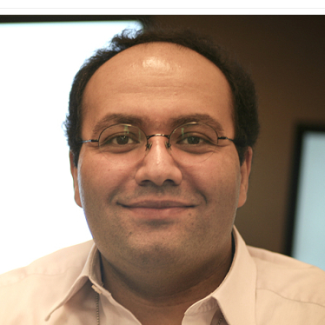
Deliverables
Design: adapt an ultrasound transducer for use within an 18-gauge needle
Improve: develop/optimize algorithm for identifying the recto-vaginal space
Evaluate: evaluate hydrogel injection success rates using a female pelvic phantom
Size group: 3
Skills: Image Analysis, Ultrasound, Hardware Development
Mentors
Dr. Emad Boctor (eboctor1@jhmi.edu)
Dr. Akila Viswanathan (anv@jhu.edu)
Support/Peer Advice:
Carmen Kut MD/PhD Student (ckut1@jhmi.edu)
Akila Viswanathan MD
Radiation Oncology
anv@jhu.edu
Emad Boctor PhD
Radiology
eboctor1@jhmi.edu

