Slide 1
3D Triangle Mesh-Based Edge Detection and Segmentation
Project #2 Seminar Presentation
En.600.446 Spring 2015
Joshua You
Mentors: Dr. Armand, Dr. Gordon, Captain Grant, Dr. Ryan Murphy

Slide 2
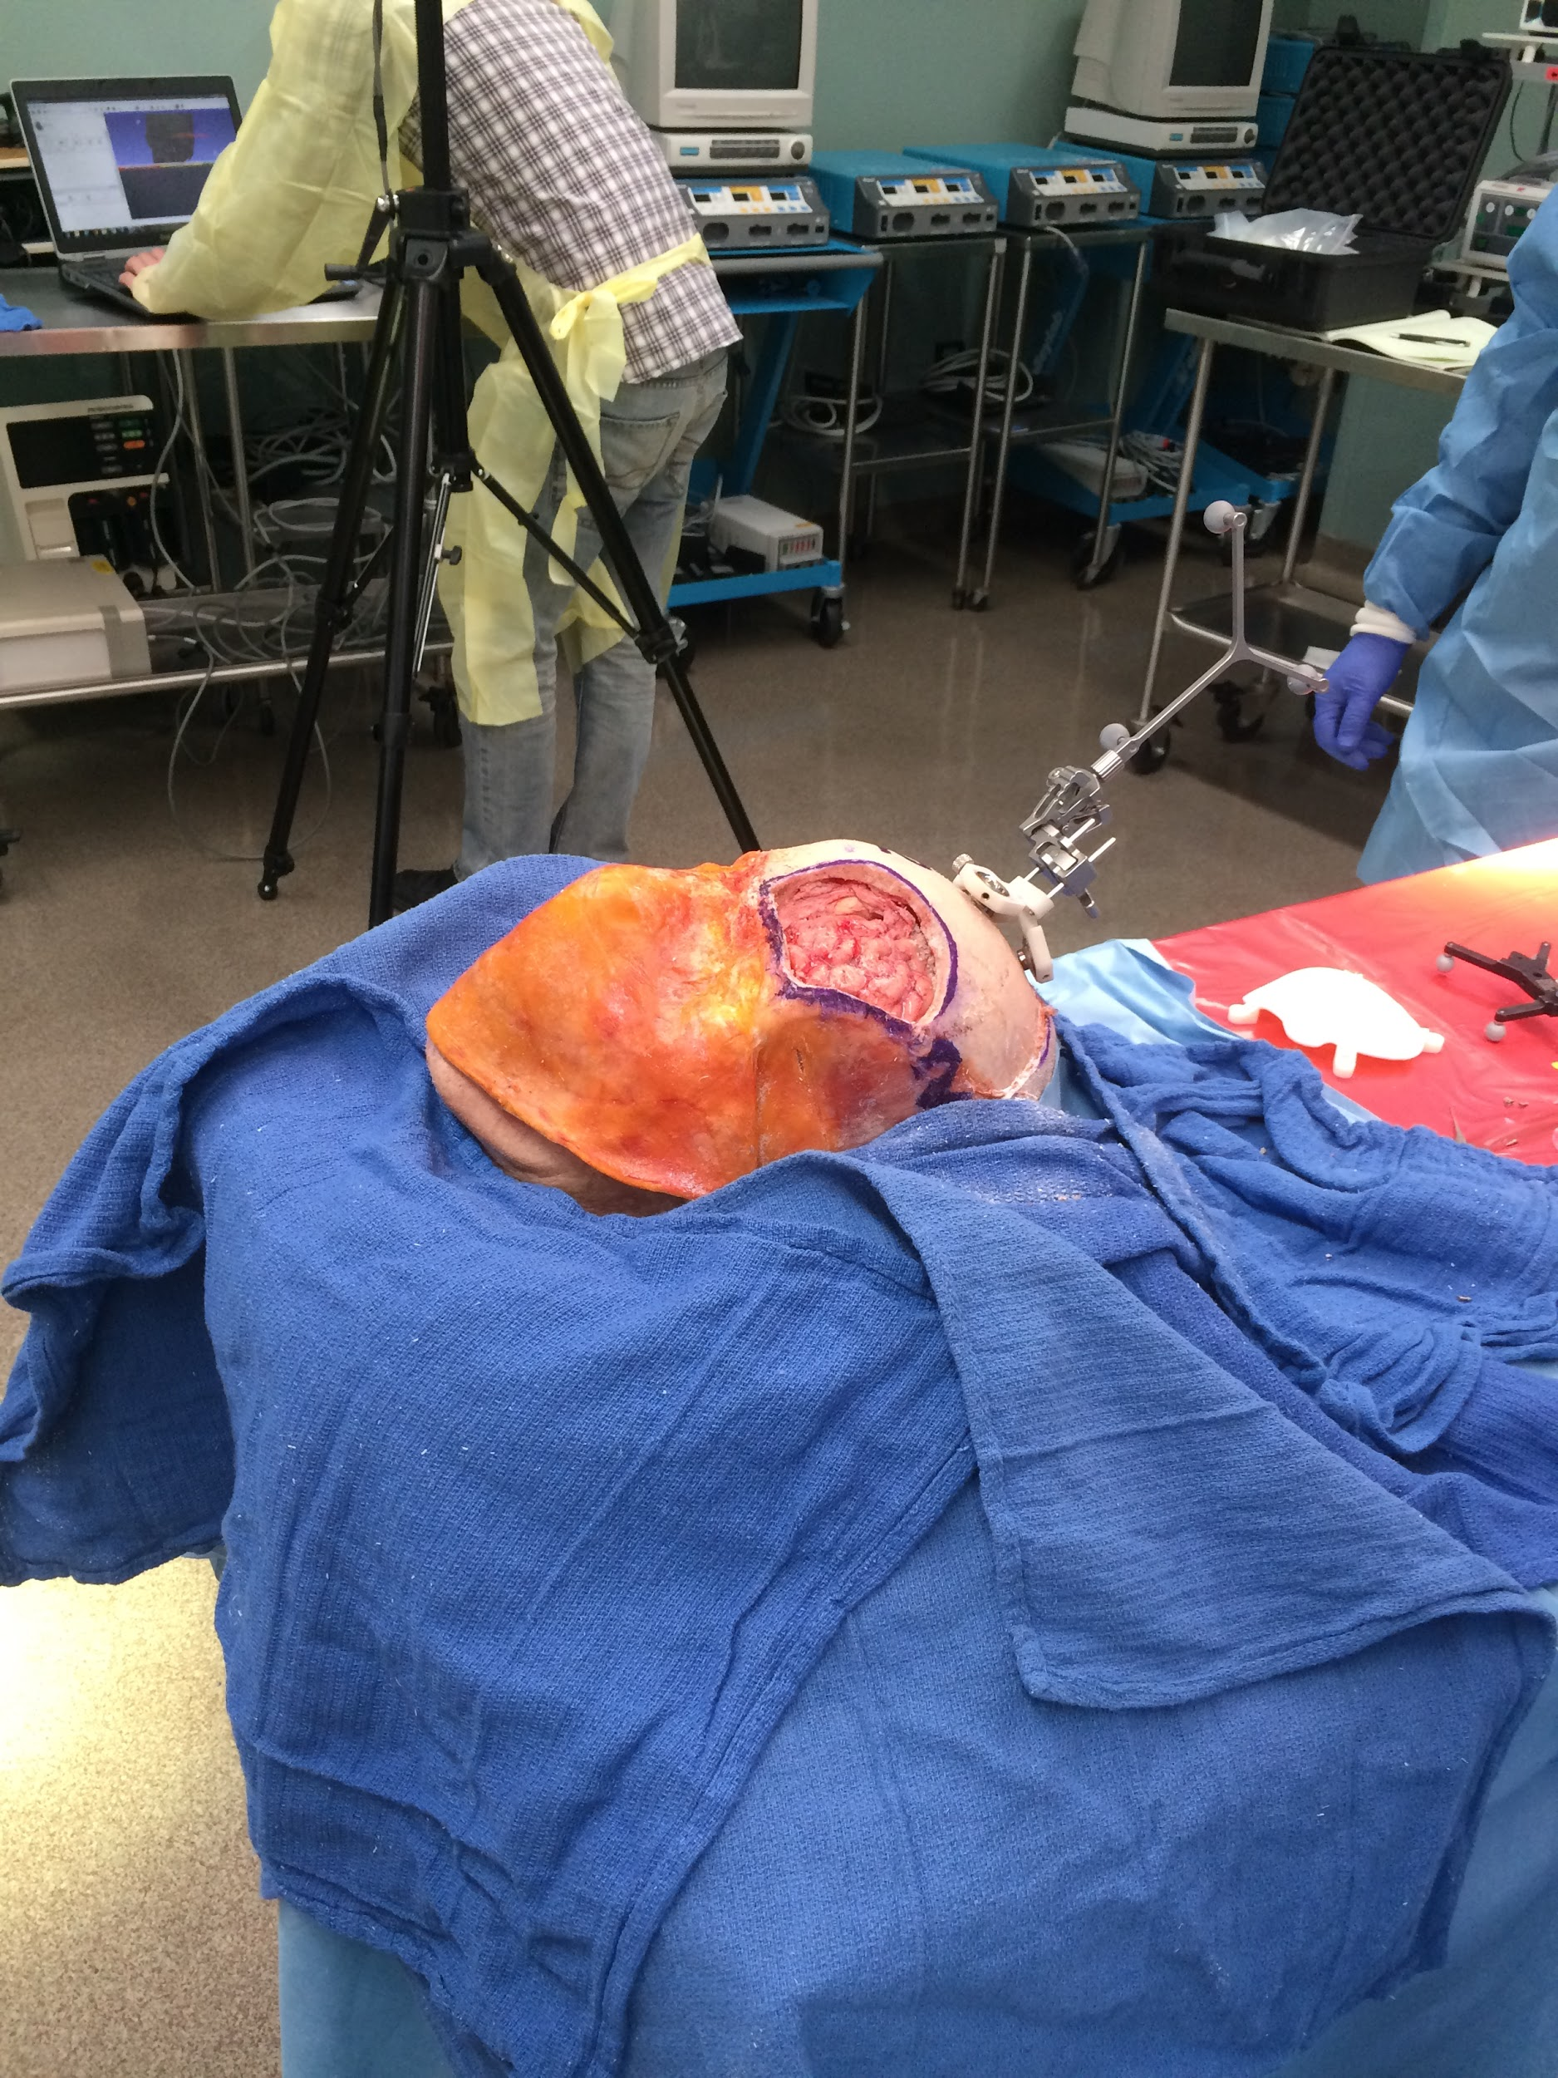
Project Overview
Project Goal: Integration of 3D scanning solutions for defect identification and reconstruction in cranioplasty procedures.

Slide 3
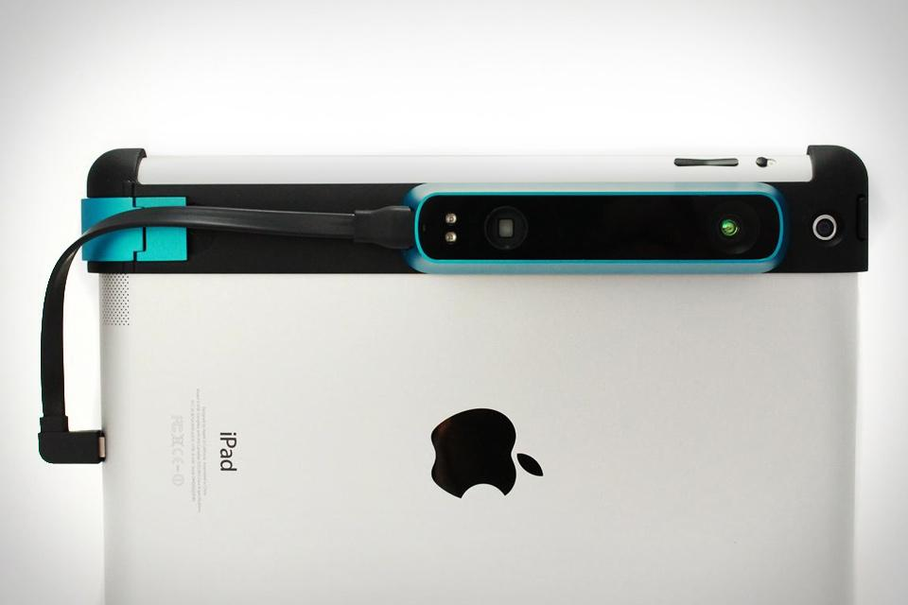
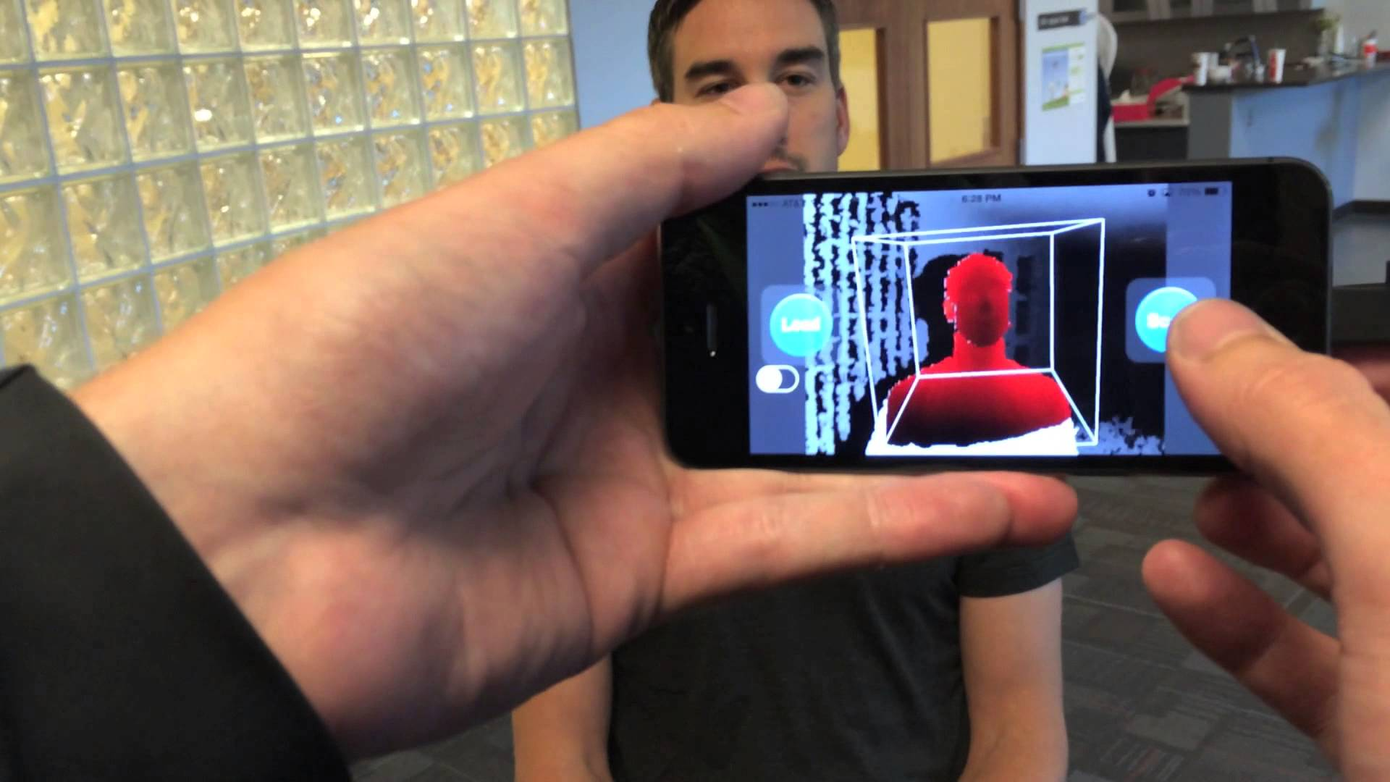
Structure Sensor
$350 iPad accessory
USB interface
Open Source code
Comes with SDK
Supported by Occipital

Slide 4
Today’s Papers
(1) Y. Sun, D. L. Page, J. K. Paik, A. Koschan, M. A. Abidi. Triangle Mesh-Based Edge Detection and Its Application to Surface Segmentation and Adaptive Surface Smoothing. Imaging, Robotics, and Intelligent Systems Laboratory. IEEE ICIP: 2002.
(2) M. Kolomenkin, I. Shimshoni, A. Tal. On Edge Detection on Surfaces. Computer Vision and Pattern Recognition. IEEE Conference: 2767-2774, 2009.
(3) V. Vidal, F. Dupont. Robust Feature Line Extraction on CAD Triangular Meshes. International Conference on Computer Graphics Theory and Applications. GRAPP: 2011.

Slide 5
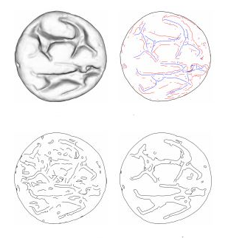
Motivation
Need to be able to accurately process the mesh model
Depth segmentation especially needs to be precise

Slide 6
Paper 1: Introduction
Proposed in 2002
Proposes an edge detection algorithm for triangle meshes
Uses edge strength to segment surfaces

Slide 7
Paper 1: Math Terminology
Eigen analysis - “Method of simplifying coordinates”
Geodesic - A curve whose tangent vectors remain parallel if they are transported along it
Normal (Tensor) Voting - A way of estimating the orientation information and curvature of a surface at a given point

Slide 8
Paper 1: The Formula
For all vertex q in the mesh:
The neighboring triangles, T_i, “cast votes”:
Where μ is the weight of the vote
and n' is the voted normal by T_i’s normal n

Slide 9
Paper 1: The Formula
The collection of tensor votes at q is:
Where M is the number of triangles inside a geodesic window of q
μ_i exponentially decreases, based on geodesic distance between p (barycenter of T_i) and q

Slide 10
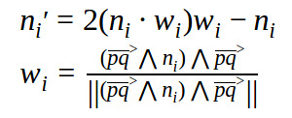
Paper 1: The Formula
And, to find n_i', the voted normal:
It is not clear what the ⋀ operator is
Pretty sure it’s just a tensor product: ⊗

Slide 11
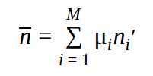
Paper 1: The Formula
Finally, to calculate edge strength:
Where v_1 ≥ v_2 ≥ v_3 are eigenvalues of T
e_1 is the eigenvector corresponding to v_1
And

Slide 12
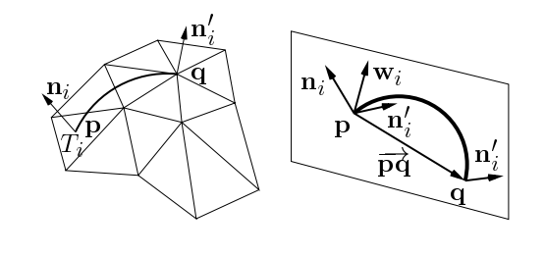
Paper 1: The Formula

Slide 13
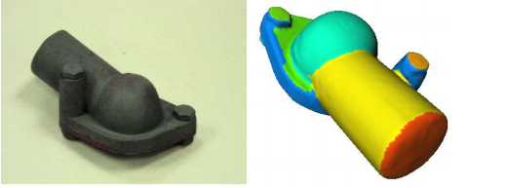
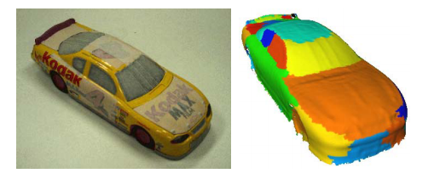
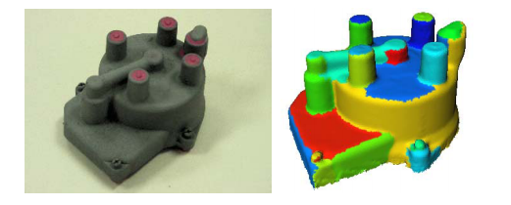
Paper 1: The Results

Slide 14
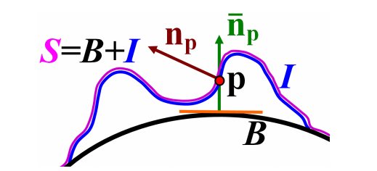
Paper 2: Brief Overview
Triangle Mesh = “smooth manifold (base)” + “local height function (relief)”
Relief edges are then just the zero crossings of the normal curvature defined by the local height function.

Slide 15
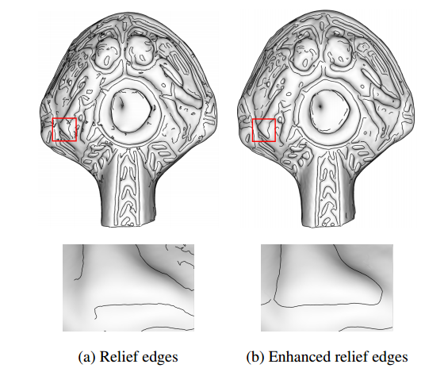
Paper 2: Results
Very complicated, though extremely accurate
“Too much” for what we need

Slide 16
Paper 3: Potential Addition
Seems like a similar idea to what is proposed in paper 1
Talks about making system more robust by machine learning
Support Vector Machines

Slide 17
Questions?

