Slide 1
Endoscope Motion Prediction with Surgeon’s Gaze Data
Goal: Predict the motion of endoscope from the surgeon’s gaze data and the endoscope image.
What Students Will Do:
Process raw gaze data
Overlap gaze data onto image
Design algorithms/train models to predict the motion of the endoscope
Validate the results
Deliverables:
Processed dataset
A model that can predict the target of the endoscope
A model that can predict the motion of the endoscope
Validation of the model
Wiki, Report, & Poster
Size group: 2 or 1 with strong knowledge
Skills: Machine Learning, Visual Servoing, ROS, Commitment
Mentors: Prof. Chien-ming Huang, Dr. Masaru Ishii, Ruiqing Yin

Slide 2
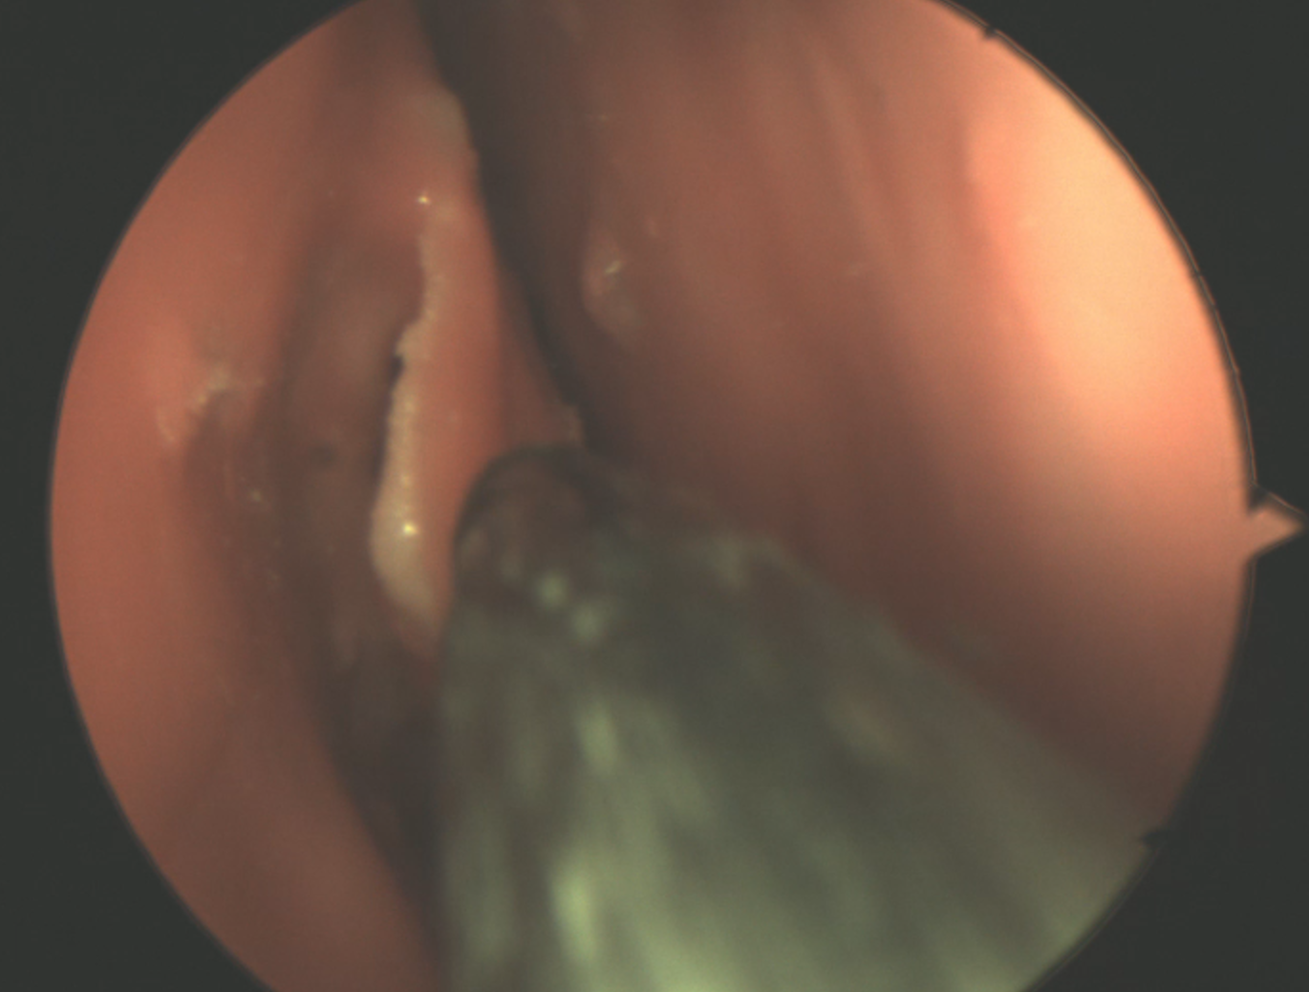
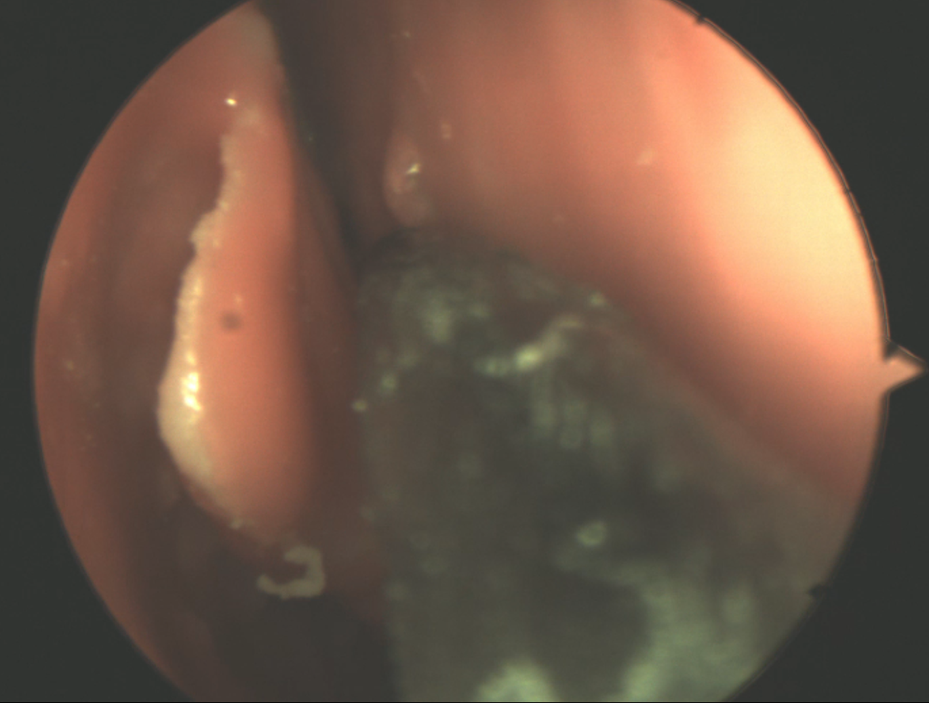
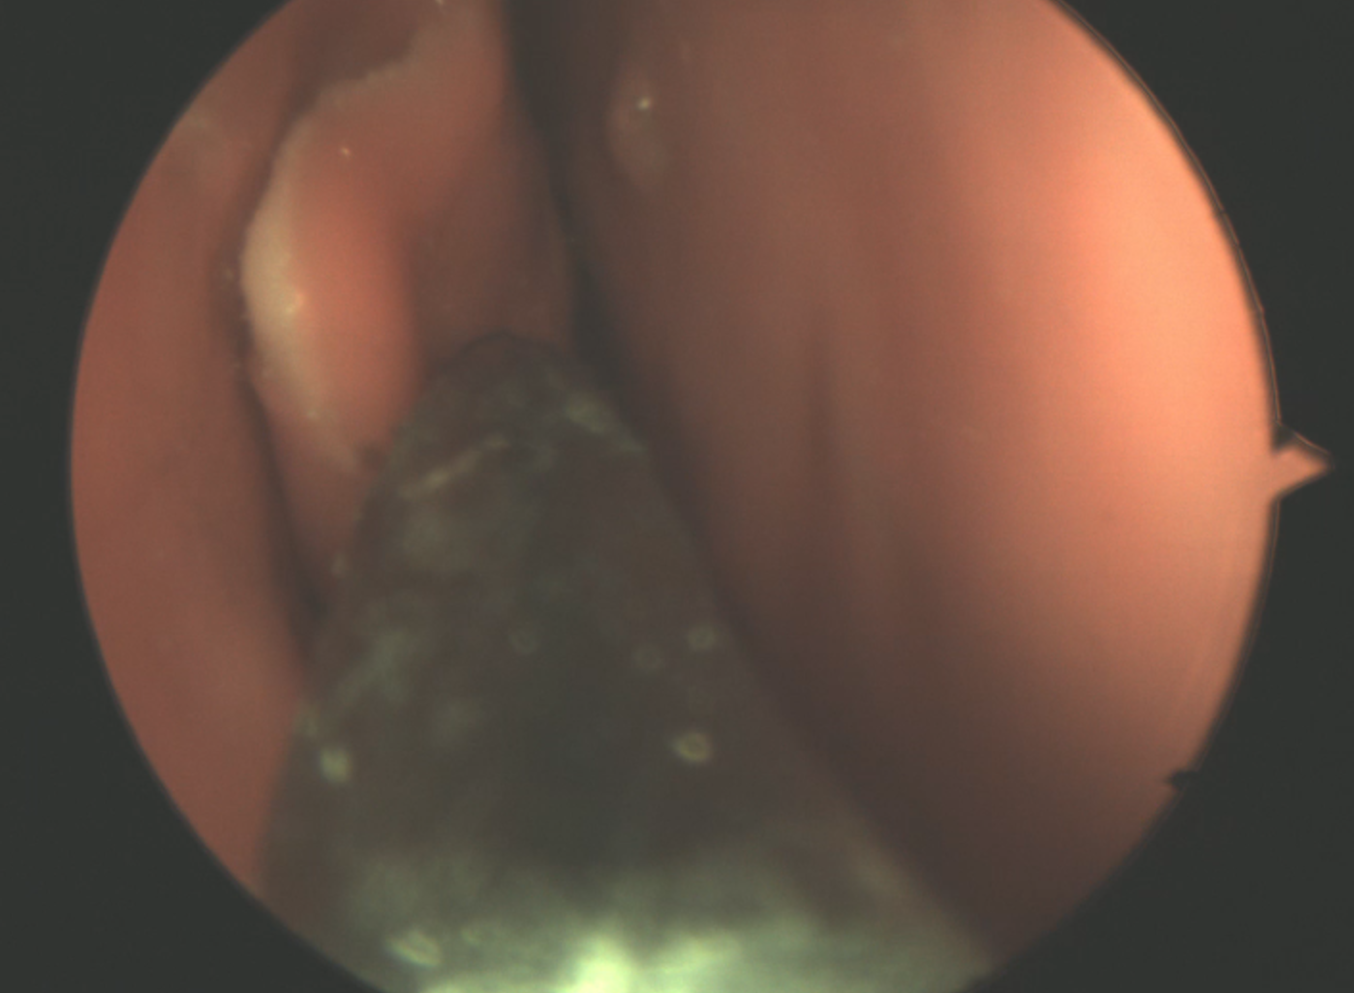
Endoscopic View

Slide 3
Gaze Tracking Data
Click here

