Slide 1
Visual Annotation of Clinically Important Anatomical Landmarks for VitreoRetinal Surgery
Vincent Ng
Xin Yuan Wang

Slide 2
Outline
Background
Relevance
Project Goals
Technical Approach
Timeline
Deliverables
Assigned Responsibilities
Dependencies
Management Plan

Slide 3
Team Members
Student:
Xin Yuan Wang
Vincent Ng
Mentors:
Prof. Russ Taylor
Rogerio Richa
Marcin Balicki
Prof. Gregory Hager (Computer Vision)

Slide 4
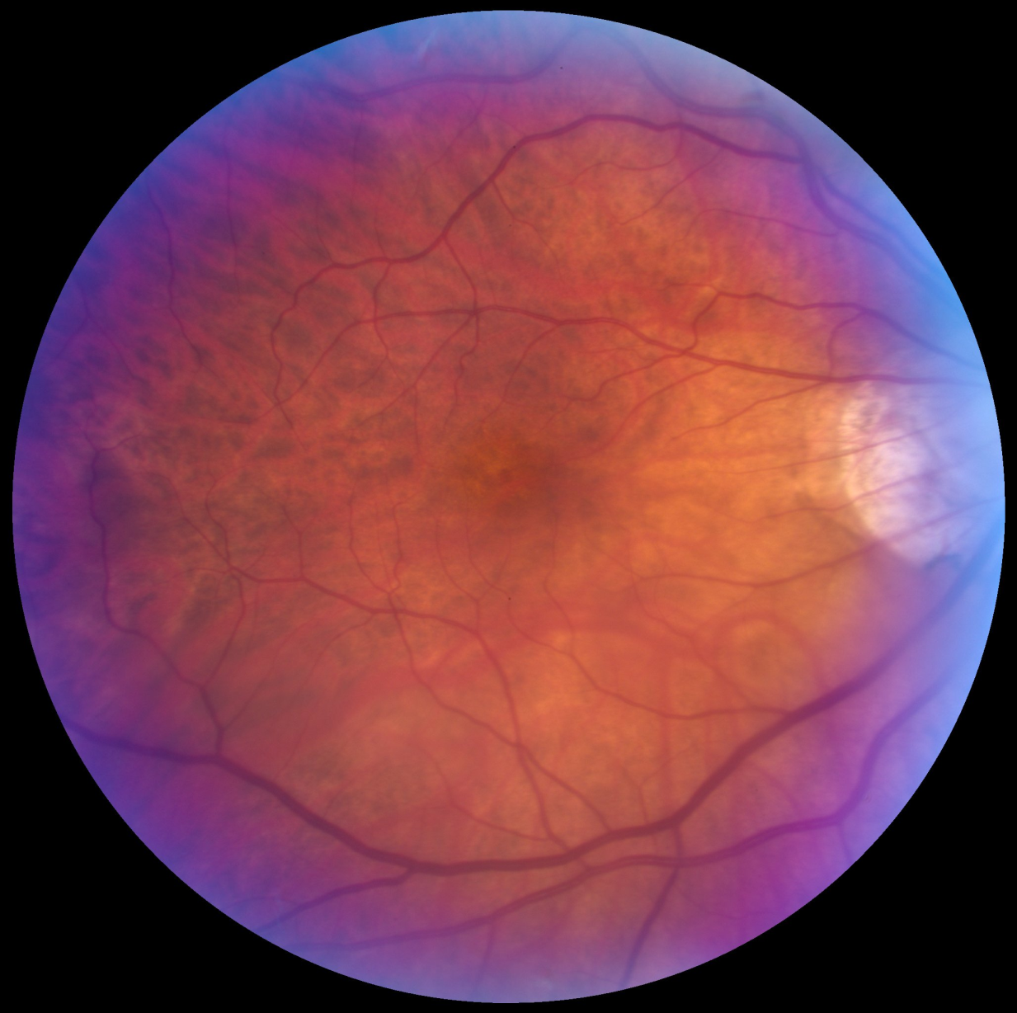
Background
Fundus
Interior surface of the eye
OCT
Surgical Tools
Macular Hole Surgery
Internal Limiting Membrane (ILM)
Images courtesy of Rogerio Richa
Notes:
Fundus – Interior surface of the eye, you can see the vessels.

Slide 5
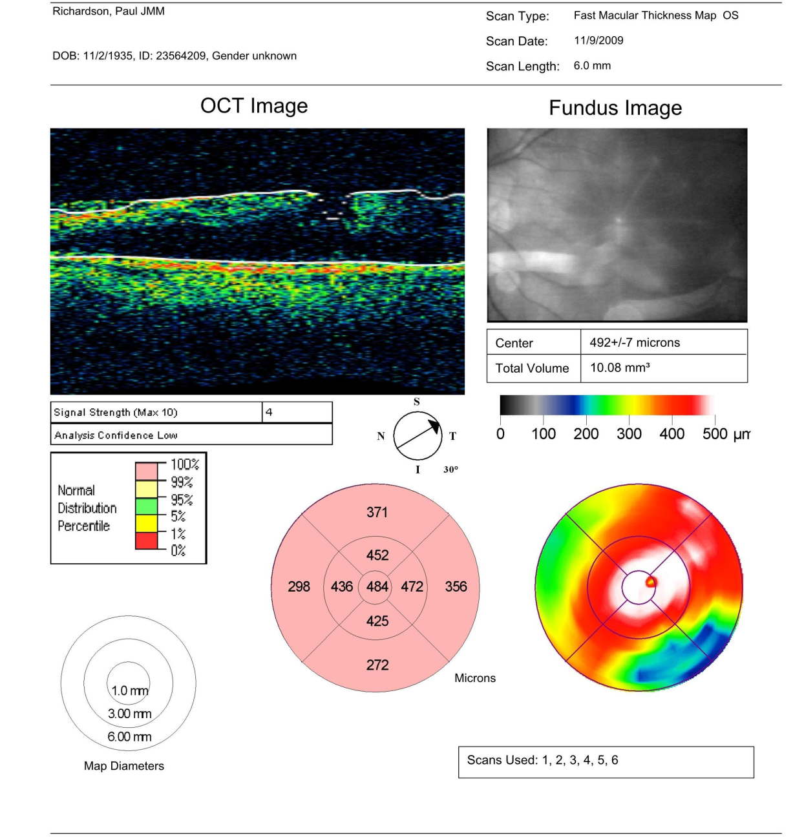
Background
Fundus
Interior surface of the eye
OCT
Surgical Tools
Macular Hole Surgery
Internal Limiting Membrane (ILM)
Images courtesy of Rogerio Richa
Notes:
OCT - An optical coherence tomography. Done when a surgeon finds certain distinct or visually interesting areas of the retina to explore, allows to see the layer of the eye. For ILM, part of the first layer is peeled off, and the OCT image allows the surgeon to pick a good spot to start.

Slide 6
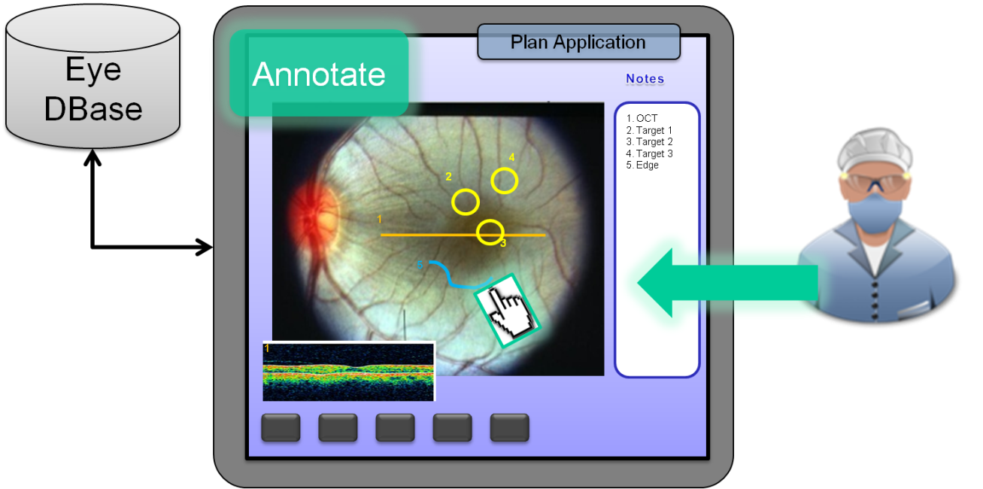
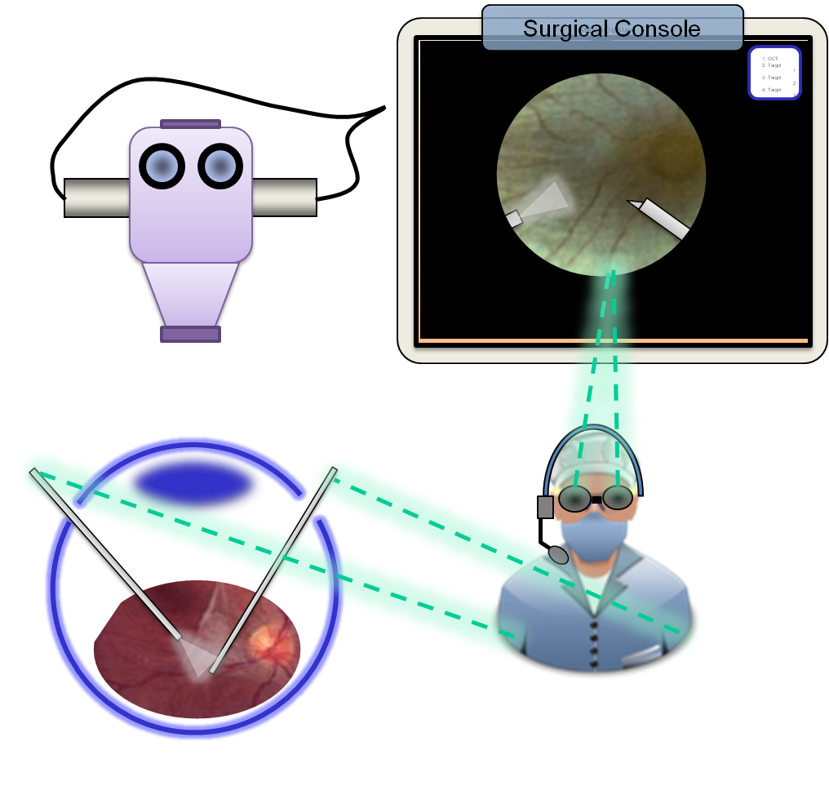
Background
Fundus
Interior surface of the eye
OCT
Surgical Tools
Macular Hole Surgery
Internal Limiting Membrane (ILM)
Images courtesy of Rogerio Richa
Notes:
OCT - An optical coherence tomography. Done when a surgeon finds certain distinct or visually interesting areas of the retina to explore, allows to see the layer of the eye. For ILM, part of the first layer is peeled off, and the OCT image allows the surgeon to pick a good spot to start.

Slide 7
Relevance
Surgeon annotates preoperative image
Problem:
Mentally track notes & locations during surgery, adding significant load to the already challenging surgical task.
3
Solution:
Annotations overlay on video
Slide taken from Rogerio Richa’s presentation
Notes:
Surgeon annotates preoperative image
Problem:
Mentally track notes & locations during surgery, adding significant load to the already challenging surgical task.

Slide 8
Project Goals
Registration
Preoperative images to intraoperative images
Overlay of landmarks on live microscopic feed
Integration
GUI for surgeons
Frameworks – CISST, OpenCV
Modern Hardware
Parallel
GPU
Multi-core

Slide 9
Technical Approach
Registration
Intra-intra feature registration
Preop-intra registration
OpenCV, SURF/SIFT
Image processing
OpenCV
Modern Computing Power
Multi-core
GPU
Notes:
Understanding frameworks
Intra-intra registration using sample video, feature-detcet the first few frames, register the rest
Identifying areas to work with

Slide 10
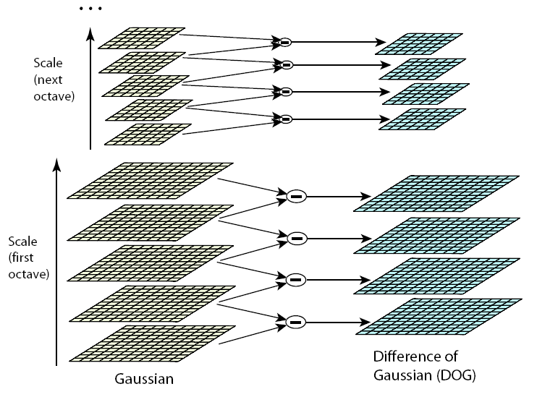
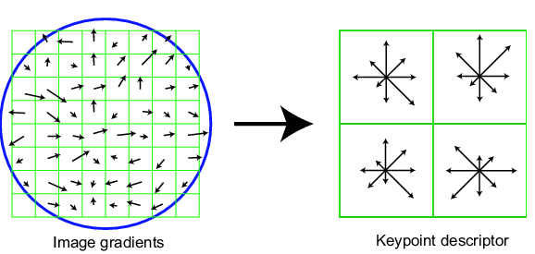
Technical Approach(SIFT)
Scale-space extrema detection
Keypoint localization
Orientation assignment
Keypoint descriptor
Courtesy of David Lowe

Slide 11
Technical Approch(SIFT)
(a) 233x189 image
(b) 832 DOG extrema
(c) 729 left after peak
value threshold
(d) 536 left after testing
ratio of principle
curvatures
Courtesy of David Lowe

Slide 12
Technical Approch(RANSAC)
RANdom SAmple Consensus
Courtesy of wiki

Slide 13
Technical Approach
Image Processing
Aperture
Light cone
Focus
Exposure issues
Interference with floaters
Tool interference
Registration
Intra-intra feature registration
Preop-intra registration
OpenCV, SURF/SIFT
Image processing
OpenCV
Modern Computing Power
Multi-core
GPU
Notes:
Understanding frameworks
Identifying areas to work with

Slide 14
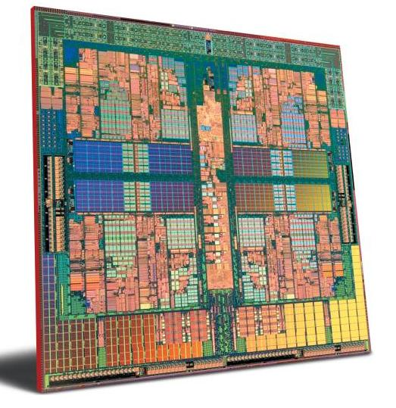
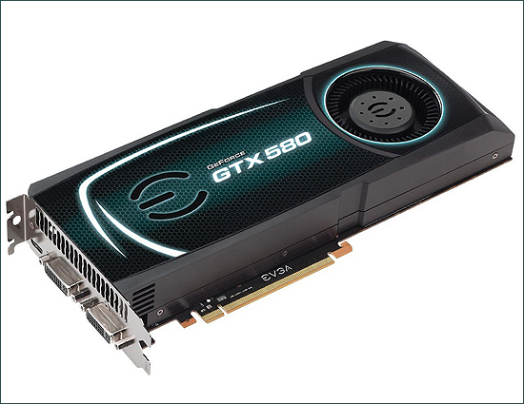
Technical Approach
Registration
Intra-intra feature registration
Preop-intra registration
OpenCV, SURF/SIFT
Image processing
OpenCV
Modern Computing Power
Multi-core
GPU
Notes:
Understanding frameworks
Identifying areas to work with

Slide 15
Deliverables
Minimum
Utilize, understand and implement SURF
Test/Validate program using manually picked annotations as ground truth
Data: Surgical and non-surgical
Expected
Multicore processor speedup
Simple GUI that marks annotation for surgeon
Initial Image processing for real surgery data
Maximum
Deploy solution into OR.
Integrate fundus/OCT data to surgeon’s screen
Real-time image processing with GPU acceleration

Slide 16
Timeline
Cycle 1
Cycle 2
Cycle 3
Task | 14-Feb | 21-Feb | 28-Feb | 7-Mar | 14-Mar | 21-Mar | 28-Mar | 4-Apr | 11-Apr | 18-Apr | 25-Apr | 2-May
Presentation and Proposal
Feature detection and Matching
Pre-op image processing
Annotation registration
GUI
Speed-up with multicore
Advanced Image Processing
Refinement Final report and Poster

Slide 17
Assigned Responsibilities
Cycle 1 (Checkpoint: Feb. 17-28)
Paired Programming
Understanding CISST, OpenCV
Shared Reading List
Cycle 2 (Checkpoint: Feb 29-March 19)
Xin: Identify areas of image processing to tackle for real images
Vincent: Plan GUI/GPU strategy
Cycle 3 (Checkpoint: March 19)
Xin: More image processing, GUI
Vincent: GPU/Parallelization
Notes:
GPU – different SURF framework
Use our different strengths and knowledge

Slide 18
Dependencies
Cycle 1: (Checkpoint:Feb. 17-28)
Fundus image of the phantom model
Cycle 2: (Checkpoint:Feb 29-March 19)
Pre-op/intra-op phantom data
Pre-op/intra-op rabbit retina data
Cycle 3: (Checkpoint: March 19)
Feedback from surgeons about our test GUIs (HIPPA training, observe an actual procedure to see what the surgeon might want from our project)
Access to actual hardware (CPU/GPU).

Slide 19
Management Plan
Weekly Meetings with Richa and Dr.Taylor on Friday
Weekly FAQ session with Richa on Monday or Wednesday
Weekly programming for 20 hrs, paper-reading and algorithm discussion for 5 hours
Weekly Documentation Update
Assess the viability of cycle 2-3 when cycle 1 is completed

Slide 20
Reading List
[1] I. Fleming S. Voros, B. Vágvölgyi, Z.A. Pezzementi, J. Handa, R.H. Taylor,G.D. Hager. "Intraoperative Visualization of Anatomical Targets in Retinal Surgery." 2008. WACV. <http://www.cs.jhu.edu/~rht/RHT%20Papers/2008/wacv2008_Fleming.pdf>.
[2] Hong Shen Stewart, C.V.; Roysam, B.; Gang Lin; Tanenbaum, H.L. "Frame-rate Spatial Referencing Based on Invariant Indexing and Alignment with Application to Online Retinal Image Registration." Mar. 2003. Web. <http://ieeexplore.ieee.org/xpl/freeabs_all.jsp?arnumber=1182101>.
[3] V. Mester, F. Kuhn. "Internal Limiting Membrane Removal in the Management of Full-Thickness Macular Holes." Macular Surgery. June 1999. Web. 14 Feb. 2011. <http://www.ncbi.nlm.nih.gov/pubmed/10926987>.
[4] Johannes P.W. Grimm, Clemens Wagner and Reinhard Männer. "Interactive RealTime Simulation of ILM." 2004. Web. <http://www.springerlink.com/content/64grw7h72r7l6t75/>.
[5] Paul M. Novotny, Jeff A. Stoll, Nikolay V. Vasilyev, Pedro J. Del Nido, Pierre E. Dupont, Todd E. Zickler, Robert D. Howe. "GPU Based Real-time Instrument Tracking with Three-dimensional Ultrasound." July 2007. Web. <http://www.cs.jhu.edu/~rht/RHT%20Papers/2010/SPIE%20Ophtalmology%202010%20-%20Liu.pdf>.
[6] Herbert Bay , Andreas Ess , Tinne Tuytelaars, and Luc Van Gool. "Speeded-Up Robust Features(SURF)." 2008. Web. <http://www.vision.ee.ethz.ch/~surf/papers.html>.

Slide 21
Questions?
Thank you

