Slide 1
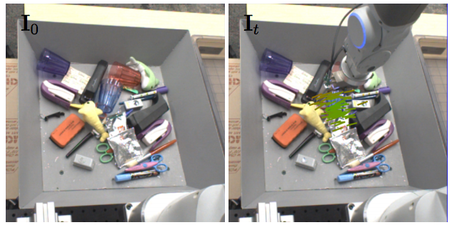
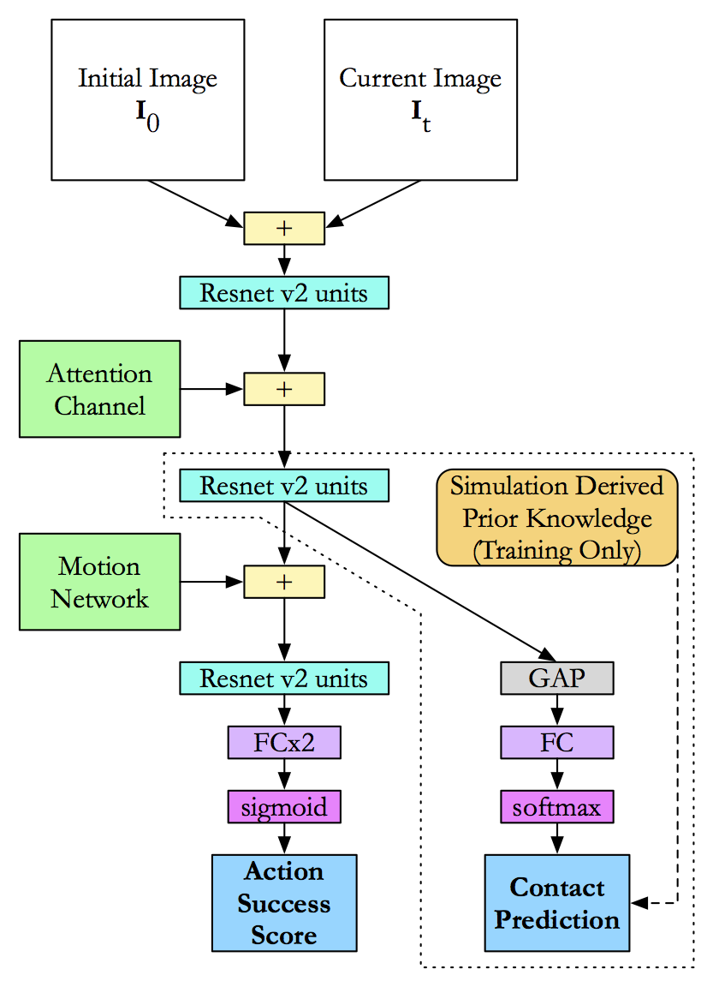
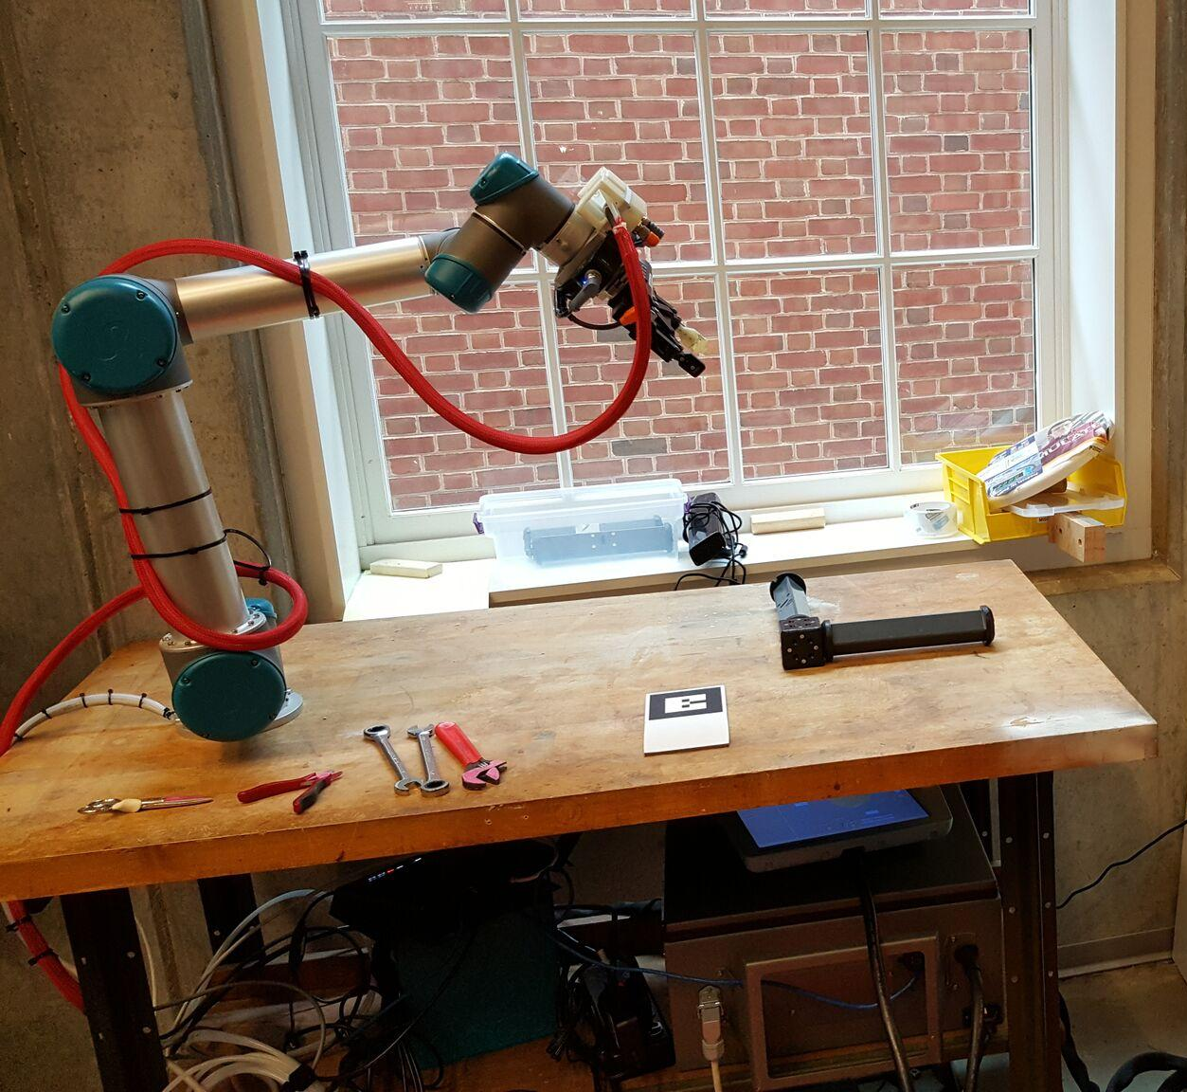
Deep Learning Robotic Tasks
Use the latest Deep Learning techniques to guide a robot towards grasping objects a large grasping dataset,
technology which could eventually be used for a robotic surgical or recovery room assistant.
Students Will
Use the latest machine learning techniques to develop control software which predicts successful object grasps,
and demonstrate the accuracy of your motion predictor on a large robotic grasping dataset.
Deliverables
Code and a report of test results.
Skills Required
Basics of Development, Robot Kinematics, Systems Programming, and Machine Learning
Opportunity to Learn
TensorFlow, Keras, and Deep Reinforcement Learning
Group Size: 1-3
Student Mentor: Andrew Hundt ahundt@jhu.edu
Faculty Mentor: Greg Hager hager@cs.jhu.edu
Reference Paper: https://arxiv.org/pdf/1603.02199v4.pdf

