Slide 1
The Galen Platform
Technology:
Custom 5-DOF architecture
“Steady Hand” cooperative control
Hand tremor cancellation
Virtual fixtures
Ease of Use:
Same footprint as a person
Accommodates standard instruments
Minimal change to existing surgical workflow
Broad Applications:
ENT, spine, brain, trauma, ….

Slide 2
Guided Bone Cutting for Robot-Assisted Neurosurgery
Implement robotically-assisted craniotomy on a phantom
Note synergy with Augmented Reality craniotomy project
What Students Will Do:
Implement method to define boundary contour and tolerance band
Implement hand-over-hand guided motion along three conditions of constrained motion to simulate cutting of a craniotomy
Deliverables: (All deliverables shown as demonstrations)
Minimum:
Follow the boundary of a convex contour defined in a plane perpendicular to the robot +Z axis within a band of 5mm.
Allow instrument motion only along plane.
Expected:
Follow the boundary of a convex contour defined on an arbitrarily defined plane within a band of 5mm.
Allow instrument motion only along the path and perpendicular to the plane.
Maximum:
Follow the boundary of a convex contour defined on an arbitrarily defined surface within a band of 5mm.
Allow instrument motion only along the path and normal to the point on the path.
Size group: Two
Skills: Algorithms, Kinematics, ROS (preferred), C++
Mentors: Dr. Taylor; Max Li zli122@jhu.edu; Contacts: Florin Neacsu (Galen Robotics); Clinical Contact: Wataru Ishida, M.D. wishida1@jhmi.edu

Slide 3
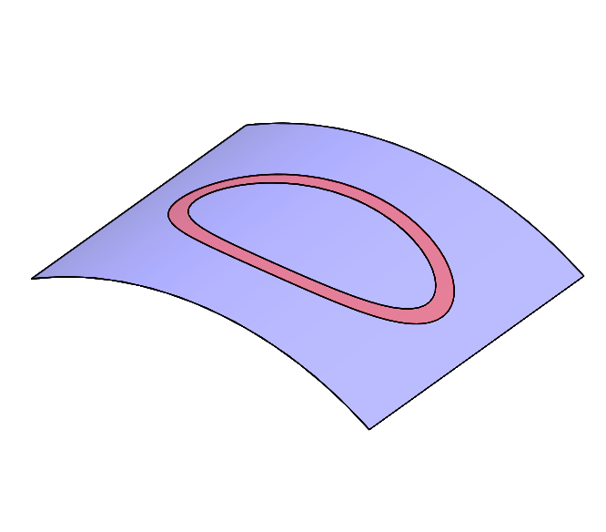
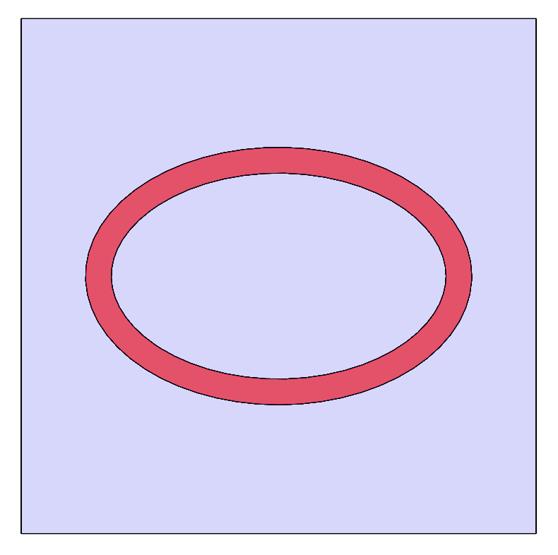
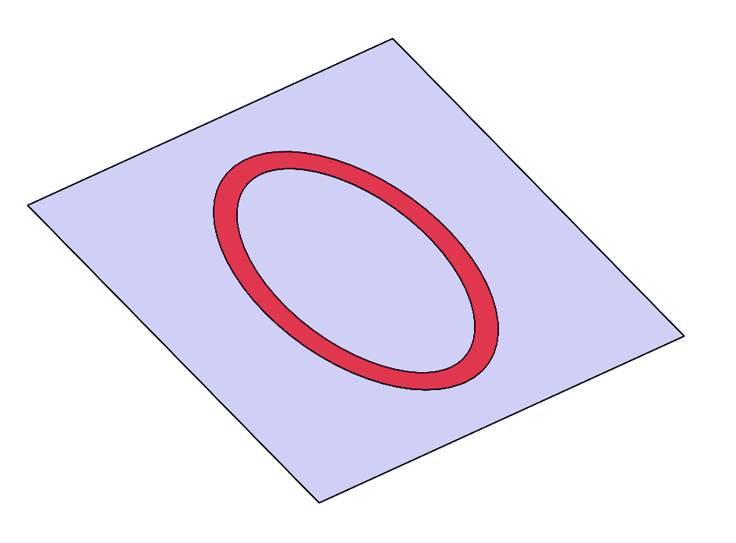
Guided Bone Cutting for Robot-Assisted Neurosurgery
Visualization of Minimum Deliverable
Visualization of Expected Deliverable
Visualization of Maximum Deliverable
Visualization of Plane Hold
Visualization of 5mm deep limit from plane
Visualization of 5mm deep limit from surface

Slide 4
Virtual Fixtures for Mastoidectomy
Engineer with no surgical training
5 identical phantoms
3 plane virtual fixture
Mean time to completion: 221 +/- 35 seconds
Antrum successfully entered with preservation of critical structures in 5/5 (100%) of cases
Conclusion: Virtual fixtures can be implemented to allow a novice surgeon to successfully perform REMS-assisted mastoidectomy with preservation of vital structures.
Francis X. Creighton, Christopher R. Razavi, Paul R. Wilkening, Rui Yin, Nicholas Lamaison, Russell H. Taylor, John P. Carey, “Image-Guided Mastoidectomy with the Robotic ENT Microsurgery System (REMS)”, AAO Conference, October 7, 2018.

