Slide 1
Paper Review: Sparse Hidden Markov Models for Surgical Gesture Classification and Skill Evaluation
Lingling Tao, Ehsan Elhamifar, Sanjeev Khudanpur, Gregory D. Hager, René Vidal
Michael Norris - Group 3

Slide 2
Project Overview
Developing system that predicts surgical scissor line of cut
Provide visual feedback for surgeon
Visualize the line of cut of surgical scissors for septoplasty

Slide 3
Paper Introduction
Sparse Hidden Markov Models for Surgical Gesture Classification and Skill Evaluation
Surgical gesture classification using sparse dictionary learning and hidden Markov models

Slide 4
Paper Introduction
Definition: A surgeme is a surgical gesture.
Example:
Surgemes in a suturing task:
Insert a needle
Grab a needle
Position a needle

Slide 5
Paper Introduction
Break surgical task into series of surgemes
Surgeme is smallest unbreakable piece of surgery
Understanding surgical gestures like Speech Recognition:
Surgery:
Speech:
Surgeme
Maneuver
Procedure
Phoneme
Sentence
Article

Slide 6
Paper Introduction
Definition: A motif is made up of one or more surgemes
Motifs are constrained to certain patterns of gestures, just as words are constrained to certain patterns of phonemes by the grammar of a language.
Motifs constrain the grammar of surgemes

Slide 7
Paper Introduction
Motif
Surgeme
Maneuver
Procedure
Grammar
Phoneme
Sentence
Article

Slide 8
Paper Introduction
Problem: In surgery, we don’t know the maneuvers or motifs

Slide 9
Markov Process
A Markov Process:
Is a Stochastic Process
The change of a Markov Process is modeled by random variables
Has the Markov Property
Memoryless
Predictions of the future state can be made without knowledge of the past

Slide 10
Hidden Markov Model
Surgery frames:
Surgeme labels:
Gesture classification assigns a label to each frame

Slide 11
Hidden Markov Models
We observe y, but not s.
Notes:
There’s some transition matrix that approximates the transition probabilities between s_t’s

Slide 12
Hidden Markov Models
In standard Hidden Markov Models,is Gaussian [pg. 3]
Parameters can be learned with the Baum Welch algorithm
In a Sparse HMM, is a sparse linear combination of elements from a dictionary of “motion words” [pg. 3]
We can solve for the most likely states of the HMM using the Viterbi algorithm (states are gestures)

Slide 13
Sparse Dictionary Learning
We want to find a sparse representation of surgical gestures, that are a linear combination of basis elements
Basis elements comprise the dictionary
This paper overfits the dictionary → basis elements are not orthogonal
We don’t know what the gestures look like beforehand in terms of basis elements, so we need to make a dictionary

Slide 14
Sparse Hidden Markov Model
Observation at time t:
D is an over-complete dictionary (D < N)
is a sparse latent variable (only a few non-zero entries)
is independent Gaussian noise
[pg 4.]

Slide 15
Sparse Hidden Markov Model
The distribution of given the latent variable is:
To make x a sparse latent variable, use Laplacian prior on the distribution for x
[pg. 4]

Slide 16
Sparse Hidden Markov Model
Given N trials and surgeme labels
we want to learn the Sparse Hidden Markov Model.
Need to learn transition probabilities
and the parameters for each surgeme model

Slide 17
Sparse Hidden Markov Model
Use KSVD for parameter learning
Also updates and , latent variable and dictionary
The paper calls its algorithm KSVD-HMM

Slide 18
Surgeme Classification with Sparse HMM
Given the trial and parameters
want to predict a sequence of surgeme labels:
[pg. 6]

Slide 19
Surgeme Classification with Sparse HMM
Since p(y_{t} |s_{t}) has a Laplacian distribution, we cannot run the Viterbi algorithm (canonical way to solve for HMM parameters)
Paper suggests using Orthogonal Matching Pursuit to find
That maximizes
[pg. 6]

Slide 20
Experimental Results
Setup:
8 surgeons of 3 different skill levels
Perform 3-5 trials of each task
Setup 1
Leave one trial from each user out for testing
Setup 2
Leave one user out for testing

Slide 21
Experimental Results
Tasks
Suturing - 39 trials
Needle Passing - 26 trials
Knot Tying - 36 trials
[pg. 7]

Slide 22
Experimental Results
Dataset: 78 variables of motion from Da Vinci
Ground truth is manually labeled sequence of surgemes

Slide 23
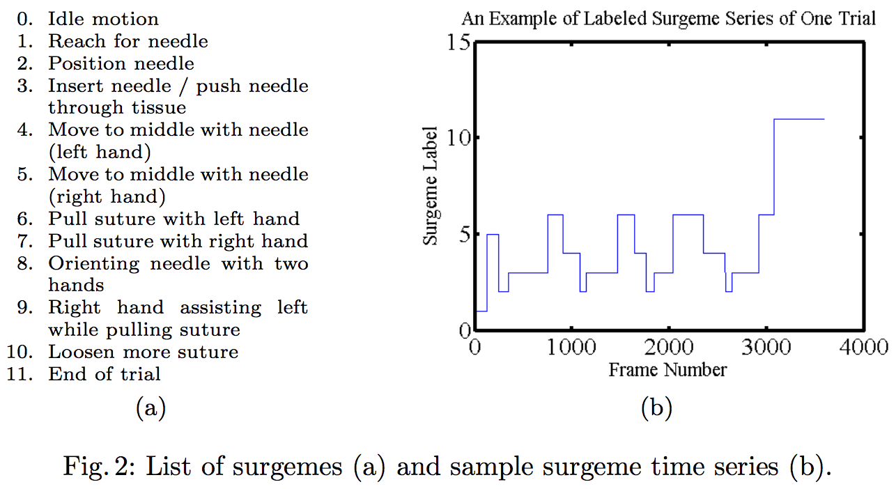

Slide 24
Experimental Results
MFA-HMM -- Mixture of Factor Analyzed HMM
KSVD-HMM -- the algorithm in this paper
FA-HMM -- Factor Analyzer HMM
SLDS -- Switched Linear Dynamical Systems

Slide 25
Experimental Results
Surgeme classification results of KSVD-HMM as a function of the sparsity level K. [pg. 8]

Slide 26
Experimental Results
Surgeme classification rates of MFA-HMM as a function of the number of subspaces M and the subspace dimension d. [pg. 8]

Slide 27
Final Thoughts
Pros
Decent results
Interesting algorithm
Similar to other methods
Cons
Some notational stuff D_{s} vs D_{s_t}

Slide 28
Final Thoughts
Application to My Project
Gesture recognition provides richer features to developers
Can animate scissors opening / closing
Can provide contextual information in visualization based on current gesture

Slide 29
Citations
Sparse Hidden Markov Models for Surgical Gesture Classification and Skill Evaluation. Lingling Tao, Ehsan Elhamifar, Sanjeev Khudanpur, Gregory D. Hager, René Vidal
Aharon, M., Elad, M., Bruckstein, A.M.: K-SVD: An algorithm for designing overcomplete dictionaries for sparse representation. IEEE Trans. on Signal Processing 54(11) (2006) 4311–4322
Hidden Markov Models. Ben Langmead. http://www.cs.jhu.edu/~langmea/resources/lecture_notes/hidden_markov_models.pdf

Slide 30
Questions?

Slide 31
Hidden Markov Models
[pg. 3]

