Slide 1
X-ray Image Based Navigation for Hip Osteotomy Experiment with a cadaver specimen to evaluate (1) feasibility of BB implantation and (2) visibility on X-ray images
Team Members: Michael Van Maele & Jesse Hamilton
Mentors: Dr. Mehran Armand, Dr. Yoshito Otake, & Ryan Murphy
Date: April 10, 2012
Location: International Center for Orthopaedic Advancement, Bayview Campus, Johns Hopkins University

Slide 2
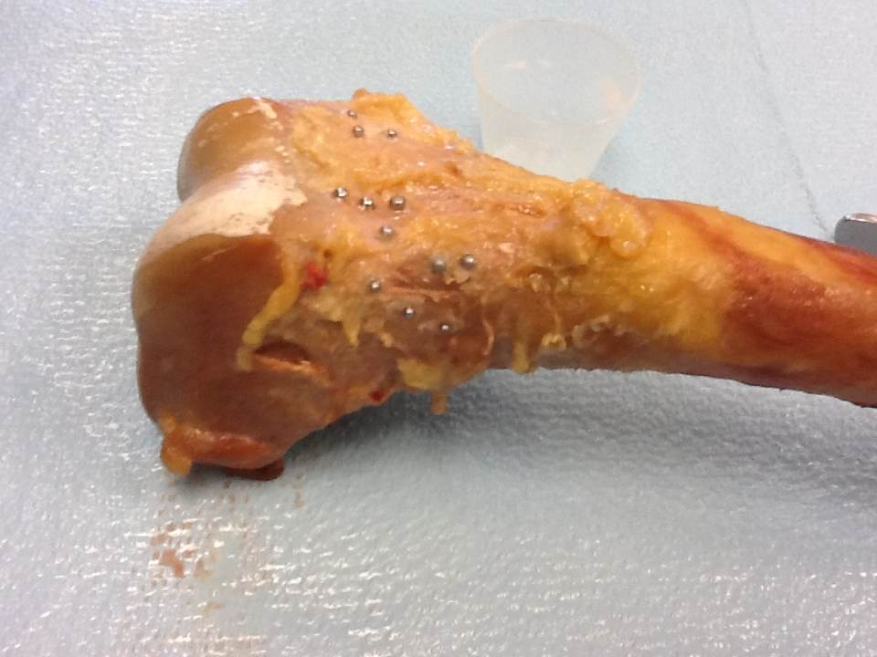
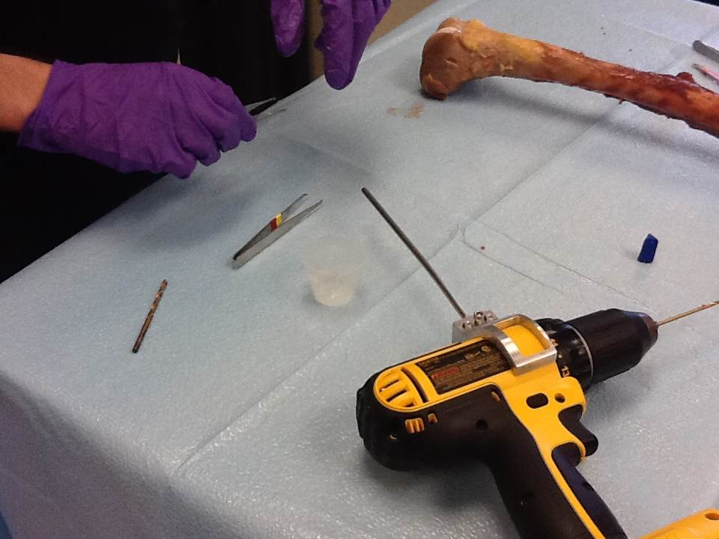
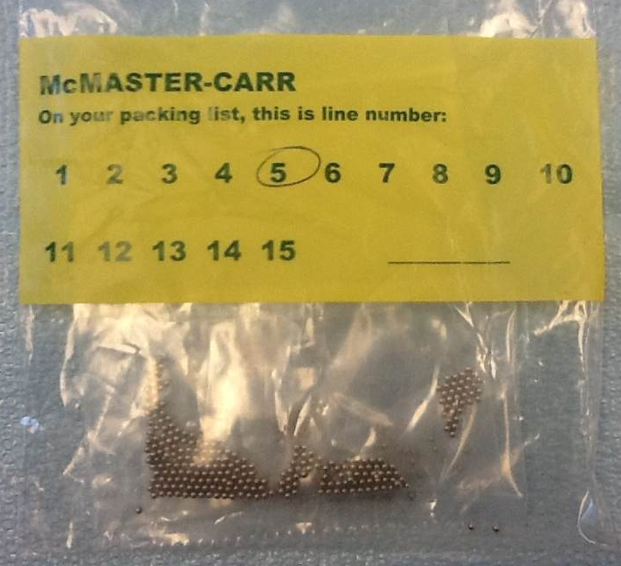
Summary
Date: April 10, 2012
Time: 11:30AM – 1:30 PM
Place: International Center for Orthopaedic Advancement, Bayview Medical Center, Alpha Center
Materials/Devices
Cadaver specimen (extracted femur)
C-arm (make/model: ***?)
Beads (McMaster-Carr, stainless steel)
Super glue (Loctite Ultra Gel Control)
Drill with small diameter bit
Forceps, scissors, scalpel
Femur with different size BBs attached with super glue

Slide 3
Methods
Cleared overlying tissue using scissors and scalpel to expose bone
Drilled three very shallow burrs in distal end of femur (closely spaced, ~1-2 cm apart)
Applied super glue to burrs
Placed BB in each burr using forceps
Generously applied super glue over the BBs
Repeated steps 1-5 for four different size BBs, using three BBs of each size.
Let glue dry for at least 10 minutes.
Acquired two C-arm images at different view angles.
Attempted to dislodge BBs from bone by
Hitting bone against hand
Striking bone with mallet
Picking BBs off with forceps
Evaluated images for
BB visibility (image contrast between BBs and surrounding bone/tissue)
Ability to distinguish between BB sizes

Slide 4
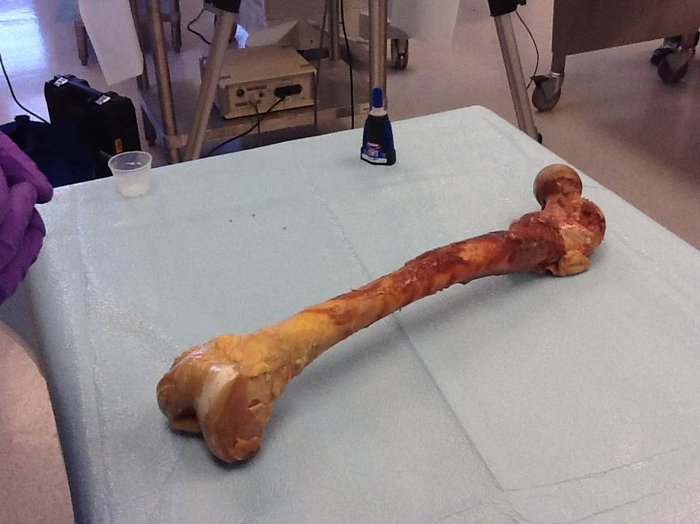
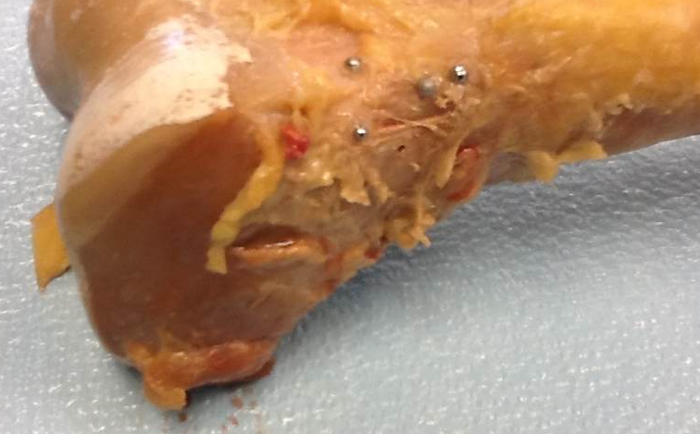
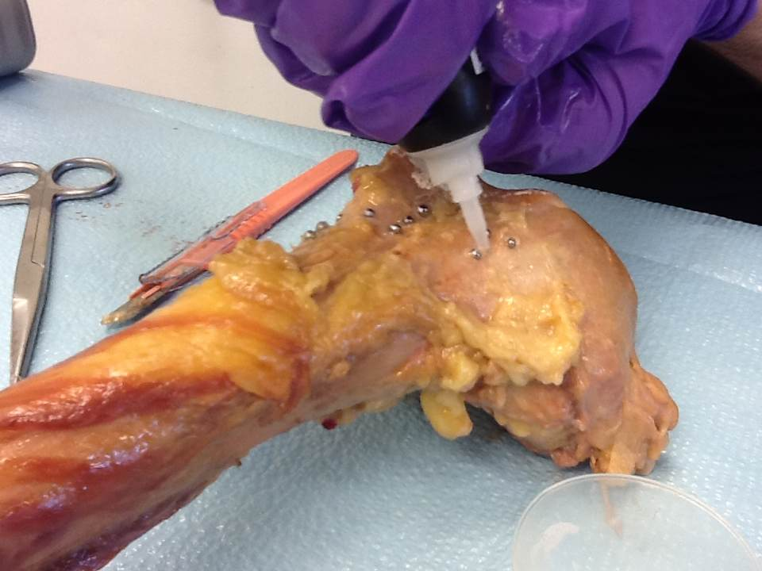
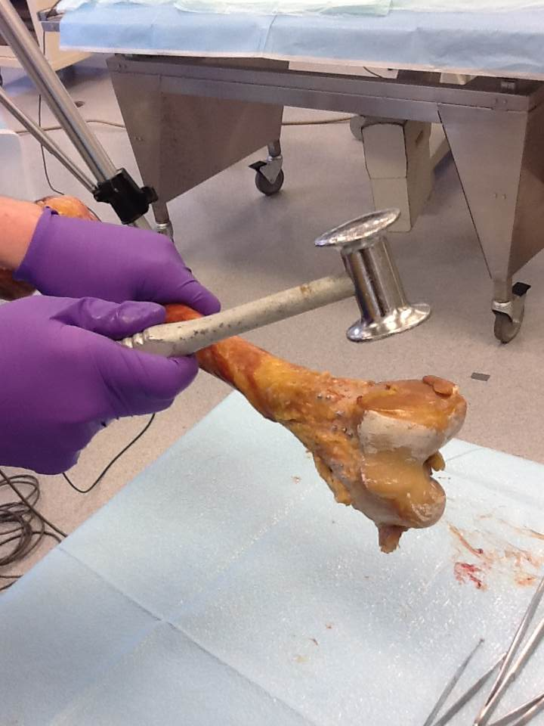
Methods
After step 1
Step 2
burr
Distal end of femur
Step 8b
Step 5

Slide 5
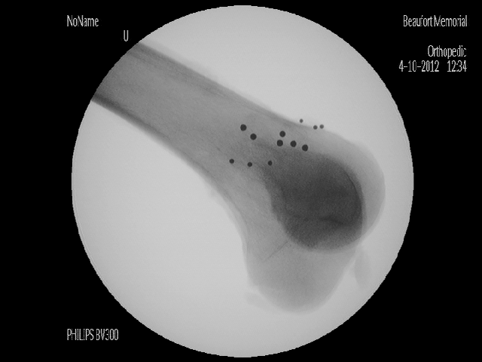
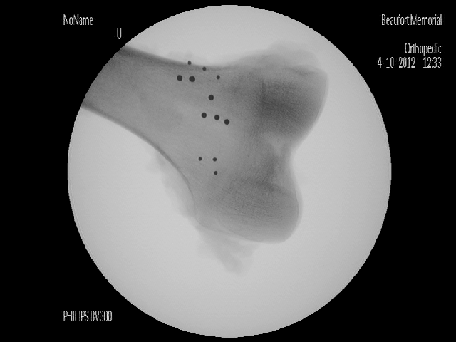
Results
What was the C-arm setup? What were the x-ray settings?
C-arm setup
X-ray shot #1
X-ray setting: **kVp, **mA
~**cm (approximate distance)
femur
table
X-ray shot #2
X-ray setting: **kVp, **mA
~**cm

Slide 6
Results (Zoom In)
1
2
4
3
5
6
7
8
9
12
10
11
11
10
9
8
7
12
6
4
5
BB ID | Size No. | Diameter (mm)
1, 2, 3 | 3 | ?? (largest)
4, 5, 6 | 5 | ?? (2nd largest)
7, 8, 9 | 6 | ?? (2nd smallest)
10, 11, 12 | 8 | ?? (smallest)
3
2
1

Slide 7
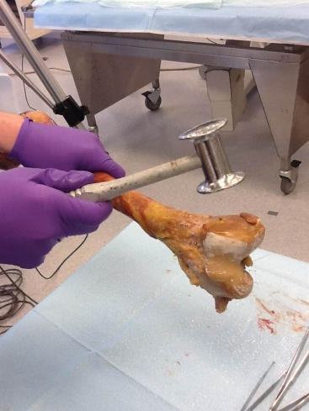
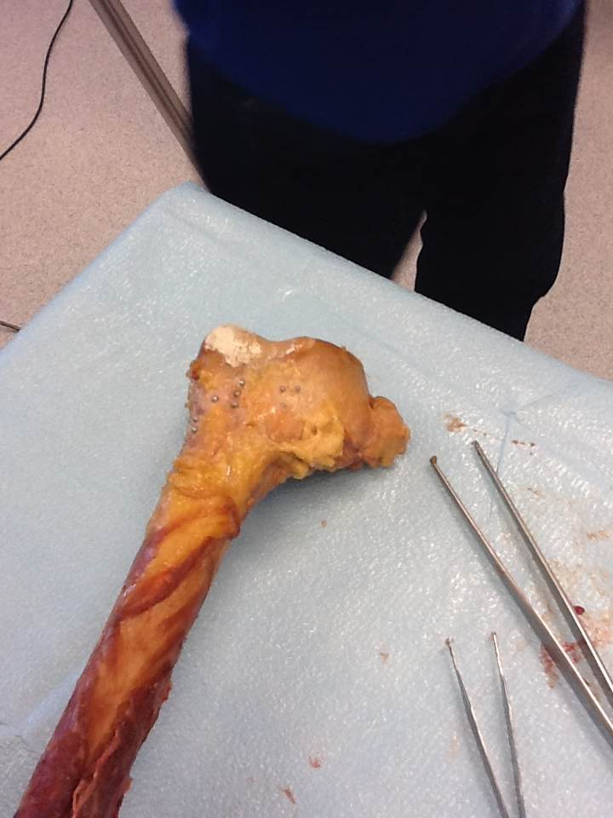
Discussion – BB Fixation
No BBs dislodged after hitting bone against hand and striking bone with mallet
Similar to mock surgical conditions
Could pick off BBs with forceps
Not similar to mock surgical conditions
Conclusion: We predict that our method should hold BBs in place during a cadaver surgery.

Slide 8
Discussion – Image Analysis
BBs visible on x-ray. Good image contrast versus background tissue.
Radial symmetry algorithm could automatically distinguish between large and small BBs.
Conclusion: Should be possible to use different size BBs as confidence and fragment points.
 | Large BBs | Small BBs
Min radius | 6 | 1
Max radius | 10 | 2
Factor | 0.5 | 0.35
ROI Radius | 200 | 200
Controls detection sensitivity (higher value ➔ fewer BBs detected)

