Slide 1
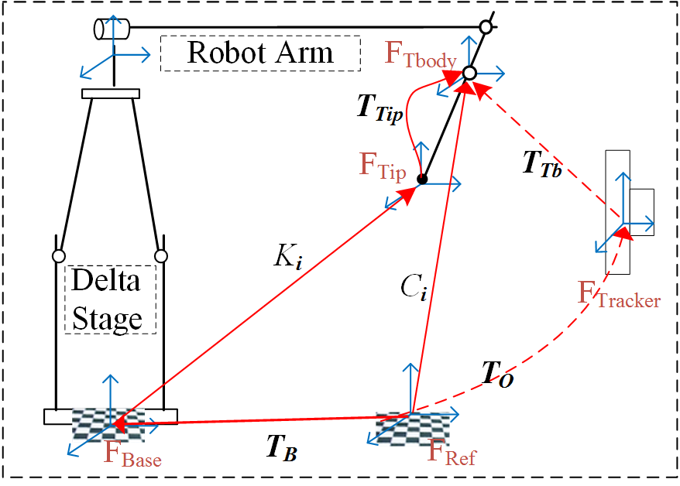
Kinematic Calibration and Improved Accuracy for Galen Robot
Goal: Perform kinematic calibration of Galen surgical robot and integrate results into software to improve its accuracy
Background:
Robot is very precise, but manufacturing tolerances reduce accuracy.
Prior work [1] successfully improved accuracy of REMS robot (predecessor to Galen)
Significance: Enable integration with surgical navigation & accurate virtual fixtures
What students will do:
Place optical markers on robot end effector and base of robot
Move robot to multiple poses and record marker positions using optical tracking system
Apply methods from CIS I and previous paper on REMS calibration
(time permitting) incorporate results into Galen Research Software; Demonstrate improvement on virtual fixture

Slide 2
Kinematic Calibration and Improved Accuracy for Galen Robot
Deliverables:
Minimum: XYZ calibration; Accuracy assessment
Expected: XYZ+wrist calibration; Accuracy assessment
Maximum:
Integration of calibration results into research software.
Possible demonstration on virtual fixtures or similar task
Size group: 1-2
Skills: (short description or key phrases)
Mentors: Prof. Taylor; Max Li; Consultation: Florin Neacsu (Galen Robotics); David Levi (Galen Robotics)
[1] L. Feng, P. Wilkening, Y. Sevimli, M. Balicki, K. C. Olds, and Russell H. Taylor, "Accuracy Assessment and Kinematic Calibration of the Robotic Endoscopic Microsurgical System", in IEEE Engineering in Medicine and Biology Conference (EMBC), Orlando, Aug. 16-20, 2016. pp. 5091-5094.

