Slide 1
Prototype of a Microsurgical Tool Tracker
Team 5
Students: Sue Kulason, Yejin Kim
Mentors: Marcin Balicki, Balazs Vagvolgyi, Russell Taylor
600.466 Advanced Computer-Integrated Surgery
Notes:
Hello I’m ____ and this is my partner _______
Our mentors are Marcin, Balazs, and Dr. Taylor.
We’re team 5, working on a prototype of a microsurgical tool tracker for eye surgery.

Slide 2
Outline
Progress & Revisions
Tracking Design
Mechanical Design
Dependencies
Project Summary
Milestones
Deliverables
Notes:
MileStone: Timeline+Gannt chart
Update on our project
-refresh you with our project summary
-talk about project goals (specifically the deliverables, aims and significance)
-then move into our progress and revisions
-dependencies
-milestones
-key papers we’ve read

Slide 3
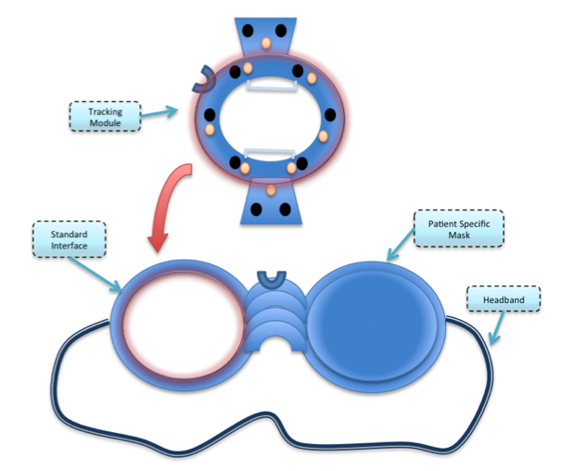
Project Summary
Problem: A need for tool tracker in eye surgery
Assess surgical performance
Ensure proper protocol
Project Goal: Micro-Surgical Tool Tracker
Build a prototype of a goggle
Provide positional feedback
Figure 1. Idea proposed by Marcin Balicki
Progress: TD
Dependencies
Milestones
Deliverables
Project Summary
Progress: MD
Notes:
As you may remember, there is a need for a microsurgical tool tracker in eye surgery in order to
-assess surgical performance
-ensure proper protocol
There is a high number of incorrect procedures (1.8 in every 1000) due to a lack of a tool tracker specialized for micro-surgical needs.
Tool tracking has the potential to improve accuracy, precision, and efficiency of surgery.
The goal of this project is to build a prototype of this tool tracker that provides positional feedback.
On the right is a figure of the prototype concept provided by one of our mentors.
This project is meant to be a proof of concept for the advantages of such a micro-surgical tool tracker.

Slide 4
Deliverables
Minimum (3/18) | Expected (4/26) | Maximum (5/13)
CAD design of prototype | A scaled prototype | Life-size prototype
Design of phantom | A scaled phantom | Life-size phantom
Specifications of equipment | Offline multi-camera calibration | Evaluation of tracking accuracy
Calibration scheme | Offline segmentation/tracking algorithms | Real-time tracking
Segmentation/tracking scheme
Progress: TD
Dependencies
Milestones
Deliverables
Progress: MD
Project Summary
Notes:
Here is a list of our deliverables.

Slide 5
Deliverables
Minimum (3/18) (4/18) | Expected (4/26) (5/3) | Maximum (5/13)
CAD design of prototype ✔ | A scaled prototype ✔ | Life-size prototype
Design of phantom ✔ | A scaled phantom ✖ | Life-size phantom
Specifications of equipment ✔ | Offline multi-camera calibration ✔ | Evaluation of tracking accuracy
Calibration scheme ✔ | Offline detection/tracking algorithms | Real-time tracking
Detection/tracking scheme ✔
✖
✔
Progress: TD
Dependencies
Milestones
Deliverables
Progress: MD
Project Summary
Notes:
So far, we have successfully designed the phantom, made equipment specifications, and designed the calibration, detection, and tracking scheme.
We originally expected to be done with the minimum expectations before spring break.
Due to a change in planning – that the mock up should be made before CADing the final prototype – the CAD design is not done.
Also, due to the camera constraints
-field of view
-focal length
-cost
we have purchased a camera that can see 40mm at a 6mm distance. As such, we will not be able to make a life-size device. The prototype will be scaled 1.5 times.

Slide 6
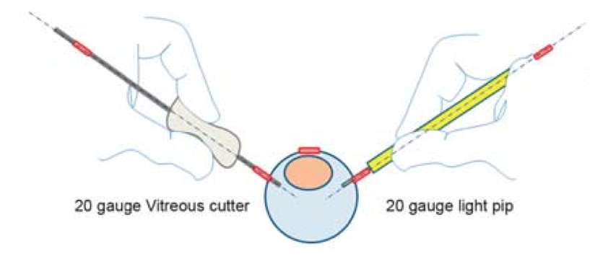
Progress:
Mechanical Design
Idea proposed
by Marcin Balicki
Plan from previous checkpoint:
Create a mock up
Determine optimized life-size design
Build CAD design scaled 1.5x
Revision in prototype design goal:
Design to avoid surgeon’s motion
Design to cover entire eye environment
Scaled up to complement field of view
of the camera
Goggled shape is not necessarily implemented
Figure from Hubschman et al
Progress: TD
Dependencies
Milestones
Deliverables
Progress: MD
Project Summary
Notes:
Camera resolution: : 640x480 pixels; 30mm by 40mm; 12 pixels in mm^2

Slide 7
Mechanical Design
Previous computer-aided-design:
Reference Camera
Patient’s Body
R=60mm
45º
Surgeon
1.5x sized eyeball
(diameter 38.1mm)
Progress: TD
Dependencies
Milestones
Progress: MD
Project Summary
Deliverables
Notes:
Prototype Building
Milestones achieved

Slide 8
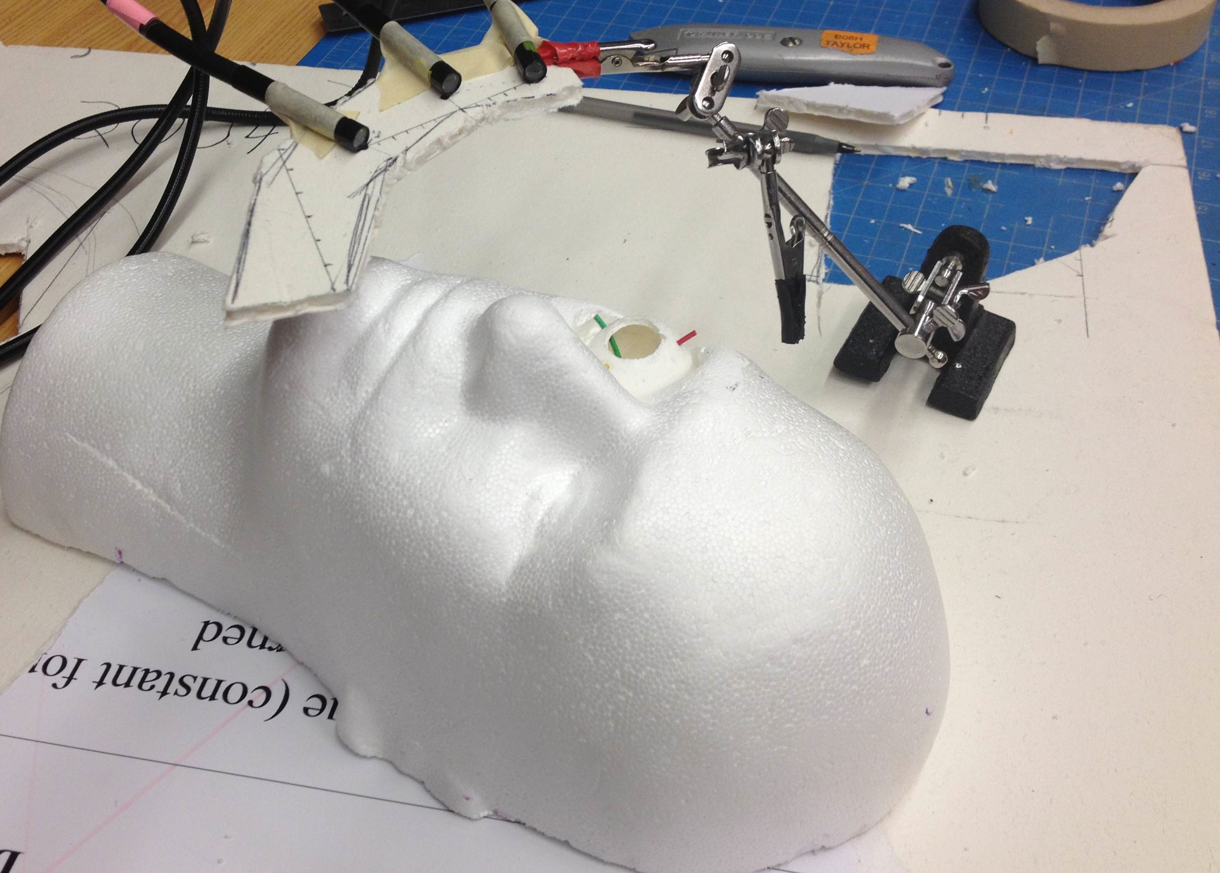
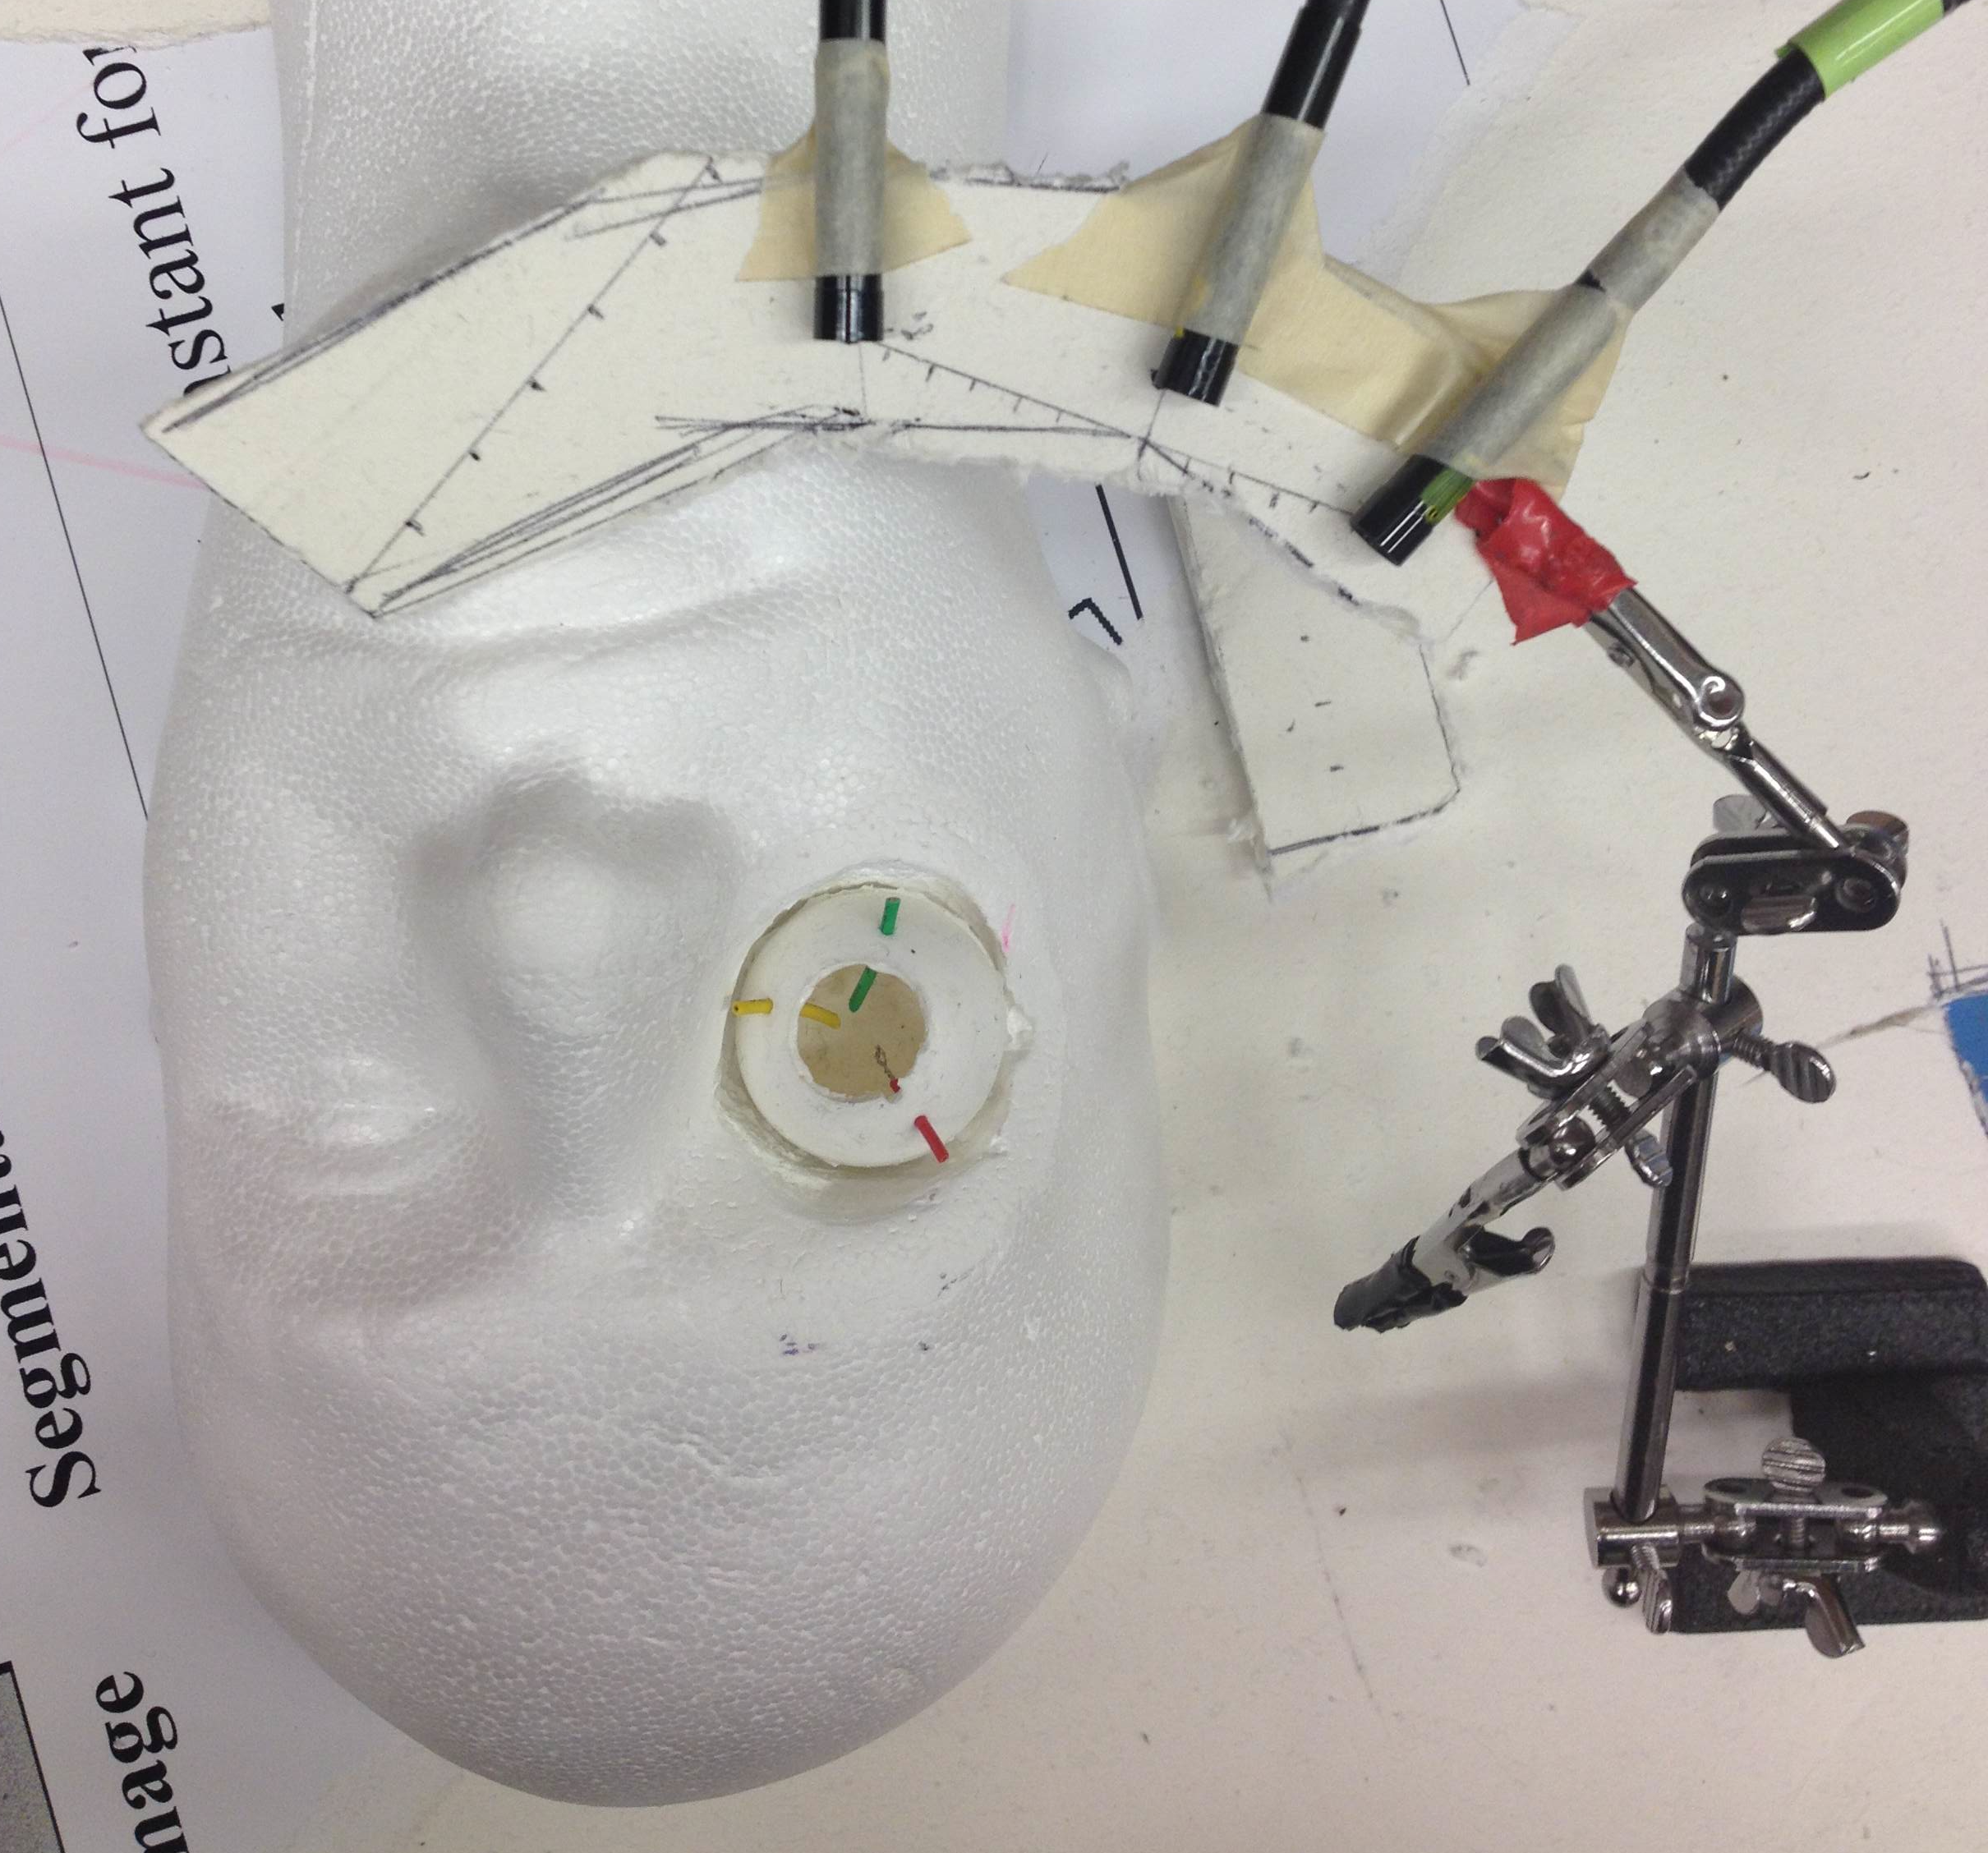
Mechanical Design
Progress:
Built a life-size phantom
Built a mock-up
Change:
Life-size eye phantom
Height and angle for each cameras
Angle between cameras
Progress: TD
Dependencies
Milestones
Progress: MD
Project Summary
Deliverables
Notes:
Prototype Building
Milestones achieved

Slide 9
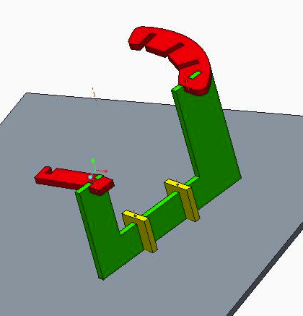
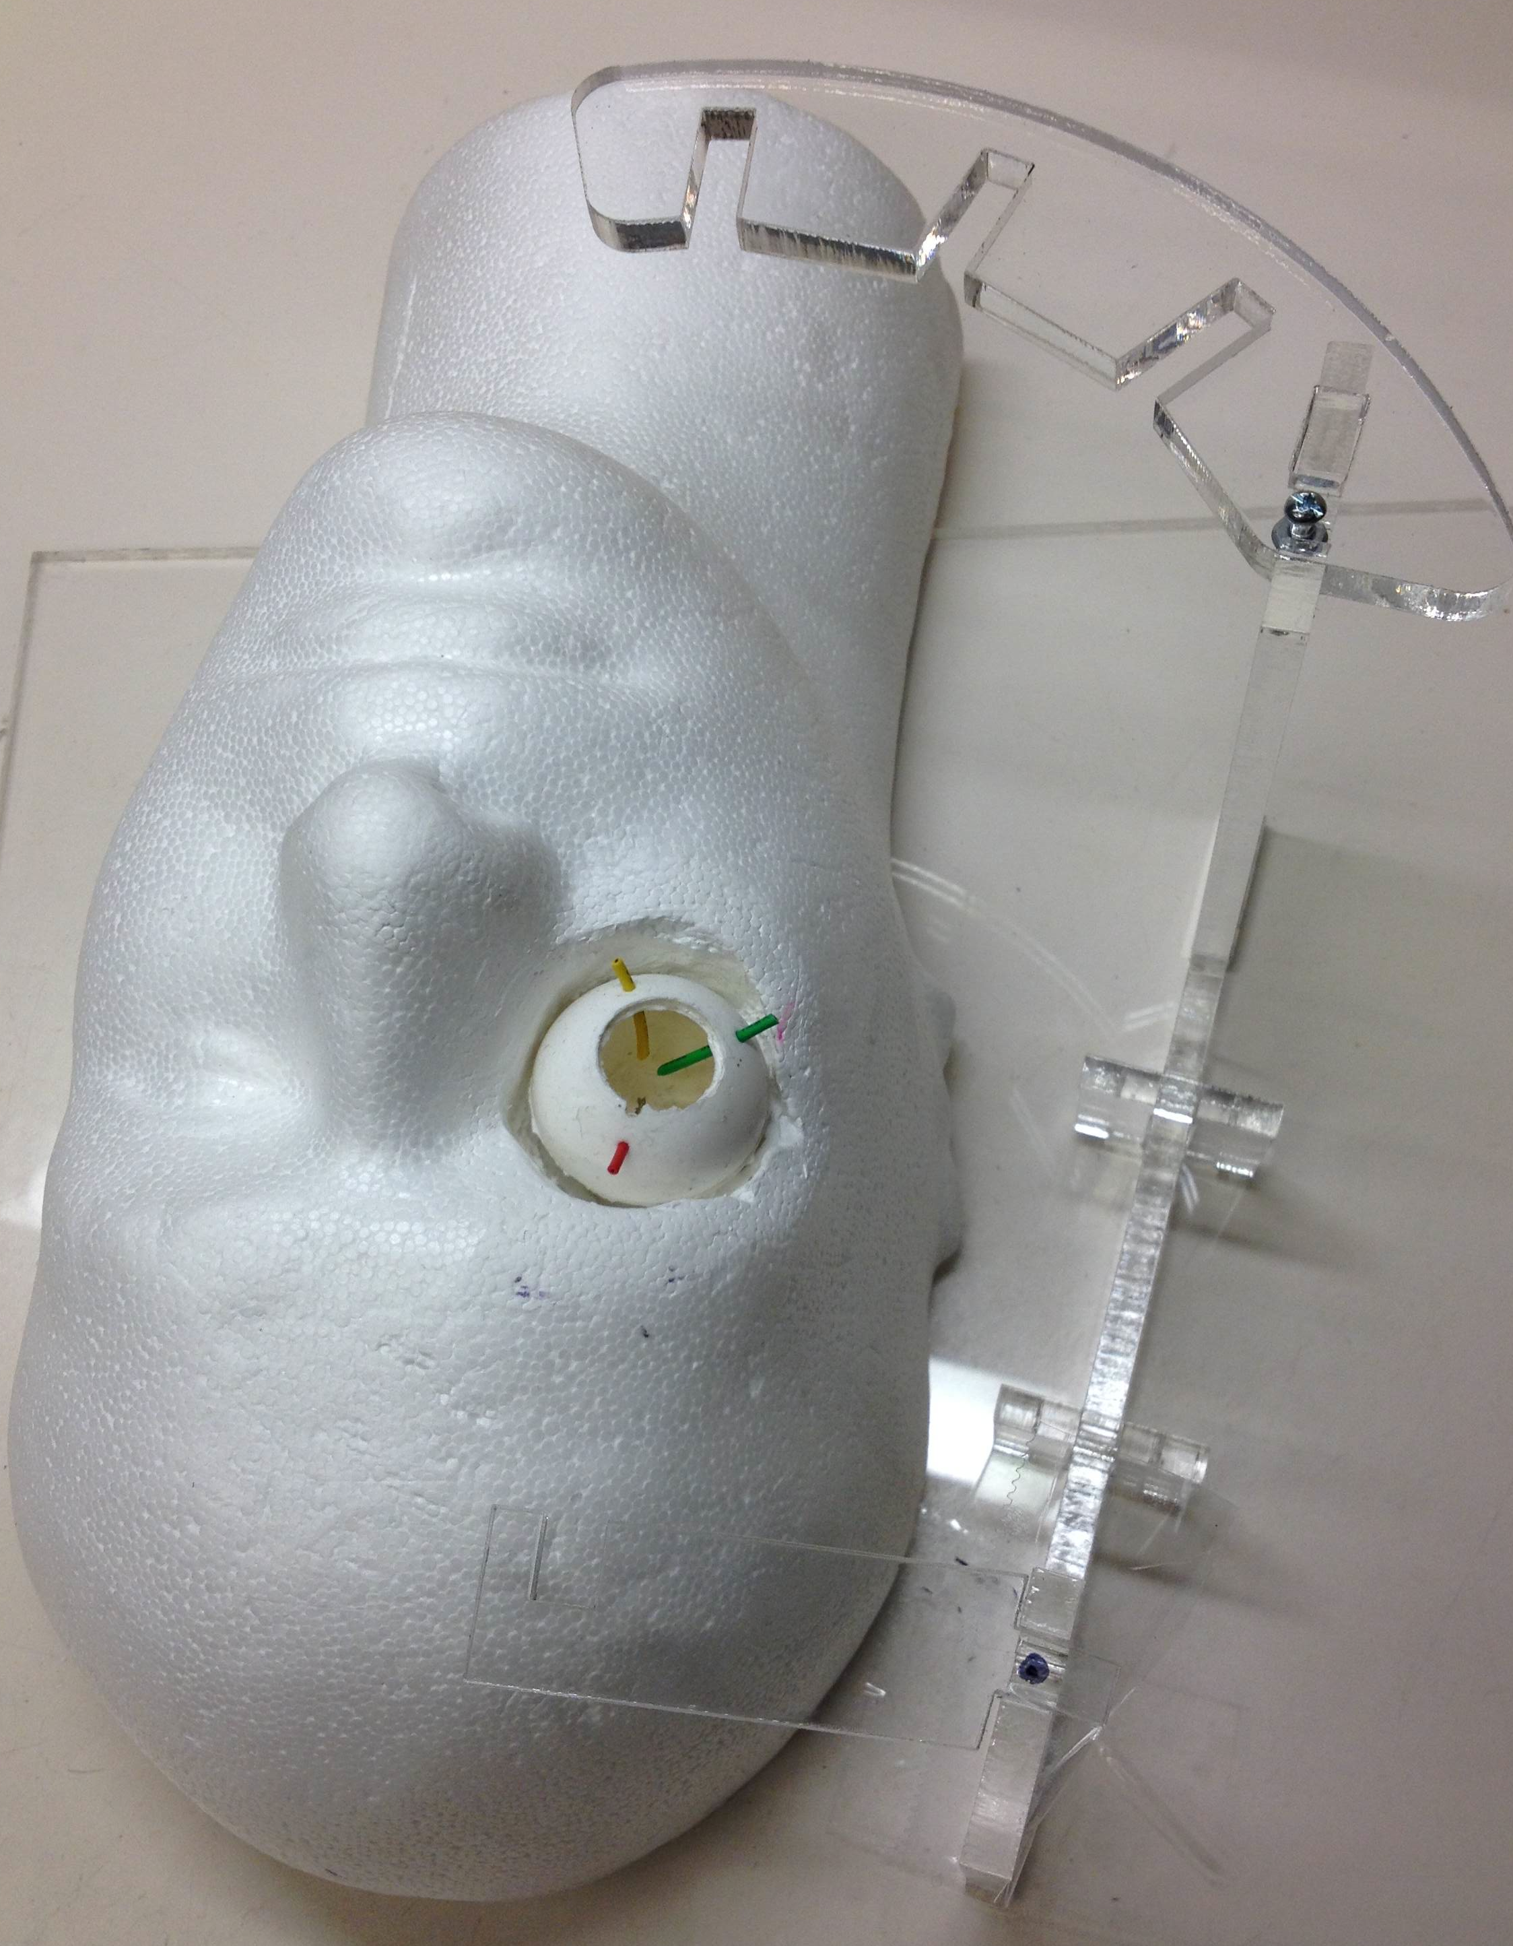
Mechanical Design
Progress:
Designed CAD platform
4. Built first platform
Next Step (4/29):
Make CAD modifications
Build rigid prototype
Install cameras
Progress: TD
Dependencies
Milestones
Progress: MD
Project Summary
Deliverables
Notes:
Prototype Building
Milestones achieved

Slide 10
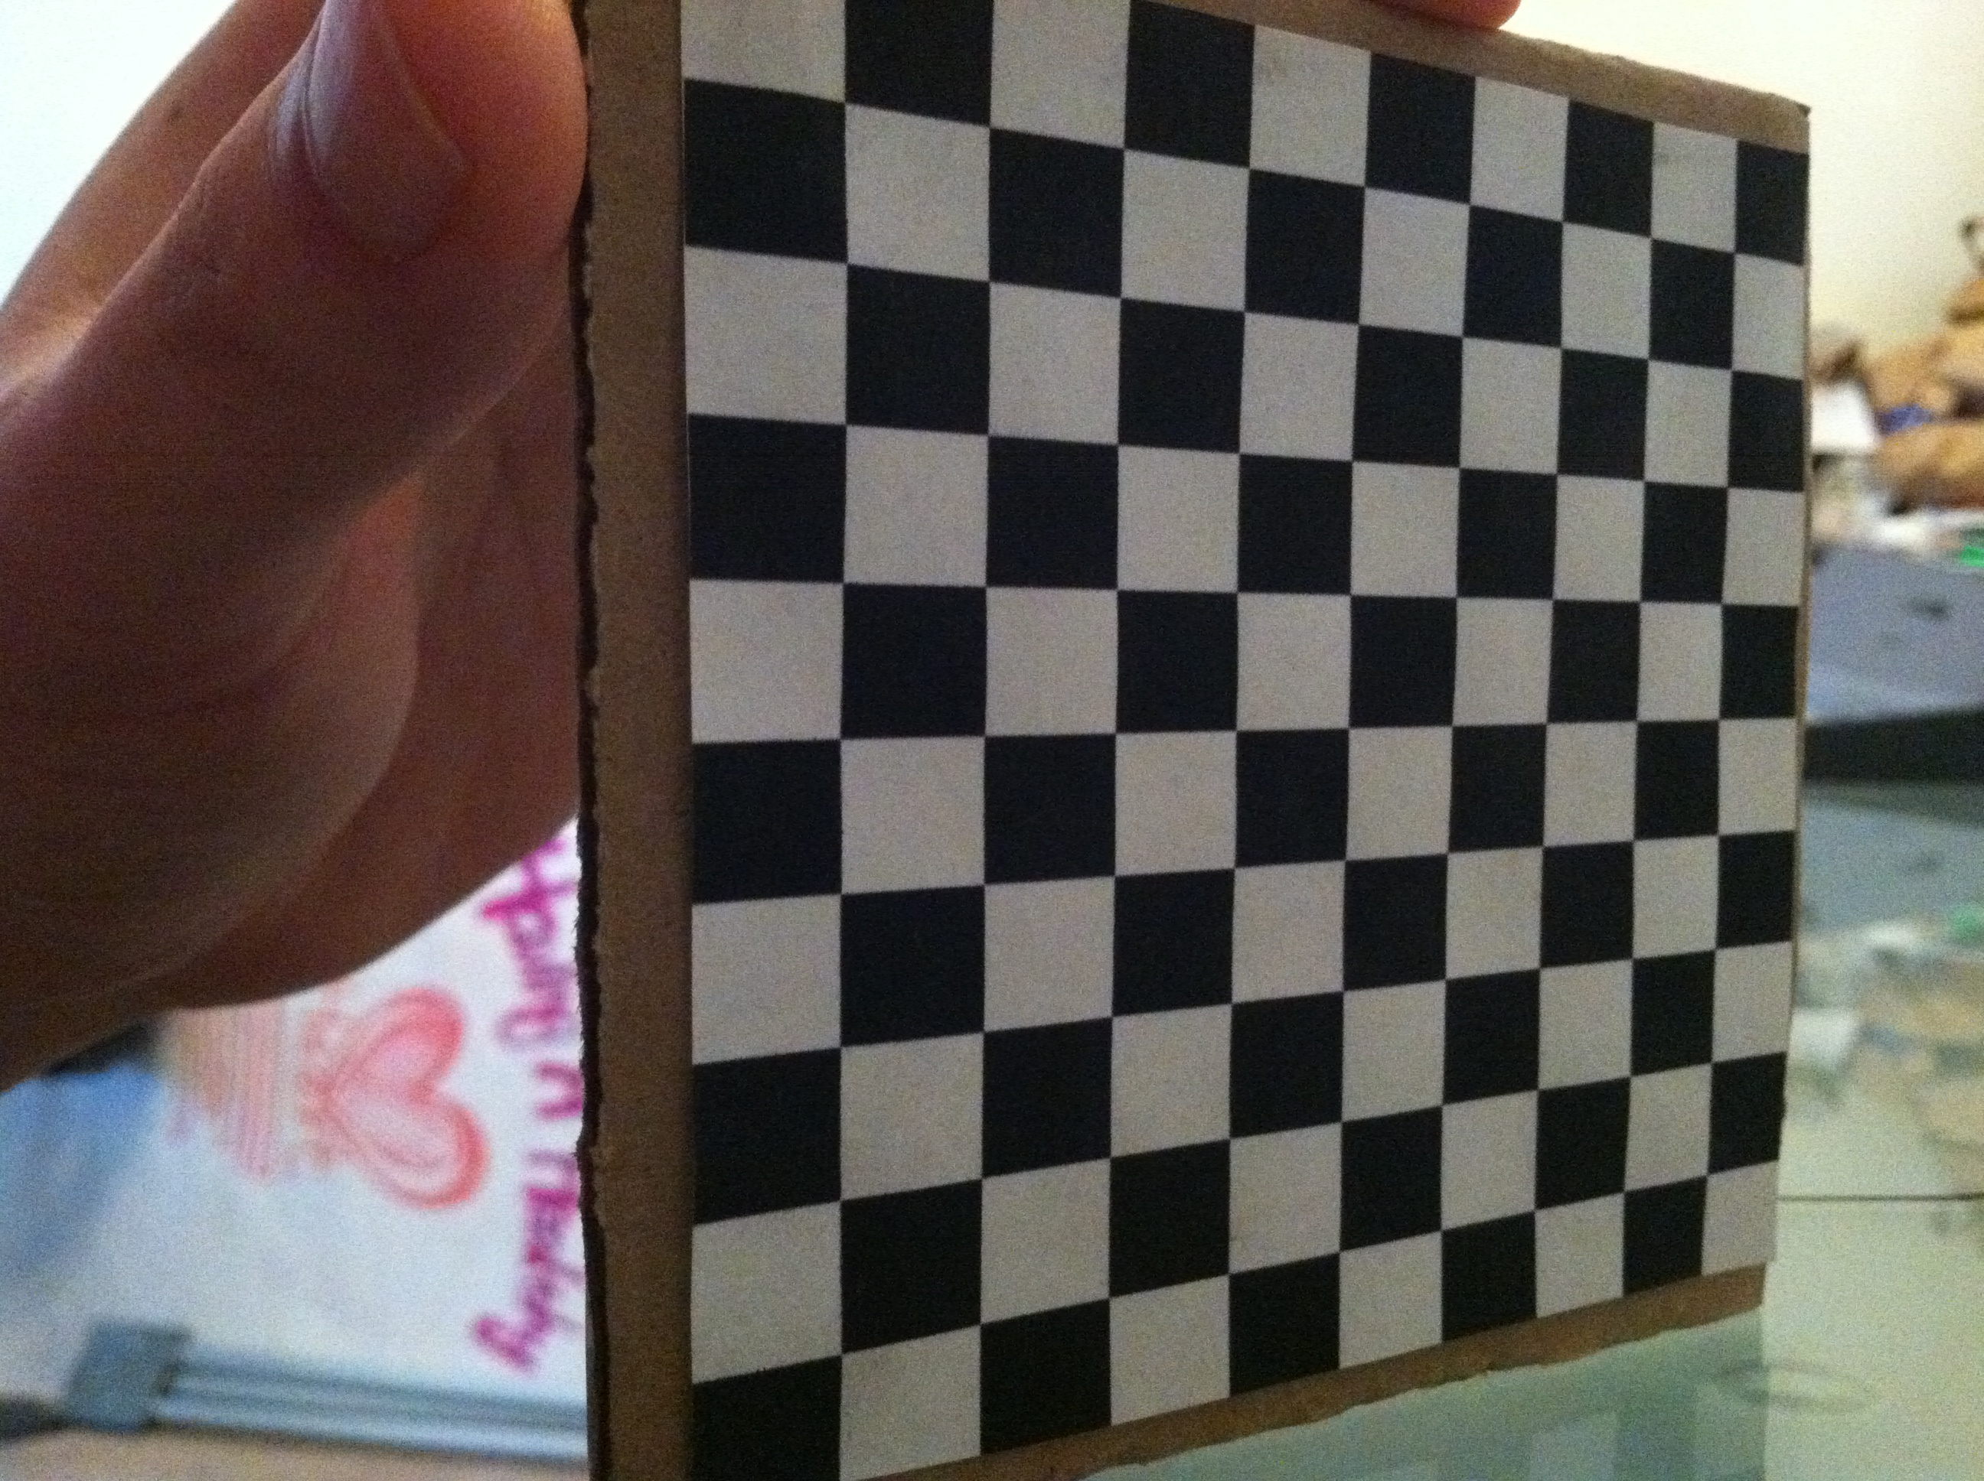
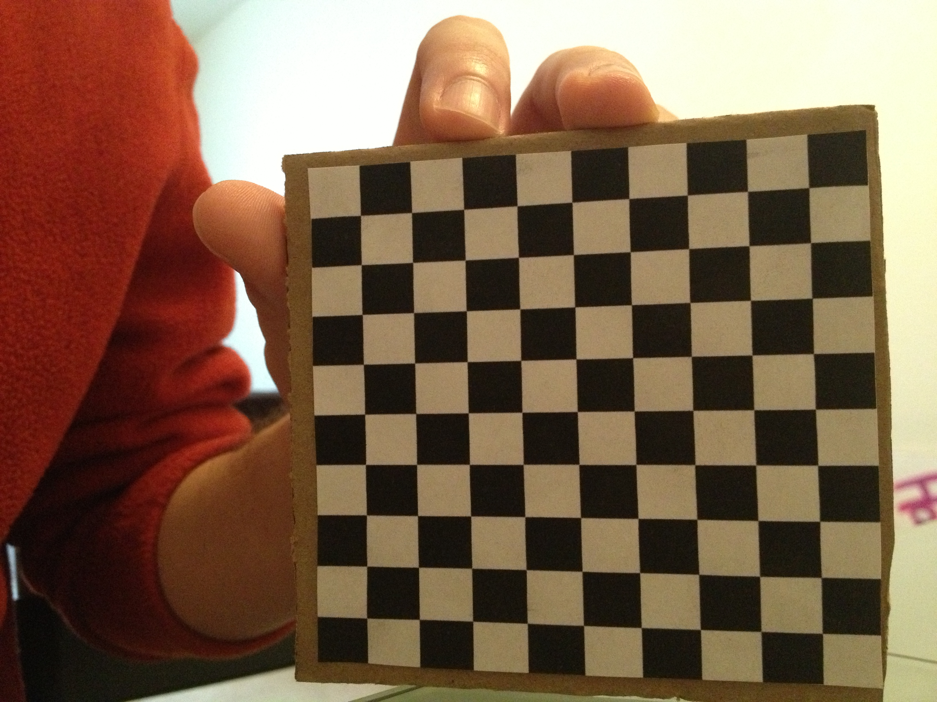
Progress:
Tracking Design
Step 1: Calibration
Sources of Error:
Warped Checkerboard
Limited Field of View
Placement Error
Next Steps: 5/1
Re-print Checkerboard
Calibrate Device
 | Error (45°) | Error (135°)
Translation | 1.0 mm | 2.2 mm
Rotation (Y) | 0.2° | 1.2°
Progress: TD
Dependencies
Milestones
Progress: MD
Project Summary
Deliverables
Notes:
On the left is the design for camera calibration.
We will implement pair-wise calibration using matlab’s calibration toolbox.
20 pairs of images are taken of a planar checkboard in different orientations as you can see in the example on the right.
Then, the grid corners are manually extracted and single camera calibration is performed.
At this point, if the detected corners are inaccurate non-linear errors can be accounted for.
Next, stereo camera calibration is performed to calculate rotation and translation matrices.
The final output is intrinsic parameters (such as focal length), and extrinsic parameters (such as translation).
This will be repeated for 3 pairs of cameras and the extrinsic parameters will be adjusted to reflect in reference to camera A.
Calibration Test
One possible problem is if stereo-camera calibration is not possible because the field of views do not have enough room for the planar checkerboard method.
In that case, an alternative approach will be taken that will put us behind schedule.

Slide 11
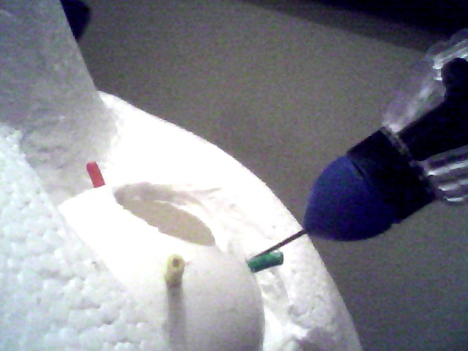
Progress:
Tracking Design
Step 2: Detection
Progress: TD
Dependencies
Milestones
Progress: MD
Project Summary
Deliverables
Notes:
On the left is the design for camera calibration.
We will implement pair-wise calibration using matlab’s calibration toolbox.
20 pairs of images are taken of a planar checkboard in different orientations as you can see in the example on the right.
Then, the grid corners are manually extracted and single camera calibration is performed.
At this point, if the detected corners are inaccurate non-linear errors can be accounted for.
Next, stereo camera calibration is performed to calculate rotation and translation matrices.
The final output is intrinsic parameters (such as focal length), and extrinsic parameters (such as translation).
This will be repeated for 3 pairs of cameras and the extrinsic parameters will be adjusted to reflect in reference to camera A.
Calibration Test
One possible problem is if stereo-camera calibration is not possible because the field of views do not have enough room for the planar checkerboard method.
In that case, an alternative approach will be taken that will put us behind schedule.

Slide 12
Progress:
Tracking Design
Step 2: Detection
Progress: TD
Dependencies
Milestones
Progress: MD
Project Summary
Deliverables
Notes:
On the left is the design for camera calibration.
We will implement pair-wise calibration using matlab’s calibration toolbox.
20 pairs of images are taken of a planar checkboard in different orientations as you can see in the example on the right.
Then, the grid corners are manually extracted and single camera calibration is performed.
At this point, if the detected corners are inaccurate non-linear errors can be accounted for.
Next, stereo camera calibration is performed to calculate rotation and translation matrices.
The final output is intrinsic parameters (such as focal length), and extrinsic parameters (such as translation).
This will be repeated for 3 pairs of cameras and the extrinsic parameters will be adjusted to reflect in reference to camera A.
Calibration Test
One possible problem is if stereo-camera calibration is not possible because the field of views do not have enough room for the planar checkerboard method.
In that case, an alternative approach will be taken that will put us behind schedule.

Slide 13
Progress:
Tracking Design
Step 2: Detection
Progress: TD
Dependencies
Milestones
Progress: MD
Project Summary
Deliverables
Notes:
On the left is the design for camera calibration.
We will implement pair-wise calibration using matlab’s calibration toolbox.
20 pairs of images are taken of a planar checkboard in different orientations as you can see in the example on the right.
Then, the grid corners are manually extracted and single camera calibration is performed.
At this point, if the detected corners are inaccurate non-linear errors can be accounted for.
Next, stereo camera calibration is performed to calculate rotation and translation matrices.
The final output is intrinsic parameters (such as focal length), and extrinsic parameters (such as translation).
This will be repeated for 3 pairs of cameras and the extrinsic parameters will be adjusted to reflect in reference to camera A.
Calibration Test
One possible problem is if stereo-camera calibration is not possible because the field of views do not have enough room for the planar checkerboard method.
In that case, an alternative approach will be taken that will put us behind schedule.

Slide 14
Progress:
Tracking Design
Step 2: Detection
Progress: TD
Dependencies
Milestones
Progress: MD
Project Summary
Deliverables
Notes:
On the left is the design for camera calibration.
We will implement pair-wise calibration using matlab’s calibration toolbox.
20 pairs of images are taken of a planar checkboard in different orientations as you can see in the example on the right.
Then, the grid corners are manually extracted and single camera calibration is performed.
At this point, if the detected corners are inaccurate non-linear errors can be accounted for.
Next, stereo camera calibration is performed to calculate rotation and translation matrices.
The final output is intrinsic parameters (such as focal length), and extrinsic parameters (such as translation).
This will be repeated for 3 pairs of cameras and the extrinsic parameters will be adjusted to reflect in reference to camera A.
Calibration Test
One possible problem is if stereo-camera calibration is not possible because the field of views do not have enough room for the planar checkerboard method.
In that case, an alternative approach will be taken that will put us behind schedule.

Slide 15
Progress:
Tracking Design
Step 2: Detection
Sources of Delay:
Lack of final device due to broken laser cutter
Lack of laptop with software due to hardware damage
Next Steps: 5/3
Prepare desktop with software ✔
Modify code for real-time detection ✔
Test segmentation with final device
Progress: TD
Dependencies
Milestones
Progress: MD
Project Summary
Deliverables
Notes:
On the left is the design for camera calibration.
We will implement pair-wise calibration using matlab’s calibration toolbox.
20 pairs of images are taken of a planar checkboard in different orientations as you can see in the example on the right.
Then, the grid corners are manually extracted and single camera calibration is performed.
At this point, if the detected corners are inaccurate non-linear errors can be accounted for.
Next, stereo camera calibration is performed to calculate rotation and translation matrices.
The final output is intrinsic parameters (such as focal length), and extrinsic parameters (such as translation).
This will be repeated for 3 pairs of cameras and the extrinsic parameters will be adjusted to reflect in reference to camera A.
Calibration Test
One possible problem is if stereo-camera calibration is not possible because the field of views do not have enough room for the planar checkerboard method.
In that case, an alternative approach will be taken that will put us behind schedule.

Slide 16
Progress:
Tracking Design
Step 3: Tracking
Sources of Delay:
Lack of final device due to broken laser cutter
Lack of laptop with software due to hardware damage
Next Steps: 5/5
Finish implementation
Run test on final device
Progress: TD
Dependencies
Milestones
Progress: MD
Project Summary
Deliverables
Notes:
On the left is the design for camera calibration.
We will implement pair-wise calibration using matlab’s calibration toolbox.
20 pairs of images are taken of a planar checkboard in different orientations as you can see in the example on the right.
Then, the grid corners are manually extracted and single camera calibration is performed.
At this point, if the detected corners are inaccurate non-linear errors can be accounted for.
Next, stereo camera calibration is performed to calculate rotation and translation matrices.
The final output is intrinsic parameters (such as focal length), and extrinsic parameters (such as translation).
This will be repeated for 3 pairs of cameras and the extrinsic parameters will be adjusted to reflect in reference to camera A.
Calibration Test
One possible problem is if stereo-camera calibration is not possible because the field of views do not have enough room for the planar checkerboard method.
In that case, an alternative approach will be taken that will put us behind schedule.

Slide 17
Dependencies
Dependency | Proposed Solution | Due Date
Ophthalmic Surgery Observation | Schedule through Marcin Balicki Acquire videos online | 2/25 ✔ 3/4 ✔
Access to Expertise | Weekly mentor meetings Survey literature | 2/14 ✔ 3/11 ✔
CISST Libraries | Training with Balazs Vagvolgyi If not, custom libraries as needed | 3/4 ✔
Other Off-the-shelf Libraries OpenCV | Research and plan accordingly Back-up plan: Implement on our own | 3/11 ✔ 4/8
Access to Steady Hand Eye Robot | Get initial plan approved Schedule through Marcin Balicki | 3/11 ✔ 4/8 4/21 ✖
Equipment | Evaluate constraints Purchase off-the-shelf components (OTC) | 3/4 ✔ 3/11 ✔
Funding | Propose budget plan to Dr. Taylor | 3/4 ✔
Progress: TD
Dependencies
Milestones
Progress: MD
Project Summary
Deliverables
Notes:
Here is the original list of our dependencies.

Slide 18
Dependencies
Dependency | Proposed Solution | Due Date
Ophthalmic Surgery Observation | Schedule through Marcin Balicki Acquire videos online | 2/25 ✔ 3/4 ✔
Access to Expertise | Weekly mentor meetings Survey literature | 2/14 ✔ 3/11 ✔
CISST Libraries | Training with Balazs Vagvolgyi If not, custom libraries as needed | 3/4
Other Off-the-shelf Libraries OpenCV | Research and plan accordingly Back-up plan: Implement on our own | 3/11 ✔ 4/8
Access to Steady Hand Eye Robot | Get initial plan approved Schedule through Marcin Balicki | 3/11 ✔ 4/8 4/21 ✖
Equipment | Evaluate constraints Purchase off-the-shelf components (OTC) | 3/4 ✔ 3/11 ✔
Funding | Propose budget plan to Dr. Taylor | 3/4 ✔
Progress: TD
Dependencies
Milestones
Progress: MD
Project Summary
Deliverables
Notes:
Here is the original list of our dependencies.

Slide 19
Dependencies
New Dependency | Proposed Solution | Due Date
Parallel Camera Function | Determine cause and plan accordingly | 4/1 4/22 ✔
Laser Cutter Machine | If not fixed, order from a company | 4/27 ✔
CV Software | Installed on desktop in Robotorium Hall | 4/22 ✔
Progress: TD
Dependencies
Milestones
Progress: MD
Project Summary
Deliverables
Notes:
As you can see here, most dependencies have been accounted for.
One off-the-shelf library that we have determined that we will use is OpenCV. This is well-documented and wrapped in Python. Initial research on relevant functions and computer vision methods have been done.
One dependency we did not account for is the camera and computer’s capability to obtain input from cameras in parallel. Currently we are experiencing issues when trying to use more than two cameras. This is most likely due to the fact that separate ports must be used so each camera has its own controller. Balazs is testing this using a USB board—if the issue is resolved we will purchase a USB express card. Another possibility is that this is not a hardware issue, but a software issue.
This dependency will not put us behind schedule because it is only important for online tracking. In the case that this dependency is not resolved, we will not be able to perform online tracking, our maximum deliverable.
There are two other dependencies that have not been accounted for. First, our current tracking scheme does not incorporate any functions from the CISST library. Therefore no training has been done. This should not put us behind schedule assuming that our design is functional.
The other dependency is to schedule to use the steady hand eye robot. It is not yet clear when we will be ready to use the robot, but Marcin has assured us that a few days notice will be plenty. We hope to be using the robot for our tracking tests, which we are scheduled to be doing the week of April 22nd.

Slide 20
Milestones
Date | Milestones | Responsibility | Status
3/11 | Offline Tracking System Design (Sue) | -Calibration Scheme -Segmentation Scheme -Tracking Scheme | Done
3/18 4/15 | Design of Prototype and Phantom(Yejin) | -Conceptual design of Eye and Face -CAD of the prototype | Done
4/1 4/8 | Build Phantom (Yejin) | -Build and attach eye to platform -Build and attach skull and nose to platform | Done
4/1 4/8 | Calibration Implementation (Sue) | -Implement single camera/multi camera calibration -Run test to verify success | Done
Progress: TD
Milestones
Progress: MD
Project Summary
Deliverables
Dependencies

Slide 21
Milestones
Date | Milestones | Responsibility | Status
4/8 4/29 | Prototype of Device (Yejin) | -Rapid prototype goggle device -Rigidly attach cameras -Attach miscellaneous fixtures | In Progress (Delayed)
4/15 5/3 | Test of Segmentation (Sue) | -Implement Segmentation Method -Run test to verify success | In Progress (Delayed)
4/29 5/5 | Test of Tracking Implementation (Sue) | -Implement tracking algorithm -Run test to verify success | In Progress (Delayed)
5/9 | Evaluation of Micro-Surgical Tracker (Yejin) | -Static tool coordinate accuracy -Dynamic tool coordinate accuracy -Miscellaneous accuracy | Not Done
Progress: TD
Milestones
Progress: MD
Project Summary
Deliverables
Dependencies

Slide 22
Timeline
Milestones\Date | W4 | W5 | W6 | W7 | SB | W8 | W9 | W10 | W11 | W12 | W13 | W14 | W15
M1: Offline Tracking System Design |  |  | 3/11
M2: Design of Prototype and Phantom |  |  |  | 3/18
M3: Build Phantom |  |  |  |  |  | 4/1
M4: Calibration Implementation |  |  |  |  |  | 4/1
M5: Prototype of Device |  |  |  |  |  |  |  | 4/8
M6: Test of Segmentation |  |  |  |  |  |  |  | 4/15
M7: Test of Tracking Implementation |  |  |  |  |  |  |  |  |  | 4/29
M8: Evaluation of Micro- Surgical Tracker |  |  |  |  |  |  |  |  |  |  |  | 5/9 | 5/13
*W# : Week #, SB: Spring Break
Progress: TD
Milestones
Progress: MD
Project Summary
Deliverables
Dependencies

Slide 23
Timeline
Milestones\Date | W4 | W5 | W6 | W7 | SB | W8 | W9 | W10 | W11 | W12 | W13 | W14 | W15
M1: Offline Tracking System Design |  |  | 3/11
M2: Design of Prototype and Phantom |  |  |  | 3/18 |  |  |  |  | 4/15
M3: Build Phantom |  |  |  |  |  | 4/1 |  | 4/8
M4: Calibration Implementation |  |  |  |  |  | 4/1 |  | 4/8
M5: Prototype of Device |  |  |  |  |  |  |  | 4/8 |  | 4/29
M6: Test of Segmentation |  |  |  |  |  |  |  | 4/15 |  |  | 5/3
M7: Test of Tracking Implementation |  |  |  |  |  |  |  |  |  | 4/29 | 5/5
M8: Evaluation of Micro- Surgical Tracker |  |  |  |  |  |  |  |  |  |  |  | 5/9 | 5/13
*W# : Week #, SB: Spring Break
Progress: TD
Milestones
Progress: MD
Project Summary
Deliverables
Dependencies
Notes:
Static tool
Dynamic tool: up, down, across, etc
Illuminatoin
Blockage

Slide 24
Questions?

