Slide 1
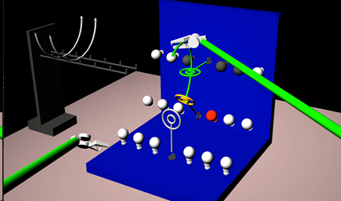
Augmentation of Haptic Guidance into Virtual-Reality Surgical Simulators Eric Cao, Vipul Bhat, Brett Wolfinger Mentors: Dr. Jeremy Brown, Dr. Mahya Shahbazi, Guido Caccianiga
Goals:
Develop and evaluate the effectiveness of real-time haptic and visual feedback in surgical task simulators of complex trajectories
Significance:
Real-time feedback has the potential
to drastically improve training programs
for minimally invasive surgeons
Results:
Implementation of several haptic and visual feedback systems
Development and setup for multi-faceted study on benefits of real-time feedback to surgical trainees

