Slide 1
Group 10: Cross Modality Medical Image Synthesis and Registration through Machine Learning
Paper Presentation
Team member: Ping-Cheng Ku (pku1@jh.edu)
Mentors: Mehran Armand, Alejandro Martin Gomez

Slide 2
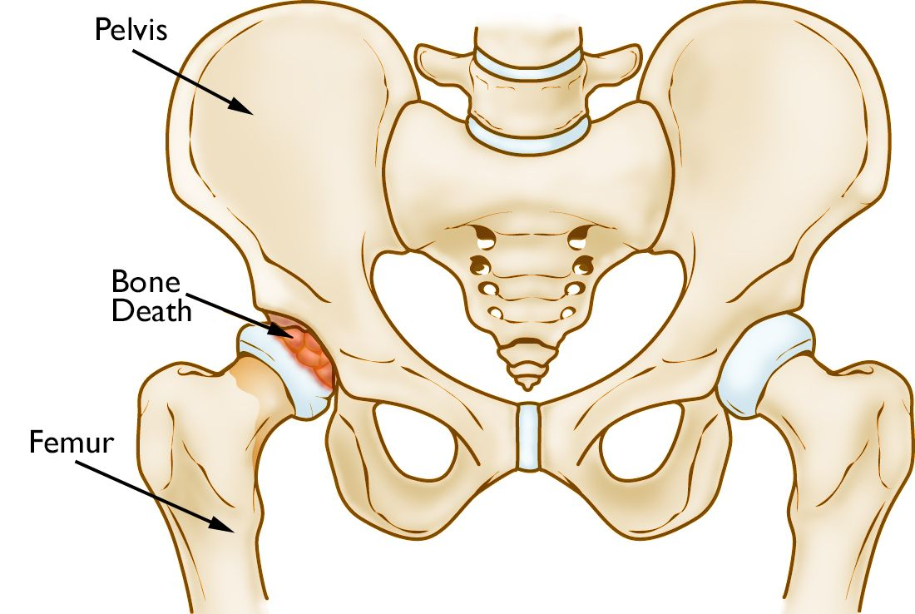
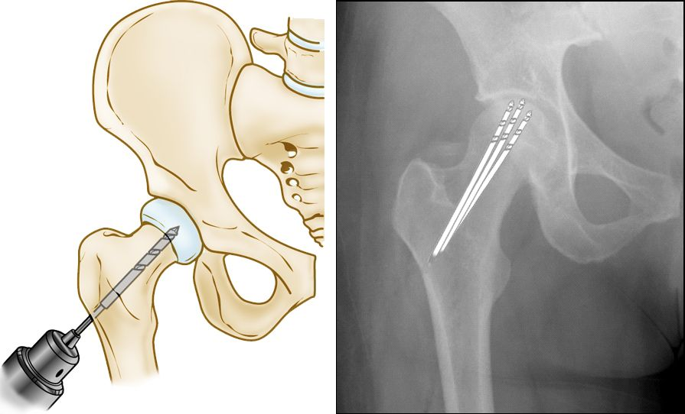
Project recap - Background
Core Decompression for Osteonecrosis
Drilling several holes into the femoral head to relieve pressure in the bone and create channels for new blood vessels to nourish the affected areas of the hip
X-rays provides images of dense structures (like bones) and intraoperative x-ray shots are taken to monitor the surgical procedure.
Image source (Left and right image): [1] orthoinfo - aaos. Retrieved February 16, 2021

Slide 3
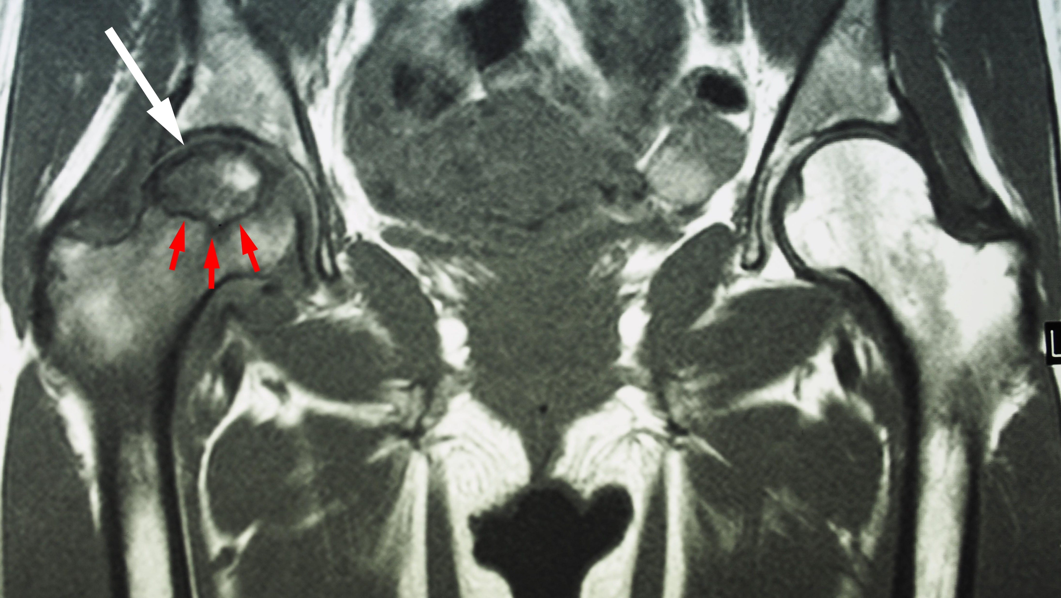
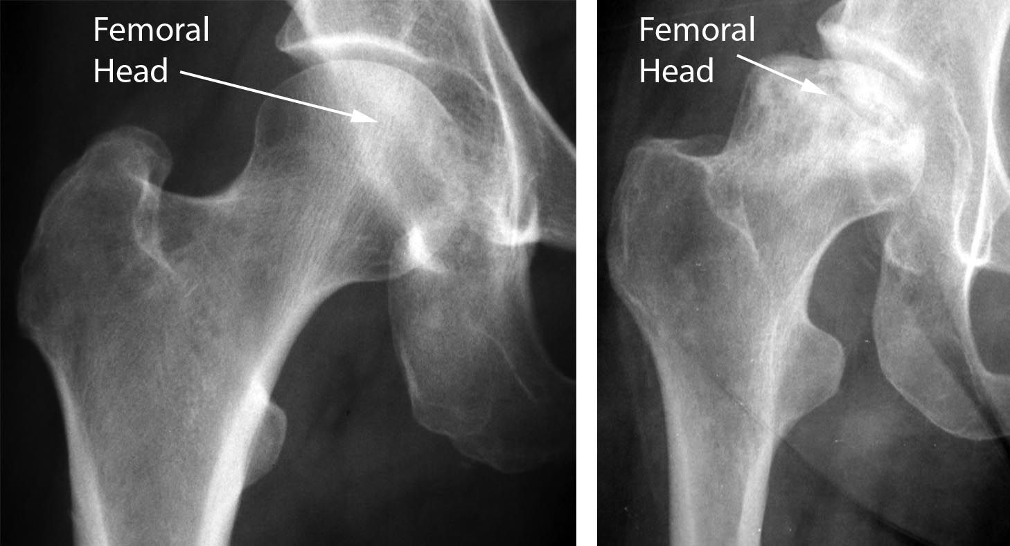
Project recap - Project Goal
Motivation
Surgeons also rely on preoperative MR scans for tool trajectory planning for core decompression surgery, but there is no easy way for them to visualize the planned paths in the intra-operative X-ray shots
Project Goal
We would like to convert the annotations of segmentation of the necrotic tissues and the drill insertion paths from preoperative MR images to intraoperative x-rays would be helpful for surgeons.
Image source (Left and right image): [1] orthoinfo - aaos. (n.d.). Retrieved February 16, 2021

Slide 4
Paper Overview
Cross-modality image synthesis from unpaired data using CycleGAN: Effects of gradient consistency loss and training data size
Yuta Hiasa, Yoshito Otake, Masaki Takao, Takumi Matsuoka, Kazuma Takashima, Jerry L. Prince, Nobuhiko Sugano, Yoshinobu Sato
Introduction of gradient consistency loss to CycleGAN loss functions to improve the boundaries in synthesized images
Accuracy of synthesized images was investigated by adjusting the number of training data and the implementation of gradient consistency loss

Slide 5
Paper: Background
CT is commonly used in orthopedic procedures, while MRI is used along with CT to identify muscle structures and diagnose osteonecrosis due to its superior soft tissue contrast [1].
Image synthesis has been performed through patch-based learning [2] as well as deep learning, including convolutional neural networks (CNN) and generative adversarial networks (GAN).
Previous CycleGAN approaches focus on more consistent field-of-view (FOV), while the entire hip region has larger variation in the anatomy and the pose.

Slide 6
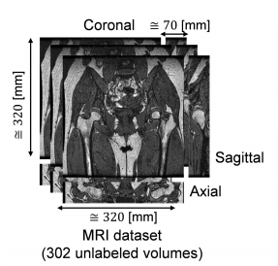
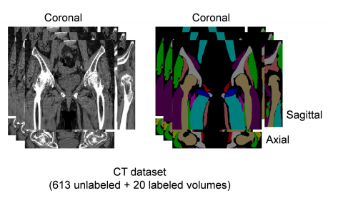
Paper: Dataset
302 unlabeled MR volumes
T1-weighted
matrix size: 256×256
field of view: 320×320 mm
slice thickness: 2 mm
613 unlabeled + 20 labeled CT volumes
matrix size: 512×512
field of view: 360×360 mm
slice thickness: 2mm
MR
dataset
Image reference: [1] Y. Hiasa
CT
dataset
Image reference: [2] Y. Hiasa

Slide 7
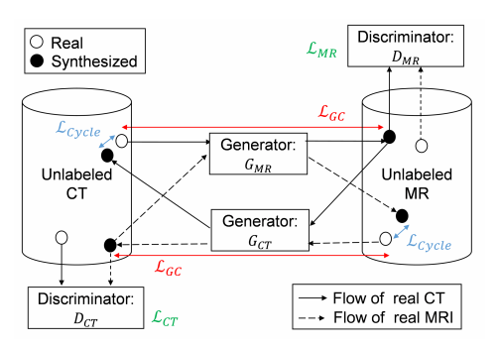
Paper: CycleGAN Workflow
Generator networks
: translates MR to CT
: translates CT to MR
Discriminator networks
: distinguish real and fake MR
: distinguish real and fake CT
Loss functions
, : adversarial losses
: cycle consistency loss
: gradient correlation loss
Image reference: [2] Y. Hiasa

Slide 8
Paper: CycleGAN loss
Adversarial losses
Generators create synthesized images, while the discriminators attempt to distinguish between the real and synthesized images by maximizing the adversarial losses
Cycle consistency loss
Compare the real image and the reconstructed images from synthesized images
Prevent convergence where generators creates same set of images
: Input CT
: Input MR
: Input CT
: Input MR

Slide 9
Paper: Gradient consistency loss
Gradient correlation (GC) is a similarity metric in medical image registration. The value is defined to be the normalized cross correlation (NCC) between two images.
Gradient consistency loss is formulated as:
Overall loss function:

Slide 10
Paper: Evaluation method
Variable: Training dataset size
20 MR volumes + 20 CT volumes
302 MR volumes + 613 CT volumes
Variable: Implementation of gradient consistency (GC) loss
with GC loss implemented
without GC loss implemented
Evaluation methods:
Data with ground truth (paired CT and MR images):
mean absolute error (MAE)
peak-signal-to-noise ratio (PSNR) [dB] (increases when mean squared error decreases)
Data without ground truth:
Mutual Information (MI)
Quantitative evaluation on segmentation

Slide 11
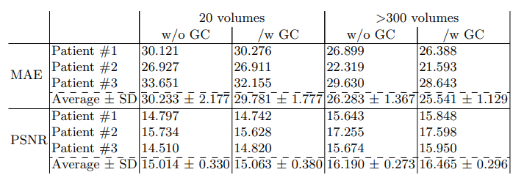
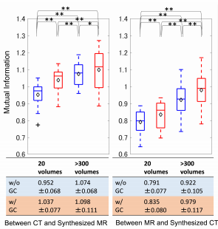
Paper: Results
MAE and PSNR:
Average MAE decreases and PSNR increases when there are more training volumes and when GC is implemented
Mutual information (MI):
Increased training data and implementation of GC both yield improvements
Image reference: [2] Y. Hiasa

Slide 12
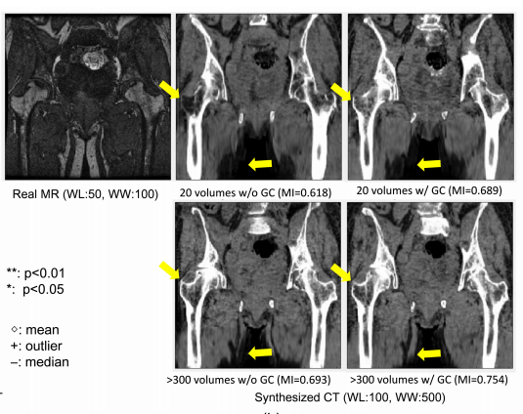
Paper: Results
With gradient consistency loss implemented, the shape of the femoral head and the adductor muscles would be more likely preserved.
Image reference: [2] Y. Hiasa

Slide 13
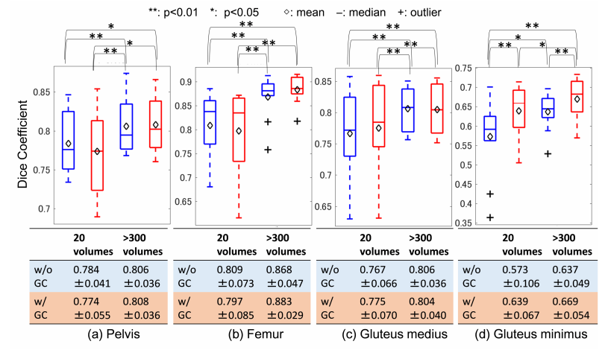
Paper: Results
Quantitative evaluation on segmentation
Image reference: [2] Y. Hiasa

Slide 14
Paper: Conclusions
Main contributions:
introduction of gradient consistency loss in CycleGAN
quantitative and qualitative evaluation of the dependency of both image synthesis accuracy and segmentation accuracy on a large number of training data
Future work:
patients with implants are excluded in the dataset for the cycleGAN training
development of a method that effectively incorporates information in unlabeled CT and MR volumes to improve segmentation accuracy

Slide 15
Paper: Critiques
Good:
Clearly explained model and clear math for all the loss functions involved
Made full use of available data (paired/unpaired volumes and few labeled volumes) to provide quantitative and qualitative evaluation of the results
Bad:
Effect of implementation of GC loss is not significant. The balancing weights for GC loss was set to a constant throughout the paper.
No publicly available code implementations, which may be difficult for researchers to reproduce the results

Slide 16
Paper: Relevance to project
Understanding the loss functions involved in CycleGAN
Provides insights to modification of network losses
Understanding the evaluation and testing methods

Slide 17
Reference
Osteonecrosis of the Hip - OrthoInfo - AAOS.url:https://orthoinfo.aaos.org/en/diseases--conditions/osteonecrosis-of-the-hip
Hiasa, Y., Otake, Y., Takao, M., Matsuoka, T., Takashima, K., Carass, A., . . . Sato, Y. (2018). Cross-Modality image synthesis From UNPAIRED data Using CycleGAN. Simulation and Synthesis in Medical Imaging, 31-41. doi:10.1007/978-3-030-00536-8_4

