Slide 1
Interventional Photoacoustic Registration
2/17/11
Robert Kim, BME, AMS
Steven Su, BME, AMS
Saurabh Vyas, BME, EE

Slide 2
Outline
Summary and Goals
Background
Motivation
Technical Approach
Deliverables
Timeline and Milestone Validation
Management Plan
Dependencies
References

Slide 3
Summary and Goals
Photoacoustic registration is a promising new technology that has the potential to replace existing registration methods such as EM an optical tracking.
The main goal of this project is to perform 3 point registration using photoacoustic registration using 3D ultrasound data.

Slide 4
Background (1)
Discovered by Alexander Graham Bell in 1880.
Electromagnetic (light) waves are converted to acoustic waves due to absorption and thermal excitation.
The photoacoustic effect has been previously exploited to lead to the invention of photoacoustic spectroscopy and is currently used in biomedical applications such as structural imaging, functional imaging, and molecular imaging.

Slide 5
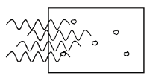
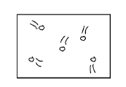
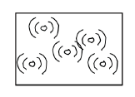
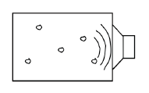
Background (2)
When matter is exposed to high frequency pulses of light, most of the light’s energy will be absorbed by the molecules in the incident matter.
As the energy from the light is converted to heat, the molecules become thermally excited.
Heat waves will then radiate away from the matter causing sound waves due to pressure variations in the environment around the medium.
These sound waves can then be detected by acoustic devices such as ultrasound.
RF/Laser Pulse
Absorption
Thermal Expansion/
Acoustic Wave Generation
Ultrasonic Detection

Slide 6
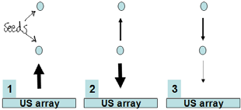
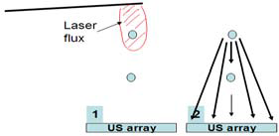
Why Use Photoacoustic Imaging?
Disadvantages of Ultrasound
False positives caused by calcifications and air bubbles
False negatives caused by shadowing effect
Advantages of Photoacoustic Imaging
Photoacoustic effect only from seeds and not other objects due to specific laser wavelength
One way path and large aperture reduces shadowing effect
Courtesy of Dr. Emad Boctor, PhD

Slide 7
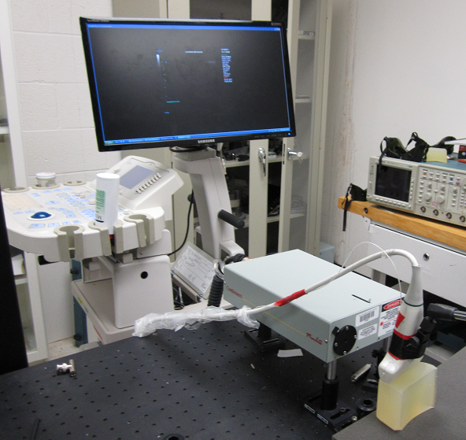
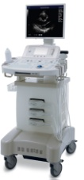
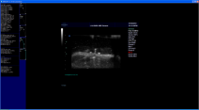
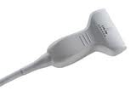
Current Setup
SonixRP
Software
Sonix CEP
Ultrasound system
L14-5W
Transducer
SonixDAQ
Module
DAQControl
Software
Phantom
Surelite II
Laser system
MATLAB
Software

Slide 8
Technical Approach (1)
Design and build a phantom that will be used for photoacoustic imaging
Single point will be projected onto the phantom using a pulse laser system (532 nm laser source).
Point on the phantom will be detected using Sonix CEP ultrasound system and Sonix DAQ module.
Horn’s registration algorithm will be used to identify the coordinates of the point in the ultrasound coordinate system.
Sensitive analysis and relative motion analysis will be done

Slide 9
Technical Approach (2)
Once system works properly, a laser pattern using three laser points will be projected onto the phantom.
Robotic stage and an adapter to mount a 2D ultrasound probe to the robotic stage will be designed and constructed to acquire 3D ultrasound data
2D ultrasound probe on the robotic stage will be moved to detect all three points on the phantom.
Develop modular software to synchronize and calibrate robotic stage with laser source.

Slide 10
Technical Approach (3)
Integrate stereo camera and continuous wavelength (CW) laser source to pulse laser source.
Software and algorithms will be implemented to calibrate the CW laser to the pulse laser and the CW laser to the stereo camera setup.
This is the maximum deliverable

Slide 11
Deliverables (Minimum)
Design phantoms
Pulse laser source will be used to project a single point onto a phantom from which several ultrasound slices will be obtained.
For each corresponding slice, the point will be identifiable.
Perform sensitivity analysis and relative motion analysis.
Most importantly, all individual components and their ability to function as one unit.

Slide 12
Deliverables (Expected)
Use a moving 2D ultrasound probe (semi-automated)
Three points will be identified using 3D ultrasound data
Build a robotic stage
Needs to be synchronized and calibrated with the laser setup
Develop modular software to integrate robotic stage into the existing ultrasound setup.
Engineer some mechanical structures to install the corresponding probes onto the stage

Slide 13
Deliverables (Maximum)
Attach and integrate a stereo camera to the laser fiber as well as a continuous wavelength laser (CWL) source
CWL will then need to be calibrated to pulsed laser pattern
CWL will also need to be calibrated to the camera setup

Slide 14
Timeline

Slide 15
Milestone Validations
Milestone 1: Phantom will exist. DAQ data can be analyzed. (Complete By 3/14/11)
Milestone 2:Obtain point using US slices. Use rigid transformations to evaluate accuracy of registration by moving point. (Complete By 3/28/14)
Milestone 3: Robotic stage will exist. Changing the laser pattern and use the obtained rigid transformation to evaluate registration. (Complete By 5/1/11)
Milestone 4: TBD. Need more physics background to create validation protocol. (Complete By TBD)

Slide 16
Management Plan
Weekly meetings with Dr. Emad Boctor at either Homewood Campus (Hackerman Hall, Postdoc Room) or JHMI JHOPC building on Mondays at 9:00 a.m.
Team meetings every Monday, Wednesday, and Friday at Hackerman 224 from 7:00-9:00 p.m.
Monday: Updates and Planning for upcoming week. Delegation of individual tasks.
Wednesday: Integration of individual work.
Friday: Testing and verification of work.
Individual tasks will be completed over the weekend or in between meetings as schedules permit.
Work and responsibilities will be split according to the following criterion:
Saurabh: Calibrate PLS, Calibrate US, Relative Motion Analysis, Engineer Mechanical Attachments
Robert: Calibrate US, Relative Motion Analysis, Develop Modular Software
Steven: Build Phantoms, Calibrate PLS, Sensitivity Analysis, Engineer Robotic Stage
ALL: Integrate PLS and US, Obtain Single Point Reading, Analyze Results From 1 Point Analysis, Integrate Robotic Stage into System, Collect 3 Point Data
Schedule appointment to meet with Dr. Russell Taylor as appropriate (Contact: Allison Morrow, allison.morrow@jhu.edu)
Updates to the management plan will be made accordingly throughout the semester. The plan will be updated online when changes are made. Mentors will be notified accordingly.

Slide 17
Dependencies (1)
Dependency: Access to Dr. Jin Kang’s lab and equipment
Resolution Plan: Dr. Boctor has collaborated with Kang previously and has gotten permission for us
Resolve By: N/A
Resolved: Yes
Fallback Plan: N/A
Affects: N/A
Dependency: Help in learning how to build phantoms
Resolution Plan: Dr. Boctor has offered his lab members for assistance
Resolve By: 2/25/11
Resolved: No
Fallback Plan: Beg Dr. Taylor for money to buy them from elsewhere
Affects: Milestone 1 (and therefore all subsequent milestones)

Slide 18
Dependencies (2)
Dependency: Access to Dr. Boctor’s lab (JHOPC)
Resolution Plan: Have Jcard access already
Resolve By: N/A
Resolved: Yes
Fallback Plan: N/A
Affects: N/A
Dependency: Learn the physics of how to calibrate CWL with PLS
Resolution Plan: Dr. Emad Boctor has offered his PhD students to help us
Resolve By: 5/1/11
Resolved: No
Fallback Plan: Don’t do maximum deliverables
Affects: Milestone 4 (Maximum Deliverables)
Dependency: Funding for poster
Resolution Plan: Ask Dr. Taylor for the $40 required for poster printing at DMC
Resolve By: 5/5/11
Resolved: No
Fallback Plan: Dr. Boctor pays out of pocket
Affects: Final Grade in 600.446

Slide 19
References
Xu et al. Photoacoustic Imaging in Biomedicine. Review of Scientific Instruments [2006]
Spike, BT. The Photoacoustic Effect. Physics 325 Lecture Notes [2006]
P Oberhammer et al. Optimization and Quantification for Rigid Point Based Registration for Computer Aided Surgery. Advances in Medical Engineering. [2007]
C. G. A. Hoelen et al. 3-Dimensional Photoacoustic Imaging of Blood Vessels in Tissue. Optic Letters. [1998]
K Kostli et al. Two Dimensional Photo-acoustic Imaging by Use of Fourier Transform Image Reconstruction and a Detector with an Anisotropic Response. Applied Optics. [2003]

Slide 20
THANK YOU! Questions?

