Slide 1
Seminar/Literature Review: Surgical Instrument Ergonomics Surgical Instruments for Robotic Open Microsurgery
Olivia Puleo and Radhika Rajaram
Mentors: Yunus Sevimli, Dr. Russell Taylor, Dr. Christopher Razavi
March 7th 2017
Notes:
Good afternoon. I’m Radhika and my project is about the development of surgical instruments for robotic open microsurgery.

Slide 2
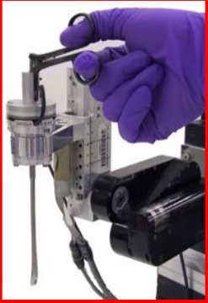
Aim
Develop normally-open microvascular needle driver and/or
forceps that can be integrated with Galen robot
1) Held at the top by the surgeon
2) Held at the middle by the robot
3) Allows for rotation about own axis
4) Ergonomic and dexterous
5) Design for manufacturability & sterilizability
Surgical Instrument Ergonomics
1) Design considerations for microsurgery
2) Tasks, models, evaluation methods (in laparoscopy)
3) Postural analysis tool
Kumar et al.,MICCAI ‘99
Notes:
Just to refresh your memories, our aim is to develop microvascular needle driver and forceps that can be integrated with the cooperatively controlled galen robot. It is required that the tool is held at the top by the surgeon and at the middle by the robot. There needs to be rotational freedom about the tools axis. The design must obviously be ergonomic and dexterous and we also hope to have good manufacturabilty and sterilizability.
In todays talk, I am going to focus on 3 papers about surgical instrument ergonomics. The first deals with microsurgery specific design consdierations in addition to what we already have. The second paper gives information about task classification, evaluation models and measurement systems. The third paper is about a popular postural analysis tool called REBA.

Slide 3
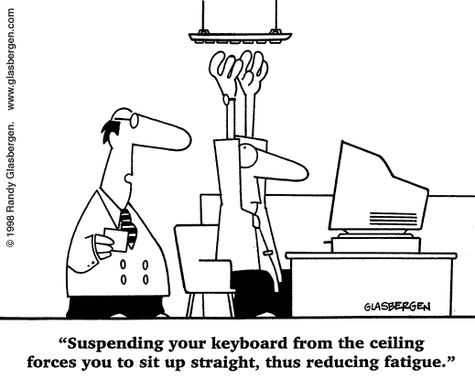
Areas for improving ergonomics
1) Tool itself - affects fingers, wrist, shoulders etc.
2) Location of tool in workspace – affects neck, eyes, overall posture
3) Environment (lighting, noise, temperature)
4) Participant numbers (nurse, endoscope holder)
5) Variety, order, frequency and duration of tasks
Notes:
the study of people's efficiency in their working environment. In any setup, there are 5 main areas of ergonomic importance.
The ergonomics of tool itself- we have a handheld instrument so the fingers, wrist and arms will be affected
Thelocation of the tool in the workspace- this will affect the posture of the surgeon
Environmental factors like lighting and temperature are also important but not in our projects control
Its not just thesurgeon in the OR, he or she has assistants too and we must consider them
We also have some control over the variety, order, frequency and duration of tasks
So 1, 2 and to an extent ,5 are within our realm of influence as far as this project is concerned

Slide 4
Patkin, M. (1977), ERGONOMICS APPLIED TO THE PRACTICE OF MICROSURGERY. Australian and New Zealand Journal of Surgery, 47: 320–329.
Paper 1: ERGONOMICS APPLIED TO THE PRACTICE OF MICROSURGERY
This paper examines five aspects of microsurgery where ergonomics is important
(i) visual feedback
(ii) accuracy of hand movement and control of tremor
(iii) the acquisition of skill
(iv) hand grip used for precise work
(v) design and care of microsurgical instruments
Notes:
Here’s the first paper. It was published in 1977 but still very relevant. It looks at ergonomics in visual feedback which involves microscopes, lighting and so on.
The galen robot will take care of hand tremor and training aspects. The fourth aspect, dealing with hand grip is what we will see now. The fifth section is a bit outdated.

Slide 5
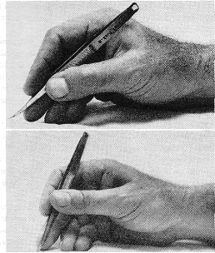
Handle design
Microsurgical “grip” different from “pen” grip
Three main movements:
A) Protraction, retraction B) rotation C) pinch/trigger
A) Length of handle – about 10 cm; the distance from fingertips to
instrument tip will depend on access to the tissues at operation
B) Handle cross-section circular, milled for friction
C) Diameter of handle 5-10 mm
D) Force required for closing is 40 – 100 gm
E) Mechanical advantage : 6:1
Microsurgical vs Pen grip
Patkin et al., . ANZ 1977
Notes:
When it comes to handle design, we have to understand the microsurgical grip. Similar to pen grip. Three movments are protraction,retraction, roataion ad pinching
Based on biomechanical testing it was found that the ideal length of handle is about 10 cm so that the tool acnrest in the thumb’s cleft. Distance from the fingertips to the instrument tip is something we have to find out, because we have a robot in our application
Handle cross section must eb circular for rotatability and must have a friction grip
Diamter of the handle must be large enough to grasp but small enough to fit in the cleft
The force required for actuation must be between 40 and 100 gm. Below that, the surgeon will not be able to hold the instrument without actuating it. Aboive that, fatigue occurs. Mechanical advantage must ideally be 6.

Slide 6
Assessment
Positives:
Mentions dimensions required exactly, along with biomechanical reasons behind them
Actionable suggestions for tool and workplace design
Negatives:
Outdated paper- manufacturing has improved greatly over 3 decades
Based on conventional surgery and not robotic assisted surgery
Notes:
This paper is very useful because it give the dimension directly, but we must be a bit careful as a robot was not involved here and it also has outdated information regarding to manfacturing

Slide 7
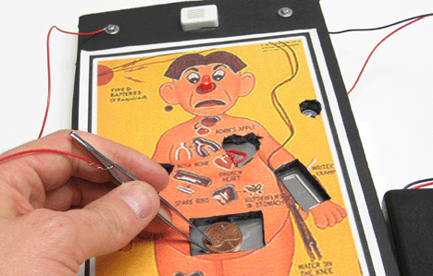
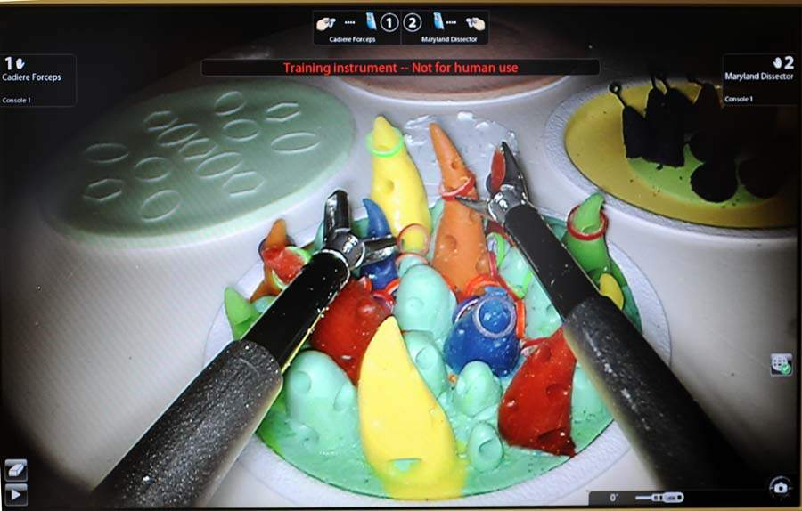
Paper 2: Tasks ,Models and Measurement Systems (Laparoscopy)
Lee, G., Lee, T., Dexter, D., Klein, R., & Park, A. (2007). Methodological Infrastructure in Surgical Ergonomics: A Review of Tasks, Models, and Measurement Systems. Surgical Innovation, 14(3), 153-167.
Types of tasks:
1) Static – opening and closing of instruments, no motion
of tool tip
2) Simple navigation – Operation game
3) Manipulation - pushing small object into
small aperture, instrument-instrument rope passing,
Cable passing, shape cutting, suturing, tying
Fundamentals of Laparoscopic skills (FLS)
Notes:
The second paper deals with task classification, ergonomic models and measurement systems
Tasks can be of gthree types: static- just actuating the gripper
Simple navigation- jusr moving along a path
Manipulation – where you actually use the tool for its intended purpose

Slide 8
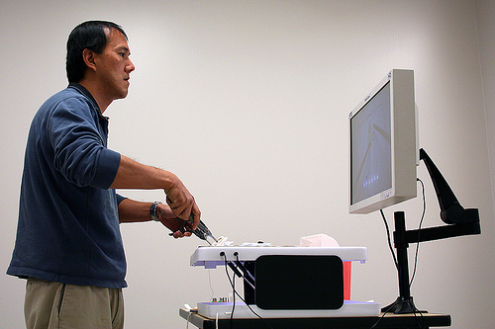
Environments for testing
1) Operating Room- on cadavers, phantoms
2) Training box- confined space roughly approximating the abdominal cavity into which ports may be placed to allow instrument access, camera within for recording
3) Virtual Reality simulators – visual, audio and haptic feedback
By measuring the success rate and speed of
completion, we can compare the
ergonomics of different instrument designs
Notes:
Again,ergonomic testing environments can be classified into 3 types: OR. Not everyone has access to such facilities.
Training boxes are good but lack sophistication/ These are just hollow boxes with access slots and camcorders,
Virtual realty simulators can give lot of information but can be expensive and not generalizable.

Slide 9
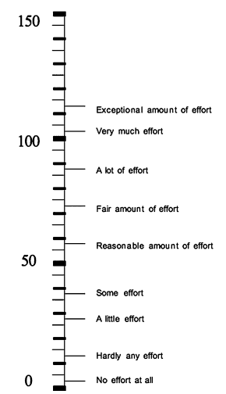
Measurement methods
1) Self-reported (subjective). Study participants fill out questionnaires, surveys
Eg: Subjective Mental Effort Questionnaire (SMEQ) and the Local Experienced Discomfort (LED) scale
SMEQ
Subjective Mental Effort Questionnaire
Olivier et al., Surgical Endoscopy 2009
Notes:
Coming to measurement methods : There are both subjective and objective measurement systems. / Subjective ones are just questonaarierss and surveys.
Objective measures use sensors to record information.

Slide 10
LED Local Experienced Discomfort Olivier et al, Surgical endoscopy 2009

Slide 11
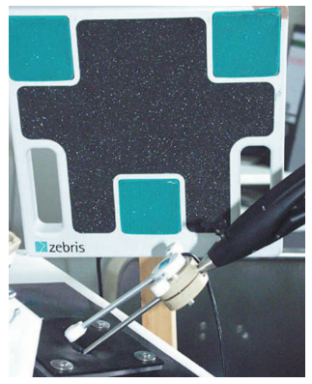
Measurement methods
2) Measured with sensors (objective):
a) Motion analysis: video- manual analysis, optical tracking , EM tracking, Orientation sensor
Optical motion systems capable of handling hundreds of markers-
Measure flexion/extension, abduction/adduction, internal/external rotation , CoM
Factors to consider: occlusion, interference, space requirements
Ultrasound tracking
Zebris, Isny, Germany
Notes:
There are 3 kinds of objective methods:
Motion analysis: optical tracking, EM tracking, video analysis

Slide 12
b) EMG- Electro-myography
Muscle exertion causes change of the action potentials which can be measured just above the skin using electrodes
EMG data analysis relates muscle activation to outcome (force, torque, movement, fatigue level)
Three types of analysis:
1) Amplitude of EMG signal averaged over time
2) Percentage of Maximum Voluntary Contraction (% MVC)
3) Frequency analysis – task induced fatigue
Notes:
Similar to ecg where you have electrodes on the skin. As the muscles flex, the electric potential changes and this is recorded. Amplitude is the most basic analysis. MVC reklates the load to muscle strength and frequency analysis studies fatigue involved.

Slide 13
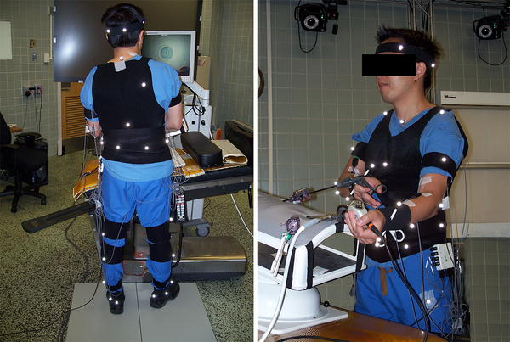
c) Force plate Systems
Plates that measure Ground Reaction Force (GRF) through piezoelectric transducers or strain gauges
Can provide:
1) 3D resolution of force
2) 2D coordinates of Centre of Pressure
3) rotational moments about x, y and z axes
This system is good only for overall posture measurement
Notes:
The third objective system is the force plate system which uses transducers or strain gauges to measure reaction force. Its good only for postural nalysis

Slide 14
Assessment
Positives:
A thorough classification and description of tasks and measurement methods
Applicable to both tool and workspace integration ergonomics
Discusses advantages and limitations of the various methods
Has been used to evaluate robot assisted surgeries
Negatives:
Does not provide a scoring system that can give actionable advice
Notes:
Thorough description. It has been used in robotic assited

Slide 15
Paper 3: Rapid Entire Body Assessment (REBA)
Hignett, S., & Mcatamney, L. (2000). Rapid Entire Body Assessment (REBA). Applied Ergonomics, 31(2), 201
-205.
Postural analysis tool specifically developed for healthcare practitioners
Features of REBA:
1) Sensitivity to musculoskeletal risks in a variety of tasks
2) Segmentation of body and coding of segments
3) Scoring system for muscle activity caused by static, dynamic, rapid changing or unstable postures
4) Hand hold is given importance
5) Action level with indication of urgency
6) Only pen and paper required
Notes:
The last paper is a semimal work on a postural analysis developed specifically for healthcare practitioners
it is basically Sensitive and generalizable for many tasks, it has a scoring system fo muscle activity and indicates action level

Slide 16
REBA scores
Group A parts:
Leg
Neck
Trunk
- 60 posture combinations
Group B parts:
Upper arms
Lower arms
Wrists
-36 posture combinations
Group A+ B:
144 combinations
Notes:
The limbs are segmented into group a and b:
Leg, neck, trunk

Slide 17
REBA scores

Slide 18
Example- physiotherapist with patient
Group A:
Trunk is flexed more than 60 degrees, side flex (4 +1)
Neck is extended (2)
Legs are both weight bearing and flexed more than 60 degrees (1 +2)
Load force < 5 kg (0)
Group B:
Upper arms flexed between 45 to 90 degrees, abducted, gravity assisted
(3 + 1 -1)
Lower arm flexed less than 60 degrees (2)
Wrist 0 to 15 degrees (1)
Coupling: (1) not ideal hand-hold

Slide 19
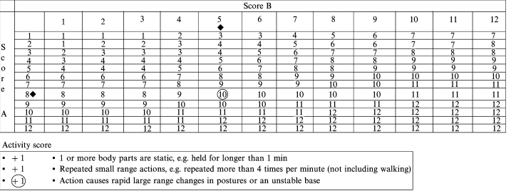
A-B table and activity score

Slide 20
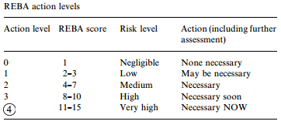
REBA action level
10 + 1 = 11
(A-B table+ action)
High risk task!

Slide 21
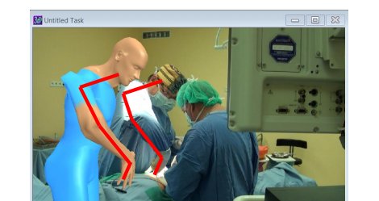
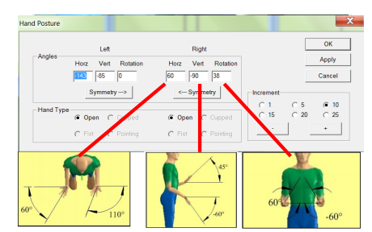
REBA software

Slide 22
Assessment
Positives:
REBA tool has been evaluated for over a decade and found to be quite accurate and popular
Easy to understand and use
Has been used to evaluate robotic assisted surgeries
Negatives:
Does not deal with fingertip forces

Slide 23
Conclusion
1) Papers together make comprehensive resource for ergonomic design and evaluation
2) Our surgical instrument is integrated with a robot, we may face unique challenges while trying to implement safe and effective instrument design
3) We do not aim to test the instruments with experienced surgeons, the knowledge of correct working posture can help in our self-evaluation.
Questions?

