Slide 1
Projection Mapping (Spatial Augmented Reality) in Surgery
Background
Projection Mapping is projection technology in which a 2D or 3D object is spatially mapped on the virtual program which mimics real environment
Goal
Develop and demonstrate handheld projector prototype that projects patient data (CT/MRI scan model) or anatomy of interest onto patient body.
http://zhouyisjtu.github.io/

Slide 2
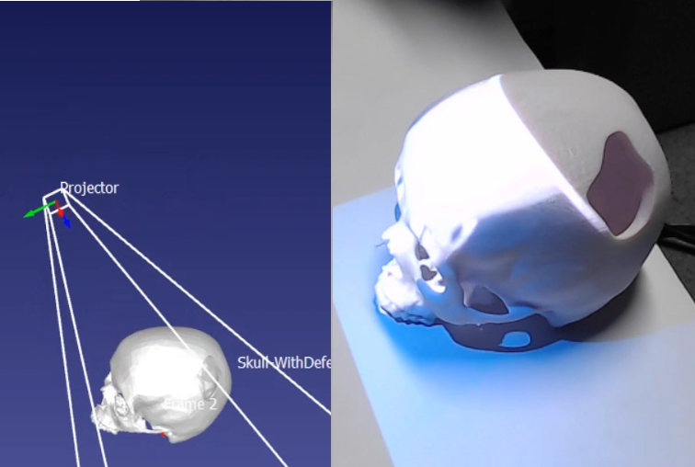
Projection Mapping in Surgery
Deliverables
Develop integrated handheld projector & 3D scanner system for intraoperative projection of patient model onto anatomy of interest
What Student Will Do
Work with RGB 2D images, 3D point cloud data
Develop object, tracking, registration, projection mapping software
Show feasibility in cranioplasty
Details
Group size: 1-3 students
Skills: Python, C++, registration (nice to have: image processing, geometric mesh processing)
Mentors: Dr. Mehran Armand (Mehran.Armand@jhuapl.edu), Joshua Liu (sliu84@jhu.edu)

