Slide 1
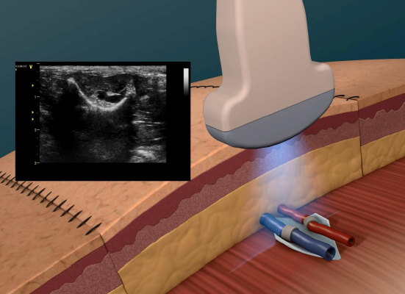
Development of a Doppler Ultrasound Simulation Environment Using Field II
The motivation of this work is to guide detection of potentially catastrophic post-operative blood clots. This project involves simulating clinical flow systems to aid in ultrasound-based methods of detecting thromboses.
What Students Will Do:
Learn Field II ultrasound simulation software
Develop test environments to represent various anatomies
Model appearance of Sonavex’s EchoMark fiducial implant
Opportunity to validate results with phantom and/or animal data using ultrasound scanner
Deliverables:
Measure flow rates in healthy and clotted models
Create test environments
Size group: 2-3
Skills: Matlab, fundamental interest
in or experience with ultrasound
Mentors: Andrew Lang, PhD – alang@sonavex.com
David Narrow – dnarrow@sonavex.com

