Slide 1
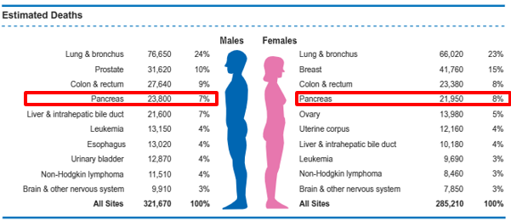
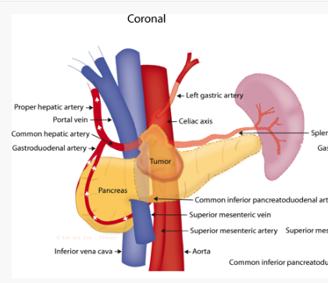
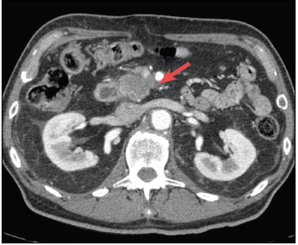
Building an immersive VR/AR educational platform for patients undergoing radiotherapy for pancreatic cancer
Background
Pancreatic cancer is a devastating disease with a 5 yr survival <5%
Radiation represents a critical tool to help downstage tumors to allow surgical removal
Delivery of radiation is challenging due to the proximity of exquisitely radio-sensitive bowel and motion of the tumor with respiration

Slide 2
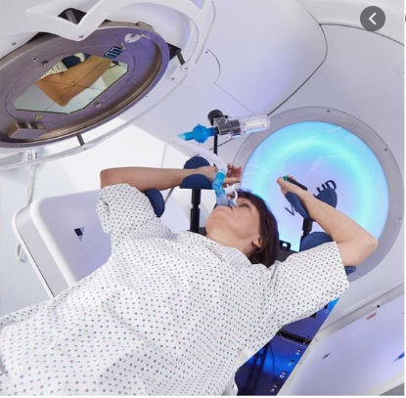
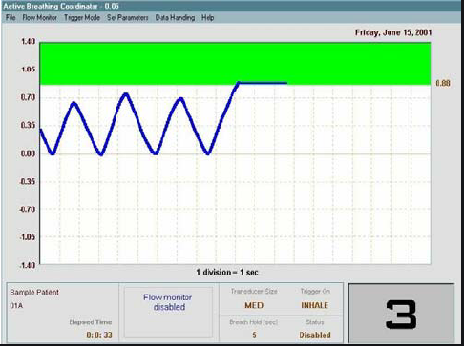
Building an immersive VR/AR educational platform for patients undergoing radiotherapy for pancreatic cancer
Background
Techniques to reduce tumor motion are available but require significant patient engagement and comprehension of a complex workflow
VR/AR technology could significantly improve success of motion management techniques

Slide 3
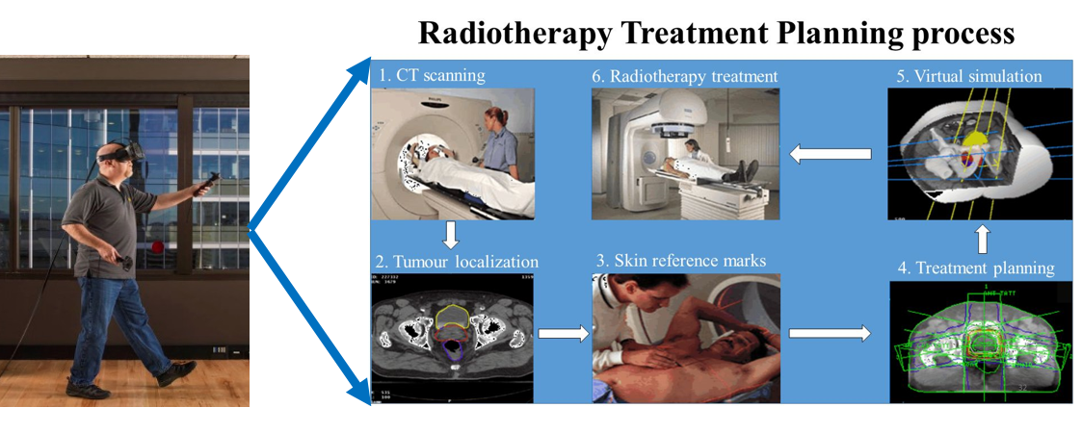
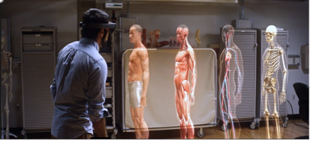
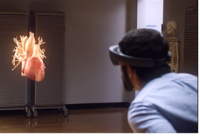
Building an immersive VR/AR educational platform for patients undergoing radiotherapy for pancreatic cancer
What students will do/Deliverables
Program transfer of user-friendly breath-hold signal to AR/VR headset for use during radiation simulation and during radiation treatment
Develop educational AR/VR patient experience for use during patient consultation
There is the potential to do more depending on experience and time – to develop a VR experience patients can immerse in to practice their motion management techniques
Size group: 1-3 students
Skill
Programming experience
Experience with AR/VR
platforms would be helpful
Mentors:
Amol Narang, MD
anarang2@jhmi.edu
Ken Wang, PhD
Sarah-Han-Oh, PhD
Colin Hill, MD
PATIENTCRAFT?

