Slide 1
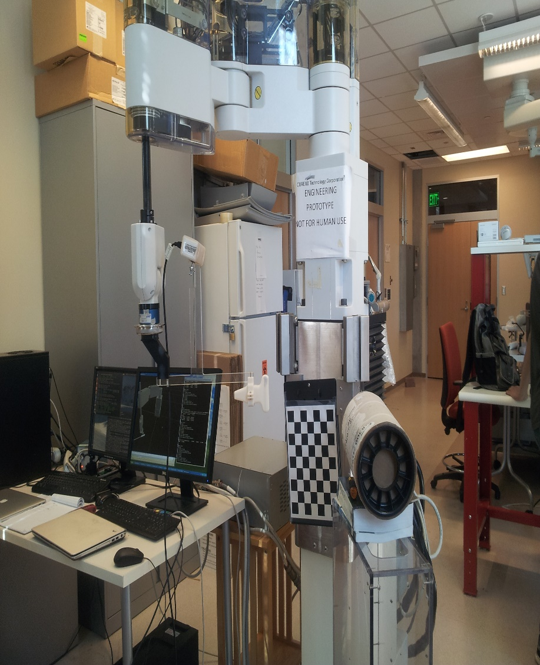
Enabling Technologies for Robot Assisted Ultrasound Tomography GROUP 11 : Fereshteh Aalamifar, Rishabh Khurana Mentors: Drs. Emad Boctor, Iulian Iordachita, Russel Taylor
Goals:
Design a prototype system that uses a robot controlled ultrasound probe to follow the motion of the free hand probe using a micron tracker.
Significance:
Use the system for Ultrasound Tomography with higher accuracy.
Results:
Ultrasound calibration, hand-eye calibration.
A mock US probe attached to a robotic arm following the position of a freehand ultrasound probe on the other side of a cylinder, using micron tracker
Study EPT and B-Mode. Implement B-Mode and conduct its accuracy study.

