Slide 1
Intraoperative Image-Based 2D/3D Registration
Paper Critique
Jesse Hamilton
Group #3
April 24, 2012
Team Member: |  | Michael Van Maele
Mentors: |  | Dr. Mehran Armand, Dr. Yoshito Otake, Ryan Murphy
Course: |  | Computer Integrated Surgery II (EN.600.646)

Slide 2
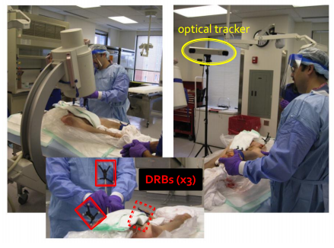
Project Overview
Current system: Periacetabular osteotomy (PAO) to correct developmental dysplasia of the hip (DDH) navigated by an optical tracker.
Polaris camera.
Dynamic rigid bodies (x3)
Point-based registration.
Optical tracker PAO setup.
Courtesy of Ryan Murphy
Notes:
DDH – malformed acetabulum – increased joint contact pressure, insufficient coverage femoral head
complications – osteoarthritisi
younger women – joint reconstruction preferred to prosthetics

Slide 3
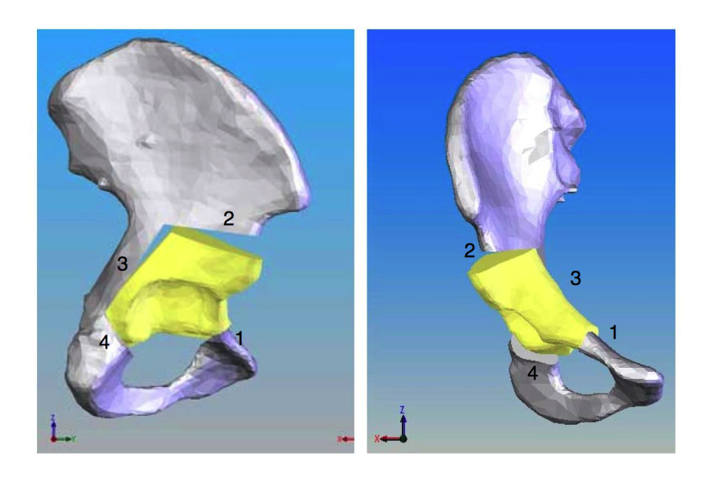
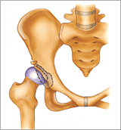
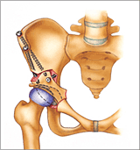
Project Overview
Current system: The Biomechanical Guidance System (BGS) utilizes angle and contact pressure to estimate the optimal fragment realignment .
3D model of hip and fragment.
Courtesy of Ryan Murphy
PAO procedure.*
*http://www.hipandpelvis.com/patient_education/periace/page2.html

Slide 4
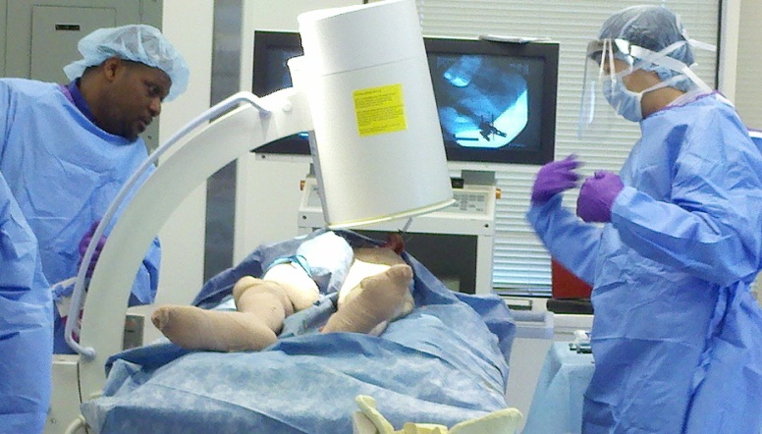
Project Overview
Our goal: We want to replace optical tracker navigation with X-ray navigation.
Optical tracker PAO setup.
C-arm fluoroscopy.
Courtesy of Ryan Murphy

Slide 5
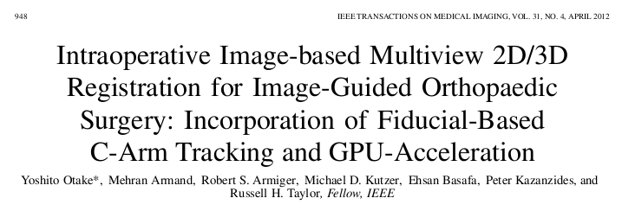
Paper Selection
Our project utilizes fiducial-based C-arm tracking to estimate relative pose between x-ray images.
Our final pipeline will incorporate this 2D-3D registration algorithm.

Slide 6
Paper Overview
Propose a framework for intraoperative 2D/3D image-based registration utilizing
Conventional C-arm imager
Graphics processing unit (GPU) acceleration
Outline of proposed procedure
Acquire x-ray images
Estimate relative pose between images using an x-ray opaque fiducial
Estimate patient pose using intensity-based 2D/3D registration
Key Result: This framework is feasible for image-guided orthopedic surgery.

Slide 7
Background
Advantages of image-based over point-based registration
No physical contact with patient anatomy
No segmentation of anatomical features needed
Reduced procedure time
Technical obstacles to 2D-3D registration for image-guided surgery (IGS)
Uncertainty of extrinsic/intrinsic calibration of mobile imager
High computational load
Notes:
Image-based registration currently used for IGRT.
* Room-mounted fixed gantry x-ray

Slide 8
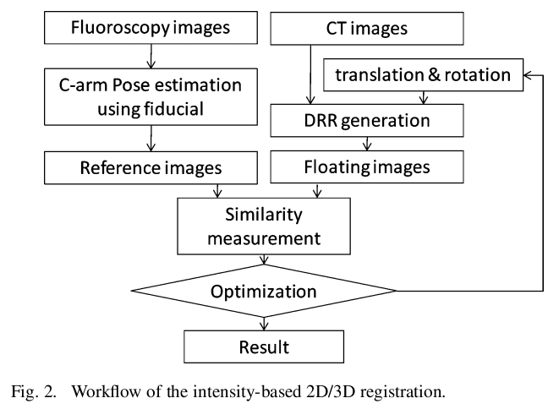
Registration Workflow

Slide 9
Methods
(1) Preoperative Calibration
Used two types of mobile imagers.
Conventional C-arm with x-ray image intensifier (XRII)
Distortion correction: Fit Bernstein polynomials to grid of metallic ball bearings spaced 1mm apart
C-arm cone beam CT (CBCT) with flat-panel detector
No distortion correction necessary
Conventional C-arms are more prevalent in hospitals.

Slide 10
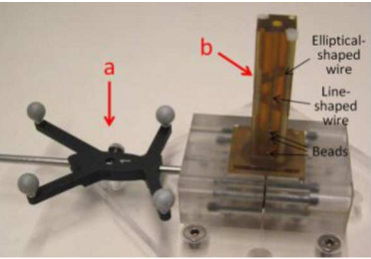
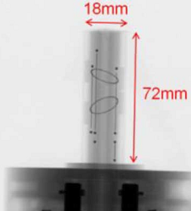
Methods
(2) C-arm Pose Estimation
Identify 4 non-coplanar beads using morphological filtering & thresholding
Estimate object pose w.r.t. x-ray source using POSIT
Create projection of CAD model of FTRAC
Compare CAD projection & x-ray image using mutual information
Optimize steps 1-4 with Downhill Simplex Algorithm

Slide 11
Methods
(3) Image Pre-processing
Pre-op CT
Convert Hounsfield Units to linear attenuation coefficient
Intra-op x-ray images
Compute line integral of linear attenuation coefficient
(4) Initialization
Create initial guess of relative pose between x-ray images and CT volume
Estimated from surgical protocol and configuration of C-arm

Slide 12
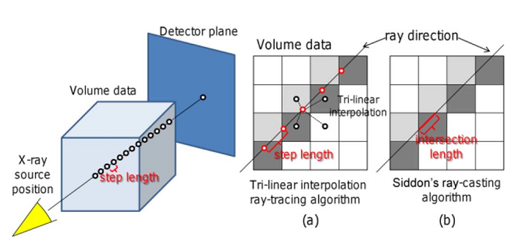
Methods
(5) DRR Generation
Investigated two algorithms
Ray tracing with tri-linear interpolation: fast, less accurate
Siddon’s ray-casting method: computation-intensive, more accurate

Slide 13
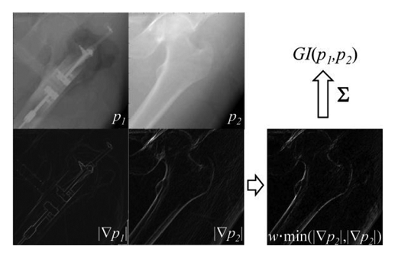
Methods
(6) Similarity Measurement
Investigated three objective functions
Mutual information (MI)
Normalized mutual information (NMI)
Gradient information (GI)
Taking minimum eliminates effects of objects present in one image but not the other.

Slide 14
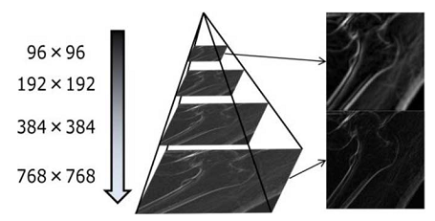
Methods
(7) Optimization
Investigated two non-gradient approaches
Simplex algorithm
Stochastic search algorithm (CMA-ES)
Also used a coarse-to-fine multiresolution strategy

Slide 15
Experimental Setup
Performed series of experiments with increasing complexity
Evaluation method
100 registration trials with randomly selected initial guesses
Initial mean target registration error (mTRE) from 0-10 mm in 1 mm intervals
4 Criteria
mTRE
success rate
(final mTRE < 2.5 mm)
# function calls
computation times

Slide 16
Experiment 1
Purpose: to validate proposed registration framework with published data
Technical Details
Tri-linear interpolation, step length = 1.5 mm
GI
CMA-ES
Multiresolution off
Success threshold $mTRE≤5 mm$

Slide 17
Experiment 2
Purpose: to evaluate proposed registration framework with ideal data set
No noise from soft tissue
No pose estimation error, calibration error, or fiducial movement
Acquired 200 x-ray projections over 180° using CBCT
Selected 1-4 evenly spaced images to test registration accuracy

Slide 18
Experiment 3
Purpose: to evaluate registration accuracy in cadaver
No pose estimation error, calibration error, or fiducial movement
Acquired 400 x-ray projections over 180° using CBCT
Selected 1-4 images
Analyzed how registration accuracy influenced by
Number of images
Range of view angles

Slide 19
Experiment 4
Purpose: to evaluate registration accuracy in a more realistic clinical setting
Calibrated C-arm one time preoperatively
Sources of error
Image distortion from XRII
Geometric calibration error from fiducial-based pose estimation
Pose-dependent changes of intrinsic C-arm parameters

Slide 20
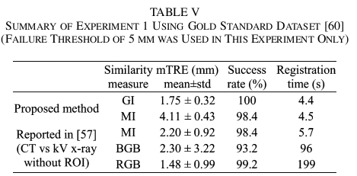
Results
Experiment 1 (gold standard data set)
Lower mean and stdev mTRE than literature values
Faster
GI more robust than MI to soft tissue deformation

Slide 21
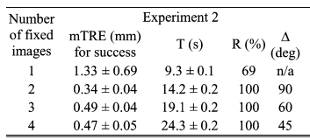
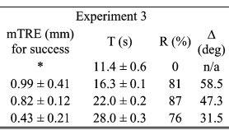
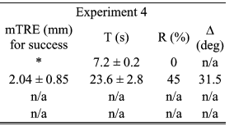
Results
Experiment 2 (plastic phantom)
31% of trials failed when using 1 image
100% success when using at least 2 images
Experiment 3 (cadaver, CBCT)
100% of trials failed when using 1 image
Experiment 4 (cadaver, C-arm)
100% of trials failed when using 1 image
Error when using 2 images twice as large as Experiment 3

Slide 22
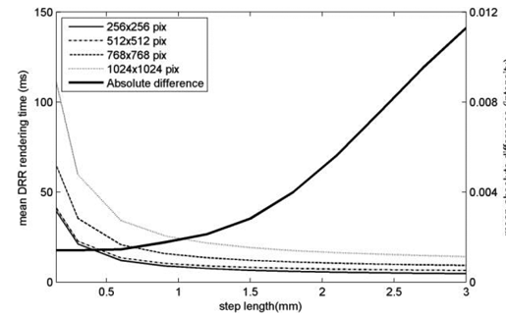
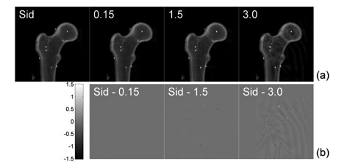
Results
Comparison of DRR Generation Algorithms
Mean Absolute Difference (intensity)
Mean DRR Rendering Time (ms)
Better accuracy as step size for trilinear interpolation decreases
For step lengths greater than 1.5 mm
Computation time plateaus
Image quality decreases
Step length (mm)

Slide 23
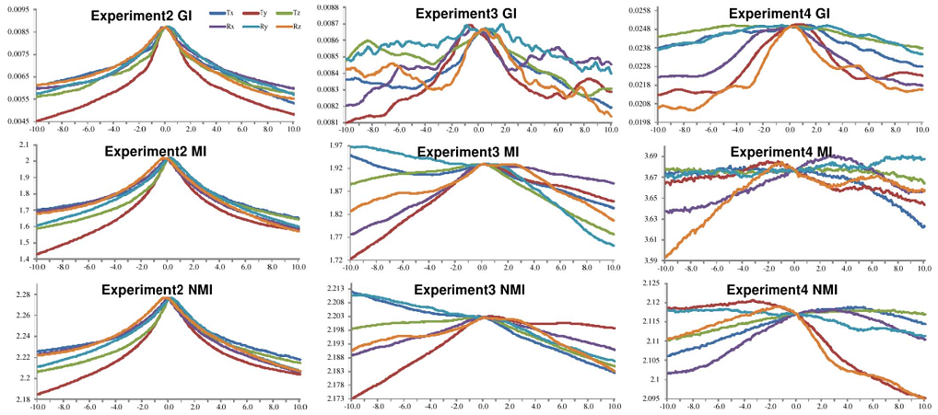
Results
Comparison of Similarity Measures
Exp 2 (plastic phantom): smooth landscape, distinct local maxima
Exp 3-4 (cadaver): rugged landscape due to noise from soft tissue
Gradient information has lowest mTRE for cadaver images

Slide 24
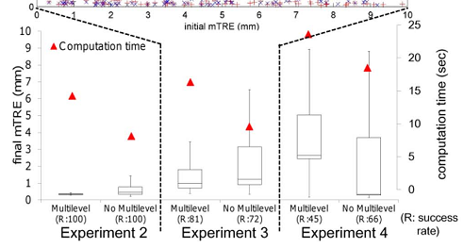
Results
Effect of Coarse-to-Fine Multiresolution Strategy
Multilevel optimization may enlarge errors in low-resolution stages when using a conventional C-arm with XRII.

Slide 25
Personal Assessment
Strengths ☺
High-level view of registration workflow was conveyed effectively
Purpose of each experiment was clearly stated
Each experiment tested the framework in progressively challenging settings
Abundance of clear figures
Weaknesses ☹
Some technical details could have been described more in-depth
Choice of initial pose (step #4 in registration workflow)
C-arm pose estimation (step #2 in registration workflow)
Possible error in ground truth registration in Experiment 4

Slide 26
Future Directions
Optimize the fiducial design
Reduce size/weight
Looser or less invasive method of attachment
Our project uses non-rigid FTRAC attachment
Investigate how to merge similarity measures for each pair of images into one objective function for multiple images
Numerical sum
Composite approach
Alternating approach
Repeat Experiment 4

Slide 27
Concluding Remarks
Proposed clinically feasible framework for intraoperative 2D/3D registration using
Preoperative CT model
2 intraoperative x-rays
Advantages
Quick (15 sec registration)
Reasonably accurate/robust
Automated

Slide 28
Appendix

Slide 29
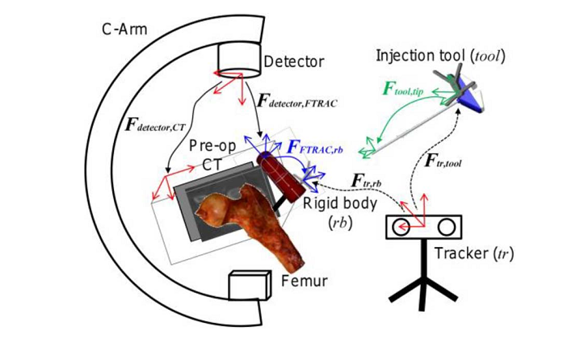
Problem Definition
Given several projection images, compute
Relative pose between each image
Relative pose between images and patient anatomy

Slide 30
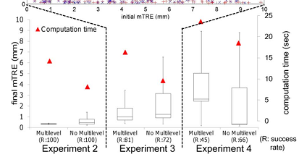
Results
Computation time increased linearly with number of x-ray images

