Slide 1
HMD-Based Fasciotomy for Compartment Syndrome
Fasciotomy is a surgical procedure where the fascia is cut to relieve tension or pressure commonly to treat the resulting loss of circulation to an area of tissue or muscle. Fasciotomy is a limb-saving procedure when used to treat acute compartment syndrome. The goal is to introduce image guidance via augmented reality on a head-mounted display (HMD).
What Students Will Do:
Implement HMD-based navigation system for fasciotomy
Deliverables:
Generating step by step fasciotomy workflow for HMD
Appropriate planning to identify the position of cut
Create overlay of cutting path on HMD superimposed on the anatomy
Create assistive feedback in the procedure using audiovisual cues
Size group: 2-3 students
Skills: HMD programming (Unity), C++ or Python, segmentation
Mentors: Ehsan Azimi (eazimi1@jhu.edu), Peter Kazanzides (pkaz@jhu.edu), Clinical Mentor: Greg Osgood (gosgood2@jhmi.edu)

Slide 2
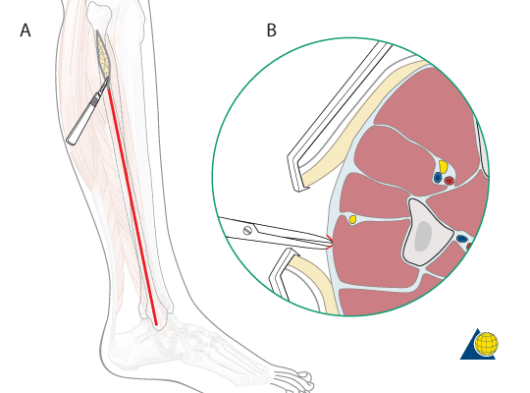
HMD-Based Fasciotomy for Compartment Syndrome
Workflow
Generating the surgical workflow for the procedure
Superimpose cutting path onto patient by touching anatomic points
Overlay of cutting tool, with possibility for adjustment
Providing audiovisual assistance in the HMD for tool pose correction
Hardware/Software
Microsoft HoloLens HMD
HMD application in Unity3D
External software in C++ or Python
Tracking of cutting tool
Eye gaze to adjust guide (optional)

