Slide 1
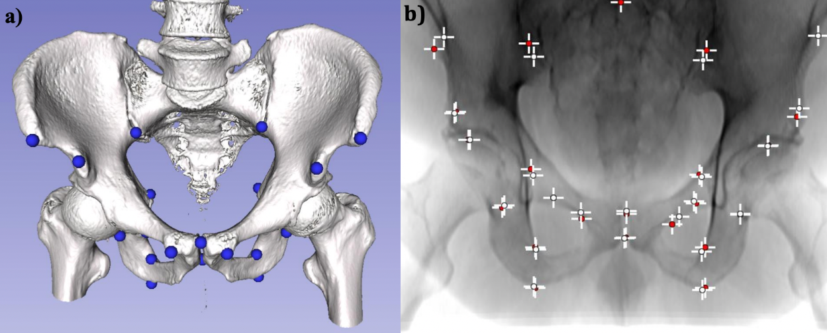
Improve Generalization of Pelvis X-ray Landmark Detection
Detect pelvis X-ray anatomical landmarks for 3D pose estimation
Deep neural networks perform well on simulated X-rays but struggle when applied to real X-rays.

Slide 2
Improve Generalization of Pelvis X-ray Landmark Detection
What Students Will Do:
Generate simulated X-rays from CT data
Try different DeepNet architectures on simulated X-rays to obtain benchmark detection results on synthetic data
Investigate techniques to improve domain generalization
Perform ablation studies on simulated and real X-ray datasets
Deliverables:
Structured simulated X-ray dataset
Baseline and improved DeepNet frameworks
Ablation study and real X-ray performance results
Size group: 1
Skills: python, pytorch, tensorflow, 2D/3D registration, computer vision
Mentors: Cong Gao, cgao11@jhu.edu; Prof. Mathias Unberath

