Slide 1
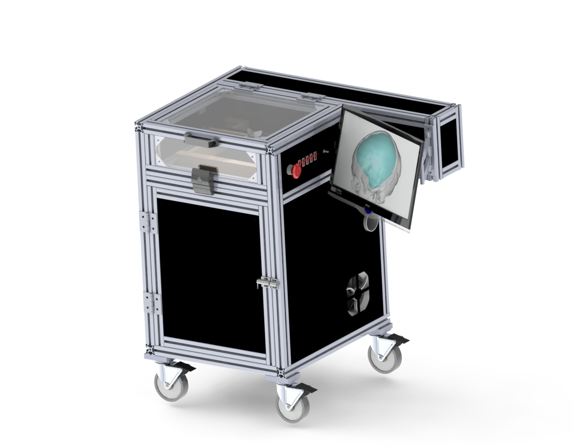
Control Architecture of Cranial Implant
Laser Cutting System
Group 18
Team members: Joshua Liu, Jerry Fang
Mentors: Dr. Mehran Armand, Dr. Ryan Murphy, Dr. Chad Gordon

Slide 2
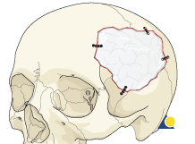
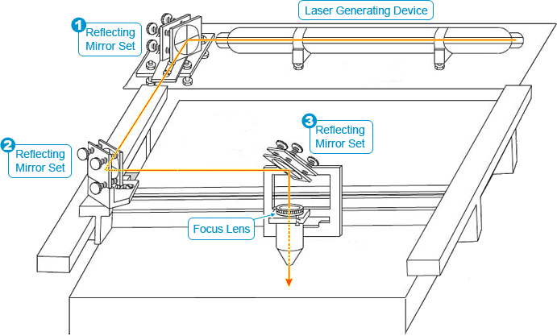
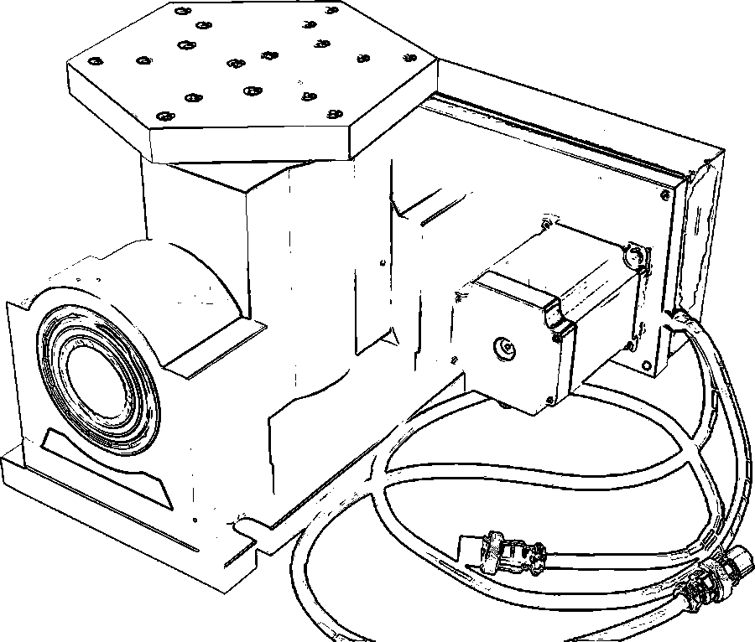
Project Overview
Existing procedure for implant creation is time consuming and done manually
Goal: to develop a 5 DOF laser cutting system that will help surgeons to quickly and accurately resize custom cranial implants (CCIs) in single-stage cranioplasty

Slide 3
Paper Selection
Li, M., Huang, T., & Li, Z. (2003). “Conceptual design and kinematic analyses of a 3-DOF robot wrist.” Proceedings of the 2003 IEEE International Conference on Robotics and Automation, Taipei, Taiwan - September 2003.

Slide 4
Importance
Develop mathematical models for forward and inverse kinematics involving 3 rotational axes
Applicable to controlling the motion of our rotary table

Slide 5
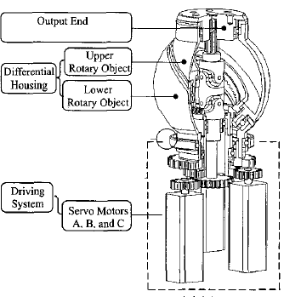
Design: Robot Wrist
Driving system
3 servo motors
Differential housing
2 parts, upper and lower, separated with certain angle
Output end

Slide 6
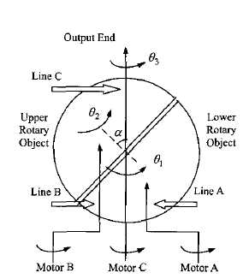
Design: Transmission path
3 transmission paths
Motor A: lower rotary object
Motor B: upper rotary object
Motor C: Output end
Differential results produce output motion

Slide 7
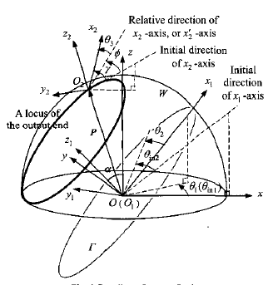
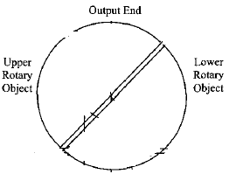
Model: Coordinate System
Reference frame
O: bottom surface
O1: contact surface Γ
O2: output end

Slide 8
Model: Rotation Angle
θ₁: bottom surface
θ₂: contact surface
relative to bottom
θ₃: output end relative
to upper
α: angle between Γ and bottom plane
Φ: relative angle of output with respect of two other axes
γ: expected angle of output relative to initial

Slide 9
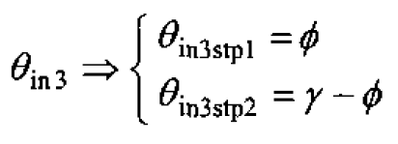
Model: Rotation Angle

Slide 10
Forward Kinematics
Process of finding the relationship between the configuration of the output end and the three input angles
The pose of the output can be expressed as a function of the three input angles {θ₁,θ₂,θ₃}

Slide 11
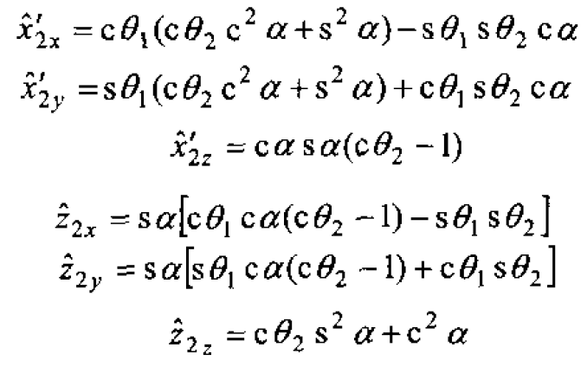
Forward Kinematics
Step 1: Solve for unit vector as the result of θ_{in1} and θ_{in2}
Step 2: Solve for final pose of the output end, γ

Slide 12
Forward Kinematics
Step 1: Solve for unit vector as the result of θ_{in1} and θ_{in2}
Step 2: Solve for final pose of the output end, γ

Slide 13
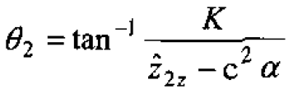
Inverse Kinematics
Given the final configuration of the output end, determine all three absolute rotation angles: θ_{in1}, θ_{in2}, θ_{in3}

Slide 15
Singularity
Locations at which the manipulator is:
Fully stretched out or folded back (workspace-boundary)
lined up at two or more joint axes (workspace-interior)
Lose DOF in this state, so want to avoid this condition

Slide 16
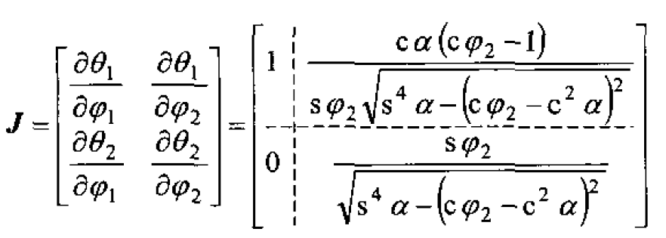
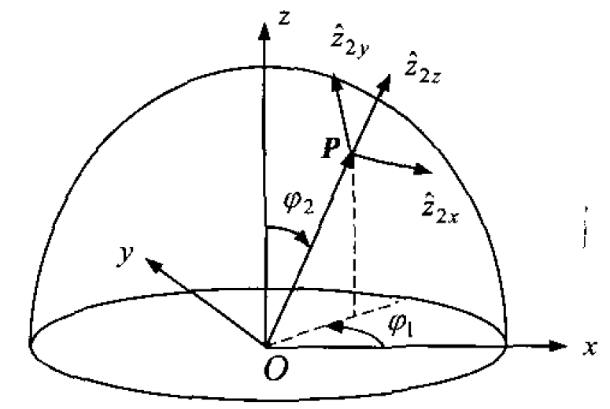
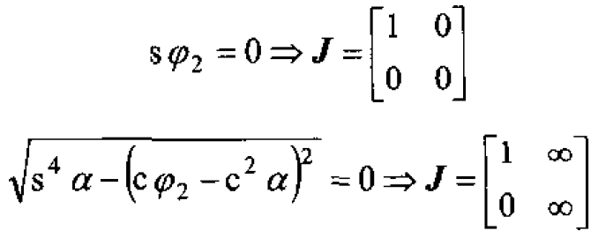
Singularity
Singularity occur when φ₂= 0 or 2α

Slide 17
Paper Assessment
Pros
Thorough kinematic analysis
Detailed description of the model parameters
Detailed derivation of the mathematical model
Cons
Dense: too much math
Complicated diagrams
Confusing example to illustrate singularity avoidance

Slide 18
Conclusion
Paper describes kinematic models for the interaction of 3 rotation axes
Similar algorithm can potentially be incorporated in our project
Questions?

