Slide 1
Statistical Shape Analysis in Congenital Heart Disease (CHD)
Lasya Gaur, MD
Assistant Professor, Pediatric Cardiology, Johns Hopkins Hospital
Bharath Ambale-Venkatesh, Phd
Instructor of Radiology and Radiological Science
Shelby Kutty, MD
Professor and Chief of Pediatric Cardiology, Johns Hopkins Hospital

Slide 2
Feasibility of Statistical Shape Analysis in Congenital Heart Disease (CHD)
What is Congenital Heart Disease (CHD)?
Patient population
Tetralogy of Fallot
Bicommissural aortic valve

Slide 3
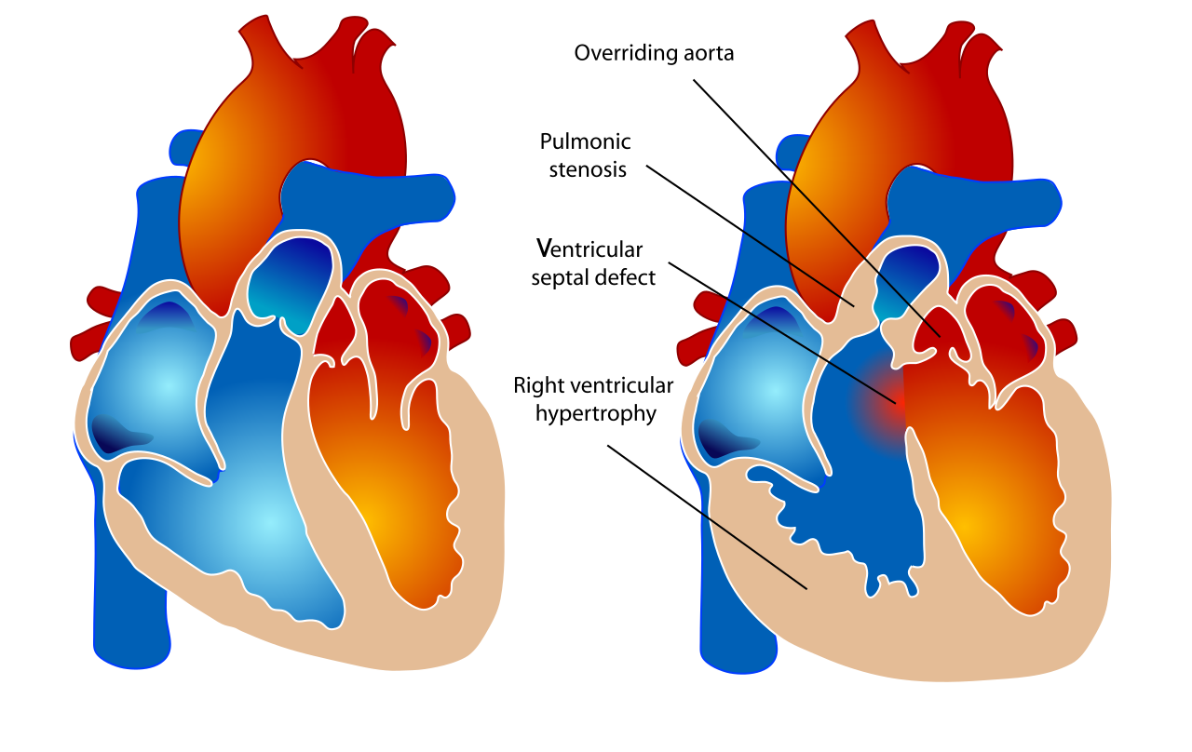
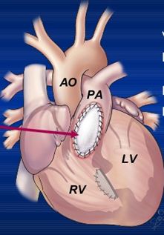
Tetralogy of Fallot (background)
NORMAL
TETRALOGY OF FALLOT
Congenital heart defect
Blood flow to the lungs is obstructed
Correction is surgical repair in infancy
Relief of pulmonary outflow obstruction
A Transannular patch relieves obstruction BUT results in pulmonary insufficiency (PI)
Transannular patch

Slide 4
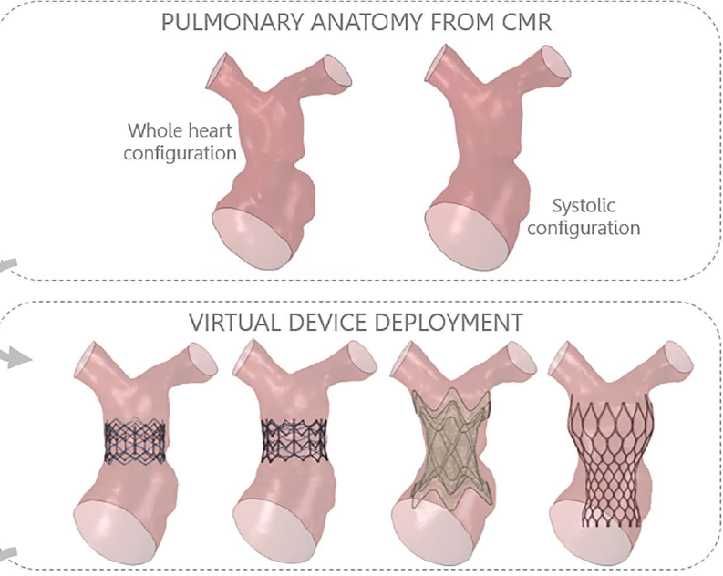
Tetralogy of Fallot – surgical repair
Pulmonary valve replacement (PVR) required in late adolescence/early adulthood.
Traditional PVR is surgical
Newer approach is via transcatheter valve implantation.
Preferred to avoid surgical risks/complications
Transcatheter approach is limited by appropriate patient selection – difficult to predict how the implanted stented valve will “fit” into RVOTs of different shapes/sizes
Bosi GM, Capelli C, Khambadkone S, et al. Patient-specific finite element models to support clinical decisions: a lesson learnt from a case study of percutaneous pulmonary valve implantation. Catheter Cardiovasc Interv 2015;86:1120–30.

Slide 5
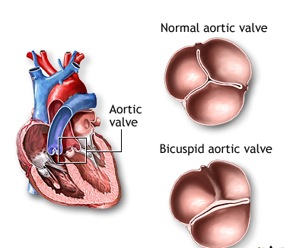
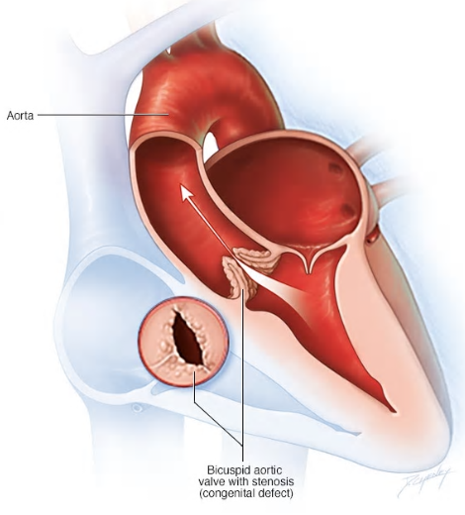
Bicommissural aortic valve (BAV) - background
Most common congenital heart abnormality, with 1–2% prevalence, and 3:1 predominance in males
Leads to Aortic valve stenosis (AS)/aortic regurgitation (AR) and progressive aortic dilation
Shape analysis of the left ventricle (LV) and Aorta may correlate with overall outcomes, including progression
2
3
3 leaflets
1
2 leaflets
Ascending
Aorta

Slide 6
Feasibility of Statistical Shape Analysis in Congenital Heart Disease (CHD)
Project goal
Create “shape biomarkers” based on current imaging (Cardiac MRI or CT)
Use “shape biomarkers” to predict clinical outcomes:
TOF: Identify properties of RVOT that predict successful transcatheter PVR
BAV: Identify specific aortic arch and LV shapes that predispose to intervention or correlate with known genotypes.

Slide 7
Feasibility of Statistical Shape Analysis in Congenital Heart Disease (CHD)
Deliverables:
Develop/utilize an efficient and automated segmentation tool utilizing existing cardiac MRI or CT images (10-15 patients per group)
Develop a statistical shape atlas of LV, aortic arch and RV, main pulmonary artery in BAV and Tetralogy of Fallot respectively
Create VR models for preprocedural planning
Size group: 3 students
Skills: MATLAB programming
Mentors:
Bharath Ambale Venkatesh (bambale1@jhmi.edu)
Lasya Gaur (lgaur1@jhmi.edu)
Shelby Kutty (skutty1@jhmi.edu)

Slide 8
References/Suggested reading
Al Habib, HF, Jacobs, JP, Mavroudis, C, et al. Contemporary patterns of management of tetralogy of Fallot: data from the Society of Thoracic Surgeons Database. Ann Thorac Surg 2010; 90: 813–819
Biglino G, et al. Computational modelling for congenital heart disease: how far are we from clinical translation? Heart 2017;103:98–103.
Jolley MA, Lasso A, Nam HH, et al. Toward predictive modeling of catheter-based pulmonary valve replacement into native right ventricular outflow tracts. Catheter Cardiovasc Interv. 2018;1–10
Sophocleous F, Biffi B, Milano EG, Bruse J, Caputo M, Rajakaruna C et al. Aortic morphological variability in patients with bicuspid aortic valve and aortic coarctation. Eur J Cardiothorac Surg 2018

