Slide 1
Haptic Interface for Surgical Manipulator System Paper Presentation
Piyush Poddar
Mentors: Mike Kutzer, Ryan Murphy, and Mehran Armand
Biomechanical and Image-guided Surgical Systems (BIGSS) Laboratory
Johns Hopkins University
Computer Integrated Surgery II: Group 5
Spring 2012

Slide 2
* All unreferenced images are taken directly from this paper
Kutzer, M. D. M., S.M. Segreti, C.Y. Brown, M. Armand, R.H. Taylor, and S.C. Mears. "Design of a New Cable-driven Manipulator with a Large Open Lumen: Preliminary Applications in the Minimally-invasive Removal of Osteolysis." International Conference on Robotics and Automation (2011): 2913-920. IEEEXplore. Web. 12 Apr. 2012. <http://ieeexplore.ieee.org/xpls/abs_all.jsp?arnumber=5980285&tag=1>.

Slide 3
Problem:
An intuitive interface for a developed dexterous manipulator does not exist.
Solution:
develop such an intuitive interface using the PHANTOM® Premium while integrating haptic feedback

Slide 4
Force feedback
PHANTOM Premium
Controller application
Snake robot & Z-Θ stage motors & sensors

Slide 5
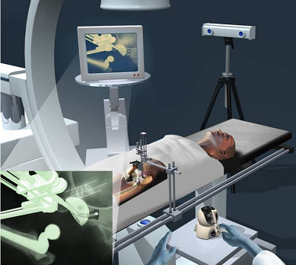
Paper Selection
Project Purpose
Physical Capabilities and Limitations
Methods for Modeling and Testing

Slide 6
Purpose:
To describe the design, fabrication, control, and modeling of a manipulator designed for surgical removal of osteolysis.

Slide 7
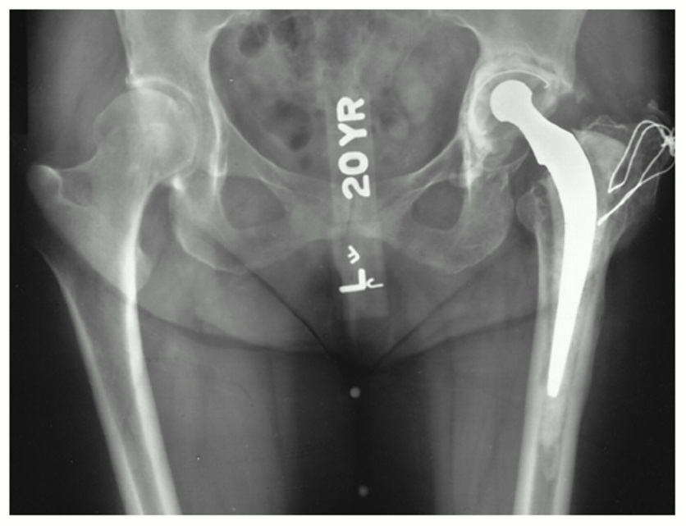
Background: Osteolysis
Osteolysis: Degeneration of bone tissue
Associated with wear particles following total hip replacement
May lead to bone fracture or implant loosening
http://www.jbjs.org/data/Journals/JBJS/759/JBJA0791218340G03.jpeg

Slide 8
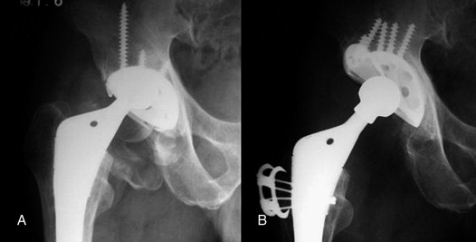
Background: Revision Surgery
Lesion accessed through screw holes
Manually eliminate particle debris and osteolytic lesions
Surgically challenging: <50% of lesion typically grafted
http://ars.sciencedirect.com/content/image/1-s2.0-S0883540307003294-gr2.jpg

Slide 9
Goal of Procedure
Orient the lumen of the Dexterous Manipulator to different point in the lesion
Allow for introduction of surgical tools
Metal Brushes
Pincers
Water Jets
Suction

Slide 10
Procedural Workflow
(1) Access screw hole by removing liner
(2) Insert rigid guide cannula
(3) Insert dexterous manipulator
(4) Insert and actuate tool tip through cannula
(5) Final cleaning and inspection
(6) Bone graft/Bone cement delivery

Slide 11
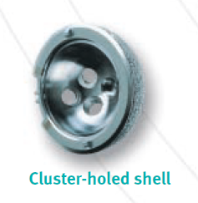
Design Requirements
Compact
Open Lumen
Scalability
High-Dexterity
Large End-Effector Forces
Zimmer Trilogy Acetabular Shell with 6.60 mm diameter holes
http://www.zimmer.com/content/pdf/en-GB/Trilogy_Acetabular_System_Brochure_(97-6200-201-00_Rev_3)(07_2010).pdf

Slide 12
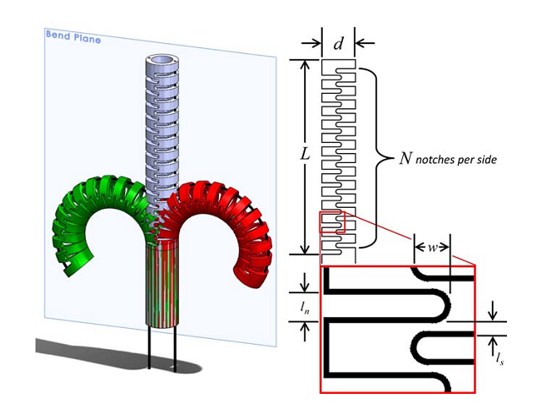
Dexterous Manipulator Geometry
Outer Diameter = 5.99 mm (< 6.60 mm)
Notches force in-plane bending
Simpler modeling and control
Higher end-effector forces
2 drive cables housed in channels 180$°$ apart to allow for marionette-like control

Slide 13
Dexterous Manipulator Geometry

Slide 14
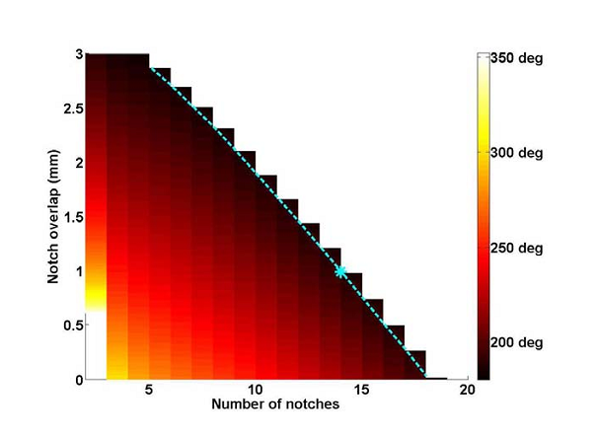
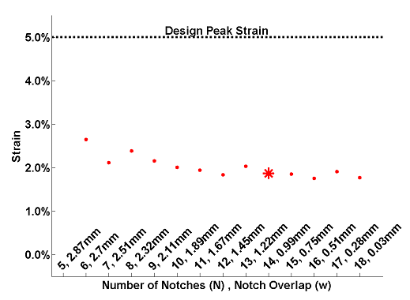
Design Decision
How many notches to have and how much notch overlap?

Slide 15
Manipulator Fabrication Process
Inner and Outer Nitinol Tubes Cut Using Lathe
Drive Cable Channels Cut on Outside of Inner Tube
Drive Cable Channels Cut on Inside of Outertube
Nesting of Tubes using Machine Vice
Notches cut using Electical Discharge Machining

Slide 16
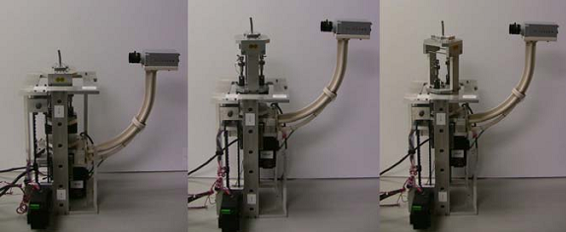
Manipulator Control
Stepper Motors Use for:
Driving left and right cables
Linear Actuation about Unbent Manipulator Axis
Rotation Around Unbent Manipulator Axis

Slide 17
System Sensors
Each cable connected to actuated via tension/compression load cell
CMOS FireWire Camera
Manipulator stays within field-of-view
Question: How to define zero position of each of 4 actuators?

Slide 18
Z-Calibration
2 Limit Switches on both ends of Translating Component
Steps:
Actuate to each Limit Switch
Choose Fixed Intermediate Point as Zero Position

Slide 19
$θ$-Calibration
Steps:
Bend manipulator
Rotate by about 360$°$
Take image at each step
Segment image (using Intensity-Based Segmentation)
Measure Distance from DM Base to End-Most Pixel for left and right side
Mark 0 Position at Bending Plane Orthogonal to Camera Axis

Slide 20
Drive-Cable Length Calibration
Each Drive Cable has 4.4N of Counter-Tension
Total Bend Angle Estimated
Slack cable on bend-ward side by # of steps proportional to bend angle
Actuate opposite cable to maintain 4.4N Counter-Tension
Cable on bend-ward side set to 4.4N counter tension and angle estimated again
Repeat until angle is about 0$°$with Counter-Tension in each cable at 4.4N

Slide 21
Kinematic Modeling
Purpose: Motion Planning and Future Design Optimization
Modeled as a Series of Pin Joints that connect a sequence of Rigid Vertebrae

Slide 22
Experimentation and Testing
Experiment 1: Investigate the Accuracy of the Kinematic Model
Methodology:
Acquire 120 images of manipulator configurations
Acquire aforementioned 58 points
For first 100 mages, use Linear Least-Squares to force equality of constant parameters ($a_{L}, a_{R}, b_{L}, b_{R}, c_{L}and c_{R}$) and calculate $γ_{i}$.
Find error between selected point and calculated point

Slide 23
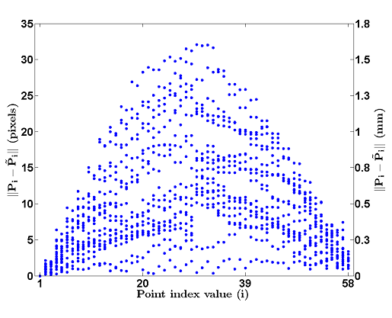
Experiment 1: Verifying the Kinematic Model
Using First 100 training images
Using determined parameters on next 20 test images

Slide 24
Experimentation and Testing
Experiment 2: Define Relationship Between End-Effector Forces and Cable -Tension
Methodology:
At bend configurations of $φ=\left\{−135°, −90°, −45°, 0°,45°, 90°, 135°\right\}$:
Apply force gauge in Eastward, Westward, and Southward directions
Bring gauge in contact with end-effector while maintaining 0.00 N reading
Step motor and record load cell and force-gauge data
Perform 3 trials with 30 data points each

Slide 25
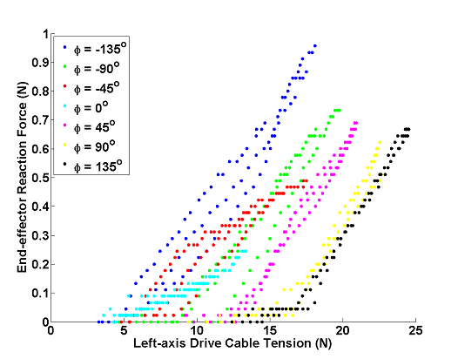
Experiment 2: End-Effector Force and Cable-Tension Relationship

Slide 26
Experiment 2: End-Effector Force and Cable-Tension Relationship

Slide 27
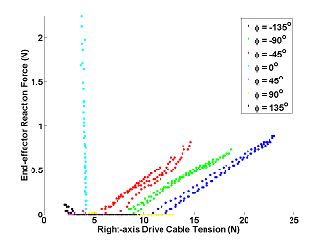
Experiment 2: End-Effector Force and Cable-Tension Relationship

Slide 28
Experiment 2: End-Effector Force and Cable-Tension Relationship

Slide 29
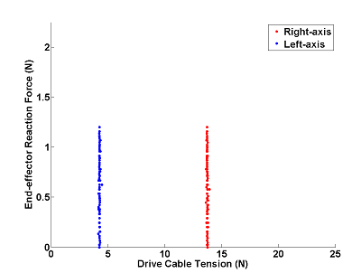
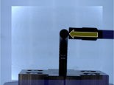
Out of the Bend-Plane
Similar Test
Only at $φ=−90°$
$θ$rotated by 90$°$ to bring bend-plane same axis as camera

Slide 30
Conclusions
Design objectives were met
No signs of fatigue or failure
Promising kinematic results
Some variability between identical trials
Path-planning work using kinematic model shows 85%-95% coverage rates

Slide 31
Next Steps
Optimization of Manipulator Geometry
3D bending via addition of more drive cables
Predicting cable lengths from known-position and vice-versa
Develop intuitive, haptic control interface!

Slide 32
Relevance and Importance to Project
Learned about Cable-Properties of Manipulator
Range of Manipulator Motion
Possible Kinematic Model
Calibration Steps

Slide 33
My Critique: The Good
Wide breadth of information
Relatively Large Sample Size during Experiments
Good Use of Figures and Plots
Clear and Concise

Slide 34
My Critique: The Less Good
Some important features were not explained
Image-based segmentation
Current control interface
Path-planning work indicating up to 95% coverage
Sometimes difficult to understand
Kinematic Model
Drive-Cable Length Calibration

Slide 35
All in All
Very useful in developing background in project
Helped to realize overall purpose
What considerations have gone into the design
Possible modeling and testing ideas

Slide 36
Questions or Comments?
Thank You!

