Slide 1
Robotic System for Automatic Transcranial Magnetic Stimulation (TMS)
This project aims to develop a real robotic system and software for automatic TMS coil placement
You will put your CIS I, robotics & software knowledge into practice
Simulation for demonstration purposes

Slide 2
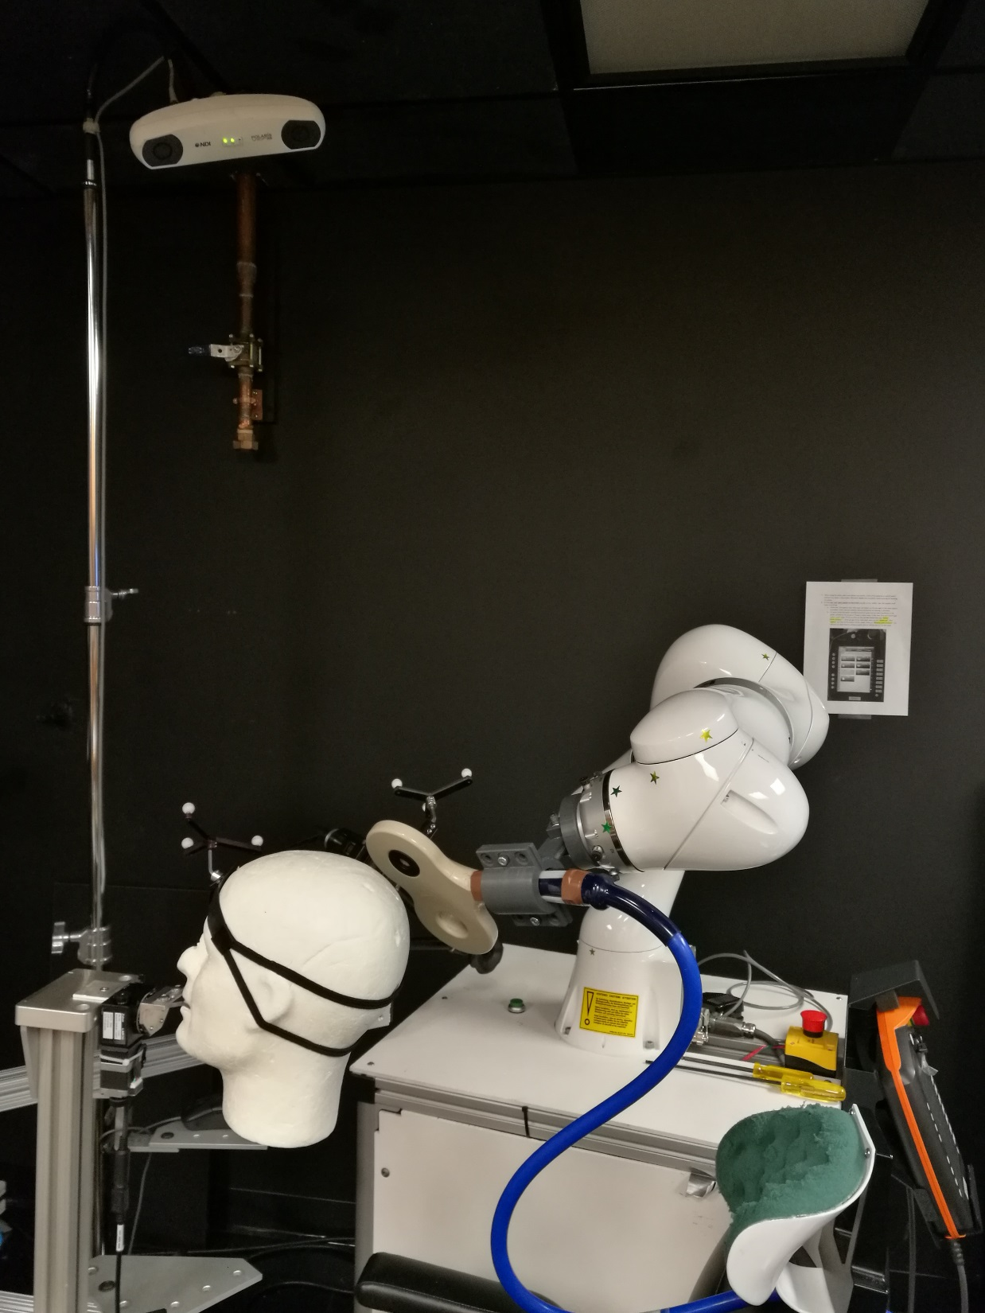
Workstation
Optical Tracker
7 DOF KUKA Robot
TMS
Coil
Bite bar

Slide 3
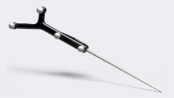
Workstation
Optical Tracker
7 DOF
KUKA Robot
High-level Control
TMS Targets
Hand-eye Calibration
MRI to patient’s head registration
Using a digitizer

Slide 4
Robotic System for Automatic Transcranial Magnetic Stimulation (TMS)
What Students will do
High-level control of 7-DOF KUKA robot using ROS
MRI to patient’ head registration
Hand-eye calibration to find robot to TMS coil transformation
Development of software modules for above
Deliverables
Minimum: High-level control of the robot to a target pose + registration of patient’s head to MRI
Expected: Complete TMS procedure by closing the loop between the robot and patient using optical tracker
Maximum: Incorporating safety features in the robot control to minimize any risks
Group Size
2 or 3 students
Skills
Proficient in programming (C++ or/and Python)
Familiarity with ROS (Robot Operating System)
Registration techniques (CIS I knowledge)
Familiarity with 3D-slicer is a plus (not required)
Outcome for students
Hands-on experience with a real medical robotic system
Great project for gaining industry experience (for future job)
Mentors:
Shahriar Sefati
Dr. Mehran Armand
Dr. Amir Kheradmand
Contact:
sefati@jhu.edu

