Slide 1
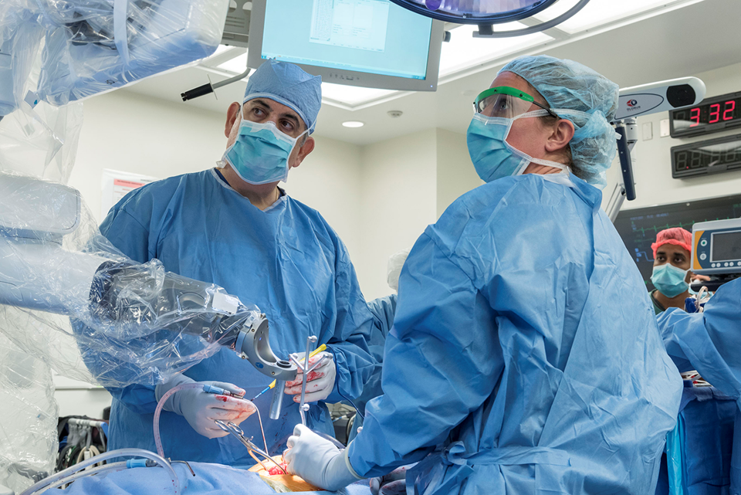
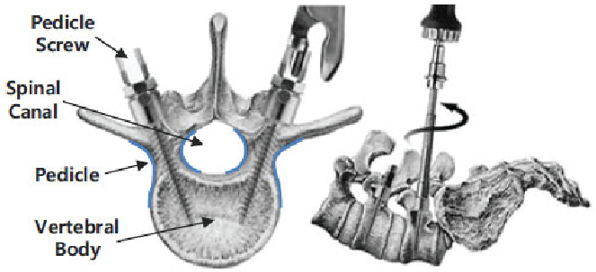
Assessing Safe Pedicle Screw Placement: Robot-assisted vs Traditional Approach
Pedicle screw trajectories are close to critical anatomy
Robot-assistance can improve safety, since screw trajectories can be pre-planned in 3D and executed accurately
Example robotic system: Excelcius robot, Globus Medical used by Prof. Nicholas Theodore at JHH
We have curated a dataset of post-op CTs of robotic-assisted and conventional cases

Slide 2
Assessing Safe Pedicle Screw Placement: Robot-assisted vs Traditional Approach
What Students Will Do & Deliverables:
Develop machine learning algorithms to automatically identify
Pedicle screws in CTs
Critical structures in CTs
Using the above, develop algorithms (potentially learning-based) to identify proximity of screws to critical structures → Ideally, resulting in a stand-alone tool for autonomous analysis of CT scans
Investigate whether the data supports the hypothesis that robot-assisted screws are placed more safely
Size group: 1-2, pref. 2
Skills:
Experience in ML, DL, and ConvNets (Python, Pytorch)
Experience dealing with volumetric medical data

Slide 3
Assessing Safe Pedicle Screw Placement: Robot-assisted vs Traditional Approach
Mentors: Radiology Artificial Intelligence Lab (rail.jhu.edu)
Technical side:
Mathias Unberath (unberath@jhu.edu)
Clinical collaborators:
Nicholas Theodore (theodore@jhmi.edu)
Paul Yi (pyi10@jhmi.edu)

