Slide 1
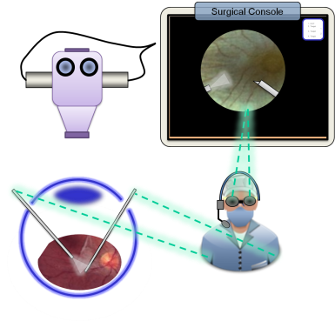
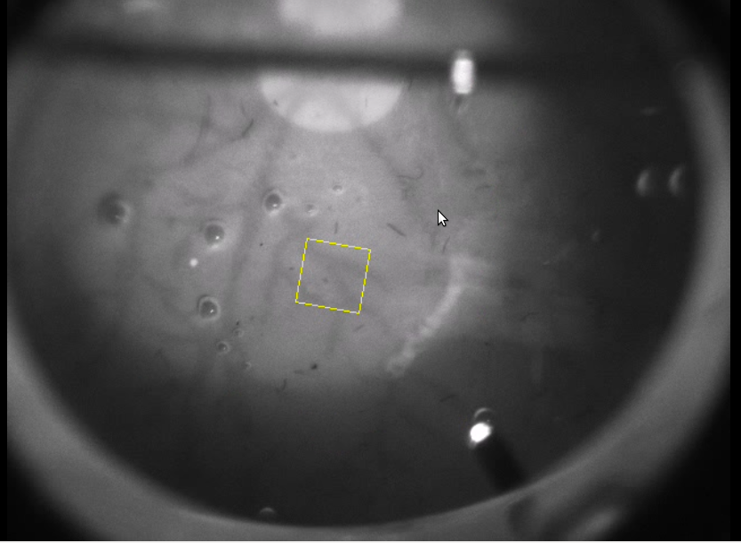
Visual Annotation of Clinically Important Anatomical Landmarks for Vitreoretinal Surgery Team Members: Vincent Ng Mentors: Rogerio Richa, Marcin Balicki, Dr. Russell Taylor
Goals:
Register Pre-op and Intra-op images in real-time
Overlaying landmarks chosen from Pre-op images into Intra-op
Significance:
Gives surgeon more visual info from planning stage
Integrating this tool with other tools to aid surgeon during complex procedure
Results:
150-300 ms running time
Valid match every 4-10 frames
Initialize (detect features on initial Image to track)
Detect features on image in live video feed
Determine matches between features in 2 images
Calculate Transformation based on matches
Overlay transformed point on live display

