Slide 1
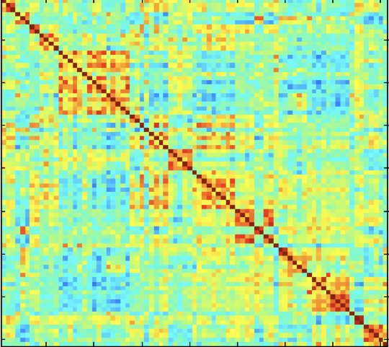
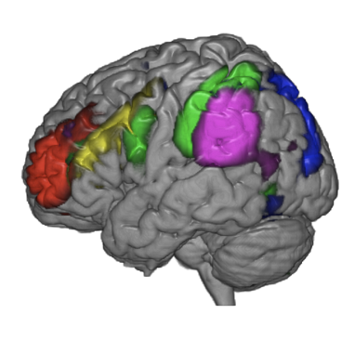
Hierarchical Labeling of resting state functional MRI brain networks
“Connectivity” of the brain can be measured using fMRI, and the time series clustered to generate maps of intrinsic brain networks
Depending on how the data is clustered, different network topologies can result. Knowledge about the hierarchy of each part of the network can inform the actual label of the network. E.g., in the above figure, knowing that the yellow ROI is part of the attention network as shown helps to distinguish it from a portion of the language network, which could be similar in appearance.
DATA: public fMRI repositories (>1000s of data); JHU: depending on source, minimum of about 100 patients with lesions. Also have several thousand fMRI on clinical patients with or without lesions
Notes:
E.g. classification hierarchy in animal kingdom.

Slide 2
Hierarchical Labeling of resting state functional MRI brain networks
What Students Will Do & Deliverables:
Develop machine learning algorithms for
Incorporating hierarchical labeling for classification of resting state functional MRI networks
Demonstrate accurate classification of network subcomponents first in healthy subjects, then in patients with brain lesions.
Long-term prospect: Develop learning-based algorithms to automatically identify, and accurately classify, intrinsic brain networks using fMRI
Supplement current efforts in incorporating automated network labeling in real-time functional MRI of the brain
If successful, goal is to develop software that can be incorporated into scanner for widespread use of this technology in clinical care, currently limited by lack of expertise in knowledge of brain networks.
Size group: 1-2, pref. 2
Skills:
Experience in ML, DL, and ConvNets (Python, Pytorch)
Ideal: Experience dealing with medical and time series data

Slide 3
Hierarchical Labeling of resting state functional MRI brain networks
Mentors: Radiology Artificial Intelligence Lab (rail.jhu.edu)
Technical side:
Mathias Unberath (unberath@jhu.edu)
Clinical collaborators:
Haris Sair (primary clinical mentor)
Ferdinand Hui, Paul Yi

